Slide 1
Plotting graphs of linear functions
Rather than choosing random coordinates to draw a line, we can find coordinates that obey a given function by constructing a table of values.
Suppose we want to plot points that obey the function
y = 2x + 5
We can use a table as follows.
Substitute the values of x to find the value of y.
x
–3
–2
–1
0
1
2
3
y
–1
1
3
5
7
9
11
(–3, –1)
(–2, 1)
(–1, 3)
(0, 5)
(1, 7)
(2, 9)
(3, 11)
Notes:
Explain that when we construct a table of values, the value of y depends on the value of x. That means that we choose the values for x and substitute them into the equation to get the corresponding value for y.
The minimum number of points needed to draw a straight line is two, however, it is best to plot several points to ensure that no mistakes have been made.
The points given by the table can then be plotted to give the graph of the required function.

Slide 2
Plotting graphs of linear functions
For example,
y
to draw a graph of y = 2x + 5:
1) Complete a table of values:
x
–3
–2
–1
0
1
2
3
y = 2x + 5
y
–1
1
3
5
7
9
11
2) Plot the points on a coordinate grid.
3) Draw a line through the points.
x
4) Label the line.
Notes:
This slide summarizes the steps required to plot a graph using a table of values.

Slide 3
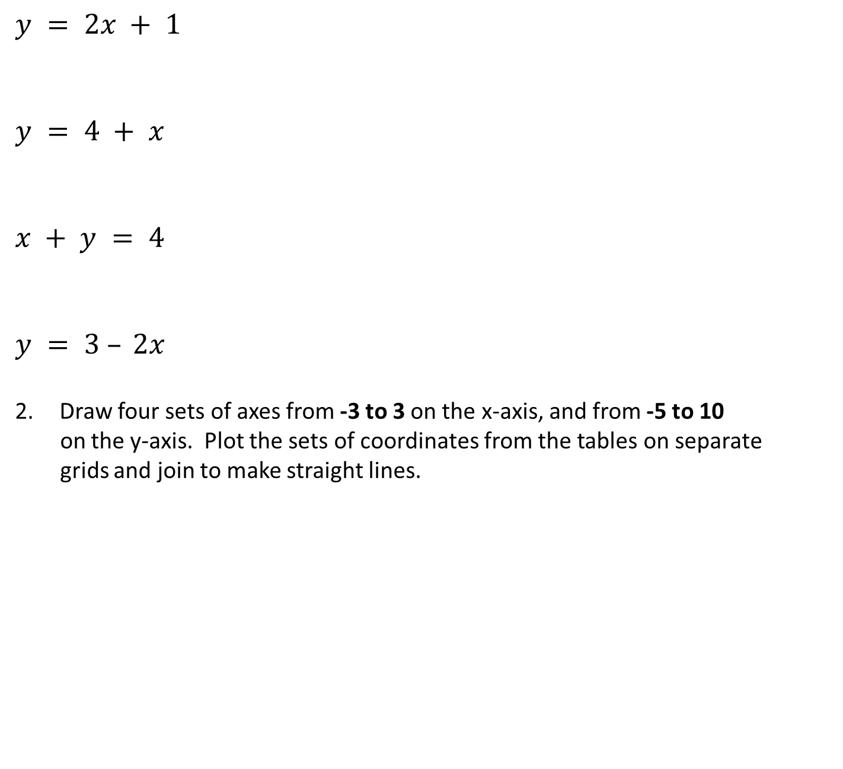
1. Fill in the table for each equation.
$$y = 2x + 1$$
$$y = 4 + x$$
$$x + y = 4$$
$$y = 3 – 2x$$
Draw four sets of axes from -3 to 3 on the x-axis, and from -5 to 10
on the y-axis. Plot the sets of coordinates from the tables on separate
grids and join to make straight lines.
x
–3
–2
–1
0
1
2
3
y
x
–3
–2
–1
0
1
2
3
y
x
–3
–2
–1
0
1
2
3
y
x
–3
–2
–1
0
1
2
3
y

Slide 4
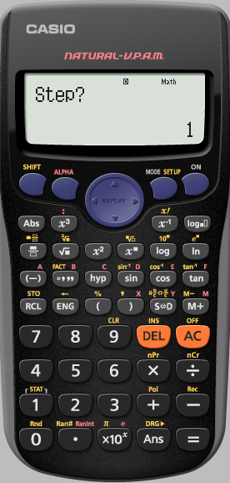
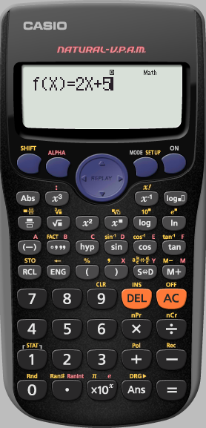
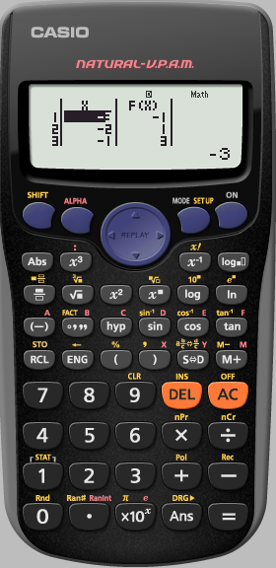
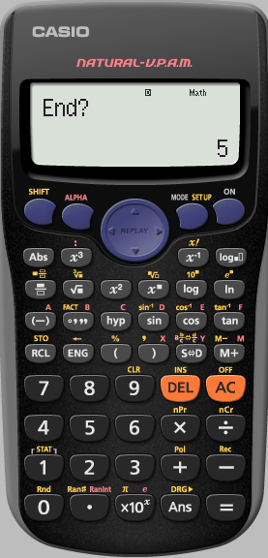
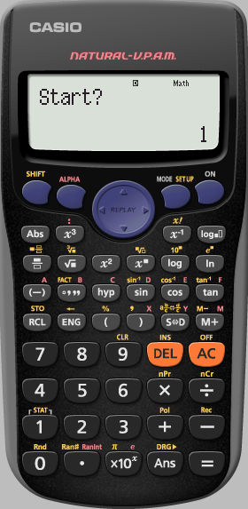
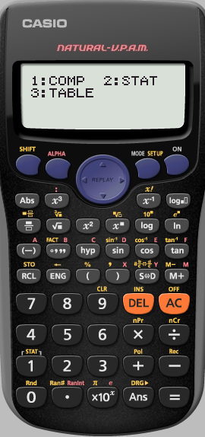
Using a calculator
To draw a graph of y = 2x + 5:
1) Complete a table of values:
Goes up in 1’s
x
–3
–2
–1
0
1
2
3
y
–1
1
3
5
7
9
11
Type in 3
Type in -3
Notes:
This slide summarizes the steps required to plot a graph using a table of values.

Slide 5
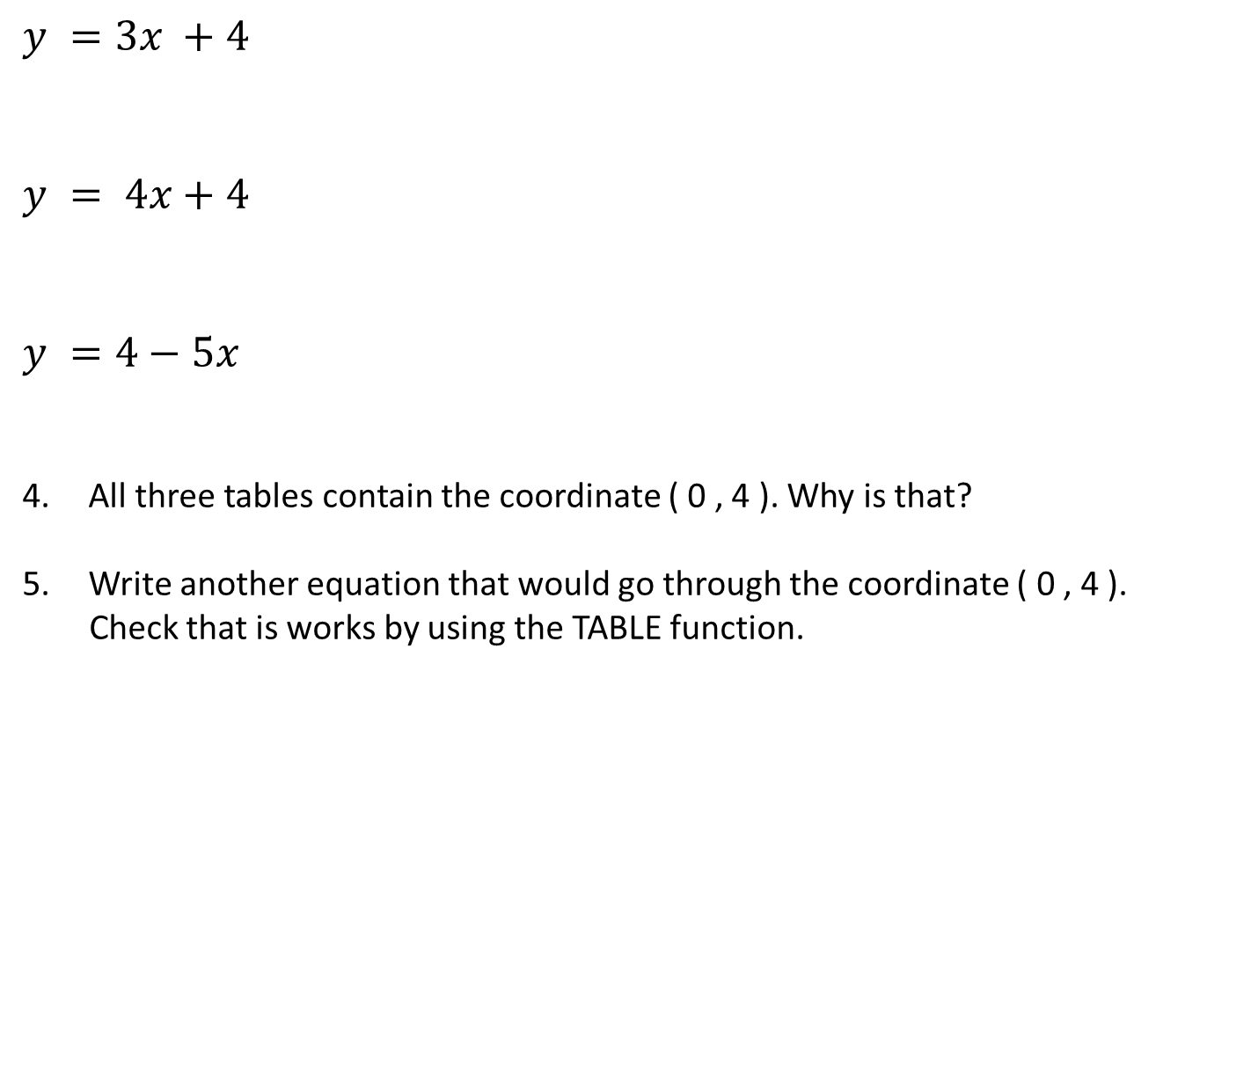
3. Fill the tables using the calculator TABLE function.
x
–1
0
1
2
3
4
5
$$y =3x +4$$
$$y = 4x+4$$
$$y =4−5x$$
All three tables contain the coordinate ( 0 , 4 ). Why is that?
Write another equation that would go through the coordinate ( 0 , 4 ).
Check that is works by using the TABLE function.
y
x
–4
–3
–1
0
1
2
y
x
-4
–2
0
2
4
6
8
y

Slide 6
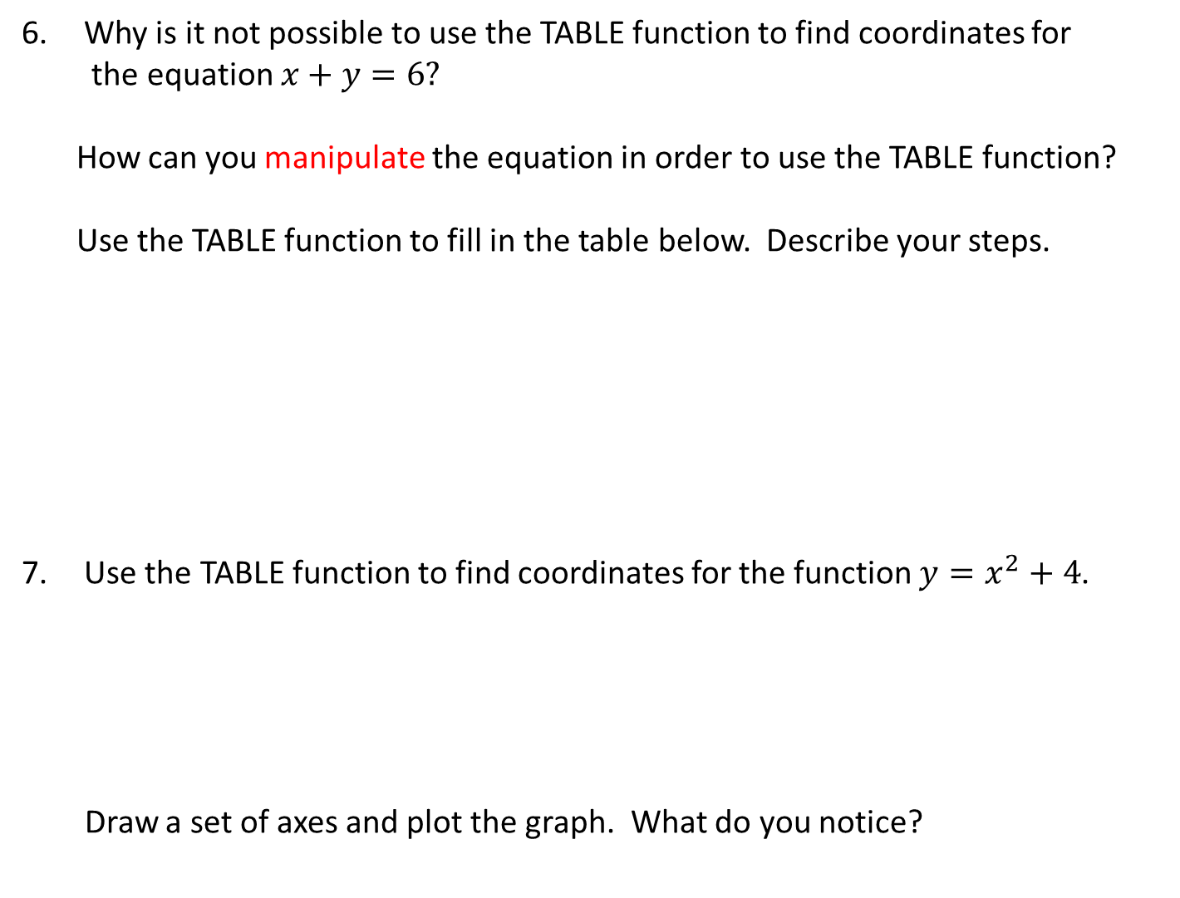
Why is it not possible to use the TABLE function to find coordinates for
the equation $x+y=6?$
How can you manipulate the equation in order to use the TABLE function?
Use the TABLE function to fill in the table below. Describe your steps.
Use the TABLE function to find coordinates for the function $y=x^{2}+4$.
Draw a set of axes and plot the graph. What do you notice?
x
0
1
2
3
y
x
–1
0
1
2
3
4
5
y

