Slide 1
Welcome to Bluecoat Beechdale Academy
Please take a seat using the following rules(!)
At least one member of staff from each of the four Trust academies must be on each table.
No two people seated next to each other can work at the same Academy.
Introduce yourselves around the table.
Phones away please…

Slide 2
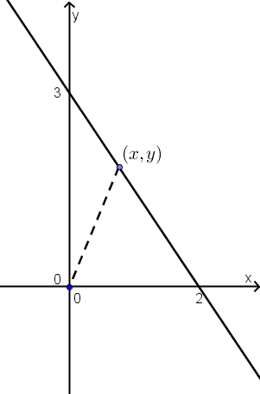
Let’s do some maths…
What are the areas of the 3 triangles you can see in the first quadrant?
Notes:
What are the areas of the 3 triangles you can see in the first quadrant?
Thinking in terms of areas of triangles we have 2y/2 + 3x/2 = 3. The marked point can be anywhere in the first quadrant and this would still hold. A collection of an infinite number of points making a line. This gives a dynamic way of understanding the equation of the line. (What if the variable point went into another quadrant?)

Slide 3
Let’s do some maths…
Combine the expressions to make an equation…
Notes:
What are the areas of the 3 triangles you can see in the first quadrant?
Thinking in terms of areas of triangles we have 2y/2 + 3x/2 = 3. The marked point can be anywhere in the first quadrant and this would still hold. A collection of an infinite number of points making a line. This gives a dynamic way of understanding the equation of the line. (What if the variable point went into another quadrant?)

Slide 4
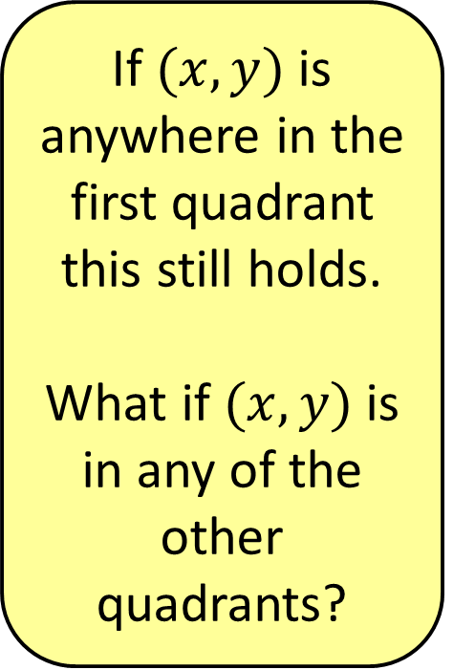
Let’s do some maths…
If $(x,y)$is anywhere in the first quadrant this still holds.
What if $(x,y)$is in any of the other quadrants?
Notes:
What are the areas of the 3 triangles you can see in the first quadrant?
Thinking in terms of areas of triangles we have 2y/2 + 3x/2 = 3. The marked point can be anywhere in the first quadrant and this would still hold. A collection of an infinite number of points making a line. This gives a dynamic way of understanding the equation of the line. (What if the variable point went into another quadrant?)

Slide 5
Deepening Understanding
Representation
& Structure
Access
Mathematical Thinking
Chains of Reasoning
Fluency
Number Facts
Variation
Procedural
Conceptual
Table Facts
Pattern
Making Connections
Making Connections
Making Connections
Making Connections
Coherence
Small connected steps are easier to take

Slide 6
Deepening Understanding
In each of the 5 sessions this year, we will concentrate on one of the five different aspects of the 5 big ideas for deepening understanding, through the lens of one of the topics or units of work that we all teach.
Today we will look at variation using the topic of coordinate geometry – for KS3 and KS4, that is straight line graphs.

Slide 7
Deepening Understanding
Representation
& Structure
Access
Mathematical Thinking
Chains of Reasoning
Fluency
Number Facts
Variation
Procedural
Conceptual
Table Facts
Pattern
Making Connections
Making Connections
Making Connections
Making Connections
Coherence
Small connected steps are easier to take

Slide 8
Understanding, and making sense of the world that we see is a very important part of our evolution. Therefore, spatial intuition or spatial perception is an enormously powerful tool and that is why geometry is actually such a powerful part of mathematics - not only for things that are obviously geometrical, but even for things that are not.
We try to put them into geometrical form because that enables us to use our intuition.
Our intuition is our most powerful tool...
Notes:
Apologies for the dense text but every word is important!
The focus of this session is to try to help teachers build on students’ intuition to give them a deeper understanding of algebra. We’ll look at using number to motivate and shape to explain algebraic ideas.
Perhaps a more accurate title for the session would be ‘rethinking algebra’

Slide 9
I think it is very fundamental that the human mind has evolved with this enormous capacity to absorb a vast amount of information, by instantaneous visual action,
and mathematics takes that and perfects it.
Sir Michael Atiyah

Slide 10
How did students fare in the coordinate geometry questions in this year’s exams?

Slide 11
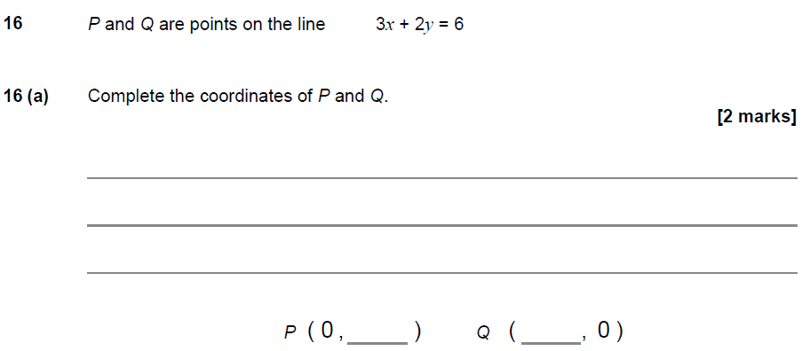

Slide 12
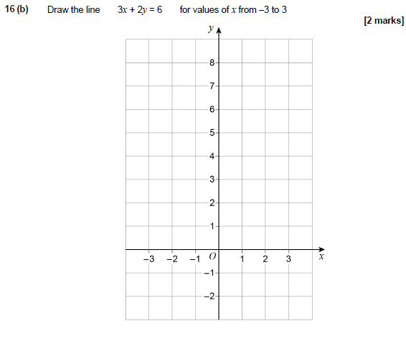
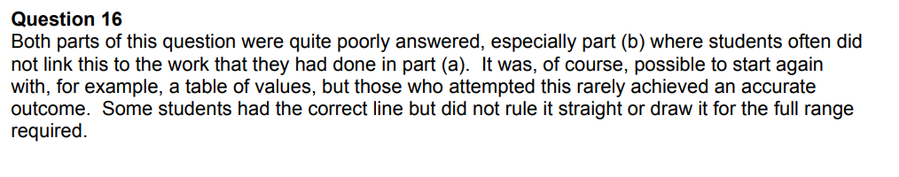

Slide 13
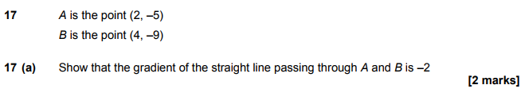
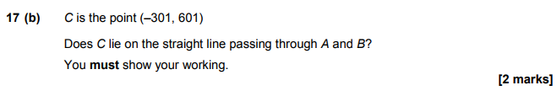
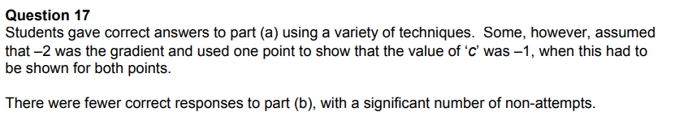

Slide 14
Variation
These questions were poorly answered because they were non-standard.
When we use intelligent practice to write questions for a topic, we should include the following:
Standard questions
Questions that intentionally bring out the difficulty points
Non-standard questions
Non-examples (what it’s not)

Slide 15
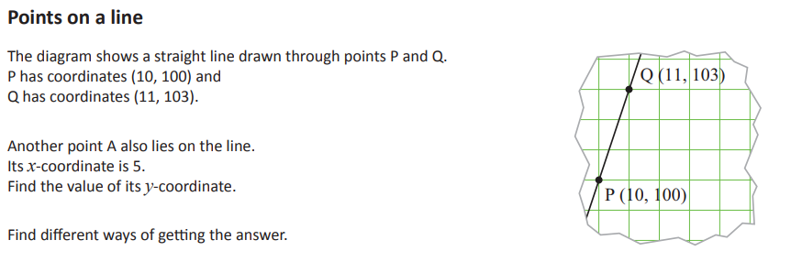
This question is taken from a lesson from the ICCAMS project

Slide 16
ICCAMS Maths Teaching Principles
(Increasing confidence and competence in algebra and multiplicative structures)
In order to improve the teaching and learning of algebra & multiplicative reasoning:
Help teachers to use formative assessment
Highlight students’ misconceptions
Set maths in realistic & intriguing problems
Use models & representations productively
Make connections explicit
Enable purposeful dialogue & collaboration
Notes:
As the teachers review the lessons taught, ask them to consider the ICCAMS principles during their discussion:
To what extent were you able to implement these principles whilst teaching the lessons?

Slide 17
On your table answer this question in as many ways as you can
Write one of your methods on your big sheet.

Slide 18
Variation
Too often the focus is on finding the answer to a problem rather than searching for different ways to reach this answer.
“It is better to solve one problem five ways than five problems one way.”
Yeap Ban Har

Slide 19
Variation
Which representations do we use to represent relationships?
Everyday language
Algebraic expressions
Tables of values
Points on a Cartesian graph

Slide 20
ICCAMS
This ICCAMS lesson starts to bring these representations together.
Read the outline of the lesson.

Slide 21
The nature and purpose of Cartesian graphs
This lesson starts with a part of a Cartesian graph.
One strength of a graph is, of course, its visual quality, which can make it seem very tangible (as well as allowing us to represent lots of information simultaneously).
However, this very property can lead us to forget that we use graphs to represent relations that are not necessarily visual at all (for example, the Cookery Course)

Slide 22
The nature and purpose of Cartesian graphs
For many students, graphs don’t seem to be about anything:
not only do they often lack a context, but students often don’t realise that a graph (in this case a simple straight line) is really a collection of points, and that there is a relationship between the two coordinates of all these points, and so the line is a representation of this relationship.

Slide 23
The nature and purpose of Cartesian graphs
In this lesson we start with such a ‘pure’ graph, which may induce this sense of being abstract.
However, in the course of the lesson students are reminded
• that the given line represents more than just the two points used to define it
• that the coordinates of points on the line obey rules • that the points can be used to represent a relationship between variables from a ‘real’ context such as the Cookery Course

Slide 24
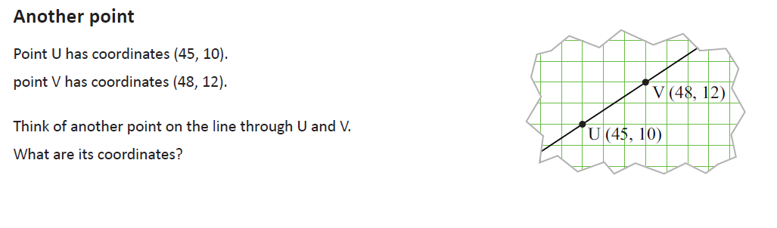
Mini assessment

Slide 25
Commentary
The aims of this mini-assessment are to get a sense of
• how readily students see a line as a set of points
• how readily they determine other points on the line (and what methods they use).
Can students find other points?
What sort of points do they find (eg ‘distant’ points, or points with fractional or negative coordinates)?
What methods do they use (eg a ‘step by step’ approach, or a general rule)?

