Slide 1
MATHEMATICAL COMMUNICATION

Slide 2
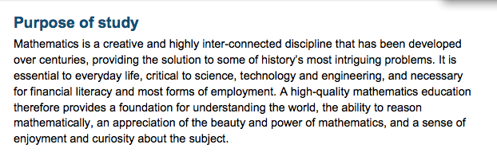

Slide 3
Maths is a creative and highly inter-connected discipline.
What could we mean by creativity?

Slide 4
Maths is a creative and highly inter-connected discipline.
Creativity is not necessarily about generating new solutions to a problem.
Creativity can be about generating an idea that is new to individual students

Slide 5
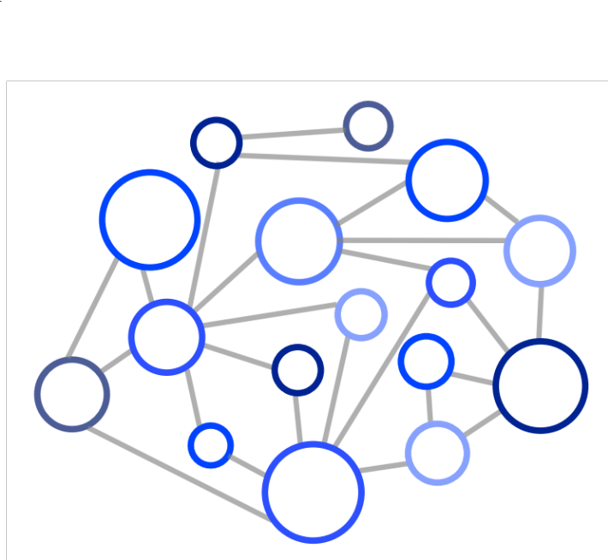

Maths is a creative and highly inter-connected discipline.
Building new ideas from old ones
Figuring out how an idea can be represented in different ways

Slide 6
National Curriculum
Students need to:
  solve non-routine problems by selecting appropriate methods and concepts;
  be able to move fluently between representations of ideas.

Slide 7
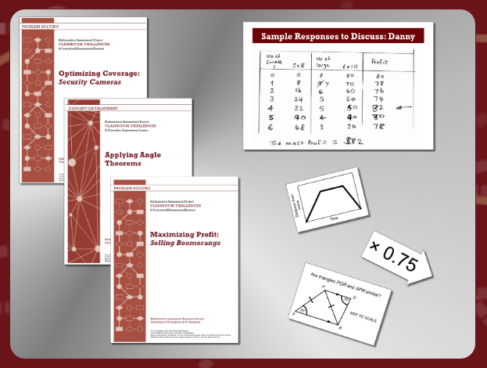
Maths Assessment Project (MAP)

Slide 8
Solving non-routine problems is challenging
A state of uncertainty is uncomfortable
  Students may apply pressure on the teacher to reduce the difficulty of the problem
Students may misinterpret the goals of the problem and over or under complicate the situation
Solutions may be difficult to understand
  novel,
  incomplete,
  include errors

Slide 9
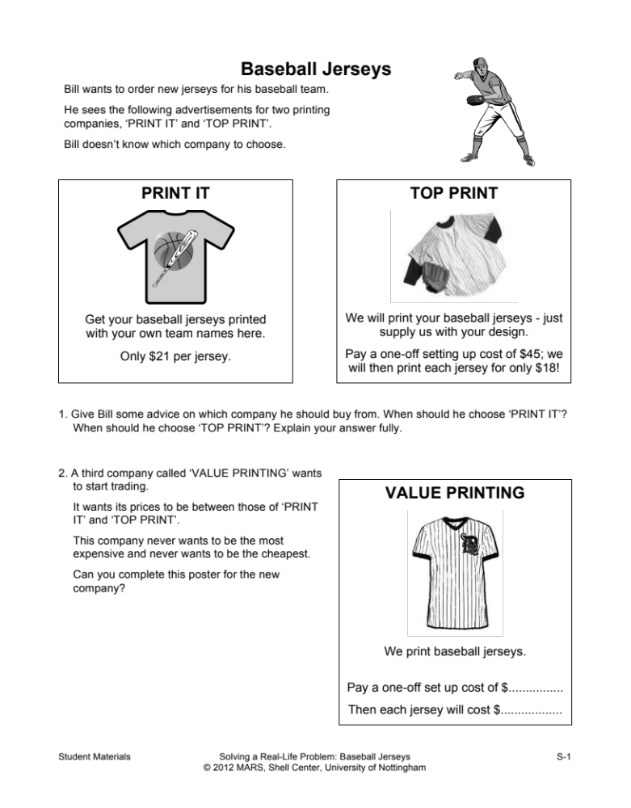
Give Bill some advice on which company he should buy from. When should he choose ‘PRINT IT’? When should he choose ‘TOP PRINT’? Explain your answer fully.
Notes:
Discuss with a neighbour how you think students will solve it

Slide 10
Take a few minutes to come up with a solution to this problem.
Can you think of another method for solving it?
What methods might students choose?

Slide 11
Teaching this lesson
Students start by creating their own individual solution.
It’s important that they work independently at this stage.
After this, students are put into pairs/threes

Slide 12
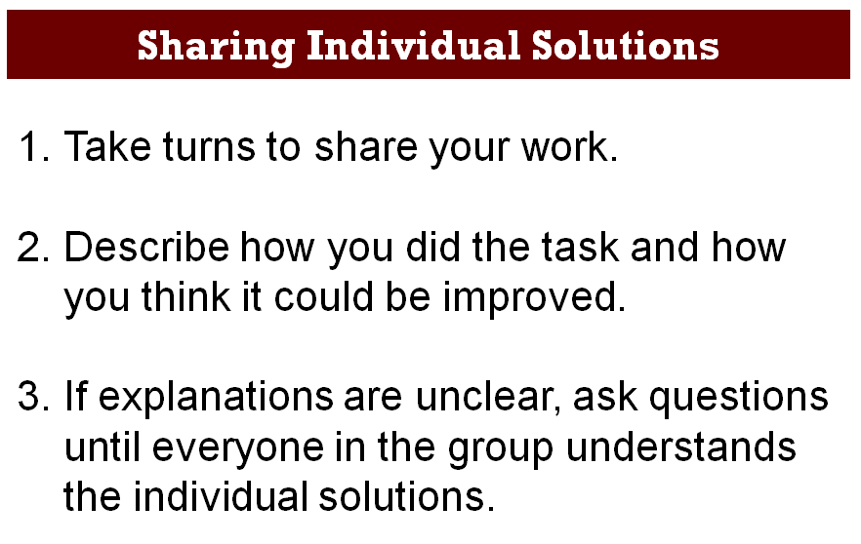

Slide 13
Deepening Understanding
Representation
& Structure
Access
Mathematical Thinking
Chains of Reasoning
Fluency
Number Facts
Variation
Procedural
Conceptual
Table Facts
Pattern
Making Connections
Making Connections
Making Connections
Making Connections
Coherence
Small connected steps are easier to take

Slide 14
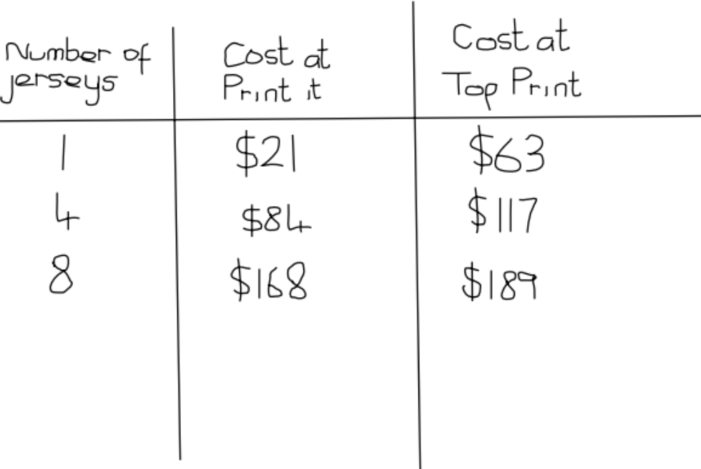
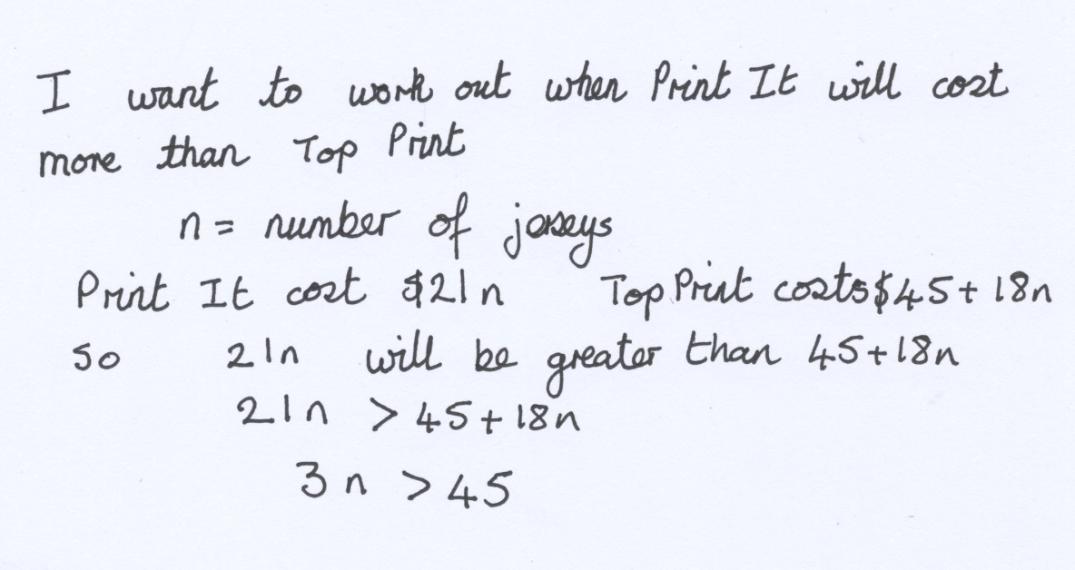
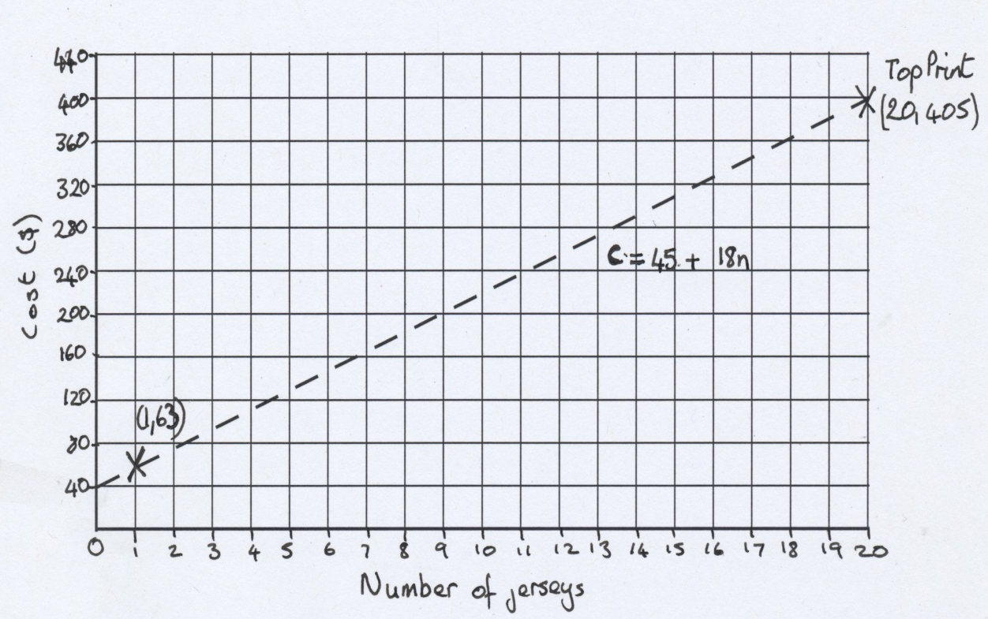
Designed Student responses to Baseball Jersey
These are all correct, but incomplete
Notes:
Chat with a neighbour about the efficacy of such responses

Slide 15
Have a look at each of these sample student responses.
Use the space underneath each one to finish off the work.

Slide 17
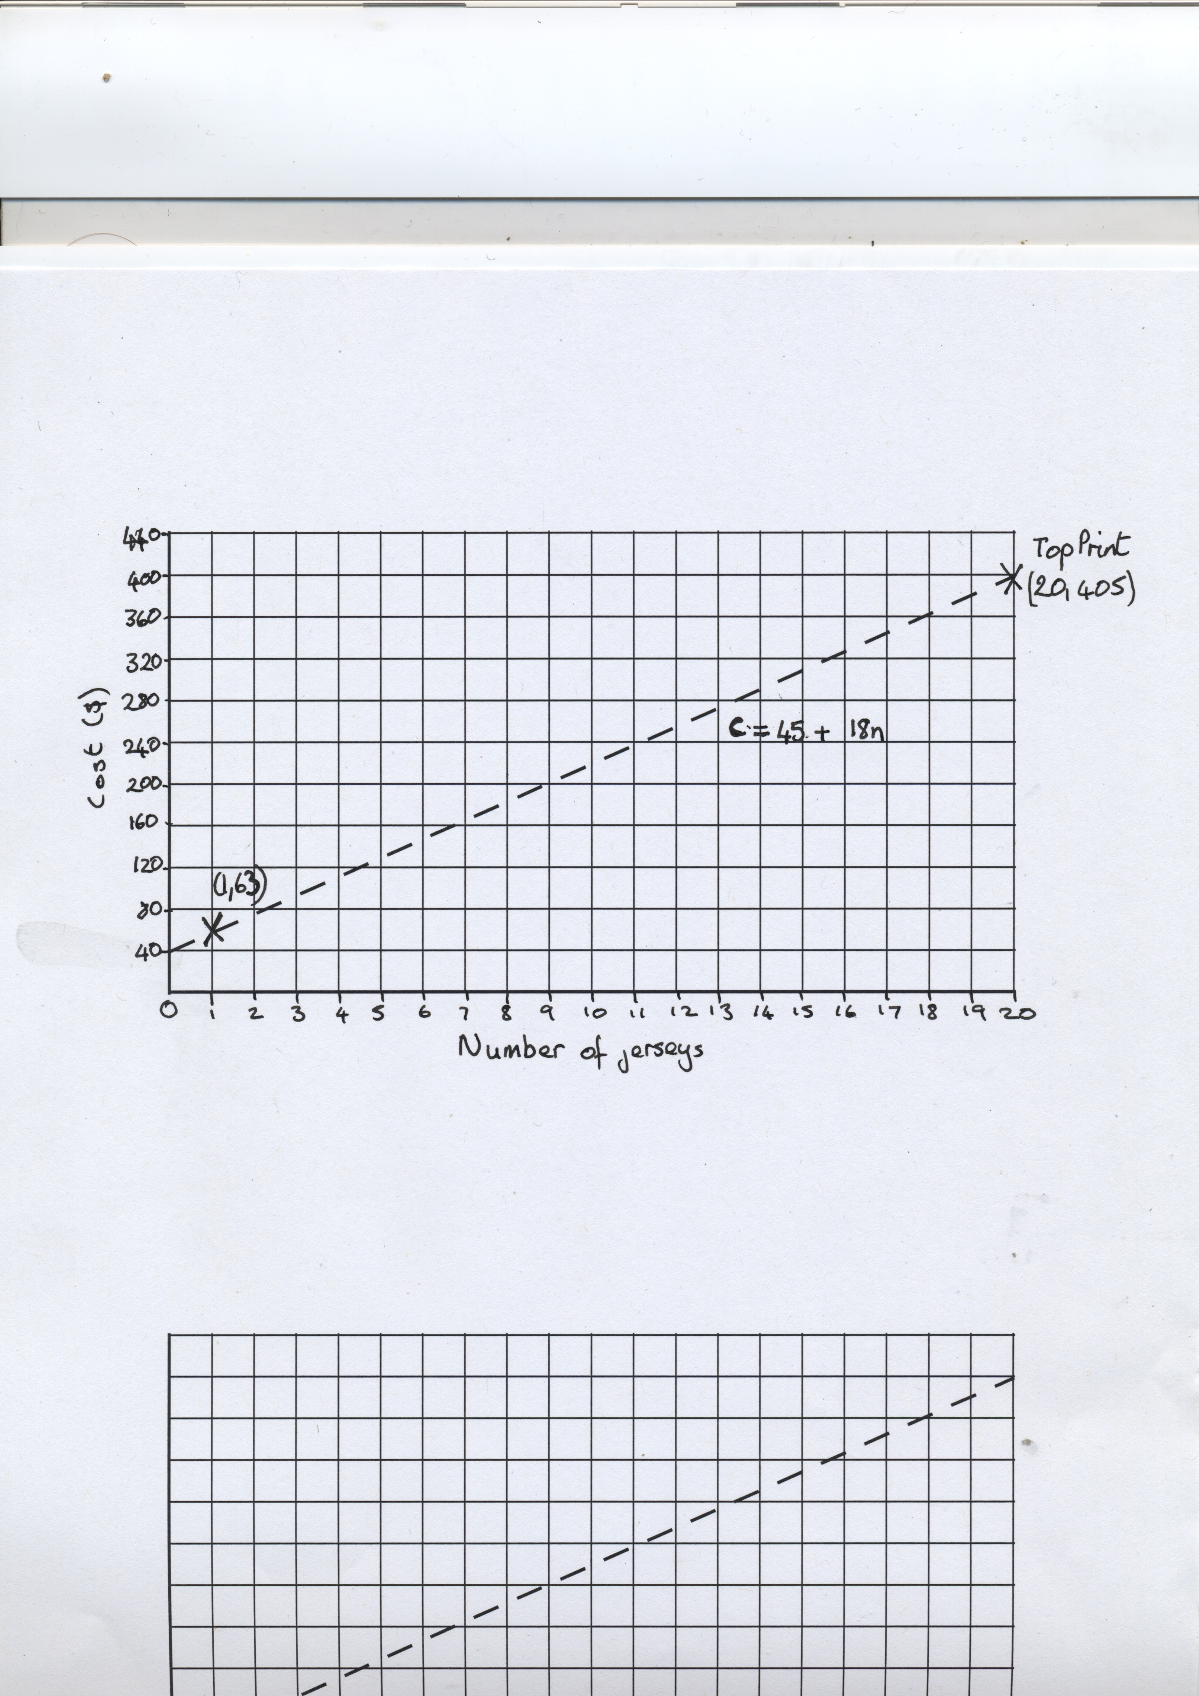

Slide 18
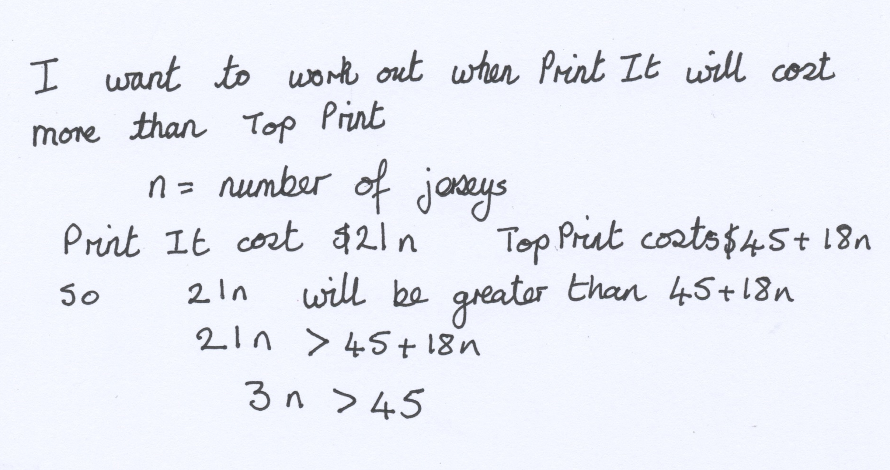

Slide 19
Features of designed student responses
They are incomplete
  Limits the illusion of understanding
They are anonymous:
  Students can critique them without worrying about upsetting someone else’s feelings
  the mathematical prowess of the author is unknown
They are correct
  Students can focus on understanding the method
  Shifts the focus from performance to understanding

Slide 20
Comparing
Comparison is used a lot in other subjects
We also do this in our lessons by asking students to comment on what they see on other whiteboards in the room.

Slide 21
Sentence Stems
Their answer is correct because…
I think the mistake they have made is…
The first solution is better than the second because…
To improve their solution they should…
I don’t understand the reasoning on…
I am not convinced by …’s reasoning because…

Slide 22
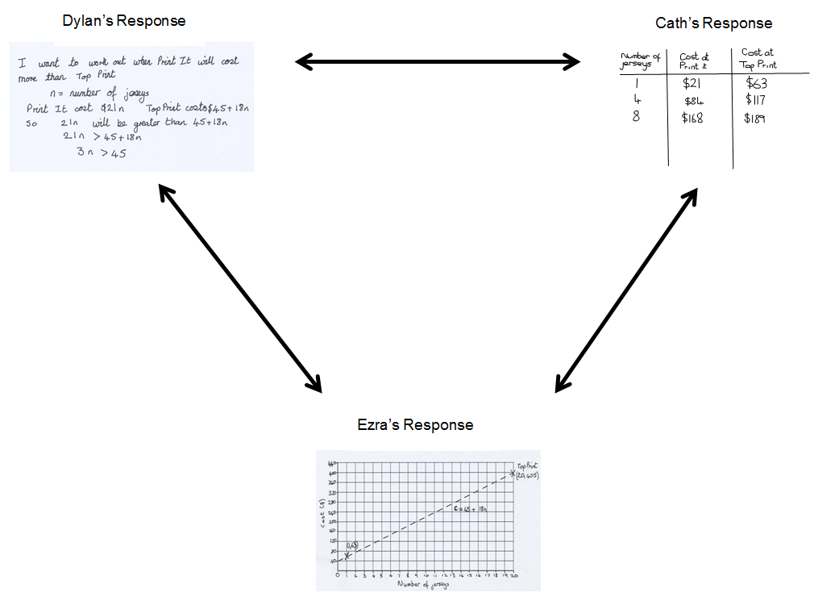

Slide 23
Comparison in action…
Video of whole class discussion of Sample Student Responses

Slide 24
End of Part 1

Slide 25
Part 2

Slide 26
Deepening Understanding
Representation
& Structure
Access
Mathematical Thinking
Chains of Reasoning
Fluency
Number Facts
Variation
Procedural
Conceptual
Table Facts
Pattern
Making Connections
Making Connections
Making Connections
Making Connections
Coherence
Small connected steps are easier to take

Slide 27
Features of designed student responses
They are incomplete
  Limits the illusion of understanding
They are anonymous:
  Students can critique them without worrying about upsetting someone else’s feelings
  the mathematical prowess of the author is unknown
They are correct
  Students can focus on understanding the method
  Shifts the focus from performance to understanding

Slide 28
The baseball jerseys scenario seen earlier seemed to lend itself naturally to many different representations.
But there are many other scenarios that can have multiple representations.

Slide 29
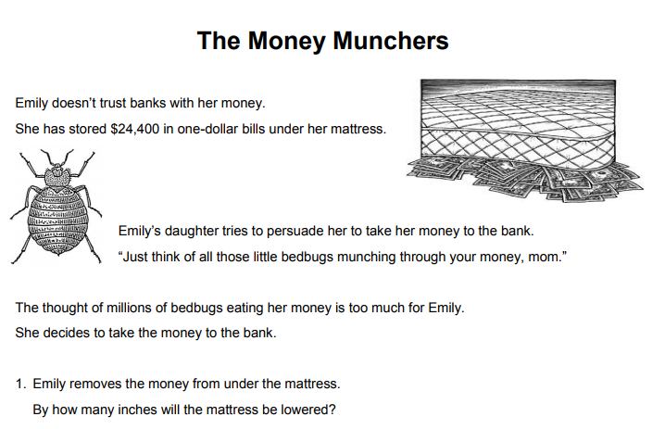

Slide 30
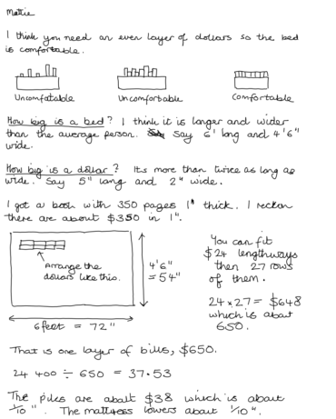

Slide 31
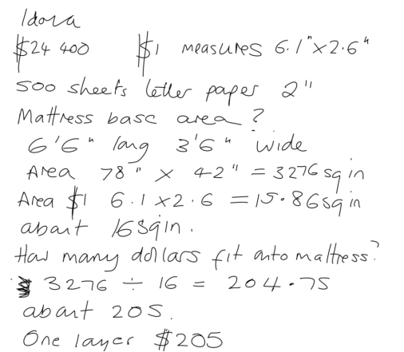

Slide 32
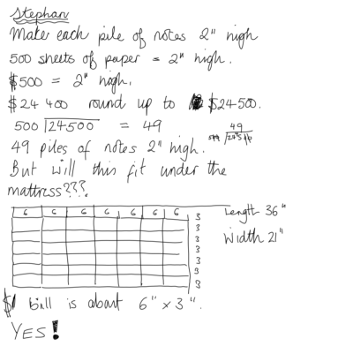

Slide 33
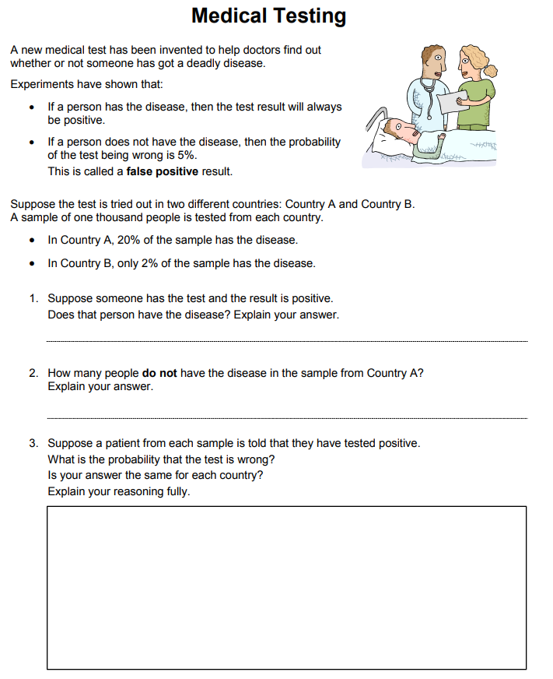

Slide 34
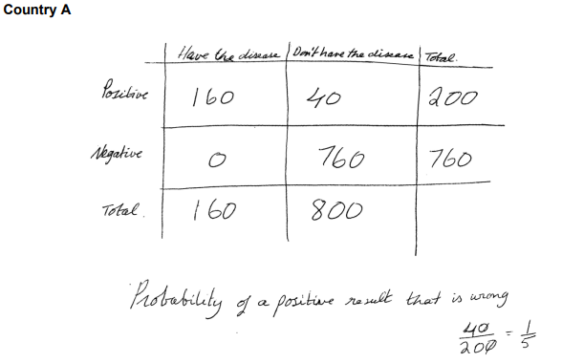

Slide 35
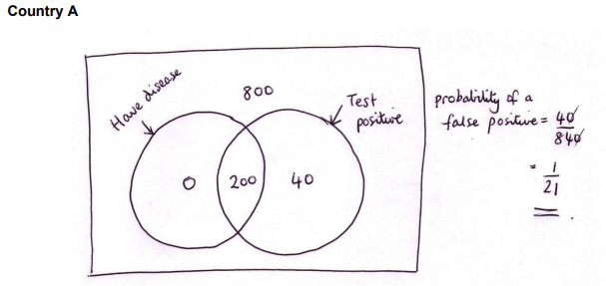

Slide 36
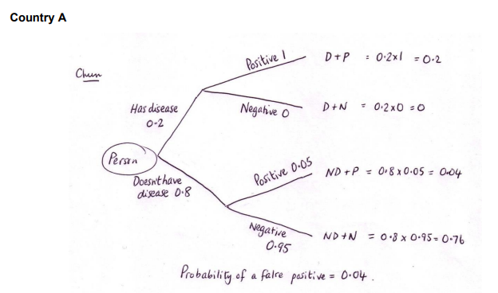

Slide 37
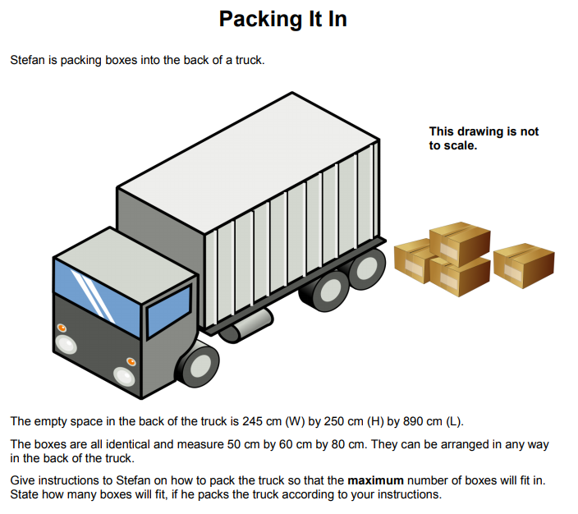

Slide 38
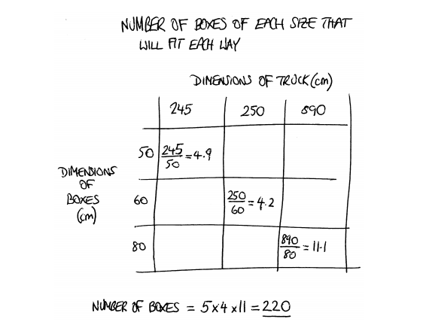

Slide 39
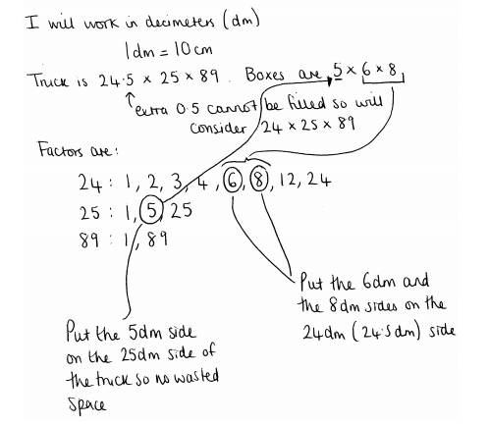

Slide 40
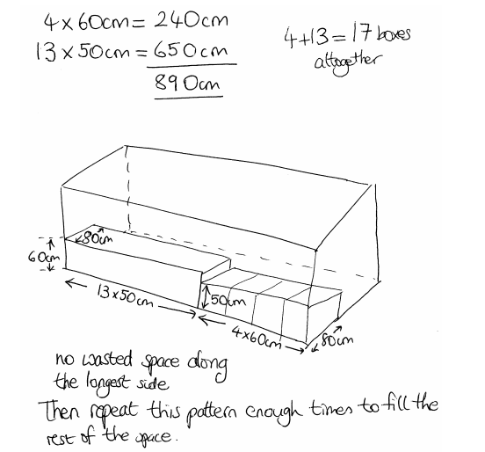

Slide 41
Designing Sample Student Work
I’ve printed off some of the MAP lessons and some lessons from our SoW.
Spend the next 30-40 minutes thinking about and designing sample student work for one of these problems.

