Slide 1
Written communication in mathematics

Slide 2
Let’s watch some Friends
https://www.youtube.com/watch?v=HTjqz0_wsZo
https://www.youtube.com/watch?v=-DcVAMk0d1I&t=4s

Slide 3
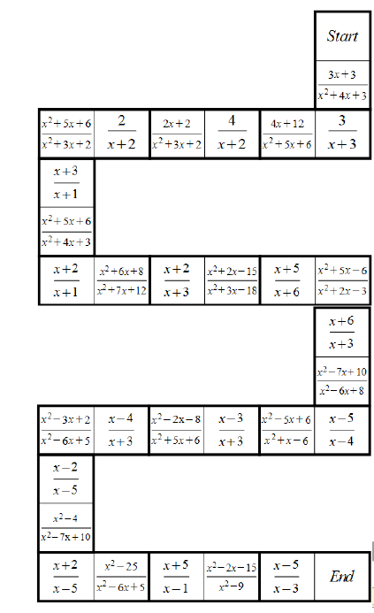
Written communication in mathematics
Year 9 mixed ability:

Slide 4
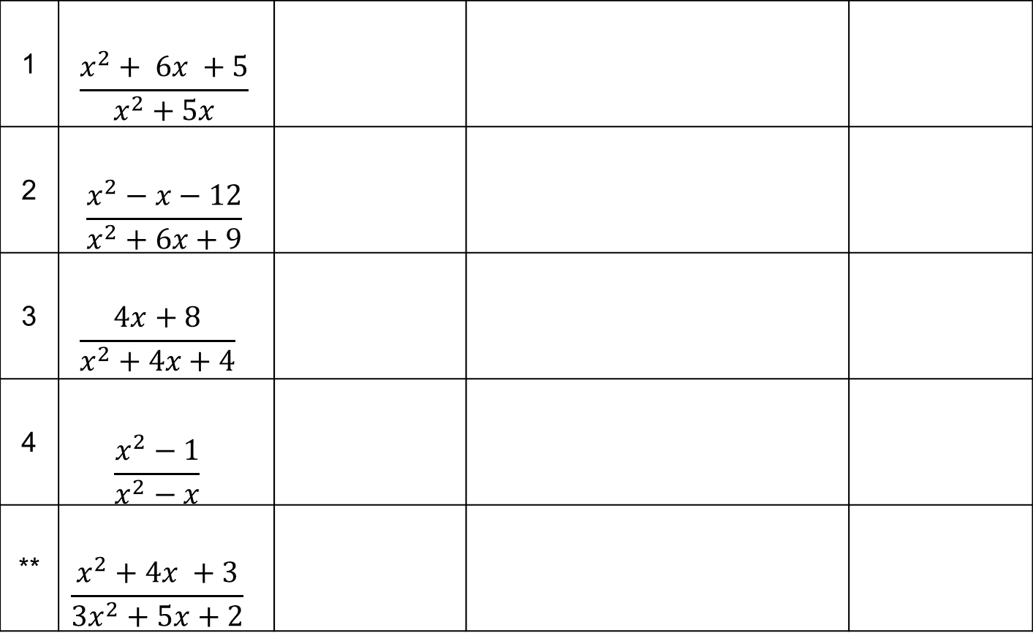
Written communication in mathematics
Year 9 mixed ability:

Slide 5
How do we get from informal work to formal work?
Journaling
Notes:
Was always supposed to include journaling – in my previous role was heavily involved in the rolling out of Maths No Problem

Slide 6
Too often the focus is on finding the answer to a problem rather than searching for different ways to reach this answer.
“It is better to solve one problem five ways than five problems one way.”
Yeap Ban Har

Slide 7

Structure of a maths lesson:
Students explore anchor task (no help, observe from the front)
Teacher helps to structure thinking by comparing approaches
Students write in their journal
Students consolidate through practice
Notes:
Was always supposed to include journaling – in my previous role was heavily involved in the rolling out of Maths No Problem

Slide 8
Maths No Problem is a Primary Textbook, so the example is from Year 2.
Notes:
Was always supposed to include journaling – in my previous role was heavily involved in the rolling out of Maths No Problem

Slide 9
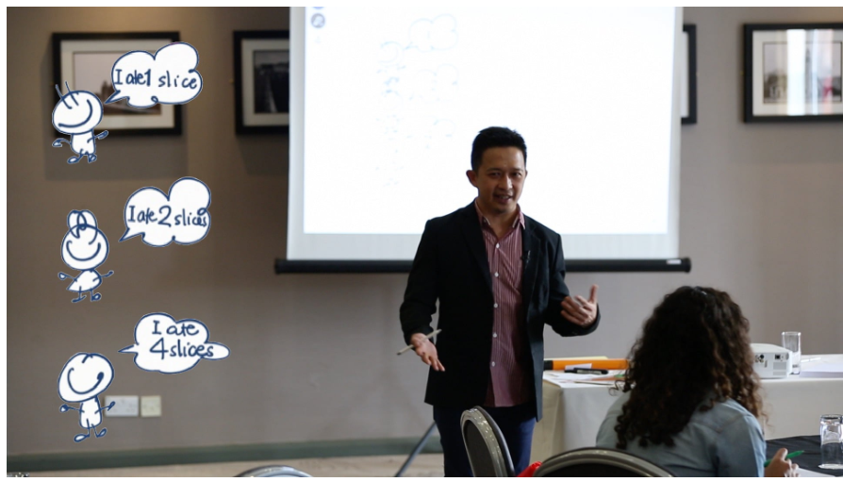
Anchor Task
Ban Har can't understand his friends! Spiky, Curly and Smiley all ate their own pizza. They claim to have eaten the same amount, even though they had a different amount of slices. How is this possible? Are Ban Har's friends lying to him? We explore how this equivalent fractions task can have multiple different answers. Can the answers be infinite...?

Slide 10
In the next video, Ban Har models journal writing to the class.
As you watch, can you write down anything that catches your attention or any questions you have.
https://mathsnoproblem.com/en/video-library/fractions-course/fractions-lesson-6/
Notes:
Was always supposed to include journaling – in my previous role was heavily involved in the rolling out of Maths No Problem

Slide 11
Things I noticed:
Students chose their own title
Training involved in journal writing
Use of colours when writing fractions – very clever!
Ensuring the key words appear in the journal
The subtle difference between teacher modelling and writing examples on the board

Slide 12
Moving away from modelling.
Needs to be frequent. May or may not be routine.
No asking ‘What’s the date?’, ‘What’s the title?’.
Ask yourself
Ask a neighbour
Look at the board
Look in your book

Slide 13
Moving away from modelling.
Which examples do you think I’m going to choose to write in the journal today?
Why?

Slide 14
Moving away from modelling.
Choose two methods you think people will understand without too much thought.
Choose two methods that you think some people wouldn’t understand. Can you explain it?

Slide 15
Things to look out for:
Evidence of creativity
Unusual for age-group
Initiative (something you didn’t ask them to do)
All of these are done because students recognise them as important, rather than because they are told to.

Slide 16
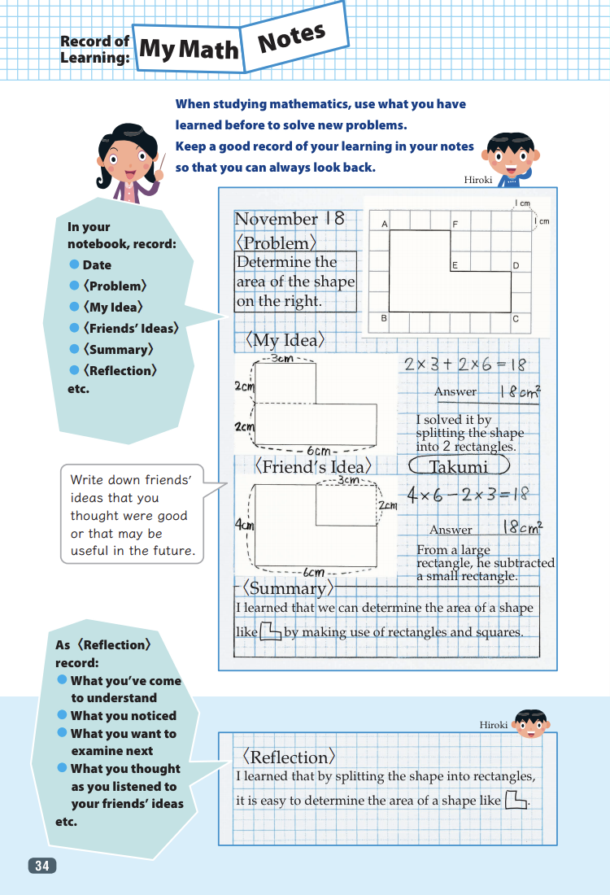
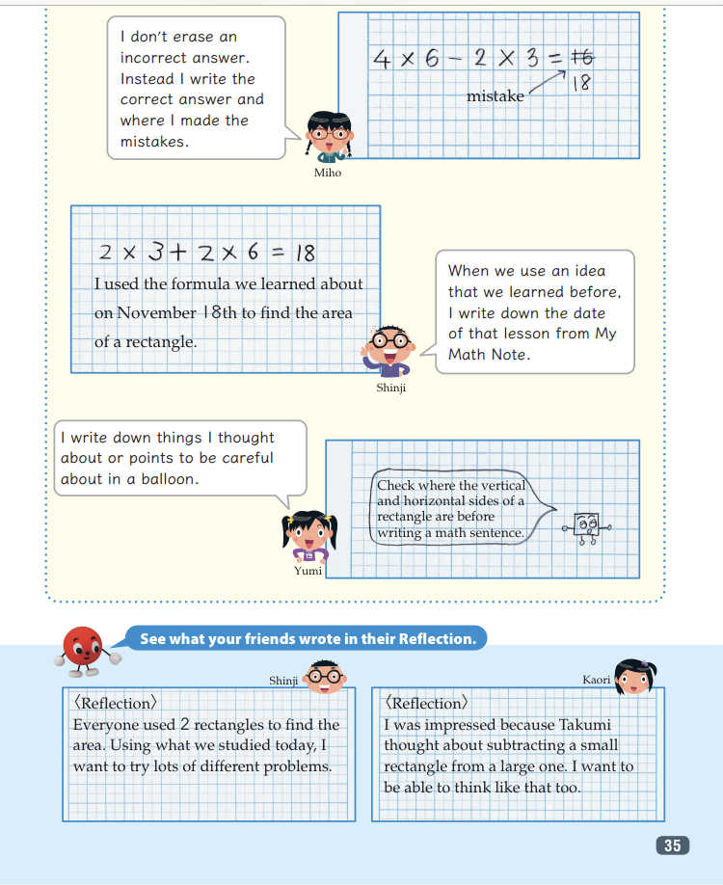
Journaling also appears in the Japanese textbooks

Slide 17
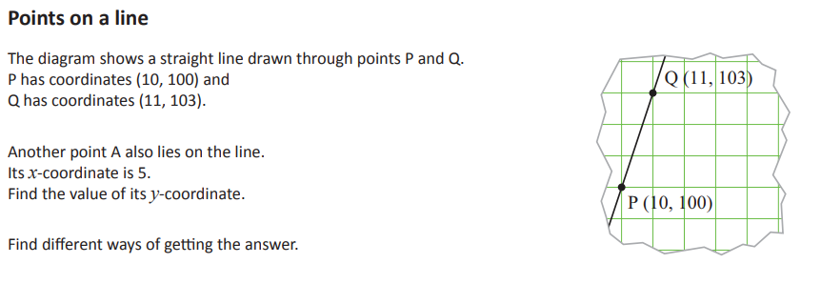
Have a go:
Write a journal for yesterday’s lesson.
What would you want it to look like?
Notes:
Was always supposed to include journaling – in my previous role was heavily involved in the rolling out of Maths No Problem

Slide 18
Now swap journals and discuss.
Notes:
Was always supposed to include journaling – in my previous role was heavily involved in the rolling out of Maths No Problem

Slide 19
Creating a measure of slope
This lesson is taught before students know about the definition of a gradient, so they wouldn’t necessarily know the formula for finding the gradient.
When solving this problem, try to think of it from the point of view of a student.

Slide 20
Creating a measure of slope
You have eight line segments: four of them are drawn and four are defined by the coordinates of the end-points.
Put all eight of them in order across the table from the least steep to the steepest.
Talk about it in your group and try to agree on the order of steepness.
You must explain how you decided.

Slide 21
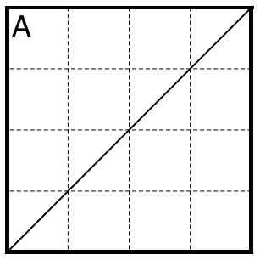
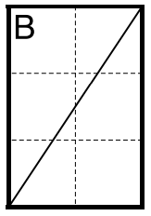
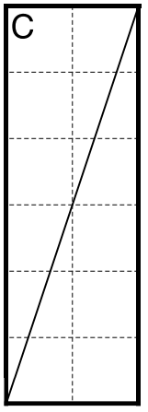

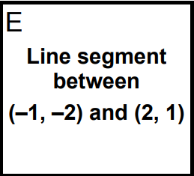
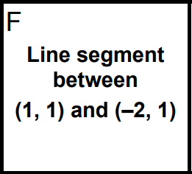
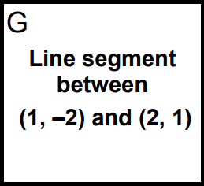
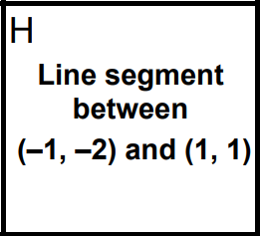

Slide 22
Journaling
What could you ask students to write for their journal for this task?

