Slide 1
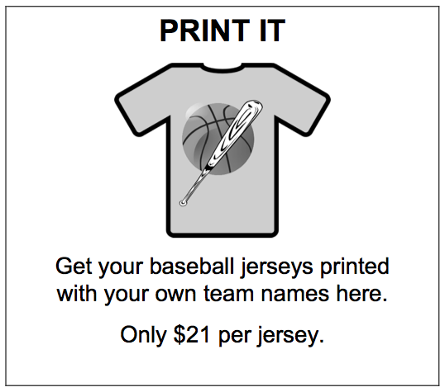
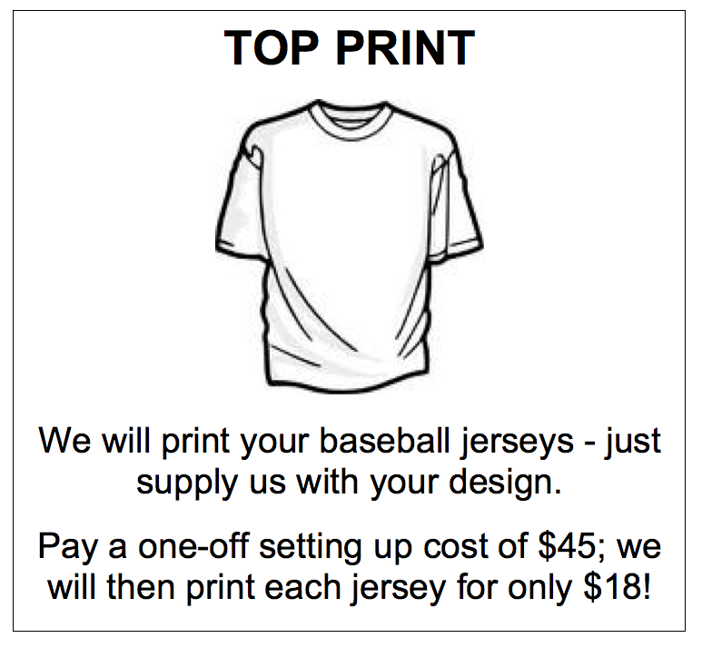
Baseball Jerseys
Bill wants to order some new baseball jerseys for his club.
.
Give Bill some advice.
When should he choose PRINT IT?
When should he choose TOP PRINT?
.

Slide 2
Baseball Jerseys
Work on this problem on your own for 10 minutes.
If you find a solution, try to find a different way to think about it.

Slide 3
Baseball Jerseys
Bill wants to order some new baseball jerseys for his club.
.
Give Bill some advice.
When should he choose PRINT IT?
When should he choose TOP PRINT?
.

Slide 4
Baseball Jerseys
Discuss your solution in your groups.
Take it in turns to explain how you approached the problem.
If explanations are unclear, ask questions until everybody understands.

Slide 5
Sentence Stems
Their answer is correct because…
I think the mistake they have made is…
This solution is better than that solution because…
To improve their solution they should…
I don’t understand the reasoning on…
I am not convinced by …’s reasoning because…

Slide 6
Baseball Jerseys
Now look at Cath, Ezra and Dylan’s responses and answer the questions on the sheet as a group.

Slide 7
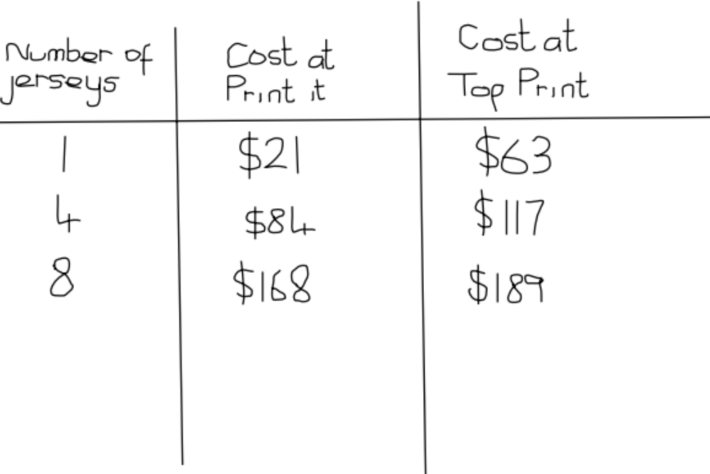
Cath’s response

Slide 8
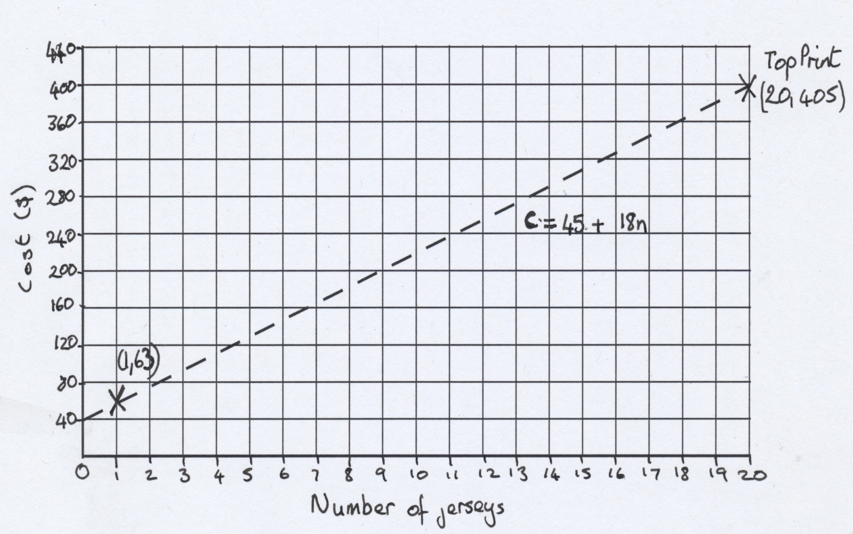
Ezra’s response

Slide 9
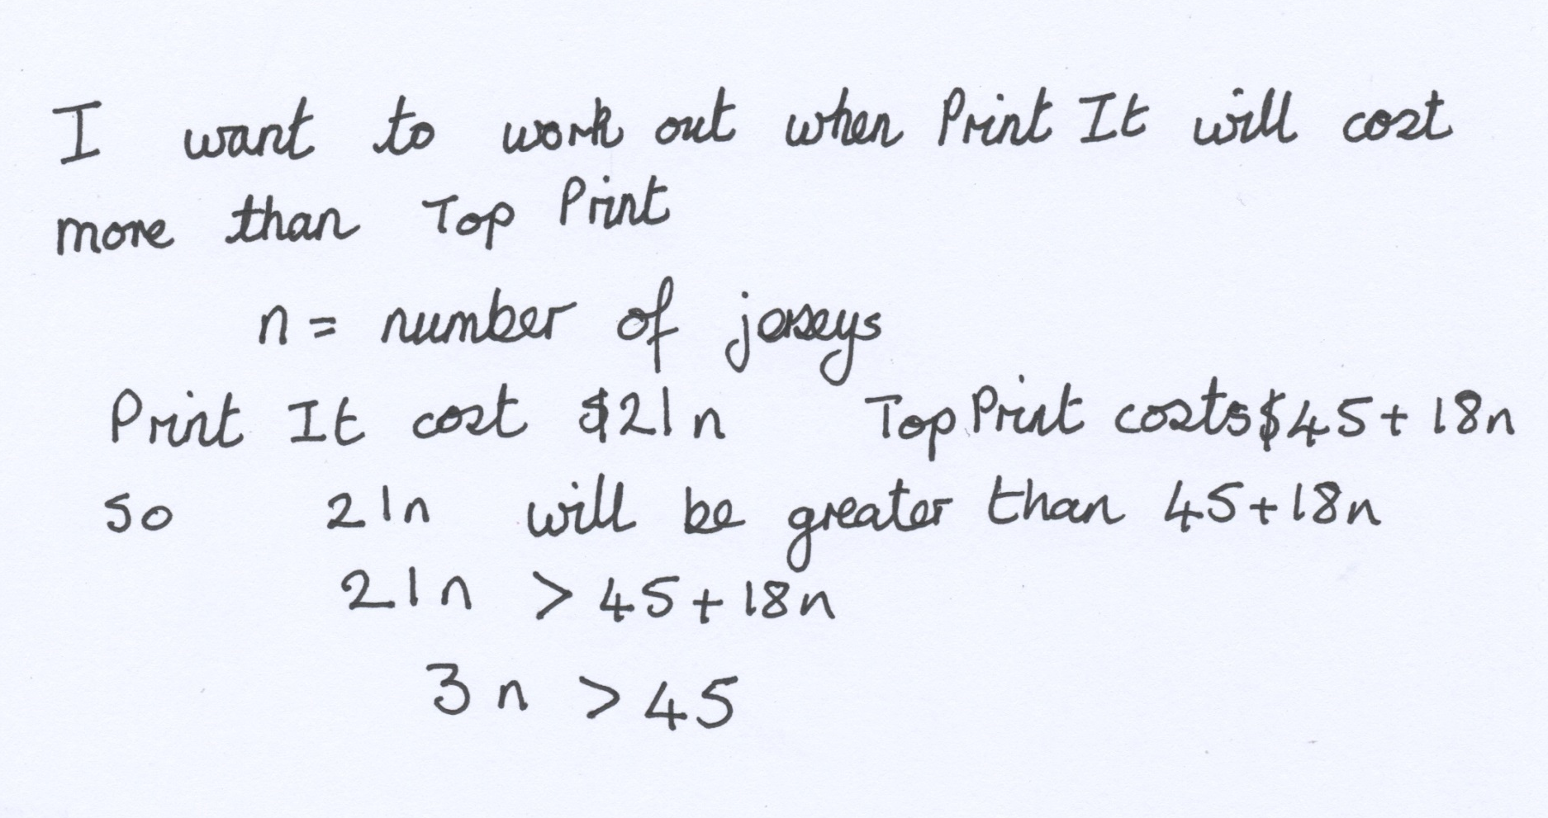
Dylan’s response

Slide 10
Baseball Jerseys
Now fill in your individual sheet about Cath, Ezra and Dylan’s work.

Slide 11
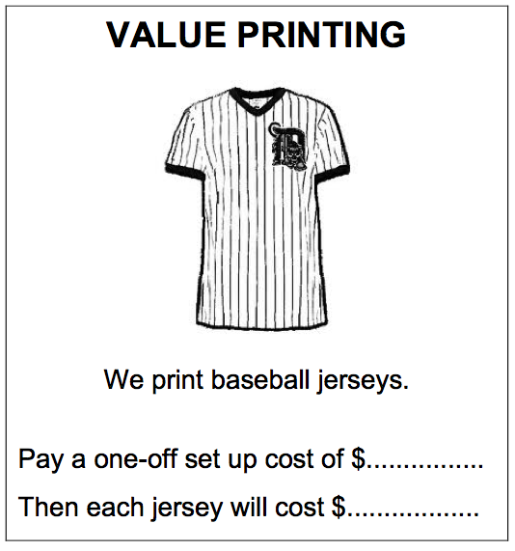
Baseball Jerseys
VALUE PRINTING never wants to be the most expensive and never wants to be the cheapest.
Fill in the costs on their flyer.

