Slide 1
Discuss:
What are the 4 different ways we can factorise an expression?

Slide 2




Single Brackets
Example: 4ab + 6a $≡$ 2a(2b + 3)
Double Brackets
Example: a² + 7a + 10 $≡$ (a + 5)(a + 2)
AC method
Example: 4a² + 9a + 5 $≡$ (4a + 5)(a + 1)
DOTS
Example: a² - 25 $≡$ (a + 5)(a – 5)

Slide 3
x² - 3x - 18
Which factorising method would you use to factorise…
Double

Slide 4
5x² - 9x - 4
Which factorising method would you use to factorise…
AC

Slide 5
6x² - 9x
Which factorising method would you use to factorise…
Single

Slide 6
9ab – 3a + 12b
Which factorising method would you use to factorise…
Single

Slide 7
x² - 25
Which factorising method would you use to factorise…
DOTS

Slide 8
x² - 81
Which factorising method would you use to factorise…
DOTS

Slide 9
3x² + x - 10
Which factorising method would you use to factorise…
AC

Slide 10
x² - x - 6
Which factorising method would you use to factorise…
Double

Slide 11
x² - 16
Which factorising method would you use to factorise…
DOTS

Slide 12
5a - 15
Which factorising method would you use to factorise…
Single

Slide 13
4x² – 81
Which factorising method would you use to factorise…
DOTS

Slide 14
x² + 5x + 4
Which factorising method would you use to factorise…
Double

Slide 15
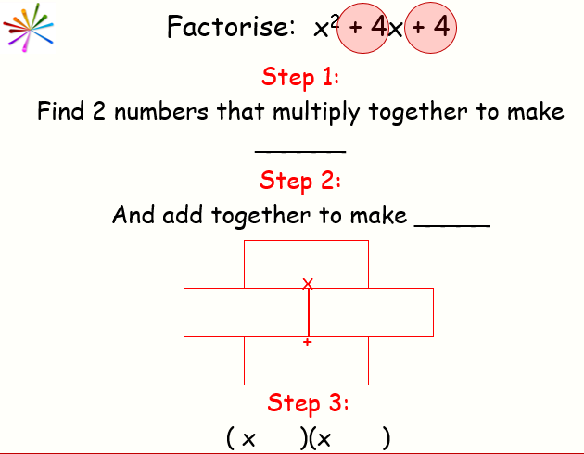
AC Method Example
Which numbers will go in my wall?
24
24
2x² + 11x + 12
+8
+3
2x² + 8x
+ 3x + 12
11
2x(x + 4)
3(x + 4)
What do you notice?
(2x + 3)(x + 4)
Where have the 2 brackets come from?

Slide 16

In your books
Title: Factorising Practice
You need to decide which type of factorising is required before factorising each expression.
It will be one of the 4 you have seen.
Show your working out for each question.
Check your solutions by multiplying out the brackets.

Slide 17
How could we make this expression easier to factorise?
3x² + 15x + 12
By taking out a factor of 3 first, factorise
3x² + 15x + 12
3(x² + 5x + 4)
3(x + 4)(x + 1)

Slide 18
By taking out a factor first, factorise the following:
1) 2x² + 18x + 36
2) 3x² - 21x + 30
3) 4x² - 4x - 24
Challenge:
12x² + 14x + 4

