Slide 1

Simplify the following …

Slide 2
Challenge …
Remember: Factorise the expressions if possible first

Slide 3
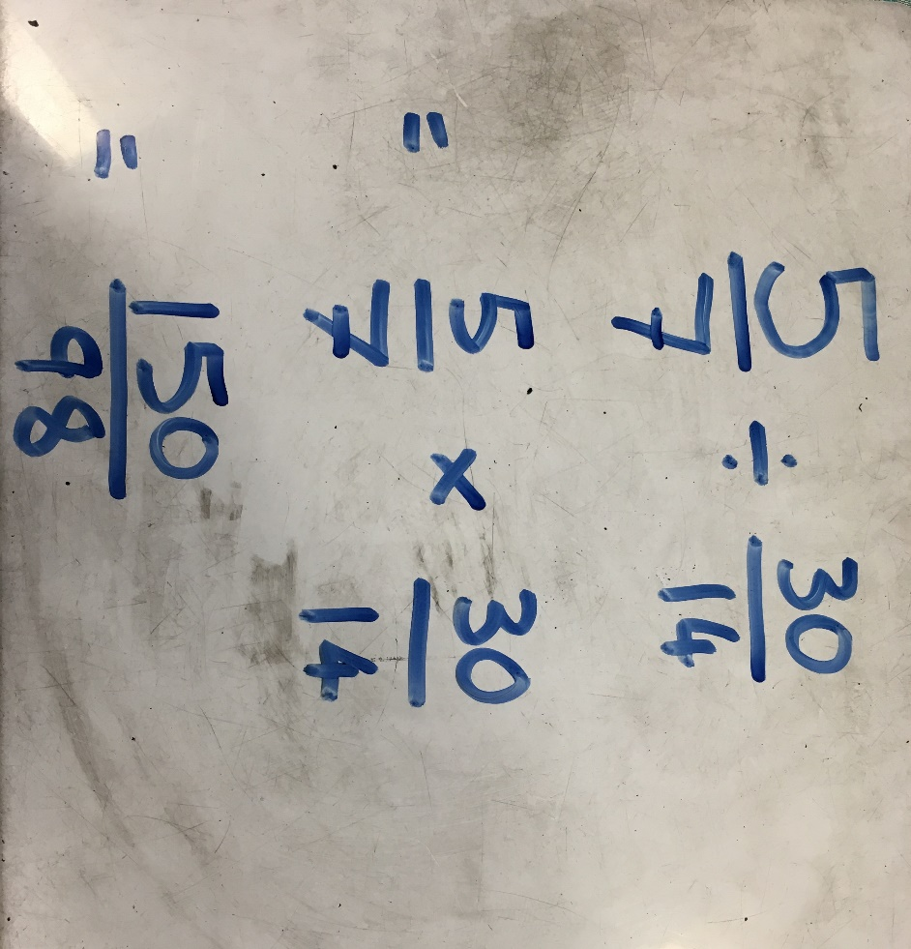

$\frac{5}{7}÷\frac{30}{14}$
John is calculating
Discuss: Do you agree with his method?

Slide 4
$\frac{5}{7}÷\frac{30}{14}$
John is calculating
What has John forgotten to do?

Slide 5
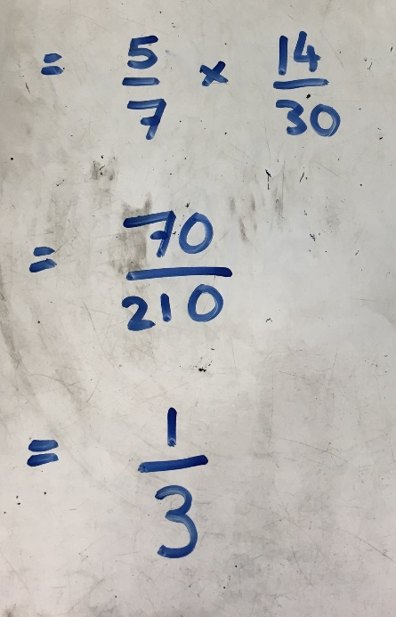
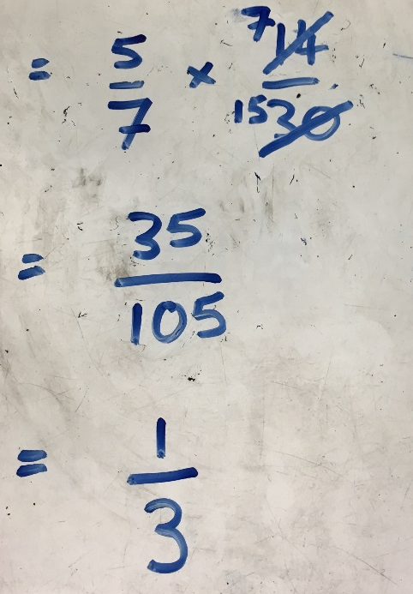
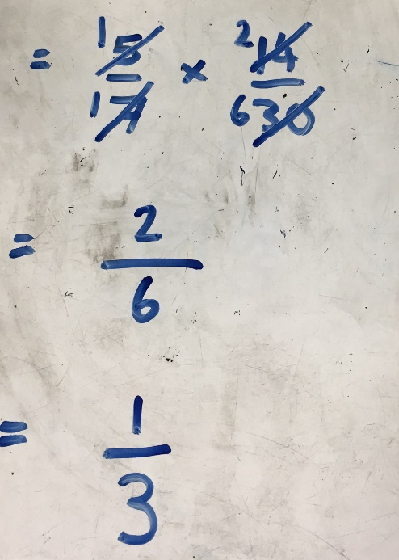

$\frac{5}{7}÷\frac{30}{14}$
John is calculating
$\frac{5}{7}÷\frac{30}{14}=\frac{5}{7}×\frac{14}{30}$
What are the 3 ways in which John could complete his calculation?

Slide 6
$\frac{5}{7}÷\frac{30}{14}$
John is calculating
$\frac{5}{7}÷\frac{30}{14}=\frac{5}{7}×\frac{14}{30}$
Which of the 3 methods is most efficient?

Slide 7
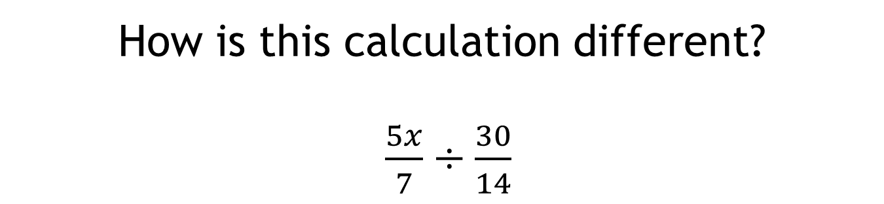
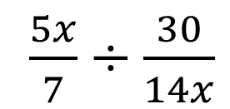
How is this calculation different?
$\frac{5x}{7}÷\frac{30}{14}$
How should John attempt to answer this calculation?
What about this one?
$\frac{5x}{7}÷\frac{30}{14x}$

Slide 8
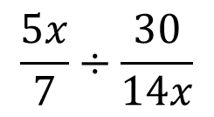
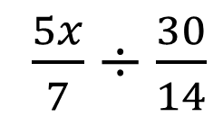
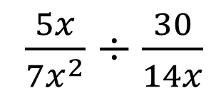
On your whiteboards, complete the calculations and find out what John will be able to cancel each time?
$\frac{5x}{7}÷\frac{30}{14}$
$$\frac{5x}{7}÷\frac{30}{14x}$$
$\frac{5x}{7x^{2}}÷\frac{30}{14x}$

Slide 9
On your whiteboards …
Express the following as a single fraction
Remember:
Once you have changed it to a multiplication
Cancel where possible

Slide 10
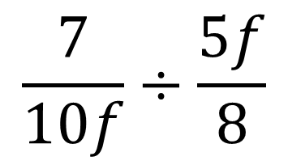
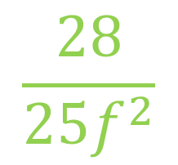
Express as a single fraction
$$\frac{7}{10f}÷\frac{5f}{8}$$
$$\frac{28}{25f^{2}}$$

Slide 11
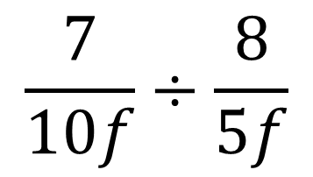
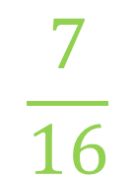
Express as a single fraction
$$\frac{7}{10f}÷\frac{8}{5f}$$
$$\frac{7}{16}$$

Slide 12
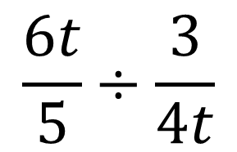
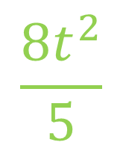
Express as a single fraction
$$\frac{6t}{5}÷\frac{3}{4t}$$
$$\frac{8t^{2}}{5}$$

Slide 13
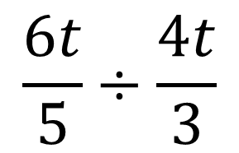
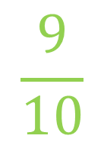
Express as a single fraction
$$\frac{6t}{5}÷\frac{4t}{3}$$
$$\frac{9}{10}$$

Slide 14
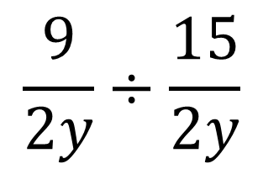

Express as a single fraction
$$\frac{9}{2y}÷\frac{15}{2y}$$
$$\frac{3}{5}$$

Slide 15
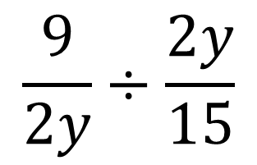
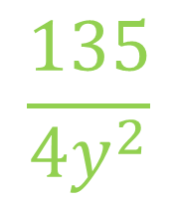
Express as a single fraction
$$\frac{9}{2y}÷\frac{2y}{15}$$
$$\frac{135}{4y^{2}}$$

Slide 16
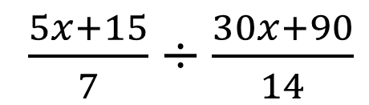
How should John attempt to answer this calculation?
$\frac{5x+15}{7}÷\frac{30x+90}{14}$
John should factorise the expressions that he can before he attempts to cancel

Slide 17
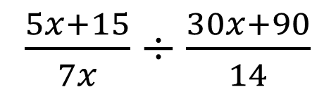
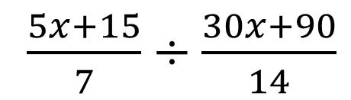
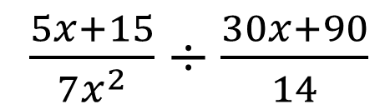
On your whiteboards, complete the calculations and find out what John will be able to cancel each time after he has factorised?
$\frac{5x+15}{7}÷\frac{30x+90}{14}$
$\frac{5x+15}{7x}÷\frac{30x+90}{14}$
$\frac{5x+15}{7x^{2}}÷\frac{30x+90}{14}$

Slide 18
On your whiteboards …
Express the following as a single fraction
Remember:
Once you have changed it to a multiplication
Factorise where possible
then
Cancel where possible

Slide 19
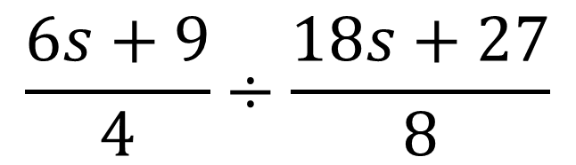

Express as a single fraction
$$\frac{6s+9}{4}÷\frac{18s+27}{8}$$
$$\frac{2}{3}$$

Slide 20
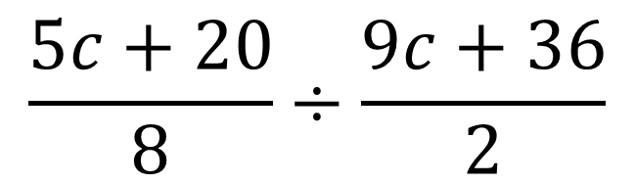
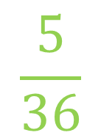
Express as a single fraction
$$\frac{5c+20}{8}÷\frac{9c+36}{2}$$
$$\frac{5}{36}$$

Slide 21
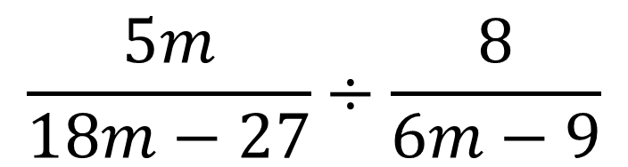
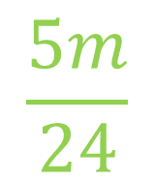
Express as a single fraction
$$\frac{5m}{18m−27}÷\frac{8}{6m−9}$$
$$\frac{5m}{24}$$

Slide 22
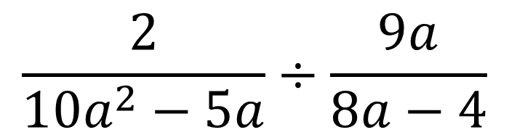
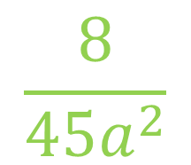
Express as a single fraction
$$\frac{2}{10a^{2}−5a}÷\frac{9a}{8a−4}$$
$$\frac{8}{45a^{2}}$$

Slide 23
Rally Coach
In your pairs:
Partner A has a go first, Partner B must watch, help if required, and mark when finished.
Partner B then takes a turn and Partner A becomes the coach.
If you finish, ask for the challenge questions

Slide 24
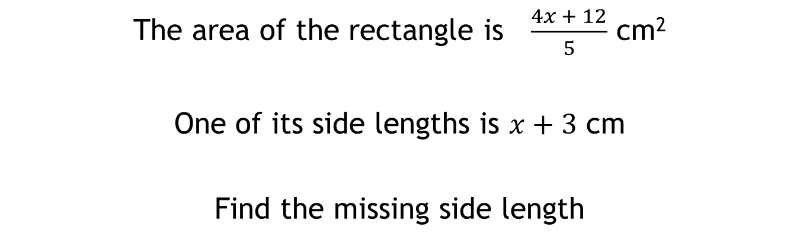
The area of the rectangle is $\frac{4x + 12}{5}$ cm²
One of its side lengths is $x+3$ cm
Find the missing side length

