Slide 1
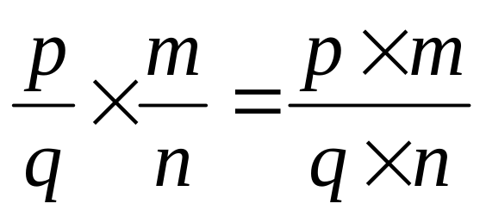

On your whiteboards …
Calculate
$$\frac{9}{15}×\frac{25}{27}$$
When two fractions are multiplied
we multiply the two numerators to make the new numerator
we multiply the two denominators to make the new denominator.

Slide 2
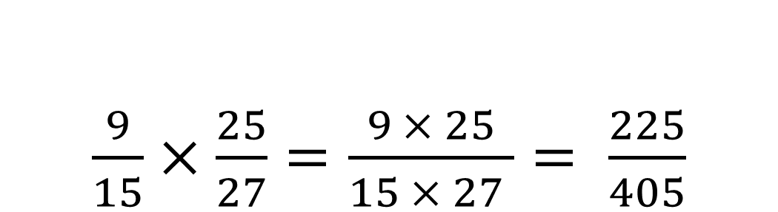
On your whiteboards …
$\frac{9}{15}×\frac{25}{27}=\frac{9 × 25}{15 × 27 }= \frac{225}{405}$

Slide 3
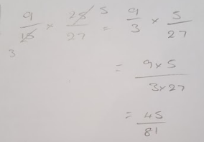
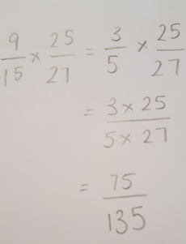
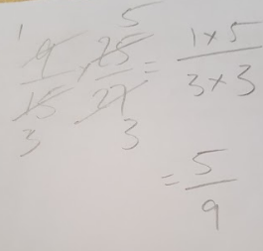
Here are 3 methods from another class
Are any of them the same as yours? Are any similar?
If any are different, can you tell what they have done?

Slide 4
Here are 3 methods from another class
Which method is the most efficient?

Slide 5
When we multiply algebraic fractions, we use the same principals as when we multiply numerical fractions.
It is usually easier to cancel fractions before multiplying them
Remember – when cancelling fractions we must cancel a numerator and a denominator

Slide 6
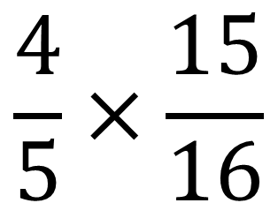
Is there anything we can cancel?
$$\frac{4}{5}×\frac{15}{16}$$
Discuss

Slide 7
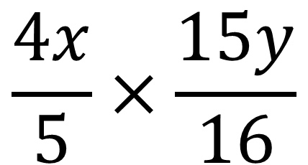
Is there anything we can cancel?
$$\frac{4x}{5}×\frac{15y}{16}$$
What about now?

Slide 8
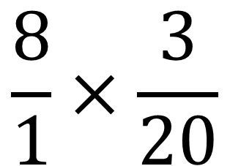
Is there anything we can cancel?
$$\frac{8}{1}×\frac{3}{20}$$
Discuss

Slide 9
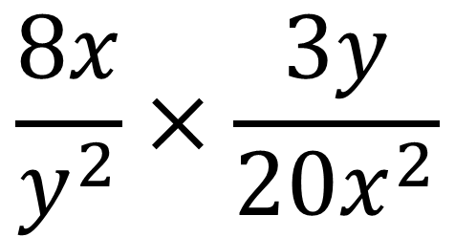
Is there anything we can cancel?
$$\frac{8x}{y^{2}}×\frac{3y}{20x^{2}}$$
What about now?

Slide 10
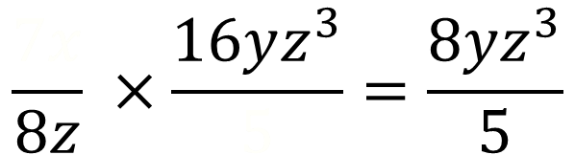
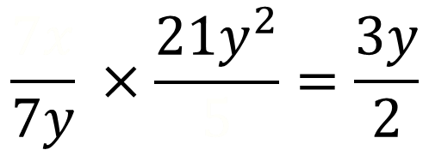
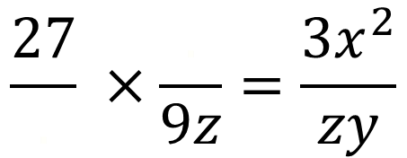
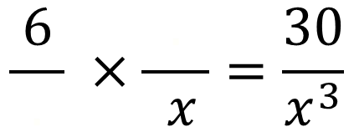
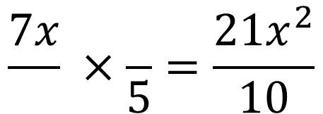
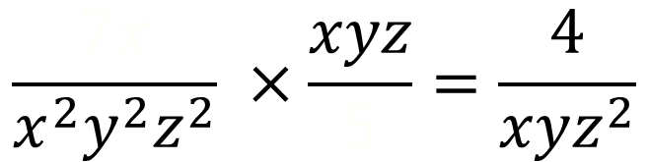
Fill in the missing gaps.
You may need to cancel first.
$$\frac{7x}{.} ×\frac{.}{5}=\frac{21x^{2}}{10}$$
$$\frac{7x}{8z} ×\frac{16yz^{3}}{5}=\frac{8yz^{3}}{5}$$
1)
4)
$$\frac{ 6 }{.} ×\frac{.}{ x }=\frac{30}{x^{3}}$$
$$\frac{7x}{x^{2}y^{2}z^{2}} ×\frac{xyz}{5}=\frac{4}{xyz^{2}}$$
2)
5)
$$\frac{27}{.} ×\frac{.}{9z}=\frac{3x^{2}}{zy}$$
$$\frac{7x}{7y} ×\frac{21y^{2}}{5}=\frac{3y}{2}$$
3)
6)

Slide 11
Fill in the missing gaps.
You may need to cancel first.
3x
$$\frac{7x}{8z} ×\frac{16yz^{3}}{5}=\frac{8yz^{3}}{5}$$
$$\frac{7x}{.} ×\frac{.}{5}=\frac{21x^{2}}{10}$$
1)
4)
2
$$\frac{ 6 }{.} ×\frac{.}{ x }=\frac{30}{x^{3}}$$
$$\frac{7x}{x^{2}y^{2}z^{2}} ×\frac{xyz}{5}=\frac{4}{xyz^{2}}$$
2)
5)
$$\frac{27}{.} ×\frac{.}{9z}=\frac{3x^{2}}{zy}$$
$$\frac{7x}{7y} ×\frac{21y^{2}}{5}=\frac{3y}{2}$$
3)
6)

Slide 12
Fill in the missing gaps.
You may need to cancel first.
3x
$$\frac{7x}{8z} ×\frac{16yz^{3}}{5}=\frac{8yz^{3}}{5}$$
$$\frac{7x}{.} ×\frac{.}{5}=\frac{21x^{2}}{10}$$
1)
4)
2
5
$$\frac{7x}{x^{2}y^{2}z^{2}} ×\frac{xyz}{5}=\frac{4}{xyz^{2}}$$
$$\frac{ 6 }{.} ×\frac{.}{ x }=\frac{30}{x^{3}}$$
5)
2)
x²
$$\frac{27}{.} ×\frac{.}{9z}=\frac{3x^{2}}{zy}$$
$$\frac{7x}{7y} ×\frac{21y^{2}}{5}=\frac{3y}{2}$$
3)
6)

Slide 13
Fill in the missing gaps.
You may need to cancel first.
3x
$$\frac{7x}{8z} ×\frac{16yz^{3}}{5}=\frac{8yz^{3}}{5}$$
$$\frac{7x}{.} ×\frac{.}{5}=\frac{21x^{2}}{10}$$
1)
4)
2
5
$$\frac{7x}{x^{2}y^{2}z^{2}} ×\frac{xyz}{5}=\frac{4}{xyz^{2}}$$
$$\frac{ 6 }{.} ×\frac{.}{ x }=\frac{30}{x^{3}}$$
5)
2)
x²
x²
$$\frac{7x}{7y} ×\frac{21y^{2}}{5}=\frac{3y}{2}$$
$$\frac{27}{.} ×\frac{.}{9z}=\frac{3x^{2}}{zy}$$
6)
3)
y

Slide 14
Fill in the missing gaps.
You may need to cancel first.
3x
4
$$\frac{7x}{.} ×\frac{.}{5}=\frac{21x^{2}}{10}$$
$$\frac{7x}{8z} ×\frac{16yz^{3}}{5}=\frac{8yz^{3}}{5}$$
1)
4)
2
5
5
$$\frac{7x}{x^{2}y^{2}z^{2}} ×\frac{xyz}{5}=\frac{4}{xyz^{2}}$$
$$\frac{ 6 }{.} ×\frac{.}{ x }=\frac{30}{x^{3}}$$
5)
2)
x²
x²
$$\frac{7x}{7y} ×\frac{21y^{2}}{5}=\frac{3y}{2}$$
$$\frac{27}{.} ×\frac{.}{9z}=\frac{3x^{2}}{zy}$$
6)
3)
y

Slide 15
Fill in the missing gaps.
You may need to cancel first.
3x
4
$$\frac{7x}{.} ×\frac{.}{5}=\frac{21x^{2}}{10}$$
$$\frac{7x}{8z} ×\frac{16yz^{3}}{5}=\frac{8yz^{3}}{5}$$
1)
4)
2
5
5
4
$$\frac{ 6 }{.} ×\frac{.}{ x }=\frac{30}{x^{3}}$$
$$\frac{7x}{x^{2}y^{2}z^{2}} ×\frac{xyz}{5}=\frac{4}{xyz^{2}}$$
2)
5)
x²
z
x²
$$\frac{7x}{7y} ×\frac{21y^{2}}{5}=\frac{3y}{2}$$
$$\frac{27}{.} ×\frac{.}{9z}=\frac{3x^{2}}{zy}$$
6)
3)
y

Slide 16
Fill in the missing gaps.
You may need to cancel first.
3x
4
$$\frac{7x}{.} ×\frac{.}{5}=\frac{21x^{2}}{10}$$
$$\frac{7x}{8z} ×\frac{16yz^{3}}{5}=\frac{8yz^{3}}{5}$$
1)
4)
2
5
5
4
$$\frac{ 6 }{.} ×\frac{.}{ x }=\frac{30}{x^{3}}$$
$$\frac{7x}{x^{2}y^{2}z^{2}} ×\frac{xyz}{5}=\frac{4}{xyz^{2}}$$
2)
5)
x²
z
x²
1
$$\frac{27}{.} ×\frac{.}{9z}=\frac{3x^{2}}{zy}$$
$$\frac{7x}{7y} ×\frac{21y^{2}}{5}=\frac{3y}{2}$$
3)
6)
y
2

Slide 17
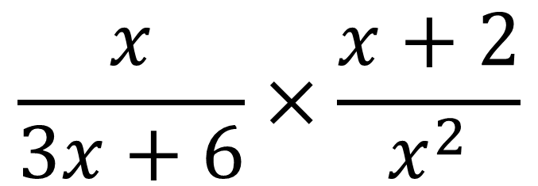
Is there anything we can cancel?
$$\frac{x}{3x+6}×\frac{x+2}{x^{2}}$$
Discuss
Notes:
Pupils may notice to factorise the denominator – hopefully they do. If so the next slide isn’t needed.

Slide 18
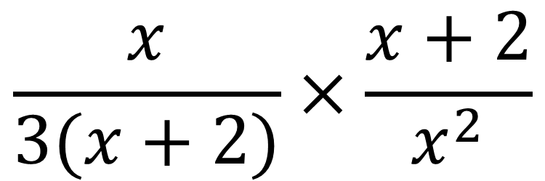
Is there anything we can cancel?
$$\frac{x}{3(x+2)}×\frac{x+2}{x^{2}}$$
What about now?
How is this different?

Slide 19
Is there anything we can cancel?
$$\frac{x}{3(x+2)}×\frac{x+2}{x^{2}}$$
Sometimes, it helps to factorise some of the expressions to check if we can cancel

Slide 20
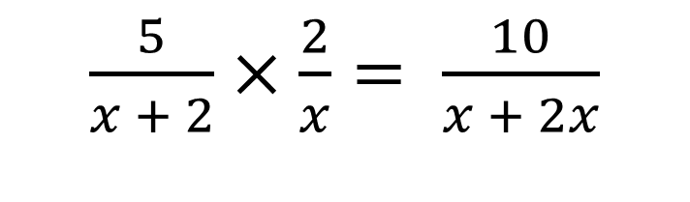
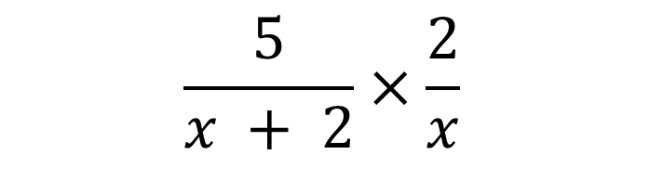
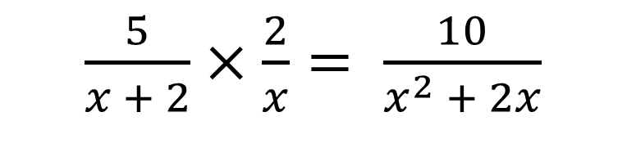
Joey and James are trying to simplify the calculation:
$$\frac{5}{x + 2}×\frac{2}{x}$$
Joey thinks that
James thinks that
$\frac{5}{x + 2}×\frac{2}{x}= \frac{10}{x + 2x}$
$\frac{5}{x + 2}×\frac{2}{x}= \frac{10}{x^{2} + 2x}$
Because x + 2 multiplied by x gives you x + 2x
Because when you multiply x + 2 by x you must multiply the x and the 2
Discuss – who do you agree with?

Slide 21
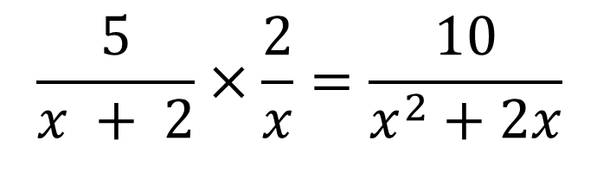
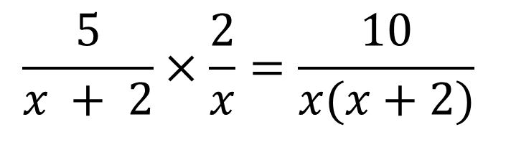
Joey and James are trying to simplify the calculation:
$$\frac{5}{x + 2}×\frac{2}{x}$$
$$\frac{5}{x + 2}×\frac{2}{x}=\frac{10}{x(x+2)}$$
Which method can we use to expand the brackets?
$$\frac{5}{x + 2}×\frac{2}{x}=\frac{10}{x^{2}+2x}$$

Slide 22


True or false …
$$\frac{3}{x}×\frac{x}{x−1}=\frac{3}{x−1}$$
Discuss
$$\frac{3}{x}×\frac{x}{x−1}=\frac{3x}{x(x−1)}$$
Discuss

Slide 23
True or false …
$$\frac{3}{x}×\frac{x}{x−1}=\frac{3}{x−1}$$
Discuss
$$\frac{3}{x}×\frac{x}{x−1}=\frac{3x}{x(x−1)}$$
How can they both be correct?

Slide 24

To finish …
On your whiteboard, simplify
$$\frac{x}{x+2}×\frac{2}{x}$$

Slide 25

To finish …
On your whiteboard, factorise and simplify
$$\frac{5y−10}{15}×\frac{3y}{y−2}$$

Slide 26

To finish …
On your whiteboard, factorise and simplify
$$\frac{3}{x+2}×\frac{3x+6}{2x+3}$$

Slide 27

To finish …
On your whiteboard, factorise and simplify
$$\frac{x}{x+2}×\frac{x^{2}+2x}{x^{2}}$$

Slide 28


Challenge Problem
Show that
$$\frac{4x+12}{7x}×\frac{5x^{2}−10x}{6−9x}×\frac{21}{2x−4}$$
Can be written as
$$\frac{10(x+3)}{2−3x}$$

