Slide 1


On your whiteboards …
Simplify fully:
$$\frac{6y}{18xy}$$
a)
$$\frac{6y}{y^{2}−y}$$
b)

Slide 2
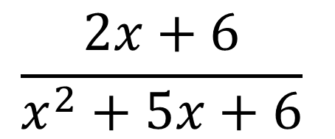
How is the following more difficult to simplify than last lesson?
$$\frac{2x+6}{x^{2}+5x+6}$$
It is very important to notice which factorising method to use before simplifying the algebraic fraction
How many types of factorising do you know?
What are they?

Slide 3
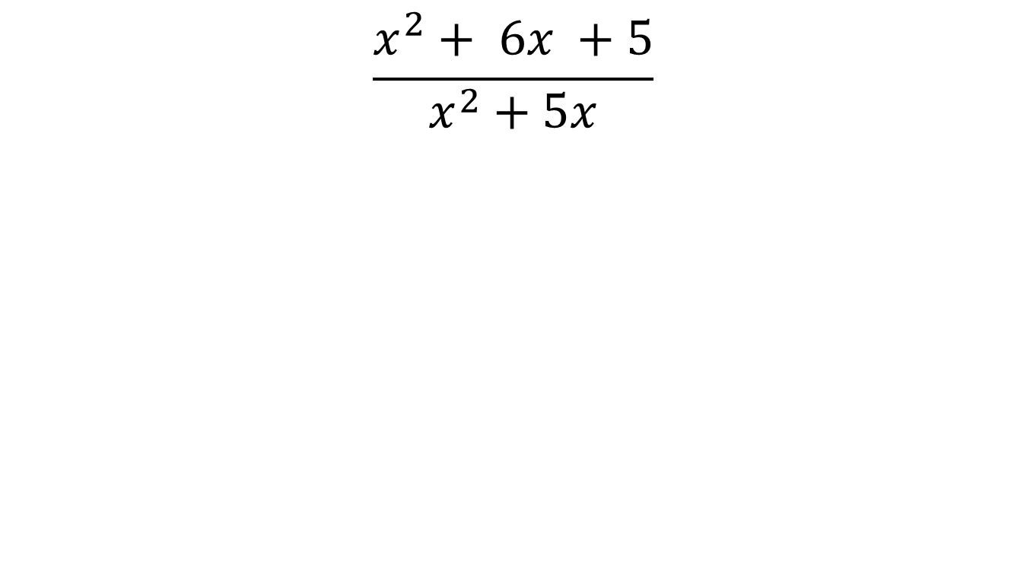

Decide which factorising method to use for the numerator and denominator
On your whiteboards …
$$\frac{x^{2}+ 6x +5}{x^{2}+5x}$$
$$\frac{Double}{Single }$$

Slide 4
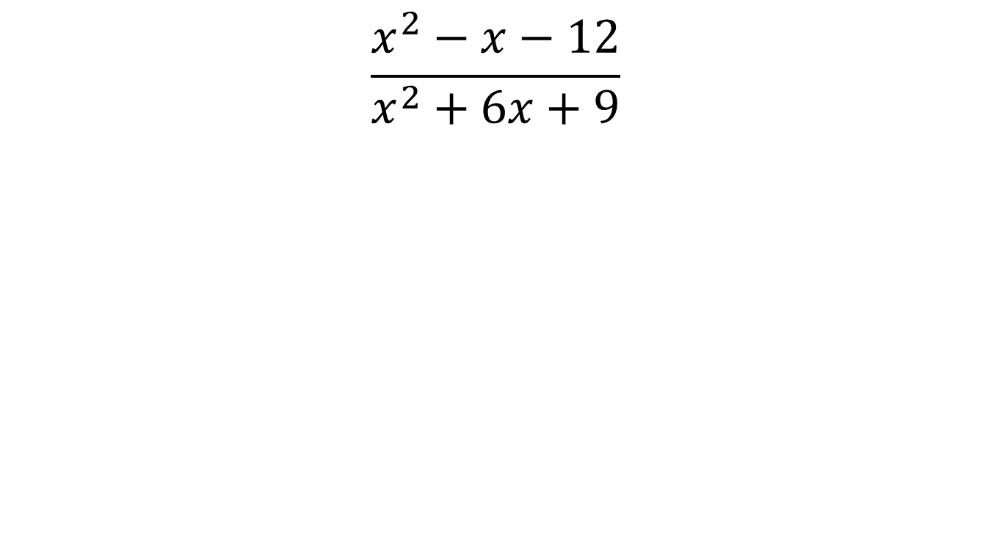

Decide which factorising method to use for the numerator and denominator
On your whiteboards …
$$\frac{x^{2}−x−12}{x^{2}+6x+9}$$
$$\frac{Double}{Double }$$

Slide 5
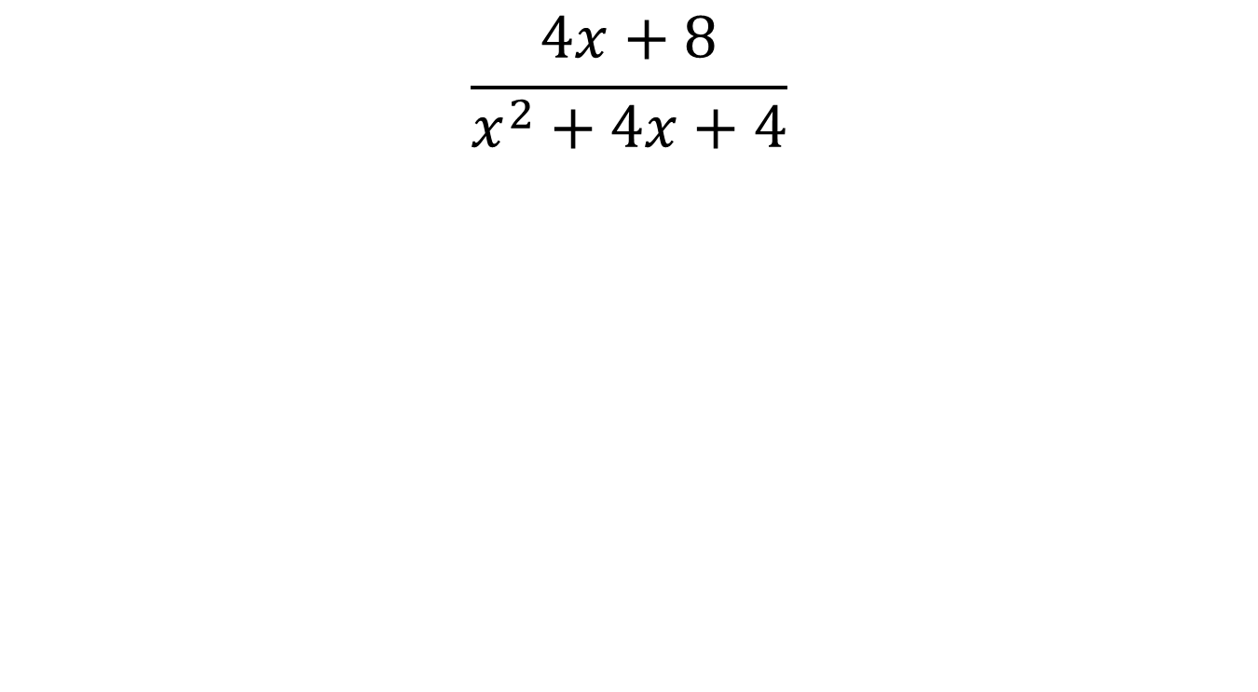

Decide which factorising method to use for the numerator and denominator
On your whiteboards …
$$\frac{4x+8}{x^{2}+4x+4}$$
$$\frac{Single}{Double }$$

Slide 6
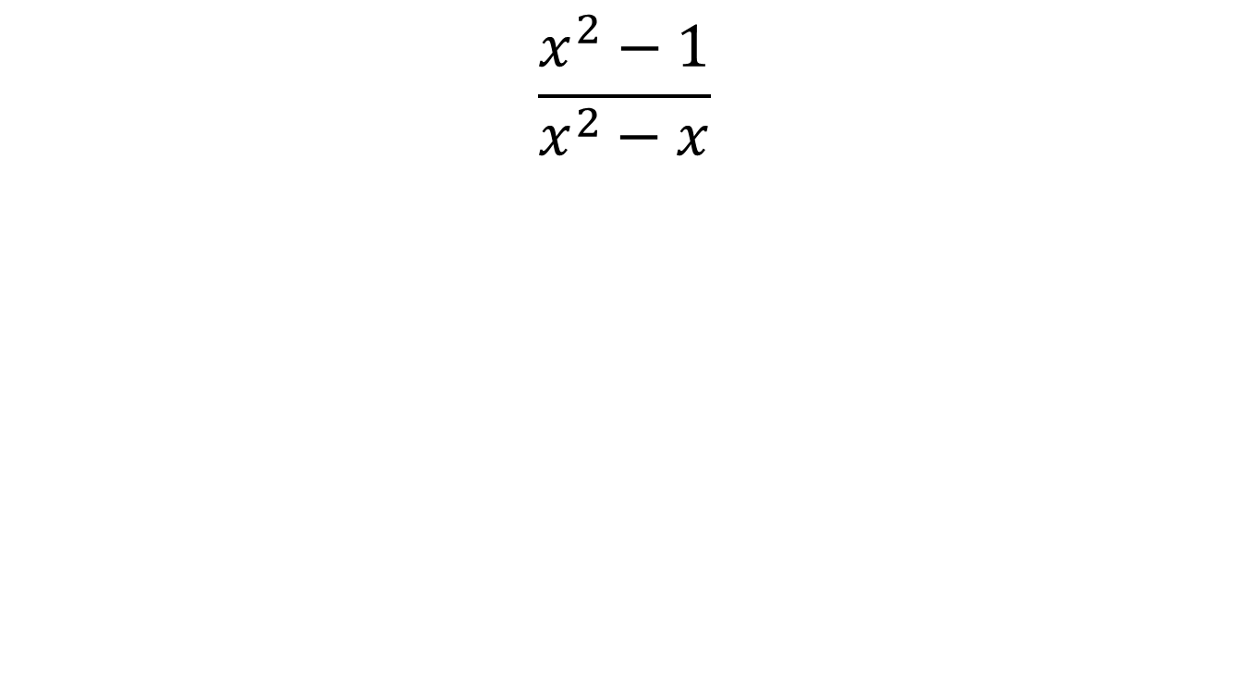

Decide which factorising method to use for the numerator and denominator
On your whiteboards …
$$\frac{x^{2}−1}{x^{2}−x}$$
$$\frac{DOTS}{Single }$$

Slide 7
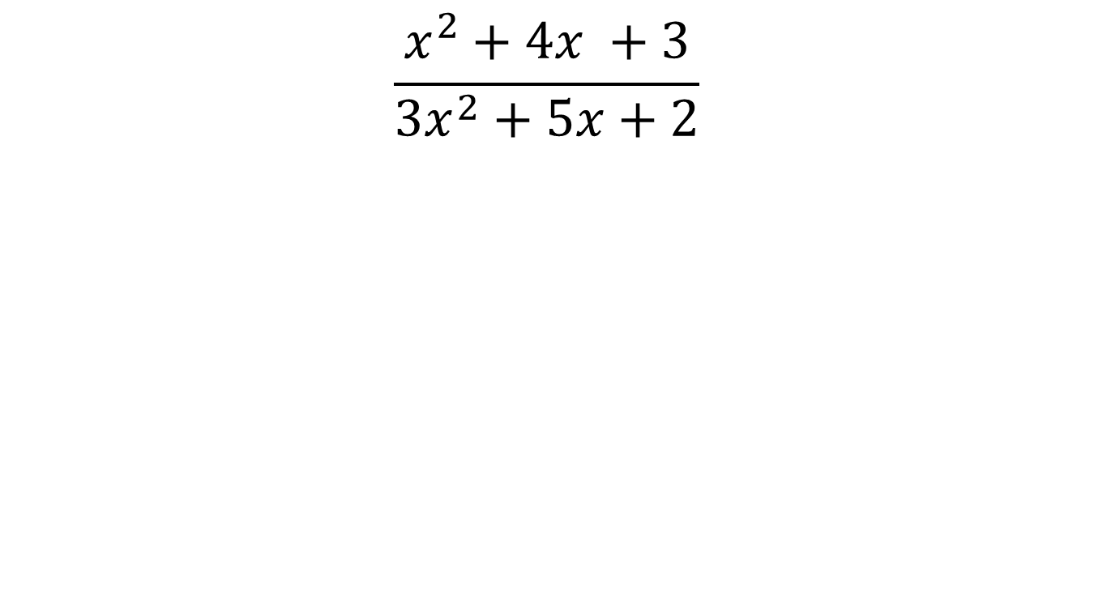

Decide which factorising method to use for the numerator and denominator
On your whiteboards …
$$\frac{x^{2}+4x +3}{{3x}^{2}+5x+2}$$
$$\frac{Double}{AC Method }$$

Slide 8
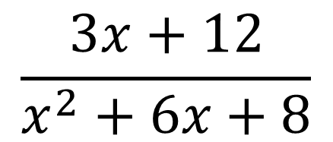
Once we have factorised first, then we can cancel our fractions
$$\frac{3x+12}{x^{2}+6x+8}$$

Slide 9
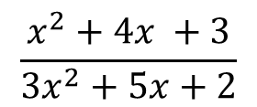
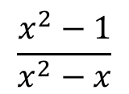
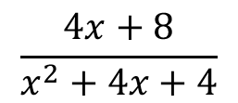
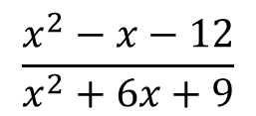
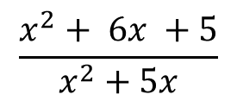
For each of the following state which factorising method you would use for the numerator and denominator
1
2
3
4
**
$$\frac{x^{2}+ 6x +5}{x^{2}+5x}$$
$$\frac{x^{2}−x−12}{x^{2}+6x+9}$$
$$\frac{4x+8}{x^{2}+4x+4}$$
$$\frac{x^{2}−1}{x^{2}−x}$$
$$\frac{x^{2}+4x +3}{{3x}^{2}+5x+2}$$
Notes:
Please make it clear the bottom row is a CHALLENGE and not many are expected to be able to complete the full table

Slide 10
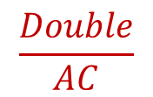
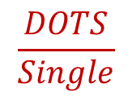
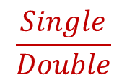
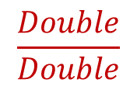
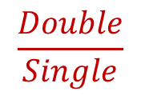
For each of the following state which factorising method you would use for the numerator and denominator
1
2
3
4
**
$$\frac{x^{2}+ 6x +5}{x^{2}+5x}$$
$$\frac{Double}{Single}$$
$$\frac{x^{2}−x−12}{x^{2}+6x+9}$$
$$\frac{Double}{Double}$$
$$\frac{4x+8}{x^{2}+4x+4}$$
$$\frac{Single}{Double}$$
$$\frac{x^{2}−1}{x^{2}−x}$$
$$\frac{DOTS}{Single}$$
$$\frac{x^{2}+4x +3}{{3x}^{2}+5x+2}$$
$$\frac{Double}{AC}$$

Slide 11
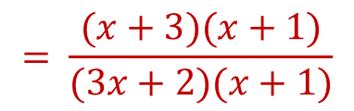
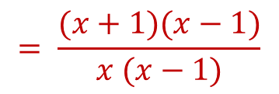
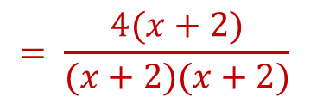
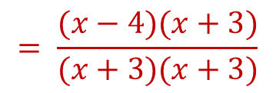
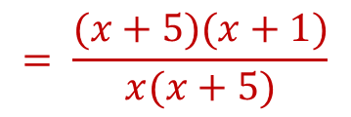
For each of the following state which factorising method you would use for the numerator and denominator
1
2
3
4
**
$$\frac{x^{2}+ 6x +5}{x^{2}+5x}$$
$$\frac{Double}{Single}$$
$$= \frac{(x+5)(x+1)}{x(x+5)}$$
$$\frac{x^{2}−x−12}{x^{2}+6x+9}$$
$$\frac{Double}{Double}$$
$$= \frac{(x−4)(x+3)}{(x+3)(x+3)}$$
$$\frac{4x+8}{x^{2}+4x+4}$$
$$\frac{Single}{Double}$$
$$= \frac{4(x+2)}{(x+2)(x+2)}$$
$$\frac{x^{2}−1}{x^{2}−x}$$
$$\frac{DOTS}{Single}$$
$$= \frac{(x+1)(x−1)}{x (x−1)}$$
$$\frac{x^{2}+4x +3}{{3x}^{2}+5x+2}$$
$$\frac{Double}{AC}$$
$$= \frac{(x+3)(x+1)}{(3x+2)(x+1)}$$

Slide 12
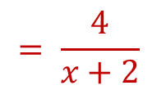
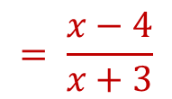
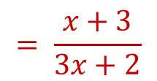
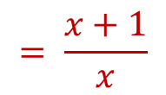
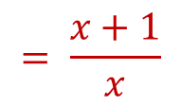
For each of the following state which factorising method you would use for the numerator and denominator
1
2
3
4
**
$$\frac{x^{2}+ 6x +5}{x^{2}+5x}$$
$$\frac{Double}{Single}$$
$$= \frac{(x+5)(x+1)}{x(x+5)}$$
$$= \frac{x+1}{x}$$
$$\frac{x^{2}−x−12}{x^{2}+6x+9}$$
$$\frac{Double}{Double}$$
$$= \frac{(x−4)(x+3)}{(x+3)(x+3)}$$
$$= \frac{x−4}{x+3}$$
$$\frac{4x+8}{x^{2}+4x+4}$$
$$\frac{Single}{Double}$$
$$= \frac{4(x+2)}{(x+2)(x+2)}$$
$$= \frac{4}{x+2}$$
$$\frac{x^{2}−1}{x^{2}−x}$$
$$\frac{DOTS}{Single}$$
$$= \frac{(x+1)(x−1)}{x (x−1)}$$
$$= \frac{x+1}{x}$$
$$\frac{x^{2}+4x +3}{{3x}^{2}+5x+2}$$
$$\frac{Double}{AC}$$
$$= \frac{(x+3)(x+1)}{(3x+2)(x+1)}$$
$$= \frac{x+3}{3x+2}$$

Slide 13
In pairs …
Complete the dominoes activity
Notes:
Most lower will not get past this point. That is not an issue, move to fractions consolidation and next lessons

Slide 14
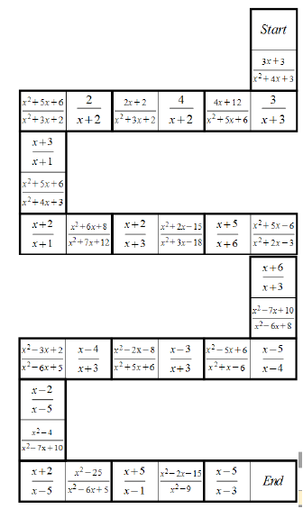

Slide 15
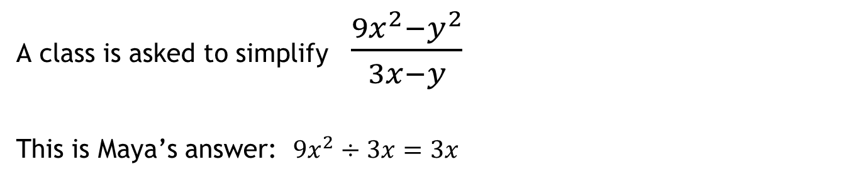
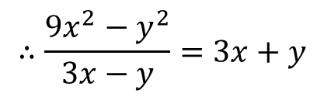

Challenge Problem
A class is asked to simplify $\frac{9x^{2}−y^{2}}{3x−y}$
This is Maya’s answer: $9x^{2}÷3x=3x$
$$−y^{2}÷−y=+y$$
$$∴\frac{9x^{2}−y^{2}}{3x−y}=3x+y$$
When the teacher read out the answer, Maya ticked her answer as correct.
Was she right to do so? If not, explain her mistakes

Slide 16
To finish …
The four rules of fractions – what are they?
Discuss

Slide 17



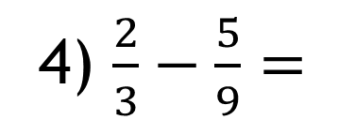
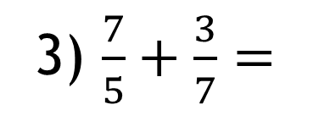
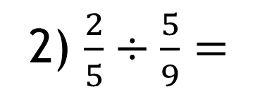
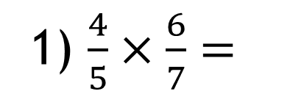
Exit ticket
Name: _________
1) $\frac{4}{5}×\frac{6}{7}=$
2) $\frac{2}{5}÷\frac{5}{9}=$
3) $\frac{7}{5}+\frac{3}{7}=$
4) $\frac{2}{3}−\frac{5}{9}=$
Rate your confidence on the four rules of fractions:
Notes:
It is vital for the next set of lessons that pupils are confident using the four operations with fractions. It is worth spending the time to recap these if it is required with your group before moving on to the next set of lessons.
Use this exit ticket to determine where you begin with the next lessons. I predict most pupils will be confident with multiplying and dividing, but may need some refreshing on the addition and subtraction.

