Slide 1
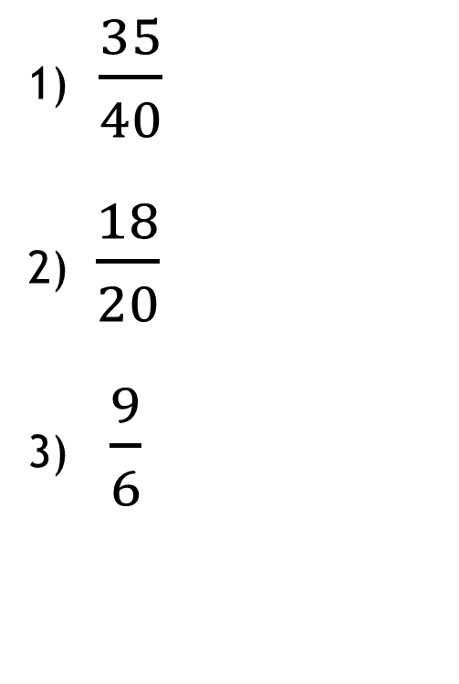
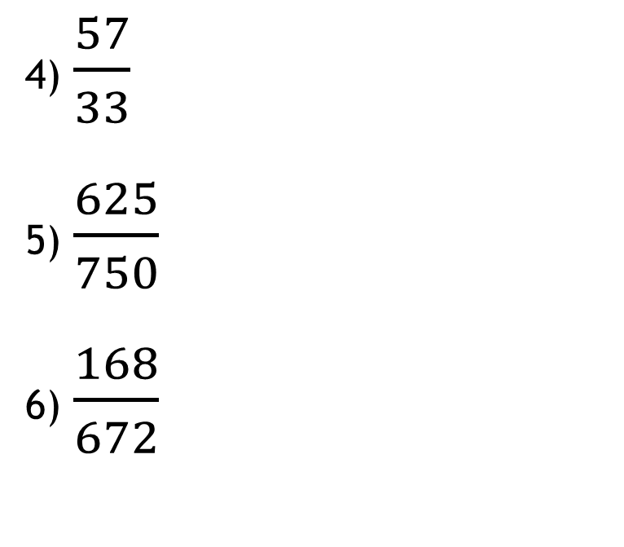
On your whiteboards
Simplify the following fractions:
1) $\frac{35}{40}$
2) $\frac{18}{20}$
3) $\frac{9}{6}$
4) $\frac{57}{33}$
5) $\frac{625}{750}$
6) $\frac{168}{672}$
7. Which fractions have a value that is greater than 1?

Slide 2
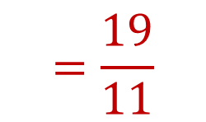
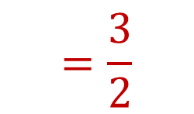
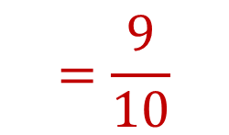
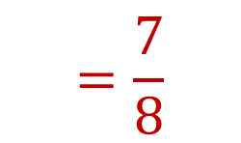
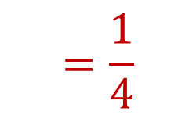
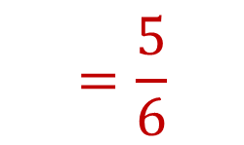
On your whiteboards
Simplify the following fractions:
1) $\frac{35}{40}$
2) $\frac{18}{20}$
3) $\frac{9}{6}$
4) $\frac{57}{33}$
5) $\frac{625}{750}$
6) $\frac{168}{672}$
$$=\frac{7}{8}$$
$$=\frac{19}{11}$$
$$=\frac{9}{10}$$
$$=\frac{5}{6}$$
$$=\frac{3}{2}$$
$$=\frac{1}{4}$$
7. Which fractions have a value that is greater than 1?

Slide 3
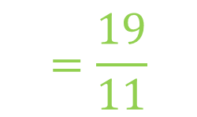
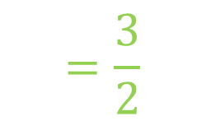
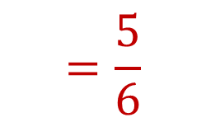
On your whiteboards
Simplify the following fractions:
1) $\frac{35}{40}$
2) $\frac{18}{20}$
3) $\frac{9}{6}$
4) $\frac{57}{33}$
5) $\frac{625}{750}$
6) $\frac{168}{672}$
$$=\frac{7}{8}$$
$$=\frac{19}{11}$$
$$=\frac{9}{10}$$
$$=\frac{5}{6}$$
$$=\frac{3}{2}$$
$$=\frac{1}{4}$$
7. Which fractions have a value that is greater than 1?

Slide 4

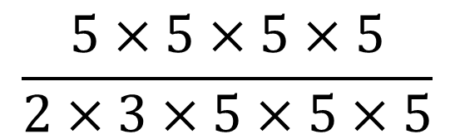

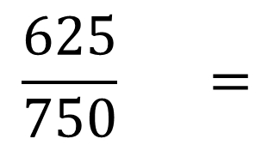


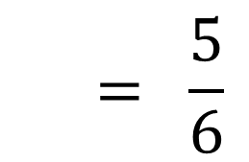


Let’s look at question 5 in more detail.
Write the numerator and denominator as a product of prime factors (think back to year 8)
$$1$$
$$1$$
$$1$$
$$\frac{625}{750} =$$
$$\frac{5×5×5×5}{2×3×5×5×5}$$
$$1$$
$$1$$
$$1$$
$$= \frac{5}{6}$$
Why can we cancel numbers on the numerator with those on the denominator

Slide 5
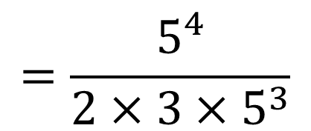
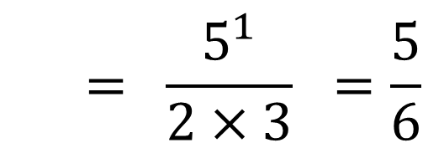
What if we wrote the numerators and denominators using index form?
$$\frac{625}{750} =$$
$$\frac{5×5×5×5}{2×3×5×5×5}$$
$$=\frac{5^{4}}{2×3×5^{3}}$$
We know from Year 8 that we can divide indices by subtracting the powers of numbers with the same base
$$= \frac{5^{1}}{2×3} =\frac{5}{6}$$

Slide 6
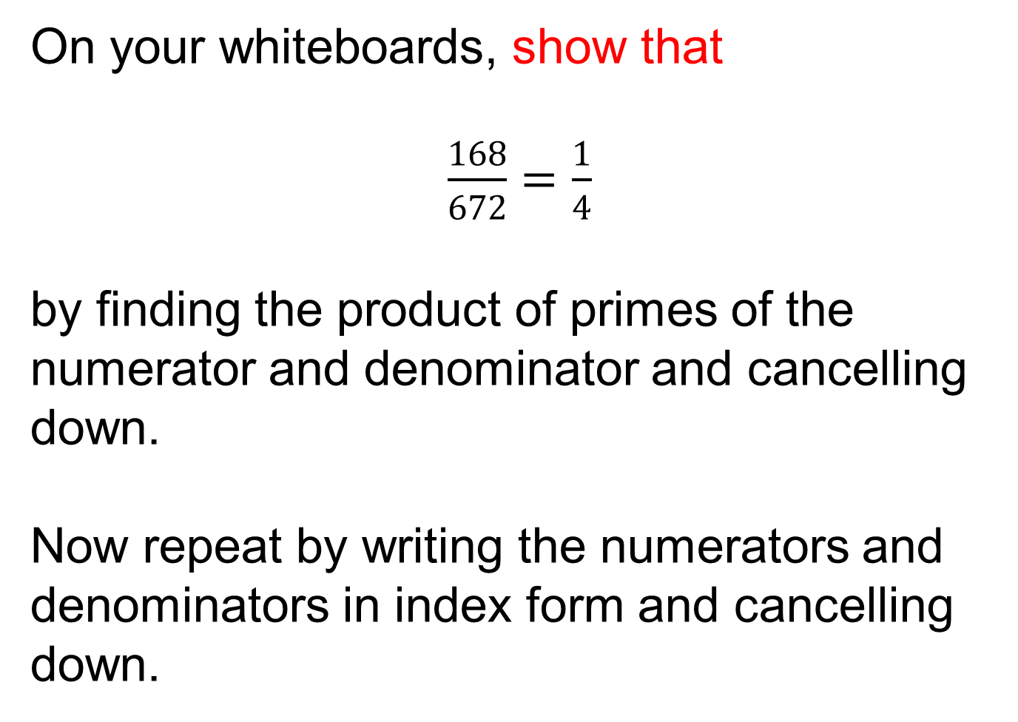
On your whiteboards, show that
$\frac{168}{672}=\frac{1}{4}$
by finding the product of primes of the numerator and denominator and cancelling down.
Now repeat by writing the numerators and denominators in index form and cancelling down.

Slide 7
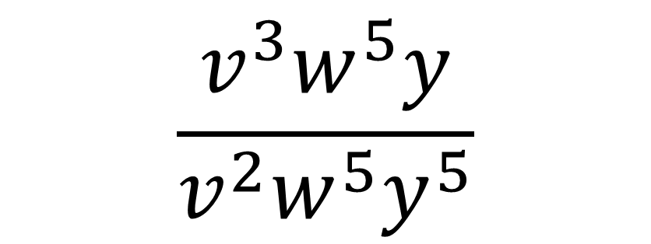
A fraction is algebraic if the numerator and/or the denominator are expressions
Algebraic Fractions
$$\frac{v^{3}w^{5}y}{v^{2}w^{5}y^{5}}$$
This fraction is algebraic.

Slide 8
In pairs discuss:
How would you simplify this algebraic fraction?
Algebraic Fractions
$$\frac{v^{3}w^{5}y}{v^{2}w^{5}y^{5}}$$

Slide 9
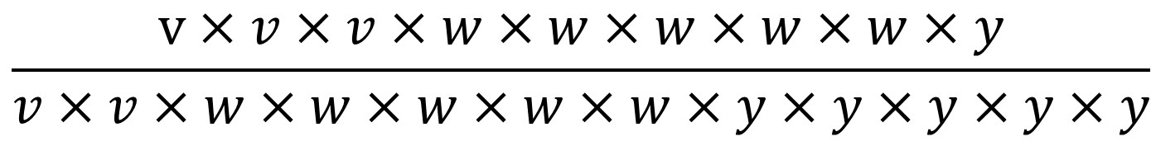
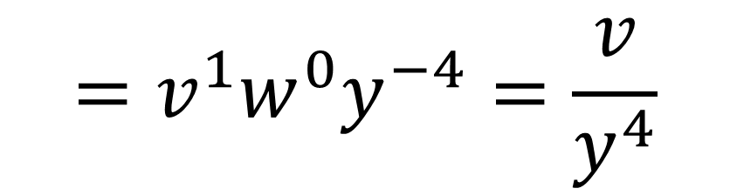


We could write it out in full:
$$\frac{\text{v}×v×v×w×w×w×w×w×y}{v×v×w×w×w×w×w×y×y×y×y×y}$$
$$= \frac{v}{y×y×y×y}=\frac{v}{y^{4}}$$
Or we could use index rules:
$$\frac{v^{3}w^{5}y}{v^{2}w^{5}y^{5}}$$
$$=v^{1}w^{0}y^{−4}=\frac{v}{y^{4}}$$

Slide 10


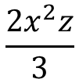


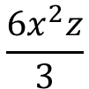






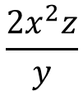
In your books
Title: Cancelling Algebraic Fractions
Simplify fully $\frac{6de}{15de^{2}}$ circle your answer
1
$$\frac{6e}{15}$$
$$\frac{6}{15e}$$
$$\frac{2e}{5}$$
$$\frac{2}{5e}$$
Simplify fully $\frac{6x^{2}yz^{3}}{3y^{2}z^{2}}$ circle your answer
2
$$\frac{2x^{2}z}{y}$$
$$\frac{6z^{2}}{3x}$$
$$\frac{6x^{2}z}{3}$$
$$\frac{2x^{2}z}{3}$$
Simplify fully $\frac{p^{4}qr^{2}}{pq^{2}}$ circle your answer
3
$$\frac{r^{2}}{p^{2}q}$$
$$\frac{p^{3}r^{2}}{q}$$
$$\frac{qr^{2}}{p}$$
$$\frac{r^{2}p^{3}}{pq}$$

Slide 11
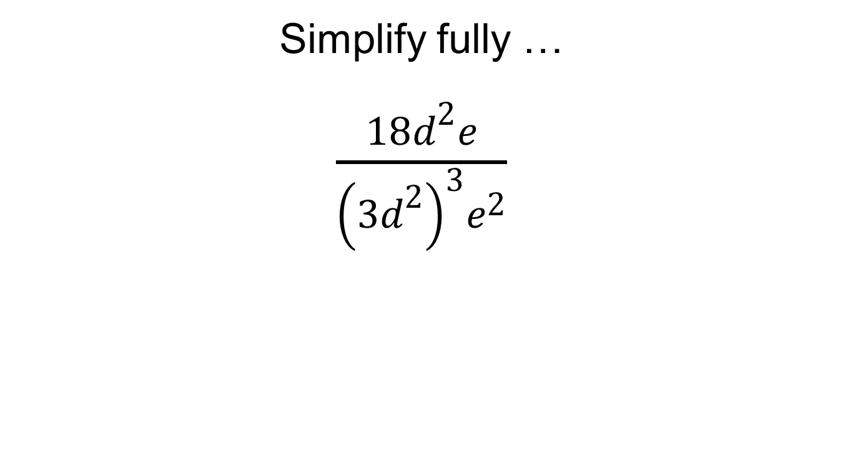
Challenge Problem:
Simplify fully …
$\frac{18d^{2}e}{{\left(3d^{2}\right)}^{3}e^{2}}$

Slide 12


David is simplifying $\frac{5x + 35}{x + 4}$
Do you agree with David’s solution?
Discuss with your partner
Notes:
Use this slide to illustrate the importance of dividing every term by a factor, not just crossing out similar values. We MUST factorise first.

Slide 13
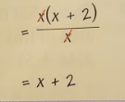
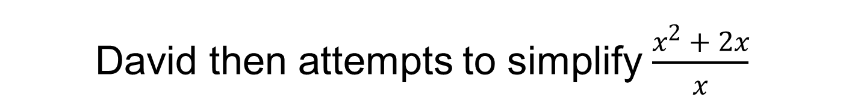
David then attempts to simplify $\frac{x^{2} + 2x}{x}$
What has David done differently this time?
Discuss with your partner

Slide 14
David then attempts to simplify $\frac{x^{2} + 2x}{x}$
In order to simplify an algebraic fraction, we must divide the numerator and denominator by a common factor.
Sometimes, this means we must factorise first.

Slide 15
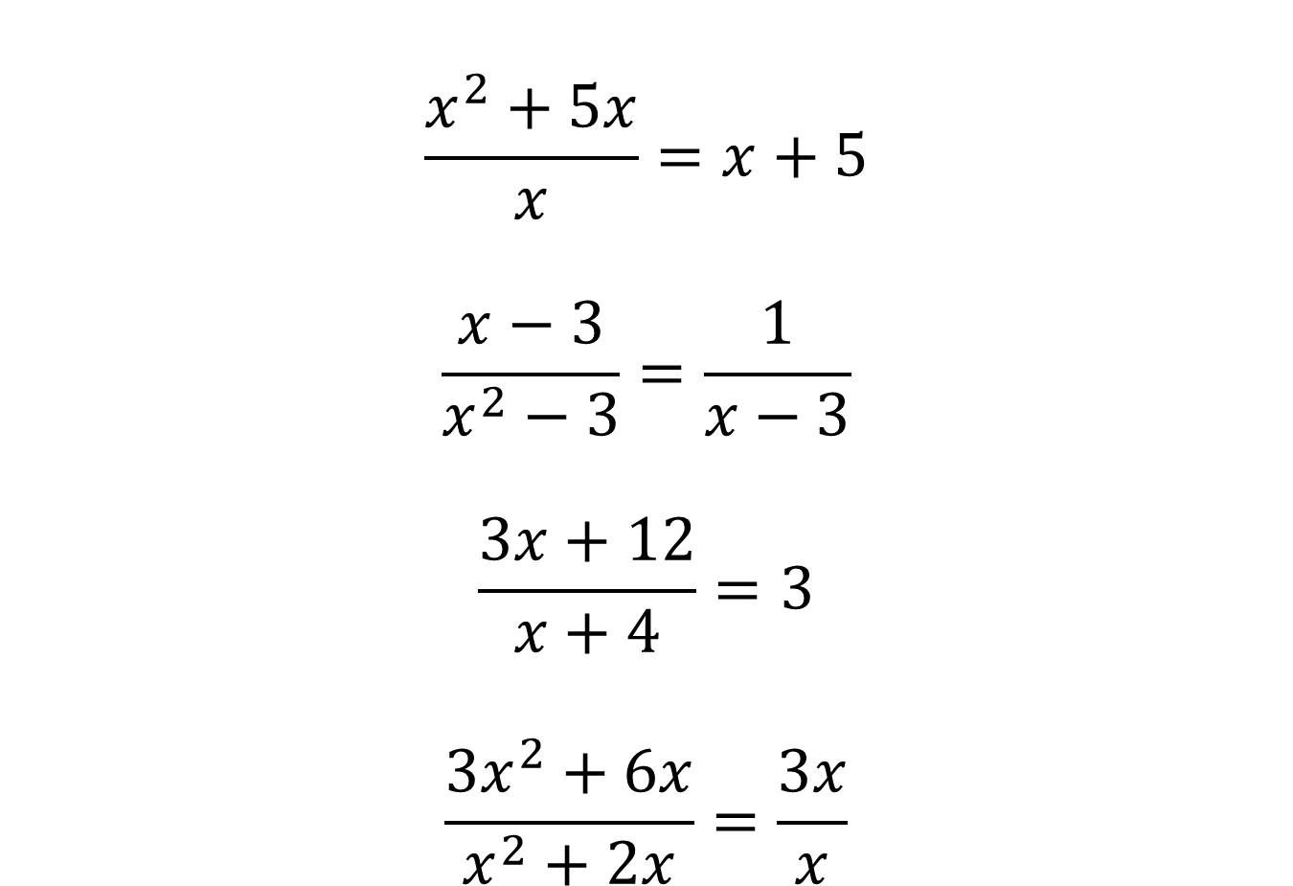
State whether the following are true or false. Where you think the answer is false, write the correct simplification
$$\frac{x^{2}+5x}{x}=x+5$$
$$\frac{x−3}{x^{2}−3}=\frac{1}{x−3}$$
$$\frac{3x+12}{x+4}=3$$
$$\frac{3x^{2}+6x}{x^{2}+2x}=\frac{3x}{x}$$

Slide 16
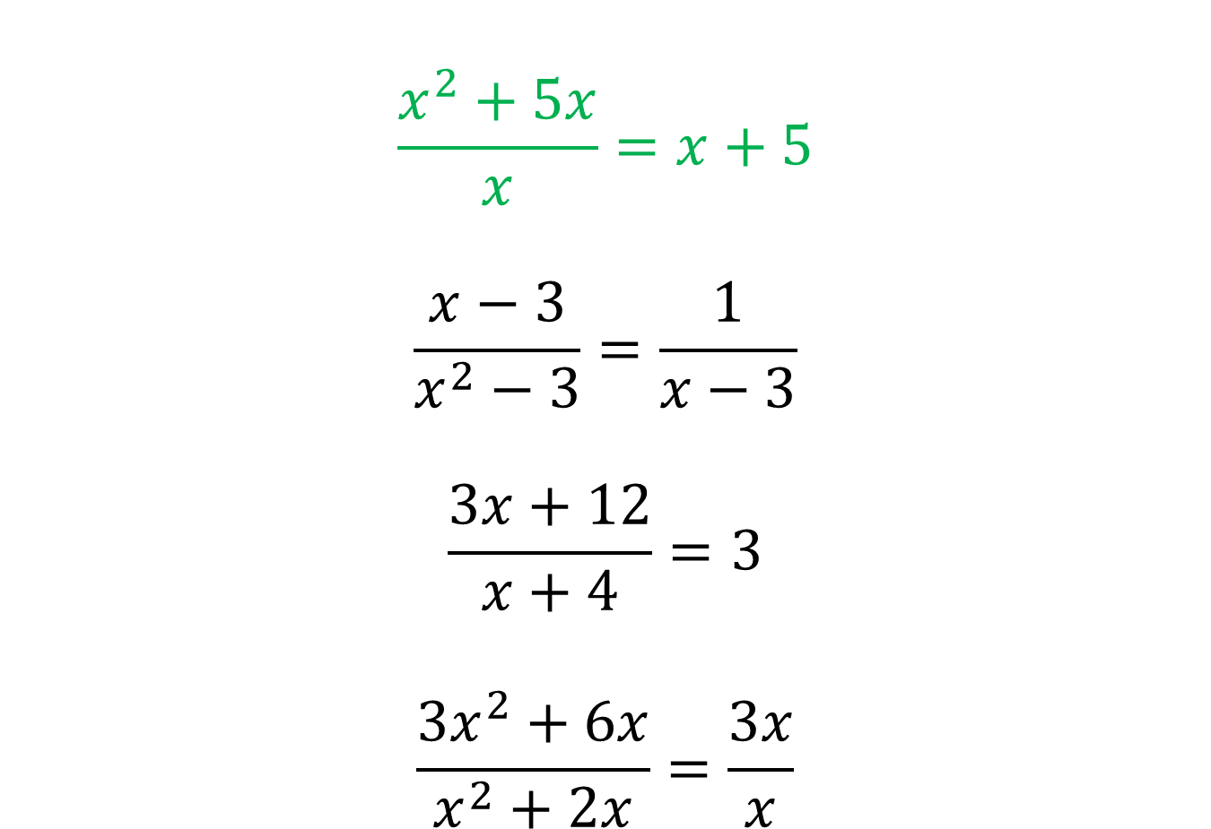
State whether the following are true or false. Where you think the answer is false, write the correct simplification
$$\frac{x^{2}+5x}{x}=x+5$$
$$\frac{x−3}{x^{2}−3}=\frac{1}{x−3}$$
$$\frac{3x+12}{x+4}=3$$
$$\frac{3x^{2}+6x}{x^{2}+2x}=\frac{3x}{x}$$

Slide 17
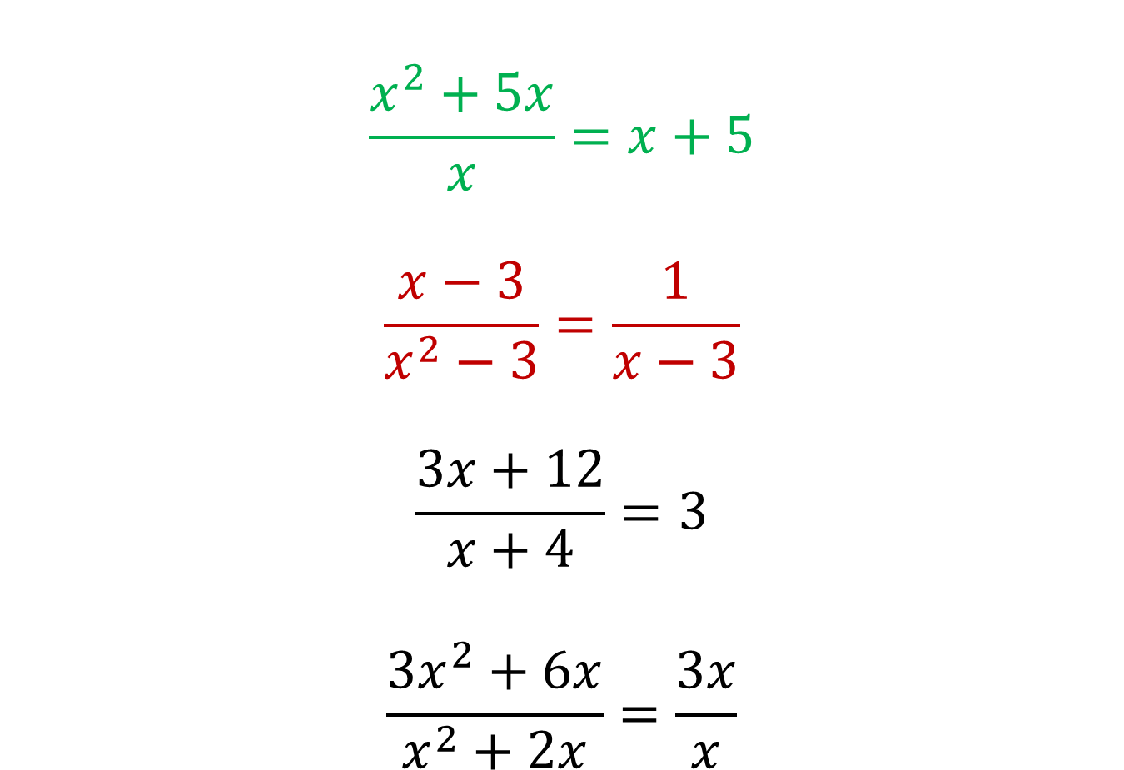
State whether the following are true or false. Where you think the answer is false, write the correct simplification
$$\frac{x^{2}+5x}{x}=x+5$$
$$\frac{x−3}{x^{2}−3}=\frac{1}{x−3}$$
$$\frac{3x+12}{x+4}=3$$
$$\frac{3x^{2}+6x}{x^{2}+2x}=\frac{3x}{x}$$

Slide 18
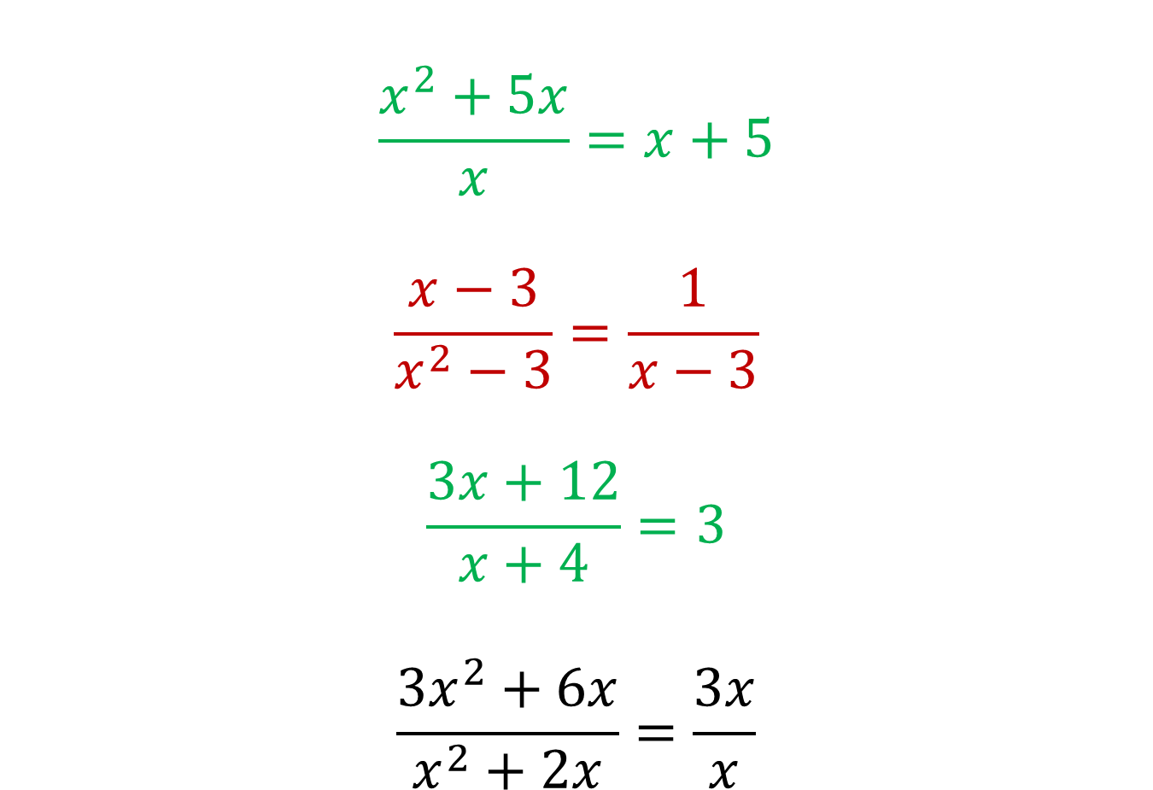
State whether the following are true or false. Where you think the answer is false, write the correct simplification
$$\frac{x^{2}+5x}{x}=x+5$$
$$\frac{x−3}{x^{2}−3}=\frac{1}{x−3}$$
$$\frac{3x+12}{x+4}=3$$
$$\frac{3x^{2}+6x}{x^{2}+2x}=\frac{3x}{x}$$

Slide 19
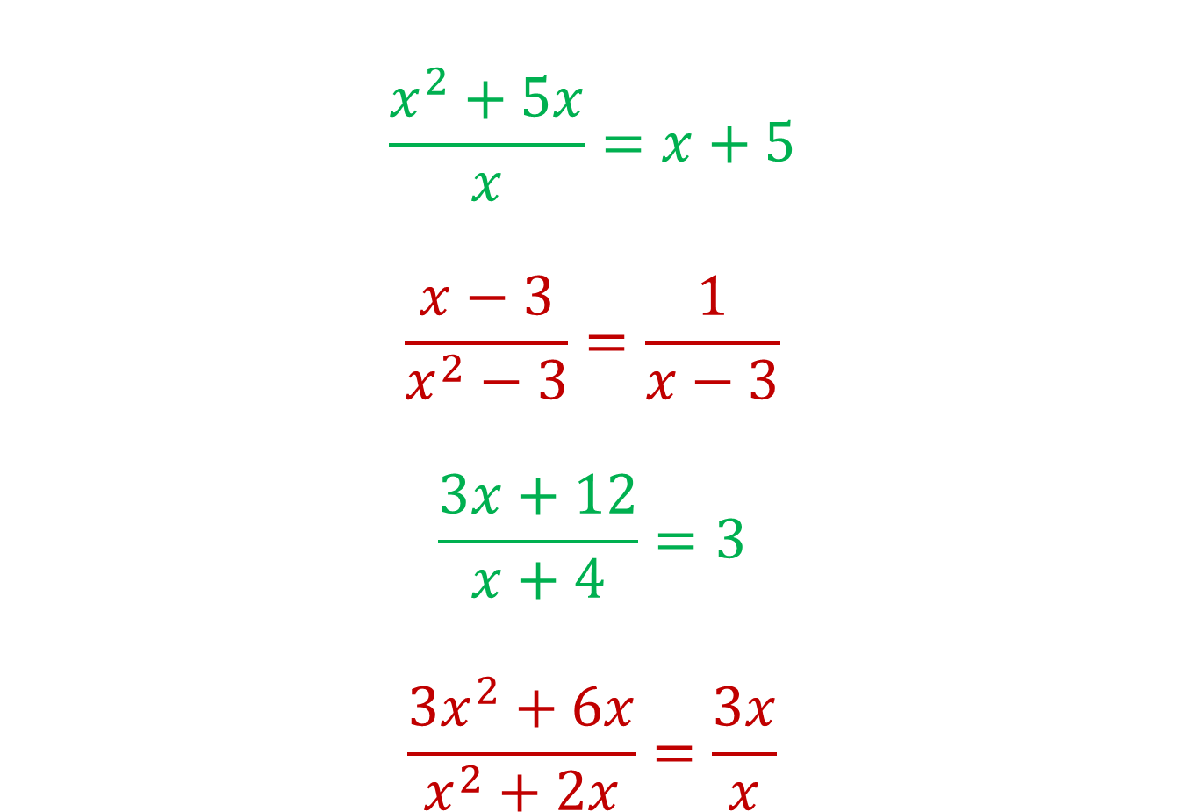
State whether the following are true or false. Where you think the answer is false, write the correct simplification
$$\frac{x^{2}+5x}{x}=x+5$$
$$\frac{x−3}{x^{2}−3}=\frac{1}{x−3}$$
$$\frac{3x+12}{x+4}=3$$
$$\frac{3x^{2}+6x}{x^{2}+2x}=\frac{3x}{x}$$

Slide 20
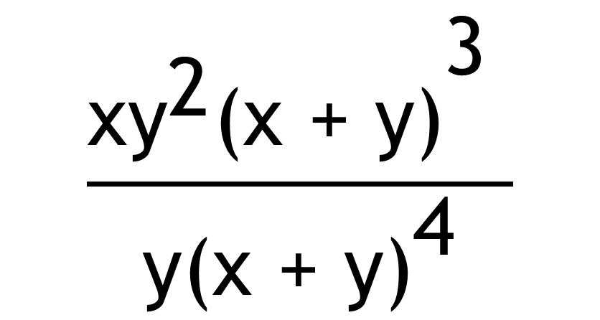
Challenge Problem
Simplify
$$\frac{{\text{x}{\text{y}}^{\text{2}}\text{(}\text{x}\text{ + }\text{y}\text{)}}^{\text{3}} }{{\text{y}\text{(}\text{x}\text{ + }\text{y}\text{)}}^{\text{4}}}$$

