Slide 1
Yr 6 Induction Day
Welcome to Bluecoat Beechdale Academy Maths Department

Slide 2
Mrs Warden
Notes:
Write your own name on this slide

Slide 3

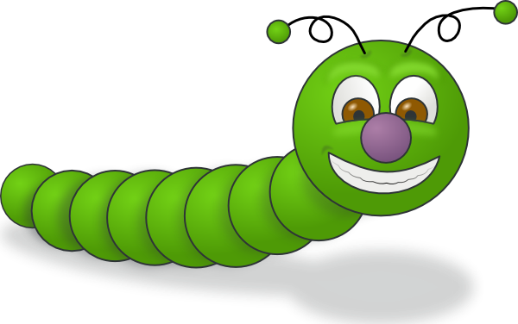
Meet Wormy
Hello BBA!
Wormy likes to move in spirals.
If you give him instructions about how to move, he will follow them.
However there are some rules Wormy always follows...

Slide 4
Wormy’s Rules
I will always move North, then East, then South, then West. This is moving clockwise through the compass points.
I will move up to 5 squares at a time.
I can only remember 3 distances. Once I have moved these 3 distances I will repeat them over and over again.

Slide 5
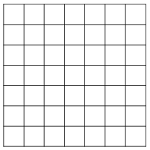

I will always move North, then East, then South, then West.
For example. If you gave Wormy the instructions
1, 3, 1. He would move as follows...
I will move up to 5 squares at a time.
Wormy has made a spiral!
I can only remember 3 distances. Once I have moved these 3 distances I will repeat them over and over again.

Slide 6
I will always move North, then East, then South, then West.
Where would Wormy move for the instruction 2, 2, 4?
I will move up to 5 squares at a time.
I can only remember 3 distances. Once I have moved these 3 distances I will repeat them over and over again.

Slide 7
I will always move North, then East, then South, then West.
Where would Wormy move for the instruction 4, 2, 1?
I will move up to 5 squares at a time.
I can only remember 3 distances. Once I have moved these 3 distances I will repeat them over and over again.

Slide 8
Try some spirals for yourself.
Don’t forget the rules!
I will always move North, then East, then South, then West. This is moving clockwise through the compass points
While you are working:
Can you spot any links between your instructions and the shape of your spiral?
I’d love to hear your ideas.
I will move up to 5 squares at a time.
I can only remember 3 distances. Once I have moved these 3 distances I will repeat them over and over again.

Slide 9
You are doing very well.
We are now going to look for patterns in the way Wormy moves.

Slide 10
Look at your spirals and see if you can answer the following questions:
Why does Wormy always end up back in the same place?
Can you tell how wide each spiral will be before you draw it?
Can you find 3 spirals which look the same? Do the instructions have something in common?

Slide 11
The original instruction we used was 1, 3, 1.
Making a table may help us understand what is happening...
N | E | S | W
1 | 3 | 1 | 1
3 | 1 | 1 | 3
1 | 1 | 3 | 1

Slide 12
Challenge questions
Does the order of the numbers matter?
What happens if the two smaller numbers add to make the 3rd?
What if the two smaller numbers add to make more or less than the 3rd number.

Slide 13
Challenge questions
Can you tell me what the spiral will look like before you have drawn it?
Meet Wormy’s sister, Wormetta. Make a new set of rules about how she moves and investigate her Spirals.

