Slide 1
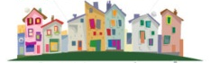
In a street the house prices are:
£129000 £101000 £120000 £99000 £99500 £105000 £450000
Find the mean price of the houses.
What is wrong with this figure?

Slide 2
In a street the house prices are:
£129000 £101000 £120000 £99000 £99500 £105000 £450000
When there is a number that doesn’t ‘fit’ with the size of the others it is called an outlier
When this happens, it is better to use a different type of average.

Slide 3

Stand up!
Form a line around the room.
Arrange yourselves into ascending height order
Who is in the middle?

Slide 4
The height of the middle person when you stood in height order was the median.
Half of the heights in the class are bigger than this number, and half are smaller.

Slide 5
Median
Find the median of these values:
5 7 10 12 15
10 is the middle value

Slide 6
Median
Find the median of these values:
8 9 10 12
9.5 is the middle value

Slide 7
Find the median of these numbers:
3, 3, 6, 1, 4, 2, 9
12, 16, 7, 2, 10
234, 653, 342, 903, 211
6.3, 6.23, 6.4, 6.65, 6.01, 6.1, 6.234

Slide 8
Find the median of these numbers:
3, 3, 6, 1, 4, 2, 9, 2
12, 16, 7, 2, 10, 12
10, 4, 5, 6, 2, 7
10, 15, 12, 20, 25, 42

Slide 9
In a street the house prices are:
£129000 £101000 £120000 £99000 £99500 £105000 £450000
When we found the mean of this data, we found that it wasn’t very representative of the data.
Find the median house price.
Is this more representative?
Why does the outlier not affect the median?

Slide 10
In a street the house prices are:
£99000 £99500 £101000 £105000 £120000 £129000 £450000
Half of the house prices are higher than this value, and half are lower.

Slide 11

1. In which of these data sets is the median a more appropriate average to use than the mean?
2. Can you find the mean and median of this set of data?
White, red, blue, green, blue, blue, red, black

Slide 12
Mode
The mode is the value that occurs with the greatest frequency in a dataset. It is representative or typical because it is the most common value.
There may be more than one mode in a dataset if several values are equally common; alternatively there may be no mode.
Can you find the mean and median of this set of data?
White, red, blue, green, blue, blue, red, black

Slide 13
Mode
Find the mode of the following:
5 7 10 10 15
The mode is 10
10 occurs the most

Slide 14



Let's practise...
5
5
6
4
6

Slide 15
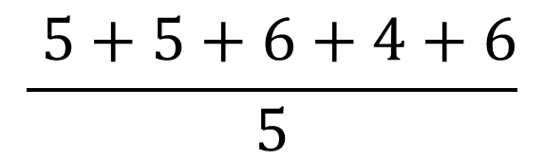
Let's practise...
5
5
6
4
6
How can you
divide by 5
in your head?
Divide by 10,
then multiply
by 2
Mean
$$\frac{ 5+5+6+4+6}{5}$$
Mean = 5.2

Slide 16
Let's practise...
5
5
6
4
6
Median
4
5
5
6
6
Median = 5

Slide 17
Let's practise...
5
5
6
4
6
Now you try…
Mode
4
5
5
6
6
There are two modes, 5 and 6.
The data is bimodal.

Slide 18

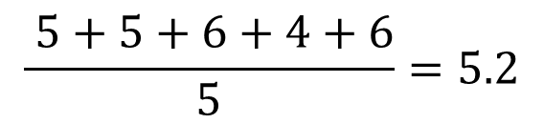
In your books
Title: Finding the mean, median and mode
Example: 5, 5, 6, 4, 6
Mean:
Median: 4, 5, 5, 6, 6
median = 4.5
Mode: 4, 5, 5, 6, 6
mode = 5 and 6
$$\frac{ 5+5+6+4+6}{5}=5.2$$

Slide 19
In your pairs, roll your dice 5 times.
Write down the numbers
Find the mean, median and mode
Set out your work exactly as the example

Slide 20
In your books
Title: Finding the mean, median and mode
Example: 5, 5, 6, 4, 6
Mean:
Median: 4, 5, 5, 6, 6
median = 4.5
Mode: 4, 5, 5, 6, 6
mode = 5 and 6
You only have
10 minutes
$$\frac{ 5+5+6+4+6}{5}=5.2$$

