Slide 1
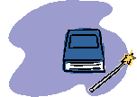
In your books
Title: Evening Out
In your books, below are the number of bricks in some Lego towers. Work out how many would be in each tower when they are evened out:
7, 8, 9, 10, 11
12, 13, 14, 15, 16
2, 4, 6, 8, 10, 12
20, 25, 30, 35, 40, 45, 50
1, 1, 3, 3, 1, 1, 3, 3
7, 7, 7, 7, 7, 7, 14
1, 1, 1, 2, 2, 2, 3, 3, 3, 82
In question g, what would the answer be if the last tower wasn’t included?

Slide 2
The Mean
Evening out in this way can be used to find a representative value for a set of data.
This is what has usually been done when people talk about finding the average. This method of evening out is called finding the mean.
The mean can be found to even out things that can’t physically be evened out.

Slide 3
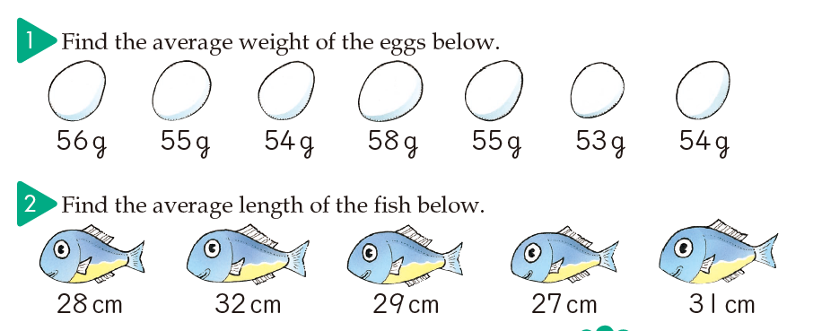
The Mean

Slide 4
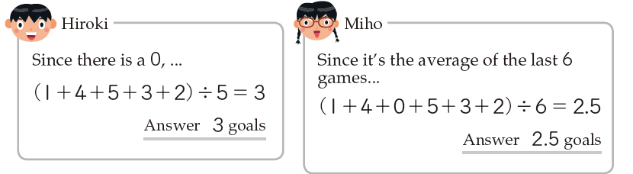
The number of goals scored by Ben’s football team in the last six games is shown below:
1, 4, 0, 5, 3, 2
What is the average (mean) number of goals for the last six games?
Discuss the two students’ ideas:
Student 1
Student 2
Should the zero be included?
How can there be 2.5 goals? What does that mean?

Slide 5
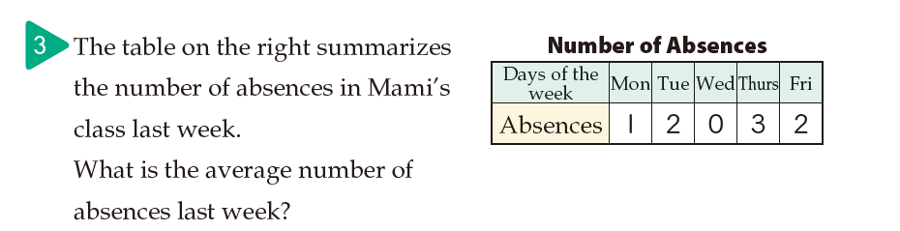
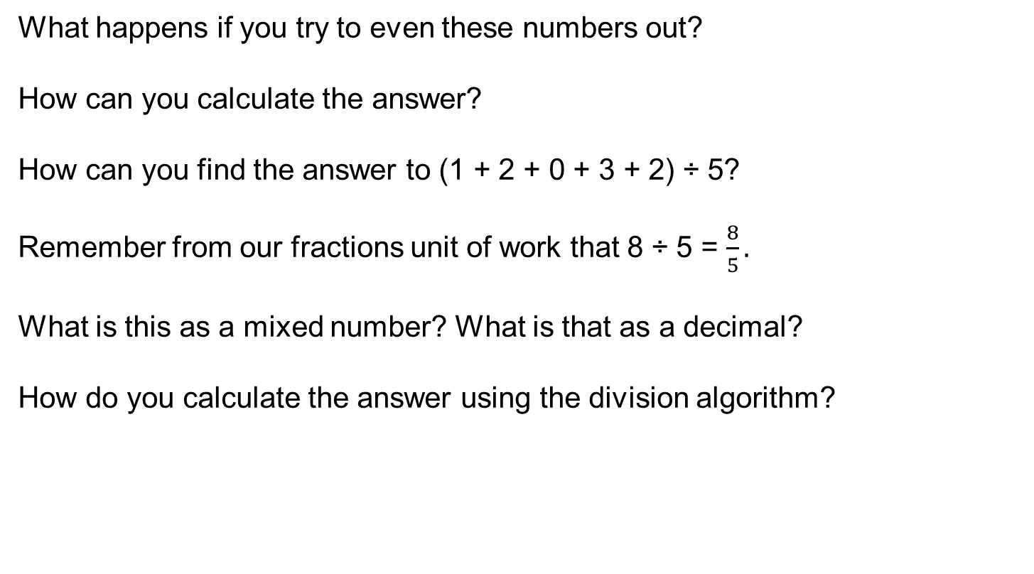
What happens if you try to even these numbers out?
How can you calculate the answer?
How can you find the answer to (1 + 2 + 0 + 3 + 2) ÷ 5?
Remember from our fractions unit of work that 8 ÷ 5 = $\frac{8}{5}.$
What is this as a mixed number? What is that as a decimal?
How do you calculate the answer using the division algorithm?

Slide 6
In your books
Title: Finding the mean of a set of data
Here are the heights of 8 year 7 students
146cm 140cm 139cm 137cm 140cm 136cm 150cm 132cm
What is the mean height?
Is this a good representation of the heights of the students
2. Here are the values of 10 houses on a street
£120 000 £125 000 £130 000 £121 000 £121 000
£132 000 £127 000 £130 000 £127 000 £350 000
What is the mean value?
Is this a good representation of the values of the houses?
Why do you think this?

Slide 7
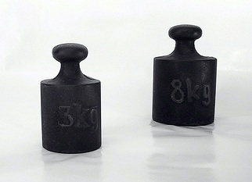
Mean puzzle
For some reason, you have many weights but they are all either 3kg or 8kg
how can you get a mean of
(i) 4kg?
(ii) 6kg?
(iii) 4.5kg?
(iv) 6.9kg?
You can also explore other pairs of weights and different means to create with these

