Slide 1
Jordan felt ill during the end of year tests.
He had done his science and English tests, but was away for his maths test.
His teacher decided to draw two scatter graphs of the other students’ results to help predict what Jordan might have scored in his maths tests had he been there.

Slide 2
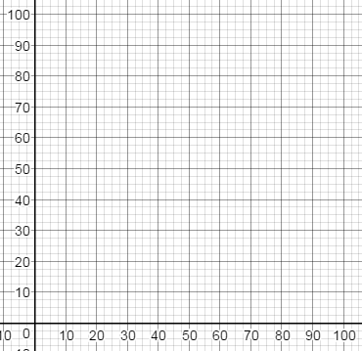
Here are the two graphs the teacher drew.
Jordan scored 55 marks in his English test and 40 in his science test
Which would be the most useful for a prediction and why?
Maths results
Maths results
English results
Science results

Slide 3
When a scatter graph shows correlation, it can be used to predict missing data.
To do this more accurately, we draw a line of best fit.
The line of best fit is a line that best represents the data on the graph.
It does:
Go in the general direction of the plotted points
Has roughly a similar amount of points on either side of the line.
It doesn’t necessarily:
Go through the points
Start in the bottom corner
Go ‘uphill’

Slide 4
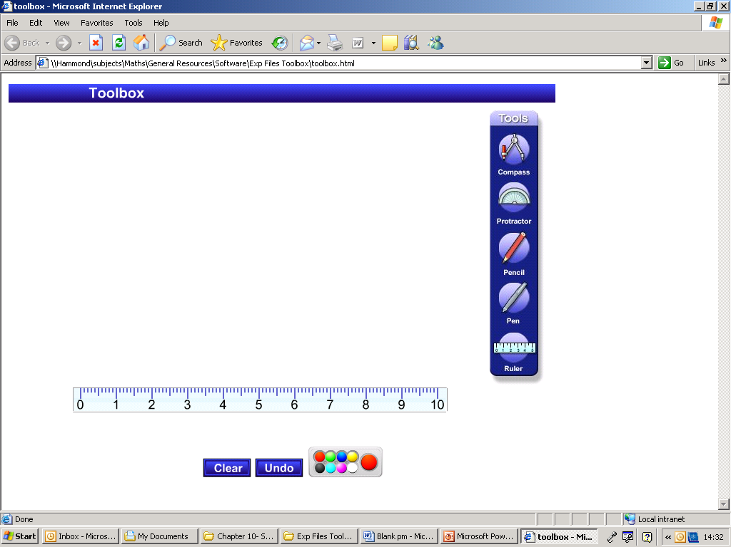

Let’s look at a graph we plotted two lessons ago that compares the mass of men with their show size.
Does the graph show a correlation between the mass and shoe size?
100
95
To draw a line of best fit:
Look at the general direction of the points, then draw a line in that direction.
Are there roughly the same amount of points on either side?
90
85
80
Mass (kg)
75
70
65
60
4
5
6
7
8
9
10
11
12
13
Shoe Size

Slide 5
Let’s look at a graph we plotted two lessons ago that compares the mass of men with their show size.
Does the graph show a correlation between the mass and shoe size?
100
95
Use your line of best fit to estimate:
The mass of a man with shoe size 10½.
(ii) The shoe size of a man with a mass of 69 kg.
90
87 kg
85
80
Mass (kg)
75
70
65
Size 6
60
4
5
6
7
8
9
10
11
12
13
Shoe Size

Slide 6
This graph shows how many visitors there were to a museum compared to the hours of sunshine each day.
Does the graph show a correlation between the number of visitors and the hours of sunshine?
Visitors
500
450
Draw a line of best fit
400
Use your line of best fit to estimate:
The number of visitors for 4 hours of sunshine.
(ii) The hours of sunshine when 250 people visit.
350
300
Number of Visitors
310
250
200
150
5 ½
100
0
1
2
3
4
5
6
7
8
9
10
Hours of Sunshine

Slide 7
To print

Slide 8
Let’s look at a graph we plotted two lessons ago that compares the mass of men with their show size.
Does the graph show a correlation between the mass and shoe size?
100
95
Use your line of best fit to estimate:
The mass of a man with shoe size 10½.
(ii) The shoe size of a man with a mass of 69 kg.
90
85
80
Mass (kg)
75
70
65
60
4
5
6
7
8
9
10
11
12
13
Shoe Size

Slide 9
This graph shows how many visitors there were to a museum compared to the hours of sunshine each day.
Does the graph show a correlation between the number of visitors and the hours of sunshine?
Visitors
500
450
Draw a line of best fit
400
Use your line of best fit to estimate:
The number of visitors for 4 hours of sunshine.
(ii) The hours of sunshine when 250 people visit.
350
300
Number of Visitors
250
200
150
100
0
1
2
3
4
5
6
7
8
9
10
Hours of Sunshine

