Slide 1
Recap from year 8:
How many different factorised forms can you find?
Which is fully factorised?
6b + 18b²
Notes:
Print slide 1 and 2 as A4 page for students

Slide 2
Recap from year 8:
How many different factorised forms can you find?
Which is fully factorised?
8xy + 24x²y

Slide 3
Challenge:
How many different factorised forms can you find?
Which is fully factorised?
20x²y³z + 24xy⁶z²

Slide 4
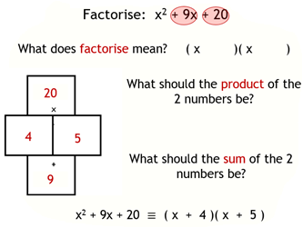
Think back to this lesson …
What is different about this expression?
2x² + 12x + 10

Slide 5
What is different about this expression?
2x² + 12x + 10
The coefficient of x² is 2
What has the coefficient of x² been in most of the examples we have looked at so far?
What technique have we been using to factorise a quadratic expression?

Slide 6
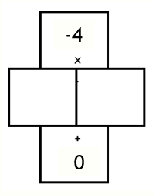
2x² + 12x + 10
To factorise this quadratic we fill in the wall as follows:
+20
+12
Discuss: Why do you think those numbers have been chosen?

Slide 7
3x² + 2x - 6
To factorise this quadratic we fill in the wall as follows:
-18
+2
Discuss: Why do you think those numbers have been chosen?

Slide 8
3x² + 2x - 6
To factorise this quadratic we fill in the wall as follows:
-18
+2

Slide 9
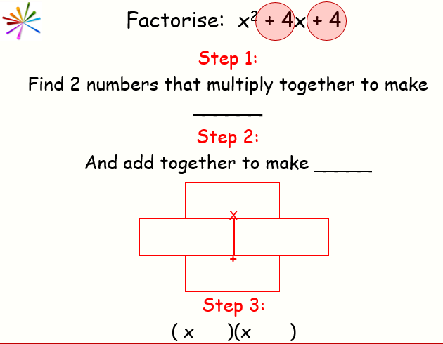
Factorise the following …
Which numbers will go in my wall?
24
2x² + 11x + 12
24
+8
+3
11

Slide 10
Factorise the following …
Which numbers will go in my wall?
24
24
2x² + 11x + 12
2x² + 8x + 3x + 12
+8
+3
11
Has anything changed?

Slide 11
Factorise the following …
Which numbers will go in my wall?
24
24
2x² + 11x + 12
+8
+3
2x² + 8x
+ 3x + 12
11
2x(x + 4)
3(x + 4)

Slide 12
Factorise the following …
Which numbers will go in my wall?
24
24
2x² + 11x + 12
+8
+3
2x² + 8x
+ 3x + 12
11
2x(x + 4)
3(x + 4)
What do you notice?
(2x + 3)(x + 4)
Where have the 2 brackets come from?

Slide 13
On your whiteboards ...
3x² + 17x + 10
What will go in the wall?
+ 30
+ 17

Slide 14
On your whiteboards ...
3x² + 17x + 10
What will go in the wall?
Which two numbers have a product of 30 and a sum of 17?
+ 30
+ 15
+ 2
+ 17

Slide 15
On your whiteboards ...
3x² + 17x + 10
Re write the expression with your new terms …
3x² + 15x + 2x + 10
+ 30
Separate and factorise …
+ 15
+ 2
3x² + 15x + 2x + 10
+ 17
3x(x + 5) + 2(x + 5)
Final Answer:
(3x + 2)(x + 5)

Slide 16
On your whiteboards factorise ...
5x² + 13x + 6
Re write the expression with your new terms …
5x² + 10x + 3x + 6
+ 30
Separate and factorise …
+ 10
+ 3
5x² + 10x + 3x + 6
+ 13
5x(x + 2) + 3(x + 2)
(5x + 3)(x + 2)

Slide 17
On your whiteboards factorise ...
5x² + 13x + 6
What would happen if I had put the 10x and 3x the other way around?
5x² + 3x + 10x + 6
+ 30
Separate and factorise …
+ 10
+ 3
5x² + 3x + 10x + 6
+ 13
x(5x + 3) + 2(5x + 3)
(x + 2)(5x + 3)

Slide 18
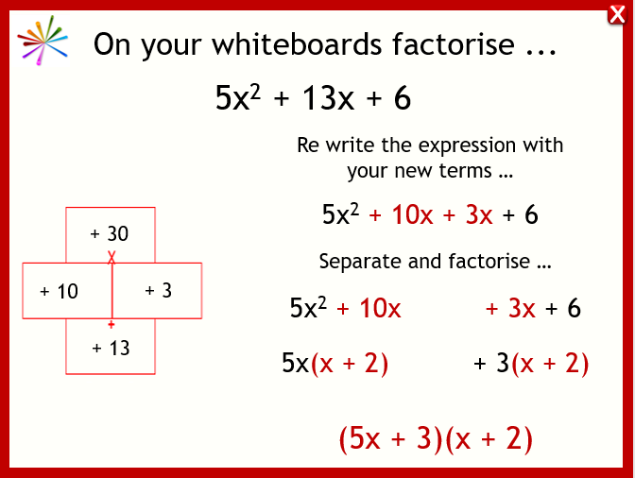
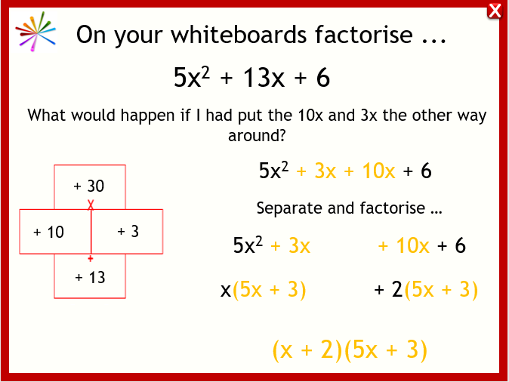
On your whiteboards factorise ...
5x² + 13x + 6
What do you notice?
+3
+10

Slide 19
On your whiteboards factorise ...
11x² + 34x + 3
(11x + 1)(x + 3)

Slide 20
On your whiteboards factorise ...
6x² + 17x + 5
(2x + 5)(3x + 1)

Slide 21
In your pairs factorise the following to see whether the following are true or false.
If false, write what has been done wrong and correct the answer
$$2x^{2}+11x+15=(2x+5)(x+3)$$
$$3x^{2}+11x+6=(3x+3)(x+2)$$
$$2x^{2}+13x+15=(2x+1)(x+5)$$
$$3x^{2}−7x−6=(3x+2)(x−3)$$

Slide 22
In your pairs factorise the following to see whether the following are true or false.
If false, write what has been done wrong and correct the answer
$$2x^{2}+11x+15=(2x+5)(x+3)$$
$$3x^{2}+11x+6=(3x+3)(x+2)$$
$$2x^{2}+13x+15=(2x+1)(x+5)$$
$$3x^{2}−7x−6=(3x+2)(x−3)$$

Slide 23
In your pairs factorise the following to see whether the following are true or false.
If false, write what has been done wrong and correct the answer
$$2x^{2}+11x+15=(2x+5)(x+3)$$
$$3x^{2}+11x+6=(3x+3)(x+2)$$
$$2x^{2}+13x+15=(2x+1)(x+5)$$
$$3x^{2}−7x−6=(3x+2)(x−3)$$

Slide 24
In your pairs factorise the following to see whether the following are true or false.
If false, write what has been done wrong and correct the answer
$$2x^{2}+11x+15=(2x+5)(x+3)$$
$$3x^{2}+11x+6=(3x+3)(x+2)$$
$$2x^{2}+13x+15=(2x+1)(x+5)$$
$$3x^{2}−7x−6=(3x+2)(x−3)$$

Slide 25
In your pairs factorise the following to see whether the following are true or false.
If false, write what has been done wrong and correct the answer
$$2x^{2}+11x+15=(2x+5)(x+3)$$
$$3x^{2}+11x+6=(3x+3)(x+2)$$
$$2x^{2}+13x+15=(2x+1)(x+5)$$
$$3x^{2}−7x−6=(3x+2)(x−3)$$

Slide 26
Challenge problem
Factorise:
3x² + x - 4
(3x + 4)(x - 1)

