Slide 1
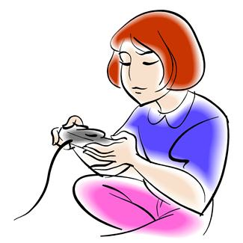
Computer Games: Ratings
Imagine rating a popular computer game.
You can give the game a score of between 1 and 6.
Show me your rating on your whiteboards.

Slide 2
Computer Games: Ratings
How can we collect this data from the class?

Slide 3
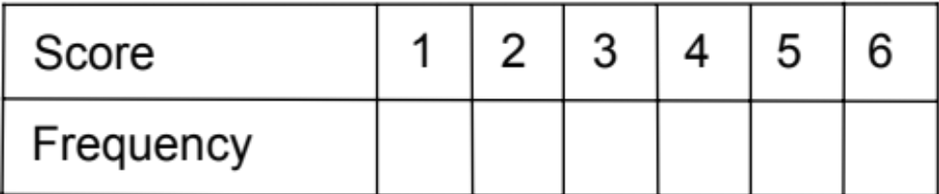
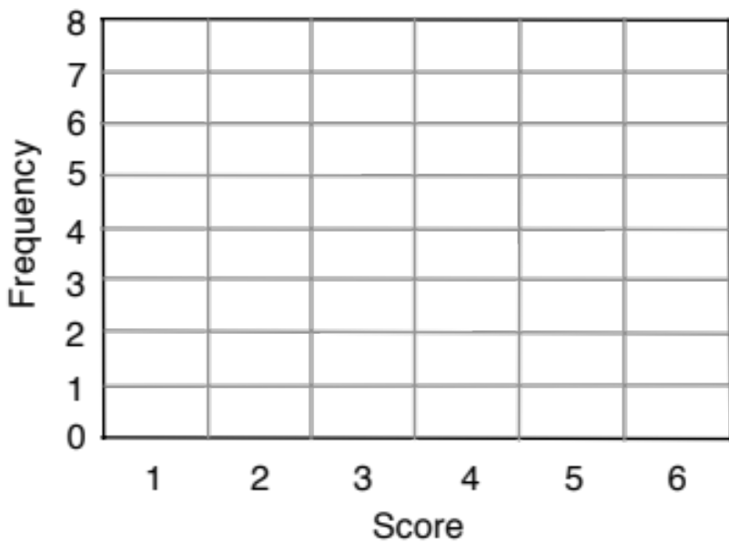
Bar Chart from a Frequency Table
Mean score
Median score
Mode score
Range of scores

Slide 4
Matching Cards
Each time you match a pair of cards, explain your thinking clearly and carefully.
Partners should either agree with the explanation or challenge it if it is unclear or incomplete.
Once agreed stick the cards onto the poster and write a justification next to the cards.
Some of the statistics tables have gaps in them and one of the bar charts is blank. You will need to complete these cards.

Slide 5
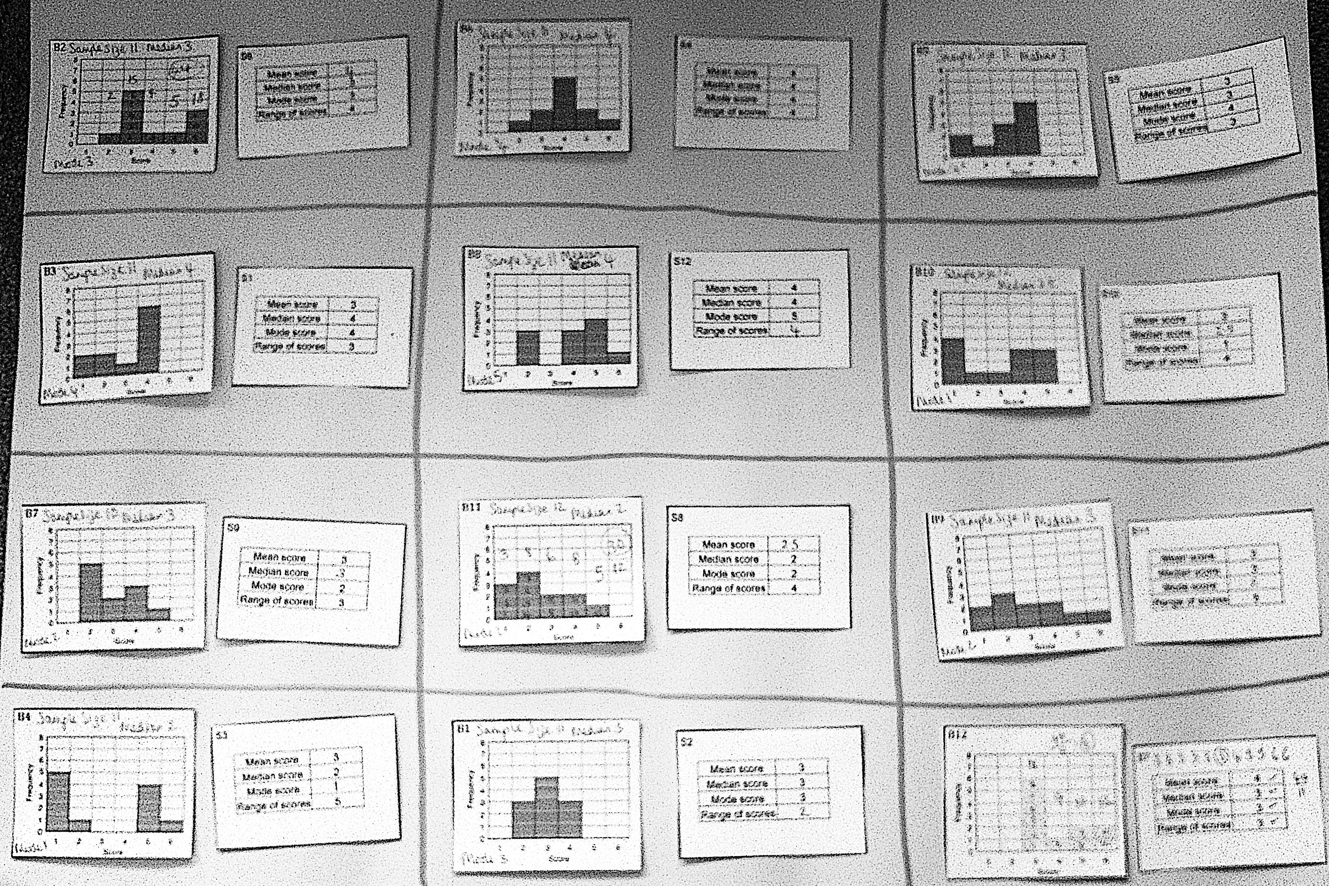
Your final poster might look something like this:.

