Slide 1
Factorise
b² + 9b + 8
b² - 9b + 8
(b + 8)(b + 1)
(b - 8)(b - 1)

Slide 2
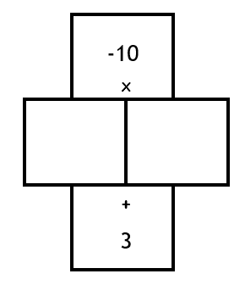
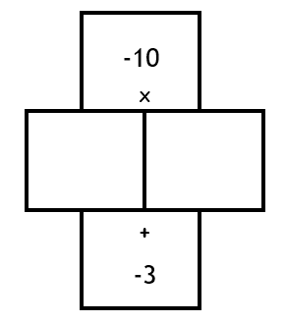
Discuss
What must the numbers in the middle be in order for their product to be negative?
What must the numbers in the middle be in order for their sum to be positive?
The bigger number must be positive

Slide 3
Discuss
What must the numbers in the middle be in order for their product to be negative?
What must the numbers in the middle be in order for their sum to be negative?
The bigger number must be negative

Slide 4
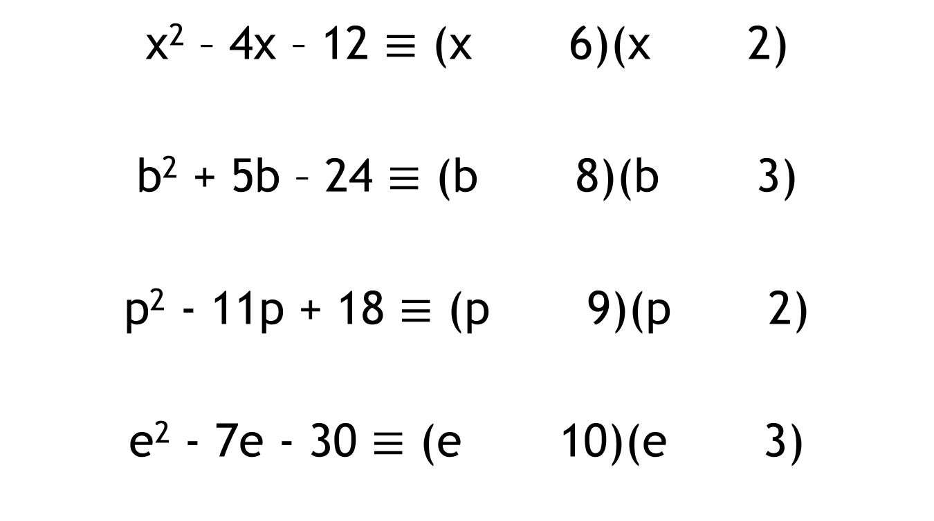
Your turn:
Fill in the missing boxes with the correct signs
x² – 4x – 12 $≡$ (x 6)(x 2)
b² + 5b – 24 $≡$ (b 8)(b 3)
p² - 11p + 18 $≡$ (p 9)(p 2)
e² - 7e - 30 $≡$ (e 10)(e 3)

Slide 5
The area of a rectangle can be given by the expression x² – 10x + 16 cm²
Draw a diagram to represent the information you have been given.
Can you add any further information to your diagram?
Is there any other information you can deduce?

Slide 6
A = x² – 10x + 16 cm²
How do we calculate the area of a rectangle?
What type of expression have we been given?
How could we re-write the expression we have been given for the area as 2 things that are multiplying each other?
We can write a quadratic identity by factorising
How does this help?
Notes:
Use this slide if your students don’t come up with any good answers!

Slide 7
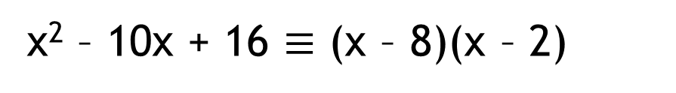
(x – 8)
A = x² – 10x + 16 cm²
(x – 2)
x² – 10x + 16 $≡$ (x – 8)(x – 2)
What does this tell us?
What else could we now calculate?
Perimeter

Slide 8
In pairs …
The area of a rectangle can be given by the expression a² – 2a – 8 cm².
By representing the information in a diagram, find an expression for the perimeter of the rectangle.

Slide 9
In pairs …
The area of a square can be given by the expression
b² - 8b + 16 cm².
By representing the information in a diagram, find an expression for the perimeter of the rectangle.

Slide 10
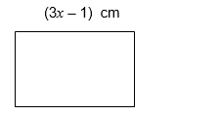
In pairs …
Below is a rectangle.
The length is 3x - 1 cm.
The perimeter is 10x cm.
Find an expression for the area of the rectangle.

Slide 11
In pairs …
The perimeter of a rectangle is 8x + 16.
Find an expression for the area of the rectangle.
Extension:
Can you find more than one expression?
Notes:
Pupils may all have different answers here. Use this as a discussion point. Why are they able to have different expressions for the area from the same perimeter expression

Slide 12
In pairs …
The perimeter of a rectangle is 8x + 16.
Find an expression for the area of the rectangle.
Extension:
Can you find more than one expression?
Why are you able to find more than one expression?
Notes:
Pupils may all have different answers here. Use this as a discussion point. Why are they able to have different expressions for the area from the same perimeter expression

