Slide 1
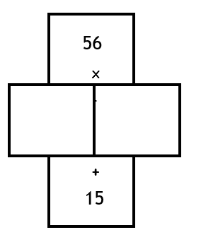
Find 2 numbers that …
Multiply together to make the top number in the wall and sum to make the bottom number
20
9

Slide 2
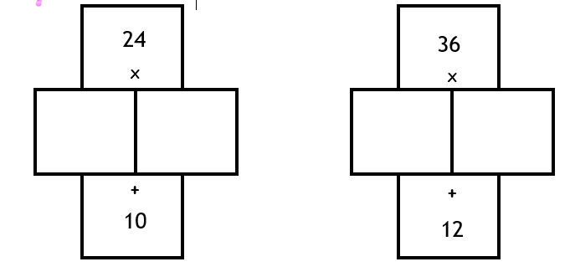
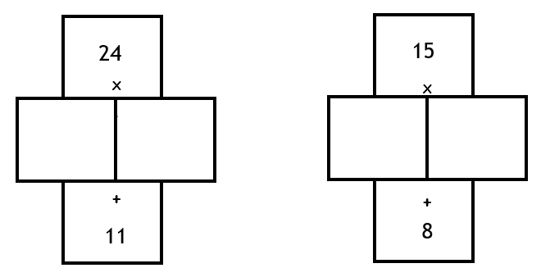
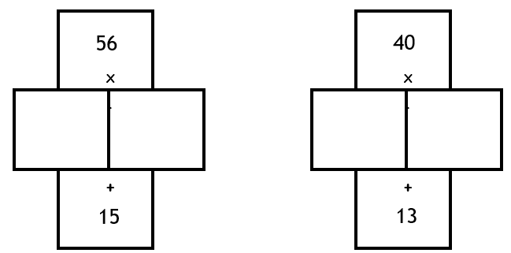
Worksheet

Slide 3
Think back to a previous lesson:
Expand and simplify the following
(x + 3)(x + 7)
(x + 3)(x + 3)
x² + 10x + 21
x² + 6x + 9
Which is the factorised form and which is the expanded form?
Is there a relationship between the factorised and expanded form?
What do you notice?

Slide 4
What about if we go the other way?
n² + 10n + 16
What numbers do you think will go in the brackets?
( )( )

Slide 5
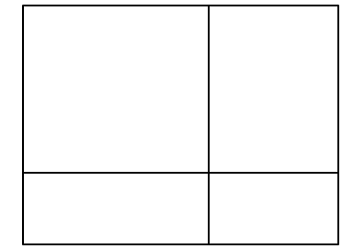
Will this always work?
Try expanding (x + a)(x + b)
x
+a
x
+b
How should we partition?

Slide 6
Will this always work?
Try expanding (x + a)(x + b)
x
+a
x
x²
+ax
+b
+bx
+ab
x² + ax + bx + ab
Notes:
Use your discretion – students to attempt in a pair or work though as a class.

Slide 7
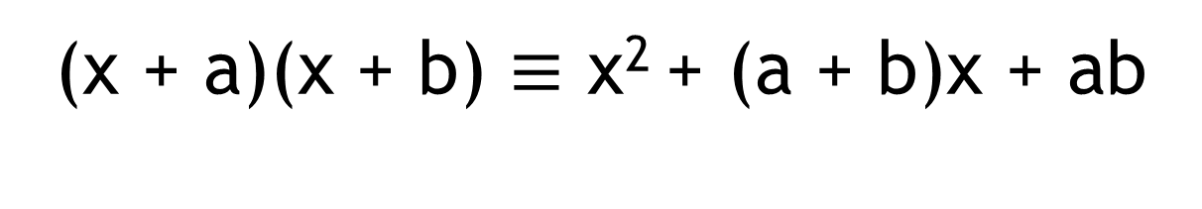
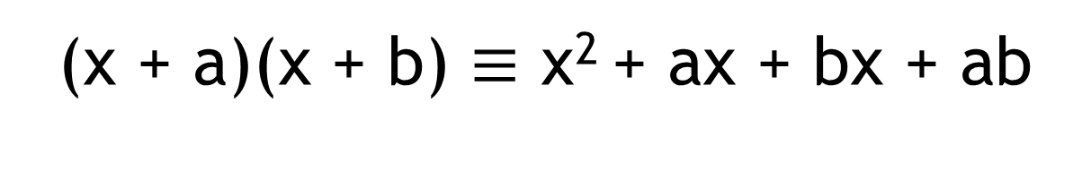
Will this always work?
(x + a)(x + b) $≡$ x² + ax + bx + ab
What do you notice about the answer?
(x + a)(x + b) $≡$ x² + (a + b)x + ab
The middle term is the sum of a and b
The final term is the product of a and b
Notes:
Use your discretion – students to attempt in a pair or work though as a class.

Slide 8
Factorise: x² + 9x + 20
What does factorise mean?
( x )( x )
What should the product of the 2 numbers be?
20
4
5
What should the sum of the 2 numbers be?
9
x² + 9x + 20 $≡$ ( x + 4 )( x + 5 )

Slide 9
Your turn …
Factorise: x² + 7x + 12
What should the product of the 2 numbers be?
What should the sum of the 2 numbers be?

Slide 10
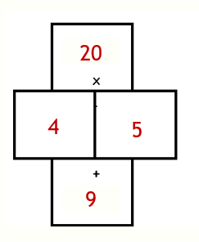
Factorise:
Example:
1 | x² + 5x + 6
2 | x² + 8x + 12
3 | n² + 7n + 12
4 | q² + 14q + 13
5 | a² + 17a + 30
6 | h² + 13h + 30
7 | m² + 14m + 48
8 | r² + 16r + 48
9 | v² + 22v + 96
10 | p² + 35p + 96
Factorise: x² + 9x + 20
Sum
Product
x² + 9x + 20 $≡$ ( x + 4 )( x + 5 )

Slide 11
1 | x² + 5x + 6 | (x + 2)(x + 3)
2 | x² + 8x + 12
3 | n² + 7n + 12
4 | q² + 14q + 13
5 | a² + 17a + 30
6 | h² + 13h + 30
7 | m² + 14m + 48
8 | r² + 16r + 48
9 | v² + 22v + 96
10 | p² + 35p + 96

Slide 12
1 | x² + 5x + 6 | (x + 2)(x + 3)
2 | x² + 8x + 12 | (x + 6)(x + 2)
3 | n² + 7n + 12
4 | q² + 14q + 13
5 | a² + 17a + 30
6 | h² + 13h + 30
7 | m² + 14m + 48
8 | r² + 16r + 48
9 | v² + 22v + 96
10 | p² + 35p + 96

Slide 13
1 | x² + 5x + 6 | (x + 2)(x + 3)
2 | x² + 8x + 12 | (x + 6)(x + 2)
3 | n² + 7n + 12 | (n + 4)(n + 3)
4 | q² + 14q + 13
5 | a² + 17a + 30
6 | h² + 13h + 30
7 | m² + 14m + 48
8 | r² + 16r + 48
9 | v² + 22v + 96
10 | p² + 35p + 96

Slide 14
1 | x² + 5x + 6 | (x + 2)(x + 3)
2 | x² + 8x + 12 | (x + 6)(x + 2)
3 | n² + 7n + 12 | (n + 4)(n + 3)
4 | q² + 14q + 13 | (q + 13)(q + 1)
5 | a² + 17a + 30
6 | h² + 13h + 30
7 | m² + 14m + 48
8 | r² + 16r + 48
9 | v² + 22v + 96
10 | p² + 35p + 96

Slide 15
1 | x² + 5x + 6 | (x + 2)(x + 3)
2 | x² + 8x + 12 | (x + 6)(x + 2)
3 | n² + 7n + 12 | (n + 4)(n + 3)
4 | q² + 14q + 13 | (q + 13)(q + 1)
5 | a² + 17a + 30 | (a + 15)(a + 2)
6 | h² + 13h + 30
7 | m² + 14m + 48
8 | r² + 16r + 48
9 | v² + 22v + 96
10 | p² + 35p + 96

Slide 16
1 | x² + 5x + 6 | (x + 2)(x + 3)
2 | x² + 8x + 12 | (x + 6)(x + 2)
3 | n² + 7n + 12 | (n + 4)(n + 3)
4 | q² + 14q + 13 | (q + 13)(q + 1)
5 | a² + 17a + 30 | (a + 15)(a + 2)
6 | h² + 13h + 30 | (h + 10)(h + 3)
7 | m² + 14m + 48
8 | r² + 16r + 48
9 | v² + 22v + 96
10 | p² + 35p + 96

Slide 17
1 | x² + 5x + 6 | (x + 2)(x + 3)
2 | x² + 8x + 12 | (x + 6)(x + 2)
3 | n² + 7n + 12 | (n + 4)(n + 3)
4 | q² + 14q + 13 | (q + 13)(q + 1)
5 | a² + 17a + 30 | (a + 15)(a + 2)
6 | h² + 13h + 30 | (h + 10)(h + 3)
7 | m² + 14m + 48 | (m + 6)(m + 8)
8 | r² + 16r + 48
9 | v² + 22v + 96
10 | p² + 35p + 96

Slide 18
1 | x² + 5x + 6 | (x + 2)(x + 3)
2 | x² + 8x + 12 | (x + 6)(x + 2)
3 | n² + 7n + 12 | (n + 4)(n + 3)
4 | q² + 14q + 13 | (q + 13)(q + 1)
5 | a² + 17a + 30 | (a + 15)(a + 2)
6 | h² + 13h + 30 | (h + 10)(h + 3)
7 | m² + 14m + 48 | (m + 6)(m + 8)
8 | r² + 16r + 48 | (r + 12)(r + 4)
9 | v² + 22v + 96
10 | p² + 35p + 96

Slide 19
1 | x² + 5x + 6 | (x + 2)(x + 3)
2 | x² + 8x + 12 | (x + 6)(x + 2)
3 | n² + 7n + 12 | (n + 4)(n + 3)
4 | q² + 14q + 13 | (q + 13)(q + 1)
5 | a² + 17a + 30 | (a + 15)(a + 2)
6 | h² + 13h + 30 | (h + 10)(h + 3)
7 | m² + 14m + 48 | (m + 6)(m + 8)
8 | r² + 16r + 48 | (r + 12)(r + 4)
9 | v² + 22v + 96 | (v + 16)(v + 6)
10 | p² + 35p + 96

Slide 20
1 | x² + 5x + 6 | (x + 2)(x + 3)
2 | x² + 8x + 12 | (x + 6)(x + 2)
3 | n² + 7n + 12 | (n + 4)(n + 3)
4 | q² + 14q + 13 | (q + 13)(q + 1)
5 | a² + 17a + 30 | (a + 15)(a + 2)
6 | h² + 13h + 30 | (h + 10)(h + 3)
7 | m² + 14m + 48 | (m + 6)(m + 8)
8 | r² + 16r + 48 | (r + 12)(r + 4)
9 | v² + 22v + 96 | (v + 16)(v + 6)
10 | p² + 35p + 96 | (p + 3)(p + 32)

Slide 21
How is this example different?
x² - 9x + 20
What would the product and the sum of the 2 numbers be this time?
20
How can we make a negative sum, but a positive product?
-9
Both numbers must be negative

Slide 22
How is this example different?
x² - 9x + 20
20
What will the identity be this time?
-4
-5
-9
x² - 9x + 20 $≡$ ( x - 4 )( x - 5 )

