Slide 1
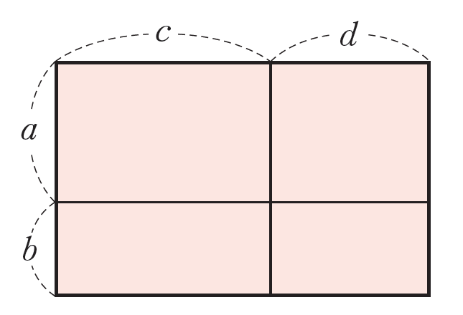
In as many ways as you can, find the area of this rectangle:

Slide 2
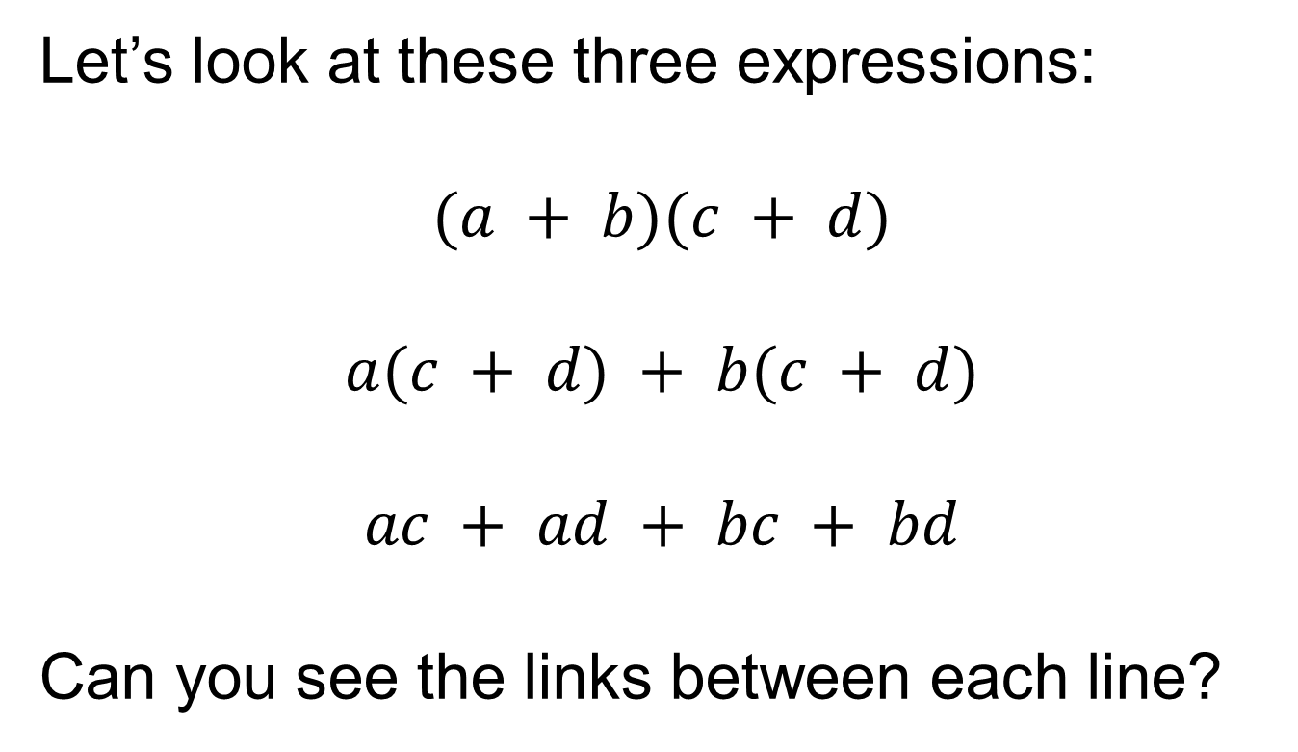
Let’s look at these three expressions:
$$(a + b)(c + d)$$
$$a(c + d) + b(c + d)$$
$$ac + ad + bc + bd$$
Can you see the links between each line?

Slide 3
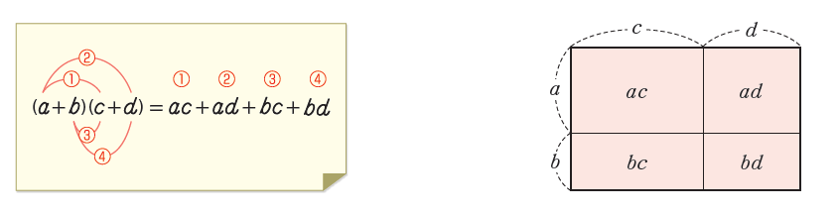
The process of removing the brackets and rewriting as a sum of terms is called expanding the brackets.

Slide 4




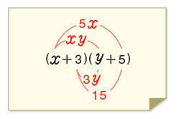
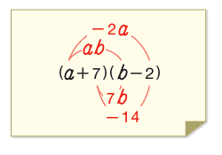

How does the negative affect the working out?

Slide 5
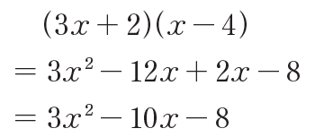

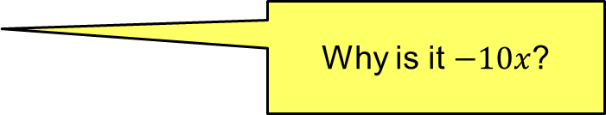
If the expression contains like terms, combine them.
Why is it $−10x$?
On your whiteboards, expand and simplify:

Slide 6

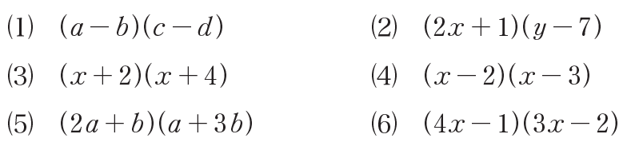

In your books
Title: Expanding brackets
Expand the following expressions:
More practice (how are these different?)

Slide 7
Checking answers
We will look at a selection of your answers using the visualiser.
Pay close attention to the working out shown, comparing to your methods and answers:
Are there any mistakes in their working?
Are there any mistakes in your working?
Have you answered in a different way?
Correct all work in your green pen, making notes to help you in the future.
Complete any unanswered questions as we go through the answers.

Slide 8

What if there are more than two terms in the brackets?
Think about how you might expand:
Try to think about it in more than one way.

Slide 9

On your whiteboards expand:

Slide 10
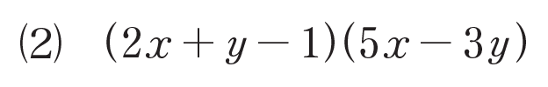
On your whiteboards expand:

Slide 11
In your books
Expand the brackets and collect like terms:

