Slide 1
Use the following diagram to create algebraic expressions for the area of the rectangle.
How many can you find?
x
3
x
(x + 3)(x + 4)
4

Slide 2
Use the following diagram to create algebraic expressions for the area of the rectangle.
How many can you find?
x
3
x
x²
3x
x² + 7x + 12
4
4x
12

Slide 3
Use the following diagram to create algebraic expressions for the area of the rectangle.
How many can you find?
x
3
x
x(x + 3)
x(x + 3) + 4(x + 3)
4
4(x + 3)

Slide 4
Use the following diagram to create algebraic expressions for the area of the rectangle.
How many can you find?
x
3
x
x(x + 4) + 3(x + 4)
x(x + 4)
3(x + 4)
4

Slide 5
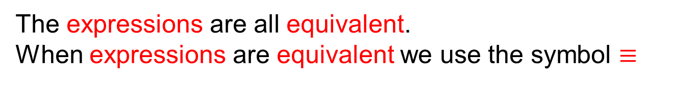
Use the following diagram to create algebraic expressions for the area of the rectangle.
How many can you find?
x
3
(x + 3)(x + 4)
x² + 7x + 12
x
x(x + 3) + 4(x + 3)
4
x(x + 4) + 3(x + 4)
The expressions are all equivalent.
When expressions are equivalent we use the symbol $≡$

Slide 6
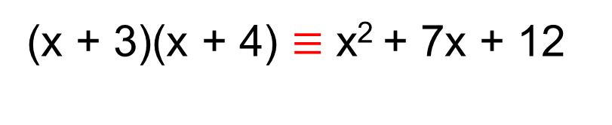
Put equivalent expressions together to make an identity
Identities are true for all values of x.
(x + 3)(x + 4) $≡\text{x}\text{2 }\text{+ 7}\text{x}\text{ + 12}$
The expression on the left is the fully factorised version.
The expression on the right is the fully simplified version.
$\text{(}\text{x}\text{ + 4)(}\text{x}\text{ + 3)}$ $≡\text{x}\text{(}\text{x}\text{ + 3) + 4(}\text{x}\text{ + 3)}$
This combination of expressions is known as the distributive law
$\text{(}\text{x}\text{ + 3)(}\text{x}\text{ + 4)}$ $≡\text{x}\text{(}\text{x}\text{ + 4) + 3(}\text{x}\text{ + 4)}$
And so is this.

Slide 7


Use each diagram to create a quadratic identity
a)
b)
2x
6
3x
2x
2x
2
3
$≡$
$≡$

Slide 8
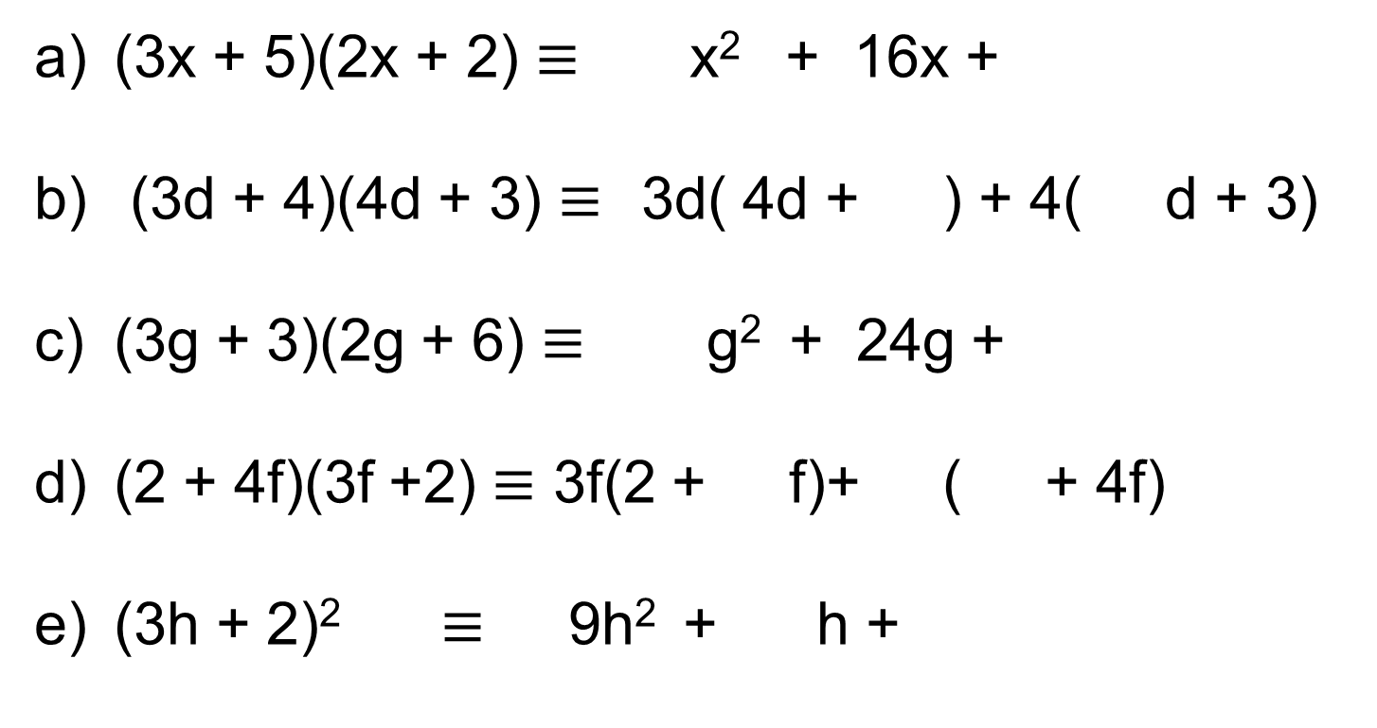
Fill in the gaps for each identity
(3x + 5)(2x + 2) $≡$ x² + 16x +
(3d + 4)(4d + 3) $≡$3d( 4d + ) + 4( d + 3)
(3g + 3)(2g + 6) $≡$ g² + 24g +
(2 + 4f)(3f +2) $≡$ 3f(2 + f)+ ( + 4f)
(3h + 2)² $≡$ 9h² + h +

Slide 9
Fill in the gaps for each identity
(3x + 5)(2x + 2) $≡$ x² + 16x +
(3d + 4)(4d + 3) $≡$3d( 4d + ) + 4( d + 3)
(3g + 3)(2g + 6) $≡$ g² + 24g +
(2 + 4f)(3f +2) $≡$ 3f(2 + f)+ ( + 4f)
(3h + 2)² $≡$ 9h² + h +
6
10
3
4
6
18
4
2
2
12
4

Slide 10
Write an expression involving brackets for the area of the red shape
2
2x + 2
Expand and simplify your expression

Slide 11
Write an expression involving brackets for the area of the red shape
2
2x + 2
3x + 2
Expand and simplify your expression

Slide 12
Write an expression involving brackets for the area of the red shape
2
2x + 2
3x + 2
Expand and simplify your expression
4x + 6

Slide 13
Write an expression involving brackets for the area of the red shape
x + 2
3x + 1
Expand and simplify your expression

Slide 14
Write an expression involving brackets for the area of the red shape
x + 2
3x + 1
3x + 2
Expand and simplify your expression

Slide 15
Write an expression involving brackets for the area of the red shape
x + 2
3x + 1
3x + 2
4x + 5
Expand and simplify your expression

Slide 16
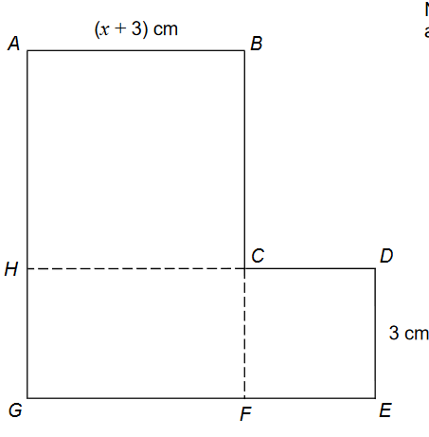
In your pairs …
ABCH is a square
HCFG is a rectangle
CDEF is a square
They are joined to make an
L-shape
Show that the area of the L-shape, in cm² is
x² + 9x + 27

Slide 17
In your pairs …
Hints …
ABCH is a square
HCFG is a rectangle
CDEF is a square
They are joined to make an
L-shape
Show that the area of the L-shape, in cm² is
x² + 9x + 27

Slide 18
In your pairs …
Hints …
ABCH is a square
HCFG is a rectangle
CDEF is a square
They are joined to make an
L-shape
Show that the area of the L-shape, in cm² is
x² + 9x + 27

Slide 19
In your pairs …
Hints …
ABCH is a square
HCFG is a rectangle
CDEF is a square
They are joined to make an
L-shape
Show that the area of the L-shape, in cm² is
x² + 9x + 27

Slide 20
If you have finished, try this one…
ABCH is a square
HCFG is a rectangle
CDEF is a square
They are joined to make an
L-shape
Find as many expressions, in terms of a and b for the area of the L-shape as you can.
Show that they are all equivalent.
(b + 2) cm
(a + b) cm

Slide 21
Write an expression involving brackets for the area of the red shape
2x + 3
3x + 1
Expand and simplify your expression

Slide 22
Write an expression involving brackets for the area of the red shape
2x + 3
x + 2
3x - 1
3
(2x + 3)(3x – 1) – 3(x + 2)
Expand and simplify your expression

Slide 23
Write an expression involving brackets for the area of the red shape
2x + 3
x + 2
3x + 1
(2x + 3)(3x + 1)
3
3(x + 2)

Slide 24
Write an expression involving brackets for the area of the red shape
2x
+ 3
x
+ 2
3x
6x²
9x
3
3x
6
+1
2x
3
(2x + 3)(3x + 1) – 3(x + 2)

Slide 25
Expand and simplify your expression
2x
+ 3
x
+ 2
3x
6x²
9x
3
3x
6
+1
2x
3
(2x + 3)(3x + 1) – 3(x + 2)
6x² + 11x + 3 – [3x + 6]
6x² + 11x + 3 – 3x - 6
6x² + 8x – 3

Slide 26
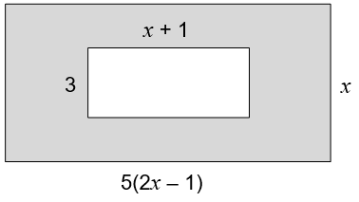
In your pairs …
The diagram shows two rectangles.
All dimensions are in cm.
Work out an expression, in terms of x, for the shaded area.
Give your answer in its simplest form.

Slide 27
Find the area of the shaded region for each shape
2h + 4
a)
n + 1
b)
h + 2
3h + 1
2n + 1
4
n + 2
2h + 1

Slide 28
Challenge problem
Write an expression involving brackets for the area of this trapezium. Expand and simplify your answer
y
2y
y + 2

Slide 29
Challenge problem
Write an expression involving brackets for the area of this trapezium. Expand and simplify your answer
y
2y
2y² + 2y
y + 2

