Slide 1
We all know that 7 x 6 = 42
7
multiplicand
multiplier
6
A row of seven, six times.

Slide 2
If I draw a horizontal line through the array, I can partition the dots into two, smaller arrays.

Slide 3
If I draw a horizontal line through the array, I can partition the dots into two, smaller arrays.
7
2
4
7 x (2 + 4)
(7 x 2) + (7 x 4)

Slide 4
How many different ways can you partition this array using one horizontal or vertical line?

Slide 5
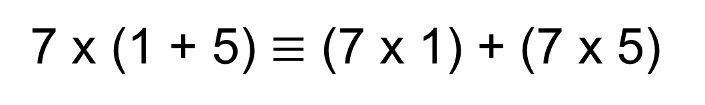
7 x (1 + 5) $≡$ (7 x 1) + (7 x 5)
7
1
5

Slide 6
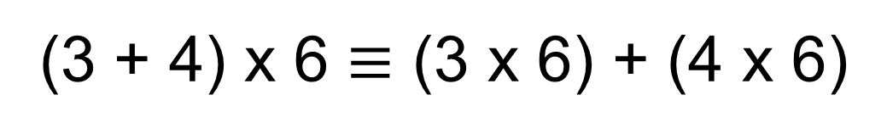
(3 + 4) x 6 $≡$ (3 x 6) + (4 x 6)
3
4
6

Slide 7
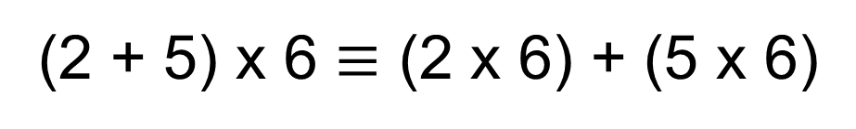
(2 + 5) x 6 $≡$ (2 x 6) + (5 x 6)
2
5
6
Remember from year 8:
The convention for writing (2 + 5) x 6 = 6(2 + 5)

Slide 8
Replace the array with a simpler representation of a rectangle.
2
5
6

Slide 9
Replace the array with a simpler representation of a rectangle.
2
5
6
Instead of counting the dots, find the areas.
6(2 + 5) $≡$ 12 + 30

Slide 10
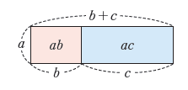

This should remind you of the distributive property we studied in year 8.
Here you can see that:
a(b + c) $≡$ ab + ac

Slide 11
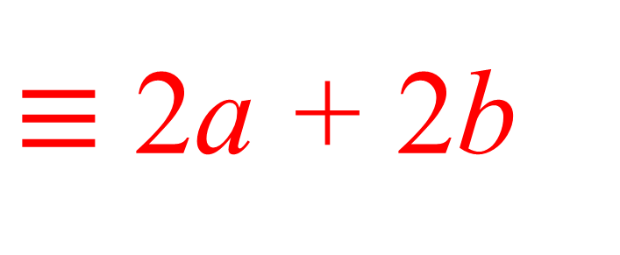
On your whiteboards:
Label the lengths and widths of the rectangles, then find the areas to demonstrate the distributive property.
2(a + b)
$≡$ 2a + 2b
a
b
2
2a
2b

Slide 12
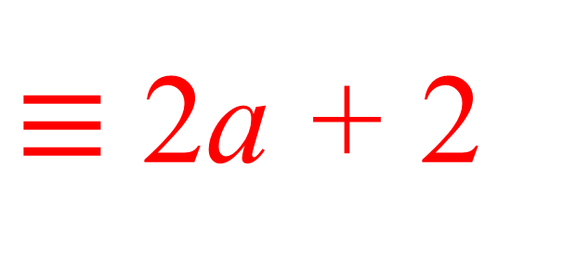
On your whiteboards:
Label the lengths and widths of the rectangles, then find the areas to demonstrate the distributive property.
2(a + 1)
$≡$ 2a + 2
a
1
2
2a
2

Slide 13
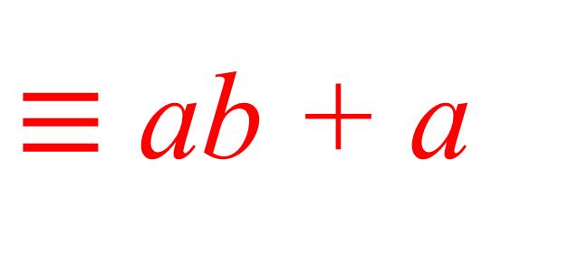
On your whiteboards:
Label the lengths and widths of the rectangles, then find the areas to demonstrate the distributive property.
a(b + 1)
$≡$ ab + a
b
1
a
ab
a

Slide 14
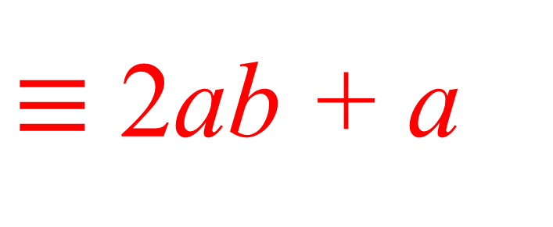
On your whiteboards:
Label the lengths and widths of the rectangles, then find the areas to demonstrate the distributive property.
a(2b + 1)
$≡$ 2ab + a
2b
1
a
2ab
a

Slide 15
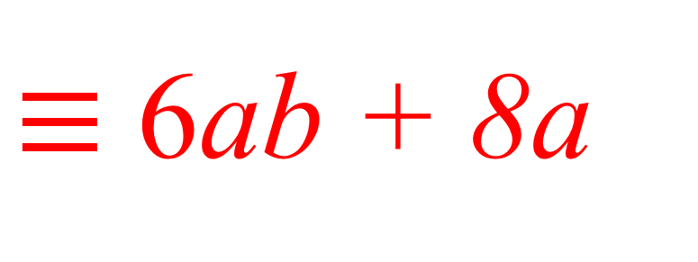
On your whiteboards:
Label the lengths and widths of the rectangles, then find the areas to demonstrate the distributive property.
2a(3b + 4)
$≡$ 6ab + 8a
3b
4
2a
6ab
8a

Slide 16
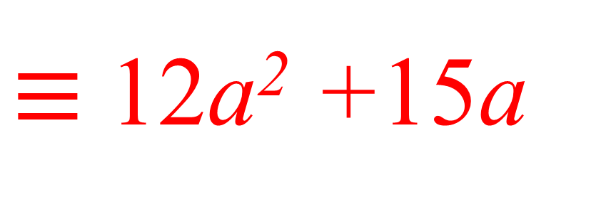
On your whiteboards:
Label the lengths and widths of the rectangles, then find the areas to demonstrate the distributive property.
3a(4a + 5)
$≡$ 12a² +15a
4a
5
3a
12a²
15a

Slide 17
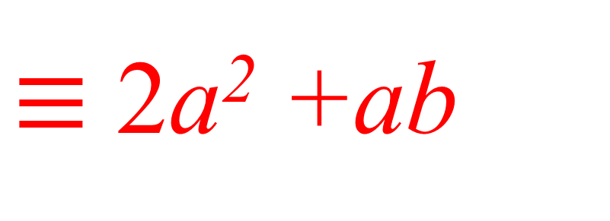
On your whiteboards:
Label the lengths and widths of the rectangles, then find the areas to demonstrate the distributive property.
a(2a + b)
$≡$ 2a² +ab
2a
b
a
2a²
ab

Slide 18

On your whiteboards:
Label the lengths and widths of the rectangles, then find the areas to demonstrate the distributive property.
3a(2ab + 5c)
$≡$ 6a²b +15ac
2ab
5c
3a
6a²b
15ac

Slide 19
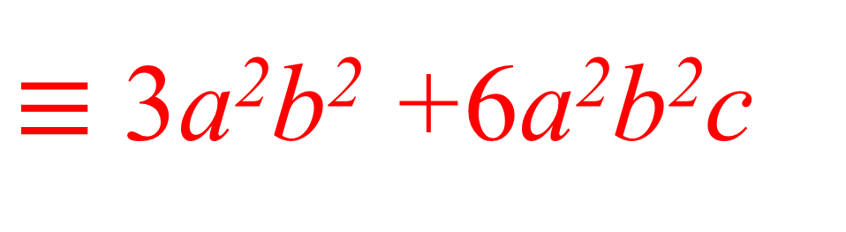
On your whiteboards:
Label the lengths and widths of the rectangles, then find the areas to demonstrate the distributive property.
3ab(ab + 2abc)
ab
2abc
3ab
3a²b²
6a²b²c
$≡$ 3a²b² +6a²b²c

Slide 20
We can partition the areas or rectangles using more than one vertical or horizontal line:
3
4
2
4
(3 + 4)(2 + 4) $≡$ (3 x 2) + (3 x 4) + (4 x 2) + (4 x 4)
Where can you see each term in the array?

Slide 21
We can partition the areas or rectangles using more than one vertical or horizontal line:
3
4
2
4
(3 + 4)(2 + 4) $≡$ (3 x 2) + (3 x 4) + (4 x 2) + (4 x 4)
Where can you see each term in the rectangle?

Slide 22
On your whiteboards:
For each diagram, write an identity.
5
7
3
5
(5 + 7)(3 + 5) $≡$ (5 x 3) + (7 x 3) + (5 x 5) + (7 x 5)
Where can you see each term in the rectangle?

Slide 23
On your whiteboards:
For each diagram, write an identity.
6
2
1
5
(6 + 2)(1 + 5) $≡$ (6 x 1) + (2 x 1) + (6 x 5) + (2 x 5)
Where can you see each term in the rectangle?

Slide 24
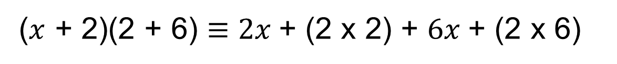

On your whiteboards:
For each diagram, write an identity.
$x$
2
2
6
($x$ + 2)(2 + 6) $≡$ $2x$+ (2 x 2) + $6x$+ (2 x 6)
Where can you see each term in the rectangle?

Slide 25

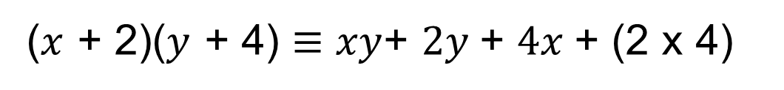
On your whiteboards:
For each diagram, write an identity.
$x$
2
$y$
4
($x$ + 2)($y$ + 4) $≡$ $xy$+ $2y$+ $4x$+ (2 x 4)
Where can you see each term in the rectangle?

Slide 26


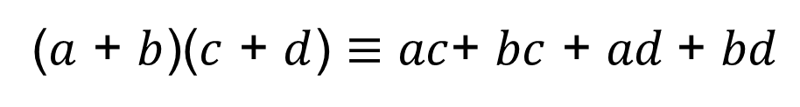


On your whiteboards:
For each diagram, write an identity.
$a$
$b$
$c$
$d$
($a$ + $b$)($c$ + $d$) $≡$ $ac$+ $bc$ + $ad$+ $bd$
Where can you see each term in the rectangle?

Slide 27




On your whiteboards:
For each diagram, write an identity.
$a$
$b$
$c$
$d$
$e$
How would you write an identity for this one?

Slide 28
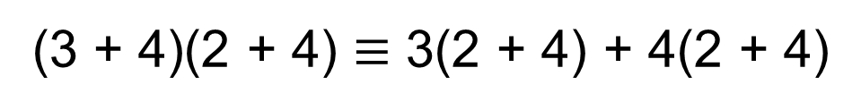
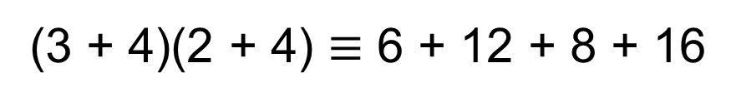
Here are one student’s identities.
Some are correct. Identify which ones are. Correct the ones that aren’t, explaining the error
(3 + 4)(2 + 4) $≡$ (3 x 2) + (3 x 4) + (4 x 4) + (4 x 3)
(3 + 4)(2 + 4) $≡$ (3 x 4) + (3 x 4) + (4 x 2) + (4 x 4)
(3 + 4)(2 + 4) $≡$ 6 + 12 + 8 + 16
(3 + 4)(2 + 4) $≡$ 3(2 + 4) + 4(2 + 4)

Slide 29
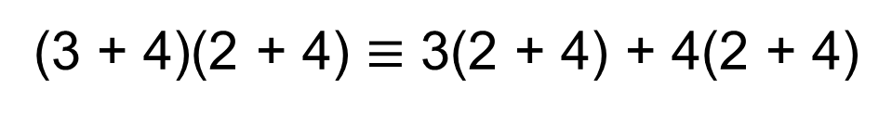
Let’s look at the last one.
Why is it true?
3
4
2
4
(3 + 4)(2 + 4) $≡$ 3(2 + 4) + 4(2 + 4)
Where can you see each term in the rectangle?

Slide 30
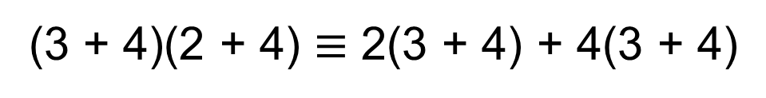
What about this identity?
3
4
2
4
(3 + 4)(2 + 4) $≡$ 2(3 + 4) + 4(3 + 4)
Where can you see each term in the rectangle?

Slide 31

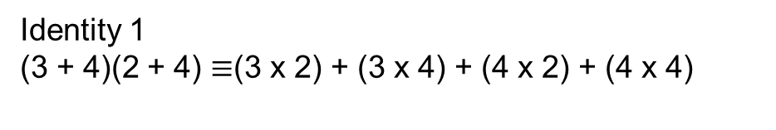
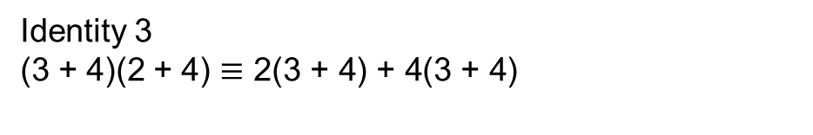
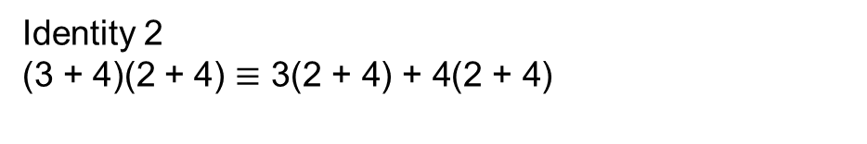
In your books
Title: Distributive Law
For each diagram on the worksheet, copy the diagram and write 3 different identities.
Use this example as guidance
Check you are correct by simplifying all of the expressions on the right hand side of the identity.
3
4
Identity 1
(3 + 4)(2 + 4) $≡$(3 x 2) + (3 x 4) + (4 x 2) + (4 x 4)
2
Identity 2
(3 + 4)(2 + 4) $≡\text{3(2 + 4) + 4(2 + 4)}$
4
Identity 3
(3 + 4)(2 + 4) $≡\text{2(3 + 4) + 4(3 + 4)}$

