Slide 1
On each of the following slides there will be a frequency diagram.
For each one, you must move your pie chart so that it shows the information on the frequency diagram as accurately as possible.

Slide 2
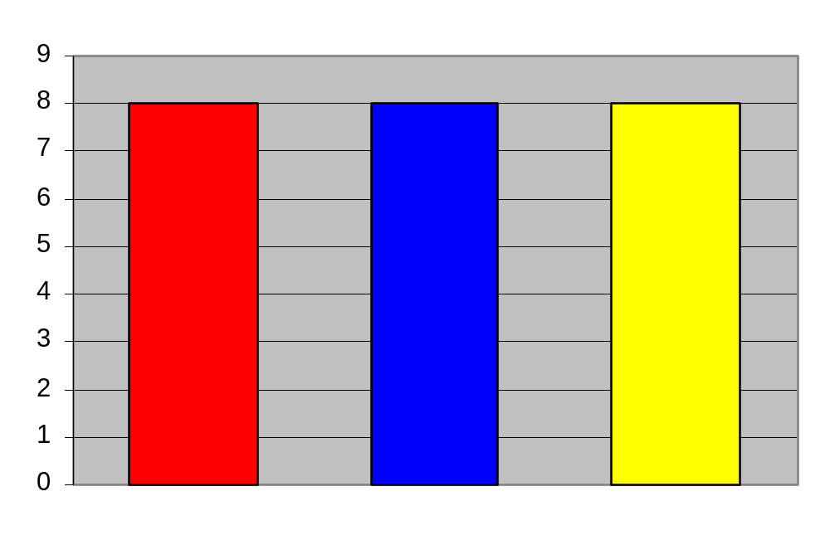
What fraction of the whole circle is each sector in your pie chart?
What angle is each sector in your pie chart.
What is the ratio of red to blue?
How many people were asked in this survey?
How is the number of people asked shown on your pie chart?

Slide 3
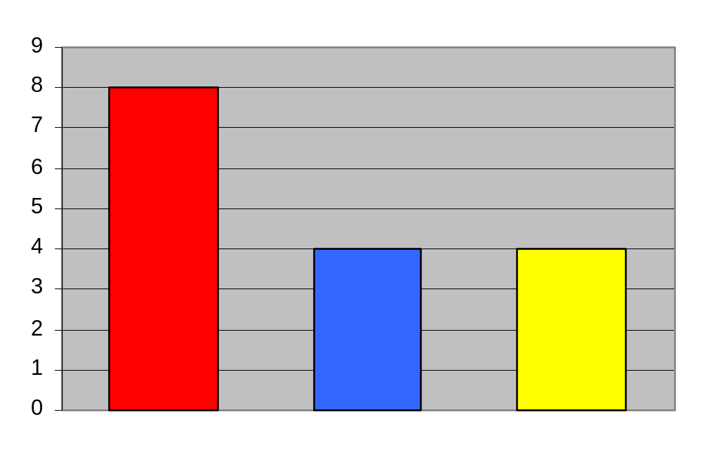
What fraction of the circle will the blue sector be in your pie chart?
What angle will that be?
What is the ratio of blue to red?

Slide 4
What is the ratio of red to blue to yellow?
What is the fraction is the blue sector in your pie chart?
What angle would this be?

Slide 5
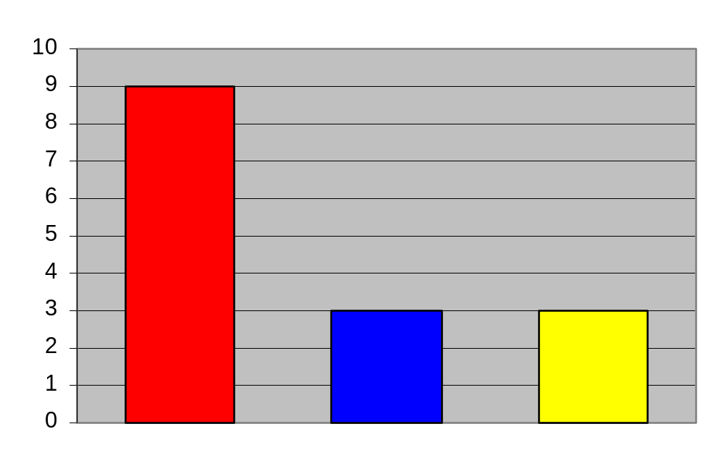
What fraction of your pie chart is yellow?
What percentage is this?
What angle is your yellow sector?
What fraction is your red sector?

Slide 6
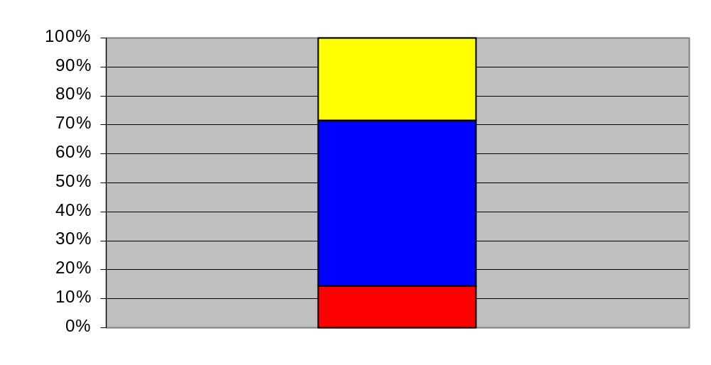
Roughly what percentage of the sample chose blue?
If 60 people were surveyed, how many chose yellow?
What angle represents red on your pie chart?
How did you work it out?

Slide 7
How do I find the angles when the fractions are more difficult?
Colour | Frequency
Blue | 20
Red | 10
Yellow | 6
What fraction of your pie chart is blue?
What fraction of your pie chart is red?
What fraction of your pie chart is yellow?

Slide 8




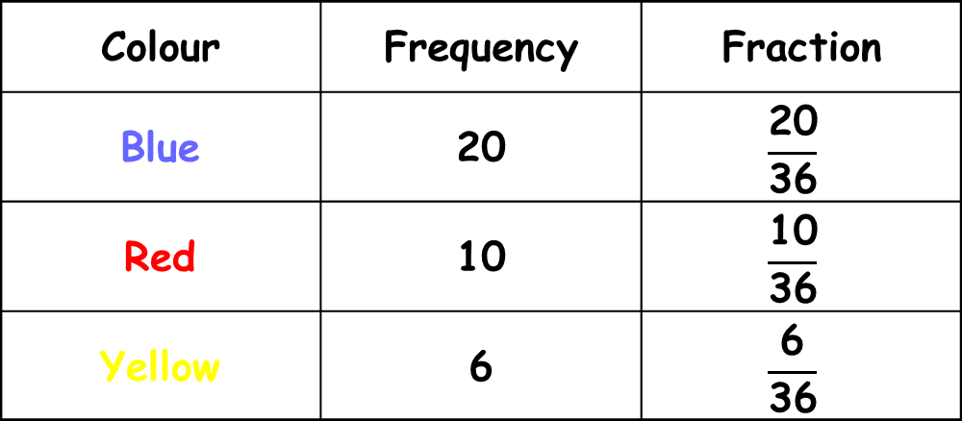
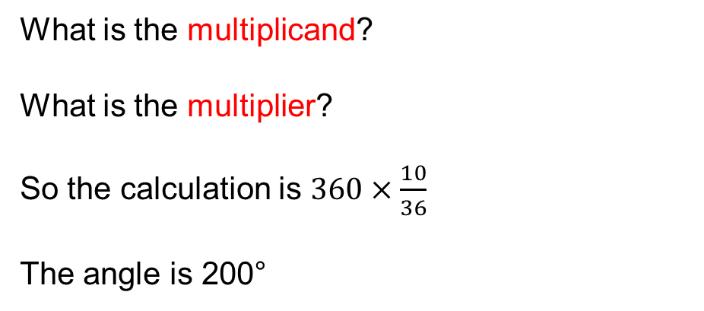
What angle of the pie chart will represent red?
Colour | Frequency | Fraction
Blue | 20
Red | 10
Yellow | 6
What is the multiplicand?
What is the multiplier?
So the calculation is $360×\frac{10}{36}$
The angle is 200°
360

Slide 9
What angle of the pie chart will represent blue?
Colour | Frequency | Fraction
Blue | 20
Red | 10
Yellow | 6
How did you work it out?

Slide 10
What angle of the pie chart will represent yellow?
Colour | Frequency | Fraction
Blue | 20
Red | 10
Yellow | 6
How did you work it out?

Slide 11
What angle of the pie chart will represent yellow?
Colour | Frequency | Fraction
Blue | 20
Red | 10
Yellow | 6
How can we draw this pie chart?

Slide 12

In your books
Title: Drawing a pie chart from a frequency diagram
Colour | Frequency
Red
Blue
Yellow
Copy the frequency diagram into your book.
Copy and complete the table.
Work out what fraction of the pie chart each colour would cover.
Work out the angle for each colour and draw the pie chart.

