Slide 1
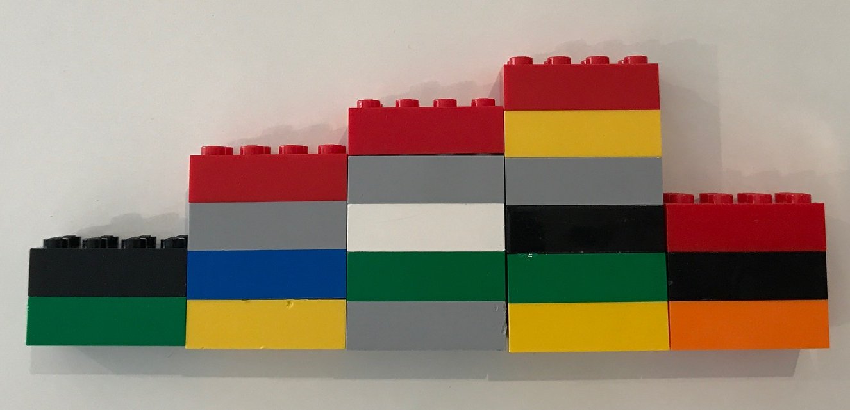
What does it mean to even something out?
How would you even these Lego towers out?

Slide 2
Moved two bricks from this column
Person 1
Moved one brick from this column
Ended up with 4 bricks in each column.

Slide 3
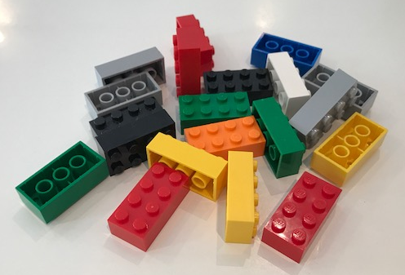
Person 2
Took columns apart and remade with equal height columns
Ended up with 4 bricks in each column.

Slide 4
Now imagine arranging the 20 lego bricks into 4 different sized columns.
Draw it on your whiteboard.
Now even them out.
How many are in each column.
Why is it always the same answer?

Slide 5
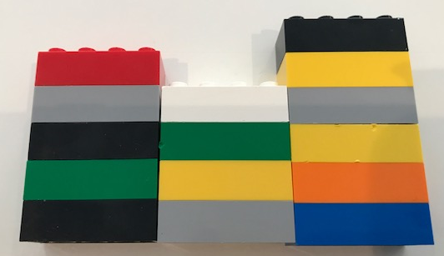
One person has 4 columns of lego bricks that even out to 5 bricks high.
How many bricks are in the missing column?
How do you know?
?

Slide 6
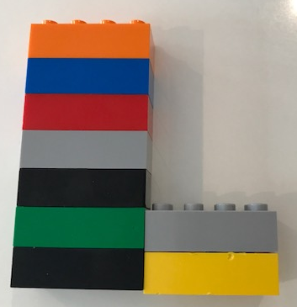
Another person has 4 columns that even out to 5 high.
How many bricks are in the missing columns a and b?
How is this question different to the previous question?
a
b

Slide 7
Another person has 4 columns that even out to 5 high.
How many bricks are in the missing columns a and b?
How is this question different to the previous question?
a
b

Slide 8
Another person has 4 columns that even out to 5 high.
How many bricks are in the missing columns a and b?
Why are there many different answers?
(How many are there?)
a
b

Slide 9
Another person has 4 columns that even out to 5 high.
How many bricks are in the missing columns a and b?
What can you say about a and b?
a
b

Slide 10
Another person has 4 columns that even out to 5 high.
How many bricks are in the missing columns a, b, c and d?
What can you say about a, b, c and d?
a
b
c
d

Slide 11

In your books
Title: Evening Out
Write the answers to the worksheet in your books.
Draw diagrams or use calculations (or both) to show how you worked out your answer.

