Slide 1
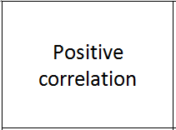
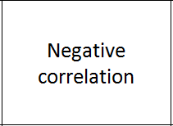
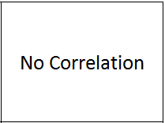
Correlation
Find these three cards:
All of the other cards fit into these groups.
If a graph has no labels, you should write appropriate labels on the axes.
Fill the blank cards with your own ideas and place in the correct group.

Slide 2
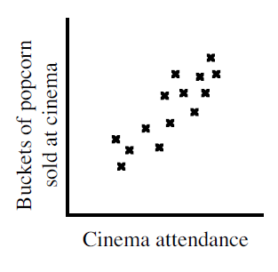
Writing sentences
This graph shows positive correlation.
Write a sentence on your whiteboard to describe what the graph is showing.

Slide 3
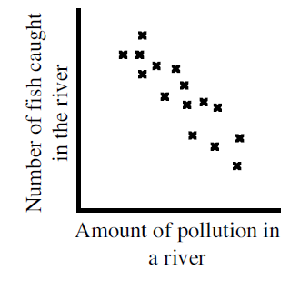
Writing sentences
What type of correlation does this graph show?
Write a sentence on your whiteboard to describe what the graph is showing.

Slide 4
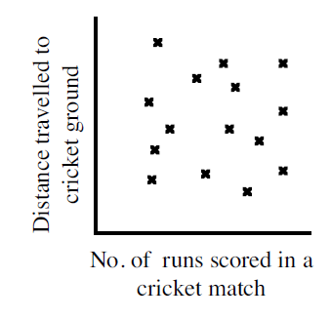
Writing sentences
Write a sentence to explain what this scatter graph is showing.

Slide 5

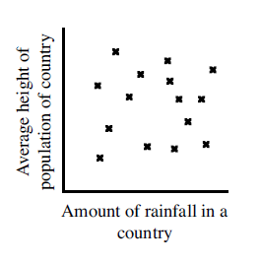
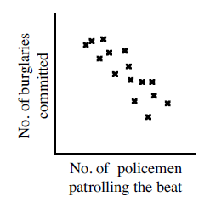
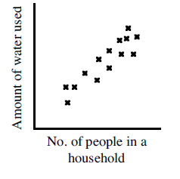
In your books
Title: Correlation
For each of the graphs below, write down the type of correlation and a sentence to explain what the graph shows.

Slide 6
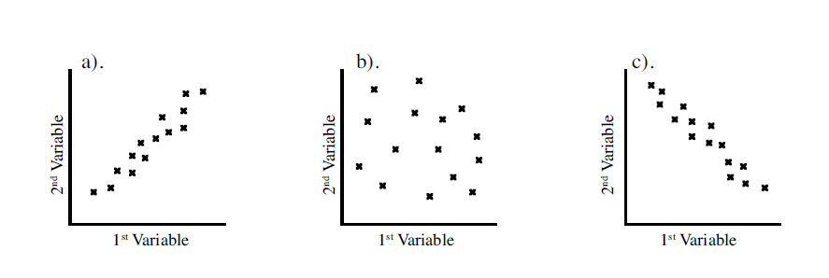
Worksheet
For each of the sentences on the worksheet:
Discuss what the graphs would look like with your partner.
Copy the sentence.
Draw the appropriate, labelled graph from above.
Write down the type of correlation
Write down a sentence.

Slide 7
Correlation
Correlation
a link or relationship between two things that happen.

Slide 8
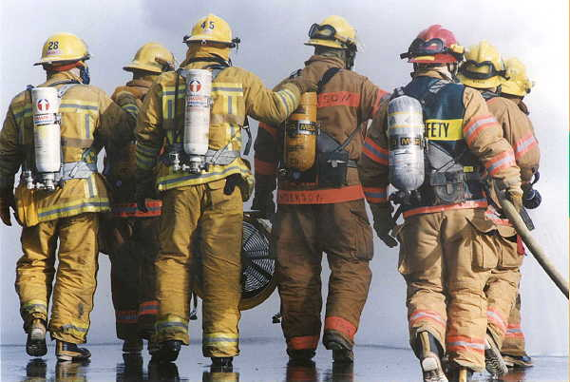
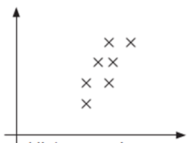
Is this a sensible correlation?
The more firemen fighting a fire, the bigger the fire is going to be.
  Therefore, firemen cause fire.
Size of fire
Number of firefighters at fire
No!
It’s the other way around. Fire “causes” firemen.

Slide 9

Is this a sensible correlation?
As ice cream sales increase, death by drowning increases sharply.
Therefore, ice cream
causes drowning.
Deaths by drowning
Ice cream sales
No!
They are both things that happen more in summer.

Slide 10

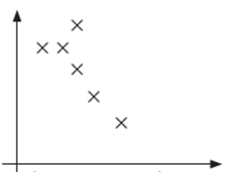
Is this a sensible correlation?
As the number of pirates has decreased, global warming has increased.
Therefore, global warming is caused by a lack of pirates.
Number of pirates
Earth’s temperature
No! We don’t need more pirates.
These are completely unrelated and are a coincidence.

Slide 11
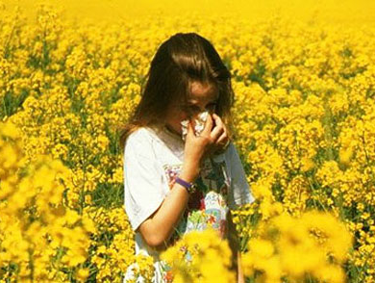
Is this a sensible correlation?
During summer, people get hayfever. There is also lots of pollen in the air.
Therefore, pollen causes hayfever.
People suffering from hay fever
Amount of pollen
Yes, it makes sense and there have been studies to prove it.

Slide 12
Correlation and causation
Just because a graph seems to show correlation, it doesn’t mean it’s true.
It doesn’t mean one thing causes the other.
Sometimes another factor is involved.
Sometimes it’s the other way around.
Sometimes it’s a coincidence.
Check that your conclusion makes sense.

