Slide 1


Slide 2
Mavis’s famous cavorting cattle have kicked down the gate of their shed, and are wreaking havoc across the festival site, leaving a trail of splintered wood, broken glass and hoof prints. Now the cows have attacked the painstakingly created main stage, reducing it to a pile of planks and rubble. Using only materials found on the site – drink cans, hay bales, crates, and so on – the FSS must build a new ‘green stage’ in time for the big show and headline act.

Slide 3
The floor of the new ‘green stage’ will be rectangular.
It will be built using a straight edge of the field as one side, and will be supported on a single layer of hay bales.
However, the teams have only 100 m of lighting strips to go along the other three edges of the stage.

Slide 4
What advice should they give Mavis about the size of the stage floor to make its area as large as possible?
Can the teams prove that they have suggested the largest possible area?
How many hay bales will be needed?
How should they be positioned to use as many as possible?

Slide 5
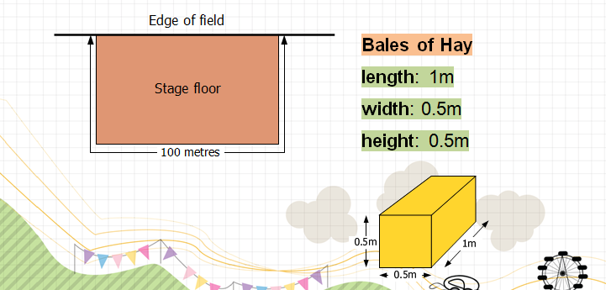
Your Challenge:
Building a new ‘green stage’.

