Slide 1


Slide 2
With the fields cleared of rainwater and sewage, and the sun breaking through the clouds, the festival is now ready for the 100 000 music fans straining at the gates. The gates are opened and the crowds swoop in past the food stalls and merchandise stands.

Slide 3
Del and Cassy, rival stallholders, give each other dirty looks as they each set up stalls by the main entrance, ready to sell band T-shirts and colourful accessories to the festival revellers.
But they are worried. Have they made enough T-shirts to sell? Will enough people buy their merchandise? What should they charge? And have they made the right decisions about the amount of each product they have brought to the festival to maximise profits?

Slide 4
Your Challenge:
You have packed your van full of goods that you hope to sell over the four days. Have you brought the right goods to maximise your profit?
Your van is 330 cm long, 175 cm wide and 190 cm high.
What is the maximum profit you could make if you brought only one type of item?
What could your profit be if you brought at least two types of items?
Can you do better than the other market traders?

Slide 5
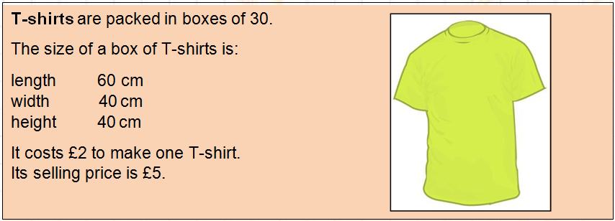
What if you only wanted to sell T-shirts, like Del?
How many boxes could you fit in the van?

Slide 6
What if you only wanted to sell T-shirts, like Del?
How much money would you make if you sold all of them?

