Slide 1


Slide 2
Megastars from all over the world are about to converge on the quiet village of Torbury, but with just hours to go until the famous festival begins, everything is going wrong. With storm clouds overhead and a herd of frisky cows on the loose, the eccentric site manager, Mavis Broom, has retired to her office with a case of the screaming wobblies. Is the festival destined for disaster? Or can the Festival Support Squad transform the floods, bickering market sellers, cow-wreckage and angry crowds into a fantastic weekend?

Slide 3
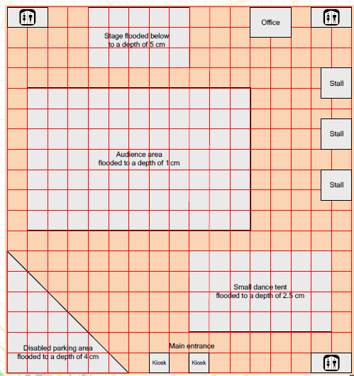
YOU are the Festival Support Squad.
Look at the sheet in front of you.

Slide 4
Four different areas are shown on the plan.
Each area has been flooded to a different depth.
There is a list of four possible ways of removing water.
The festival gates are due to open in 90 minutes. The equipment needed to remove water will be ready in half an hour. What will you do?

Slide 5
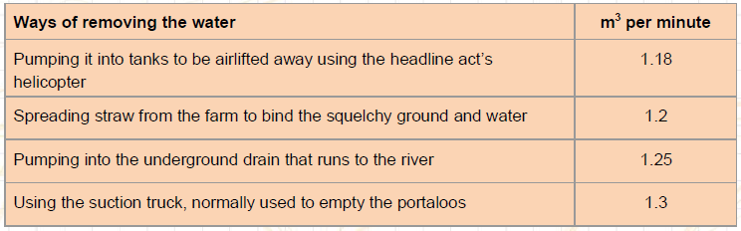

Slide 6
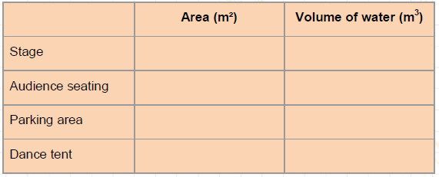

Slide 7
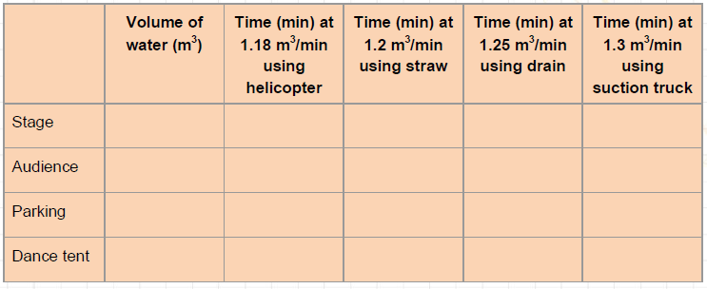

Slide 8
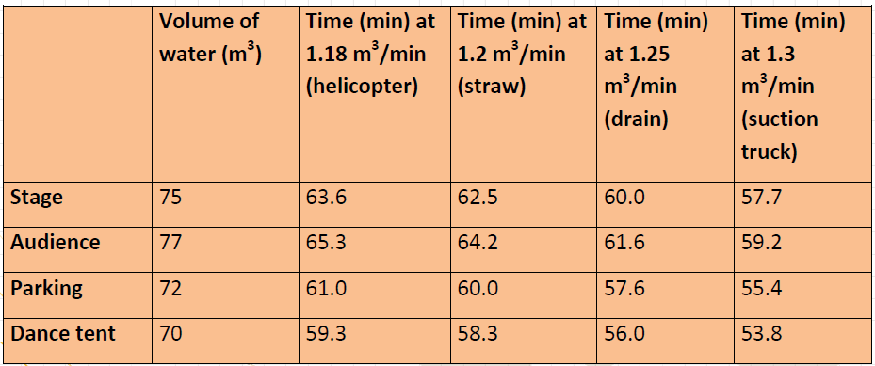
Solutions

Slide 9
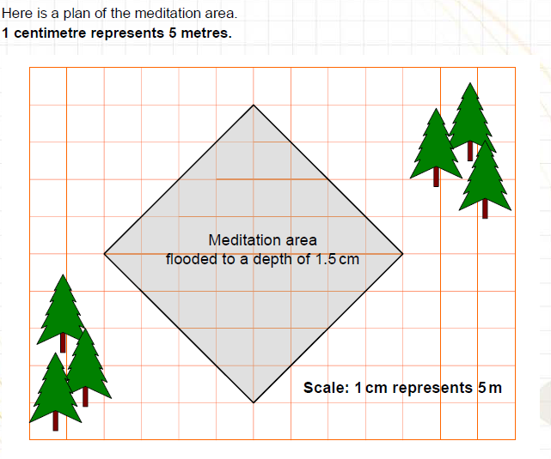
Challenge problem
(The squares are 1 cm x 1 cm)

Slide 10
Challenge problem
You will need the set of cards to use as clues.
The meditation area has been flooded to a depth of 1.5 cm.
How will you remove the water from the meditation area?
This time it might not be as simple as you imagine!
You can choose whether to use the suction truck or the helicopter. Use the clues on the cards to help you decide.
When you have chosen the method you would use to dry out the area, explain how you came to that decision.

