Slide 1
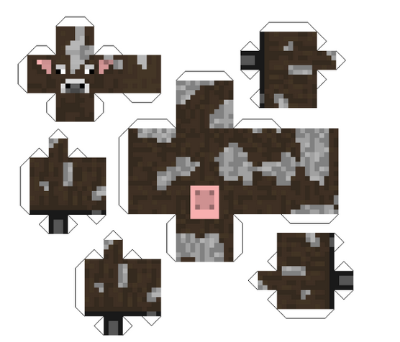
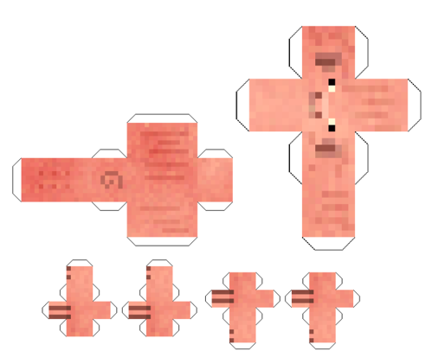
Which used the most paper to make, the cow or the pig?
How could we find out?

Slide 2
What if someone had already made one of the body parts?
How could we find the surface area then?

Slide 3
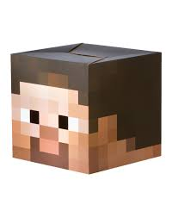
Here is a head that has been made:
Discuss in your pairs how you could find the surface area of the head.
What do you need to know?
9 cm
8 cm
8 cm
The dimensions of the head (in cm) are 8 x 8 x 9.
Can you find the surface area?

Slide 4
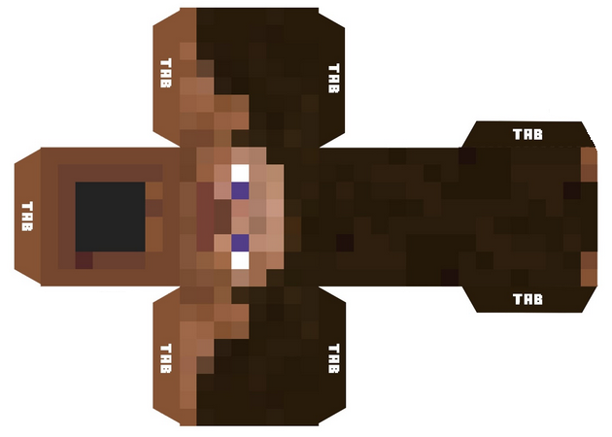
Not to scale

Slide 5
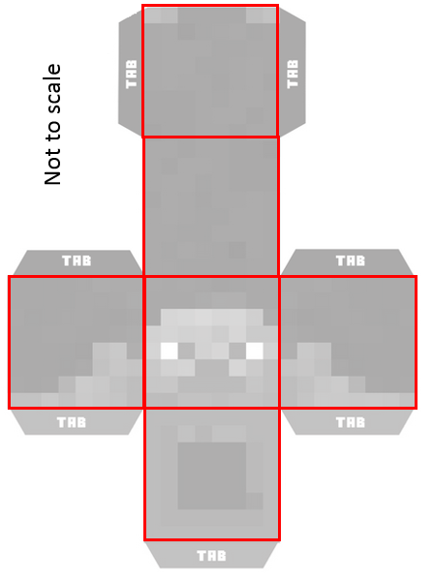
Comparing methods: Using a net
9 cm
8 cm
8 cm

Slide 6
Comparing methods: Without a net
9 cm
8 cm
8 cm

Slide 7
The last measurements weren’t really accurate. One of the dimensions was actually 8.3 cm.
How will you have to alter your method to account for this?
What is the surface area now?
9 cm
8.3 cm
8 cm

Slide 8
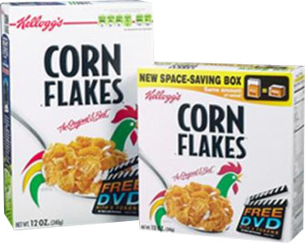
Kellogg’s have designed a new ‘space saving’ box.
How much card will Kellogg’s save per box by making the new box? (Ignoring tabs)
Dimensions (cm)
20 x 30 x 7
Dimensions (cm)
15 x 15 x 8

Slide 9
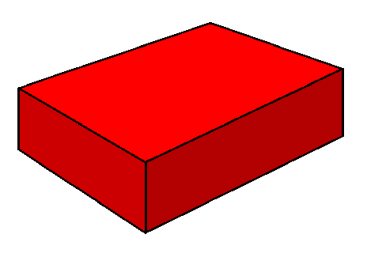
Final Challenge:
Find a cuboid (with edges of integer lengths) that has a surface area of exactly 100 square units.
Is there more than one?
Can you find them all?
Can you provide a convincing argument that you have found them all?

