Slide 1
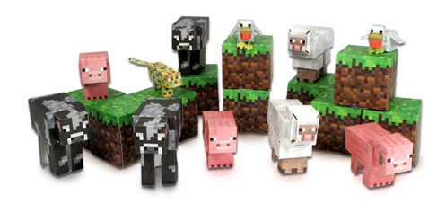
Click to watch video

Slide 2
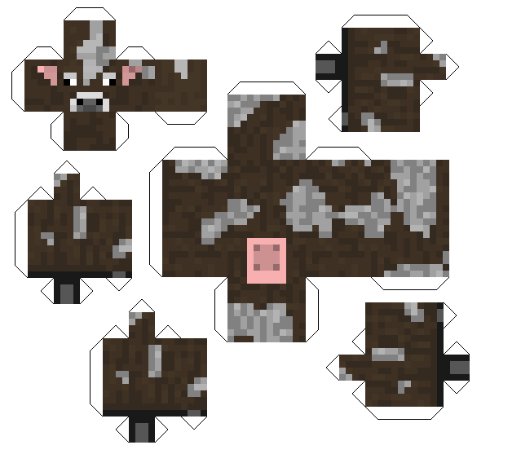

Slide 3
Now find the surface area of the whole cow.
Don’t include the tabs
Measure this line accurately
Measure this line accurately
Ext: What is the volume of the cow?
What is the area of this rectangle?
Why don’t you need to measure this line?

Slide 4
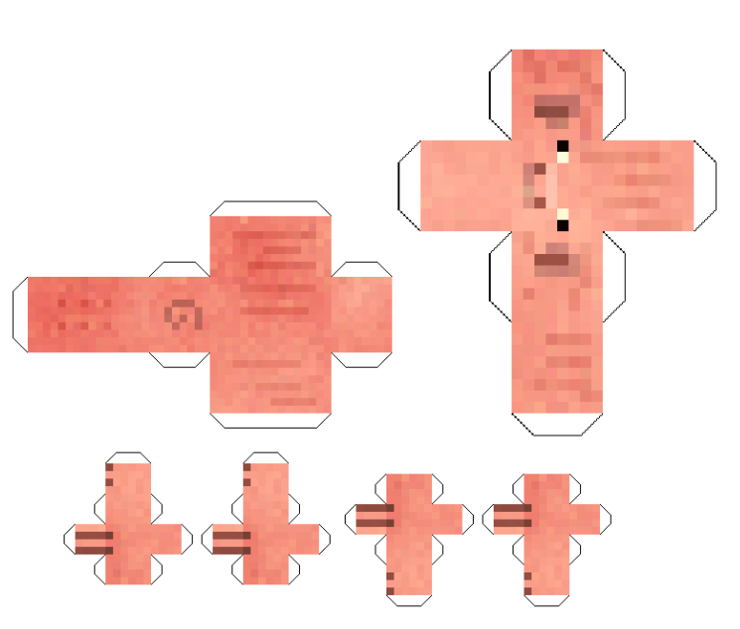
Now find the surface area of the pig.
What about the volume?

Slide 5
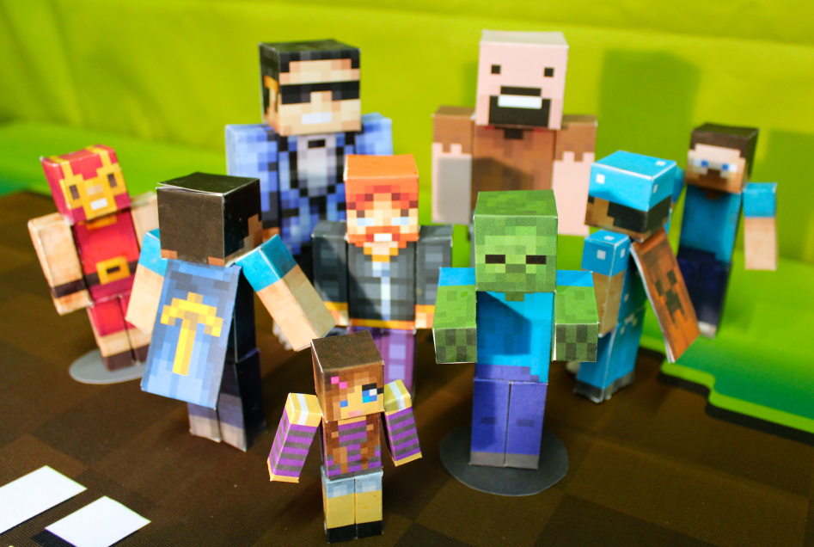
Can you make the nets for one of these?

Slide 6
Your write up must include:
Nets of all of the body parts drawn on cm squared paper.
Surface areas of all pieces
Volumes of all pieces.
An isometric drawing of each piece.
Ext – Can you make any shapes other than cuboids and cubes?

