Slide 1
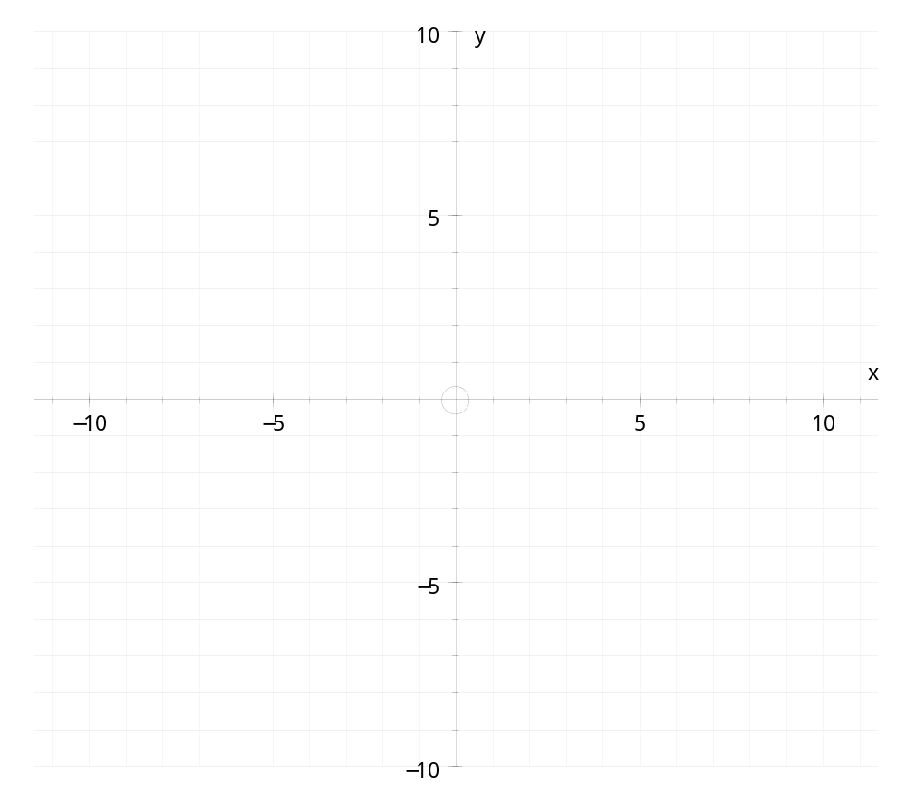
Plot the coordinates
(5 , 1)
(5 , 7)
(2 , 1)
Join them up.
What shape is it?
What is its area?

Slide 2
Plot the coordinates
Draw the line
x = 1
Reflect the triangle
in this line
What is area of the new shape?
Why is the area the same?

Slide 3
Plot the coordinates
(7 , 3)
(7 , 9)
(-2 ,3)
Join them up.
What shape is it?
What is its area?

Slide 4
Plot the coordinates
Draw the line
y = 3
Reflect the triangle in the line.
What type of triangle is the shape made up from the two triangles?
How do you know?

Slide 5

Worksheet
Think about each part of the question carefully.
Each part builds on the previous part, so any mistakes would be a disaster!
The next slide will be shown as you complete the worksheet. It will remind you how to find areas of different shapes.
Challenge:
Can you create a similar type of question, and answer it?
How could you make it more difficult?

Slide 6
A = b x h
2
A = (a + b)h
2
A = b x h
parallelogram
triangle
trapezium
a
h
h
h
b
b
b
h
b
h
a
b
b
h

Slide 7
In your pairs
Can you create a similar type of question, and answer it?

