Slide 1
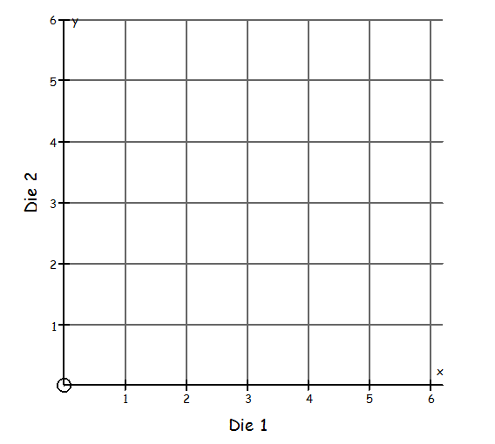
3-in-a-row
Die 1
Die 2
(4 , 3)

Slide 2
3-in-a-row
Die 1
Die 2
(5 , 1)

Slide 3
3-in-a-row
The aim is to make 3 in a row.
The line must be
vertical or horizontal.
When you have 3-in-a-row, write the coordinates down on your whiteboard.

Slide 4
3-in-a-row – a horizontal line
( , )
( , )
( , )
What do you notice about the three coordinates?
The y-coordinate is always equal to …
y = …

Slide 5
3-in-a-row – a horizontal line
( , )
( , )
( , )
What do you notice about the three coordinates?
The y-coordinate is always equal to …
y = …

Slide 6
3-in-a-row – a vertical line
( , )
( , )
( , )
What do you notice about the three coordinates?
The x-coordinate is always equal to …
x = …

Slide 7
3-in-a-row – a vertical line
( , )
( , )
( , )
What do you notice about the three coordinates?
The x-coordinate is always equal to …
x = …

Slide 8

In your books
Title: Vertical and horizontal lines
Copy this diagram into your books. Use 2 squares between each number.
(You must use a pencil and ruler!)
( 2 , 4 )
( 0 , 4 )
( 5 , 4 )
The y-coordinate is always equal to 4
y = 4

Slide 9
In your books
Title: Vertical and horizontal lines
Copy this diagram into your books. Use 2 squares between each number.
(You must use a pencil and ruler!)
Horizontal lines are always
y = ?

Slide 10
In your books
Title: Vertical and horizontal lines
Copy this diagram into your books. Use 2 squares between each number.
(You must use a pencil and ruler!)
( 1 , 4 )
( 1 , 3 )
( 1 , 1 )
The x-coordinate is always equal to 1
x = 1

Slide 11
In your books
Title: Vertical and horizontal lines
Copy this diagram into your books. Use 2 squares between each number.
(You must use a pencil and ruler!)
Vertical lines are always
x = ?

Slide 12
On your whiteboards
Show me
an equation of a horizontal line
and another.
and another.

Slide 13
On your whiteboards
Show me
an equation of a vertical line
and another.
and another.

Slide 14
On your whiteboards
Show me
a coordinate on the line y = 4
and another.
and another.

Slide 15
On your whiteboards
Show me
a coordinate on the line y = 10
and another.
and another.

Slide 16
On your whiteboards
Show me
a coordinate on the line x = 10
and another.
and another.

Slide 17
On your whiteboards
Show me
a coordinate on the line y = 0
and another.
and another.

Slide 18
On your whiteboards
Show me
a coordinate NOT on the line x = 2
and another.
and another.

Slide 19
On your whiteboards
Show me
a coordinate on the line x = ½
and another.
and another.

Slide 20
On your grids
Show me
y = 2

Slide 21
On your grids
Show me
x = 2

Slide 22
On your grids
Show me
x = 4

Slide 23
On your grids
Show me
y = 3

Slide 24
On your grids
Show me
x = 0

Slide 25
On your grids
Show me
y = 6

Slide 26
On your grids
Show me
x = 5

Slide 27
On your grids
Show me
x = 5
x = 3
y = 2

Slide 28
On your grids
Draw another horizontal line and label it.
What is the area of the enclosed rectangle?

Slide 29
Complete the worksheet, but with different answers.
You should check each other’s work to make sure it is correct

