Slide 1
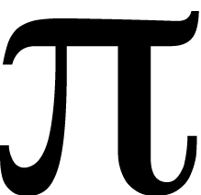
q t
Notes:
Cutie Pie

Slide 2

∏
Notes:
Pumpkin Pie

Slide 3

Notes:
Apple Pie

Slide 4
Notes:
Pie Chart

Slide 5
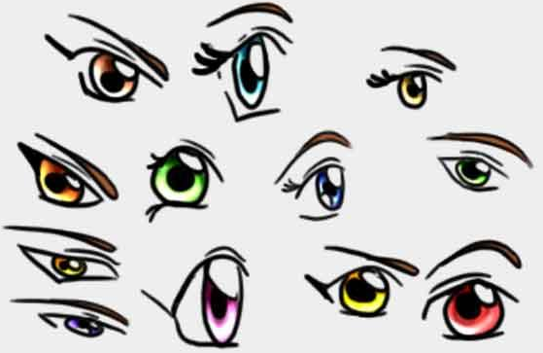

Notes:
I Spy

Slide 6
the
SK
Y
Notes:
Pie in the Sky

Slide 7


Slide 8

‘n
Notes:
Pineapple

Slide 10
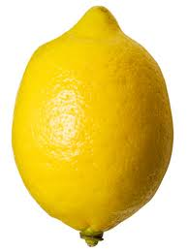


Slide 11
lon
lon
lon

Slide 12


Notes:
Popeye

