Slide 1
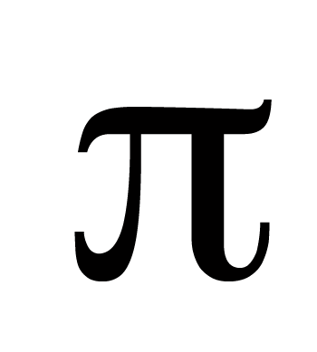
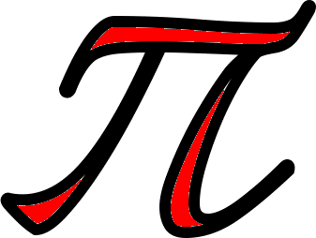
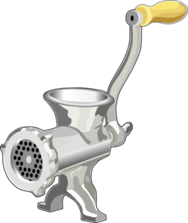

Slide 2
πR
πR
πR
πR
Notes:
Pi R Squared

Slide 3


Slide 4

Notes:
Octopi

Slide 5
PchickI

Slide 6



Slide 7

th

Slide 8
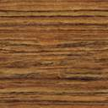


Slide 9
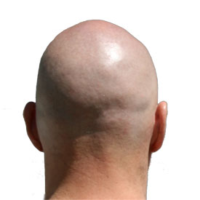

Slide 10
+
ppp

Slide 11

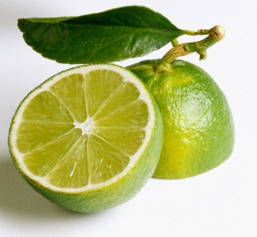

Slide 12


