Slide 1



Hi

Slide 2


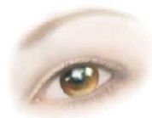
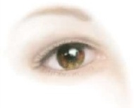
Notes:
Pie – Eyed or Pisces

Slide 3

p

Slide 4


Slide 5

Pb

Slide 6

m r

Slide 7


Slide 8
L A

Slide 9



Slide 10

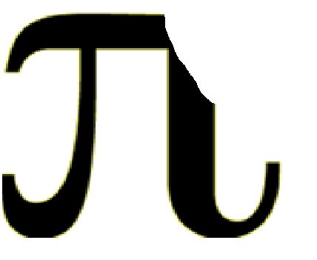


Slide 11


Slide 12
2ET

Slide 13






Slide 14
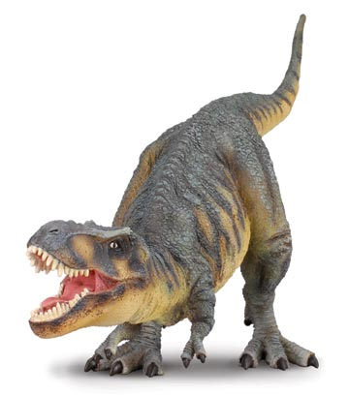

Slide 15
NT

Slide 16


Slide 17


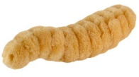

Slide 18
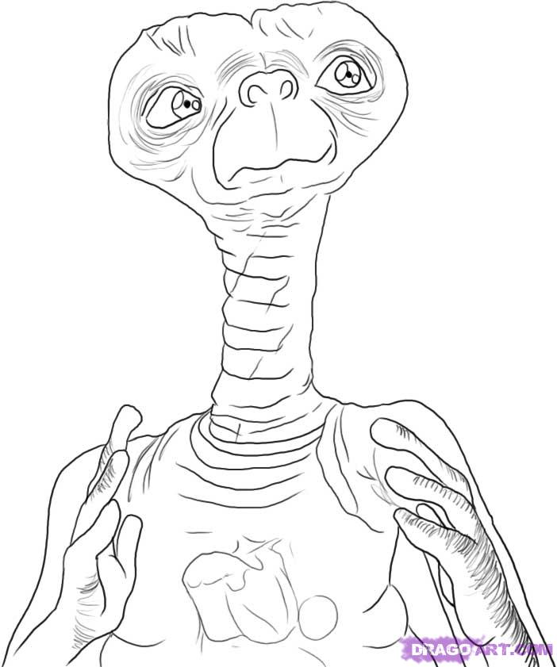

Slide 19


Slide 20
LLL

