Slide 1
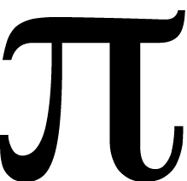
Fe

Slide 2
eeeeeeeeee
∑∏r

Slide 3
α

Slide 4
X π
(AEROPLANE)

Slide 5

E

Slide 6

Widow’s
∏

Slide 7
THE M R SEKIRTS

Slide 8









It’s not that difficult!

Slide 9

CLIFF
ELTON
GALAHAD
BASIL ROSEMARY

Slide 10
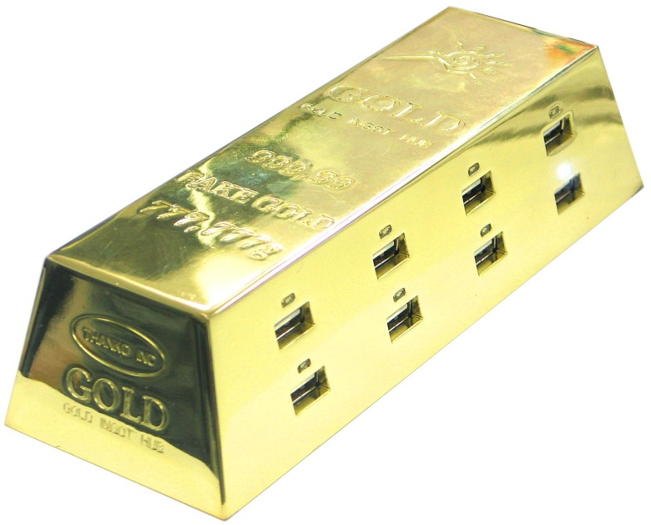
p

Slide 11
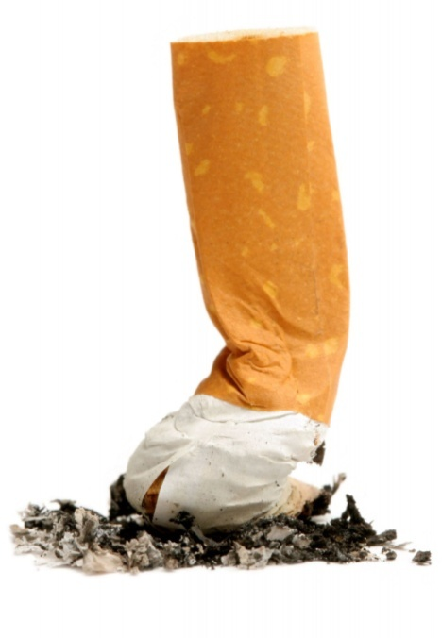
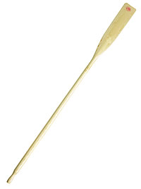


Slide 12
L
M5

