Slide 1

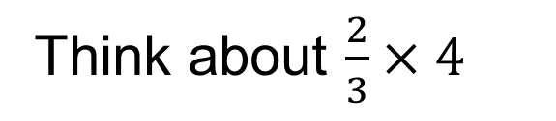
Which number is the multiplicand?
Which number is the multiplier?

Slide 2



Slide 3

Multiplying with fractions
Which number is the multiplicand?
Which number is the multiplier?
Draw a diagram to represent the problem.
What is the answer?

Slide 4



A different representation
1
2
3
Where is ‘the whole?’

Slide 5
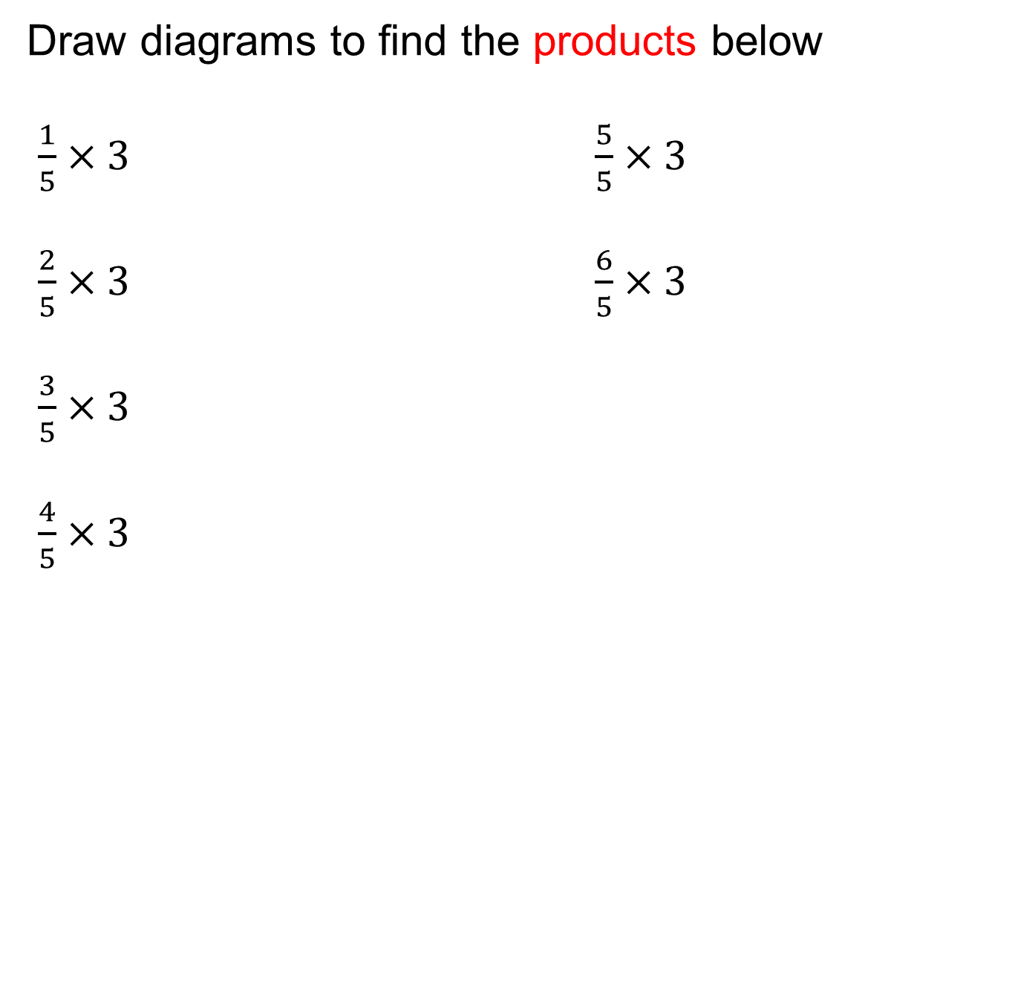
On your whiteboards…

Slide 6
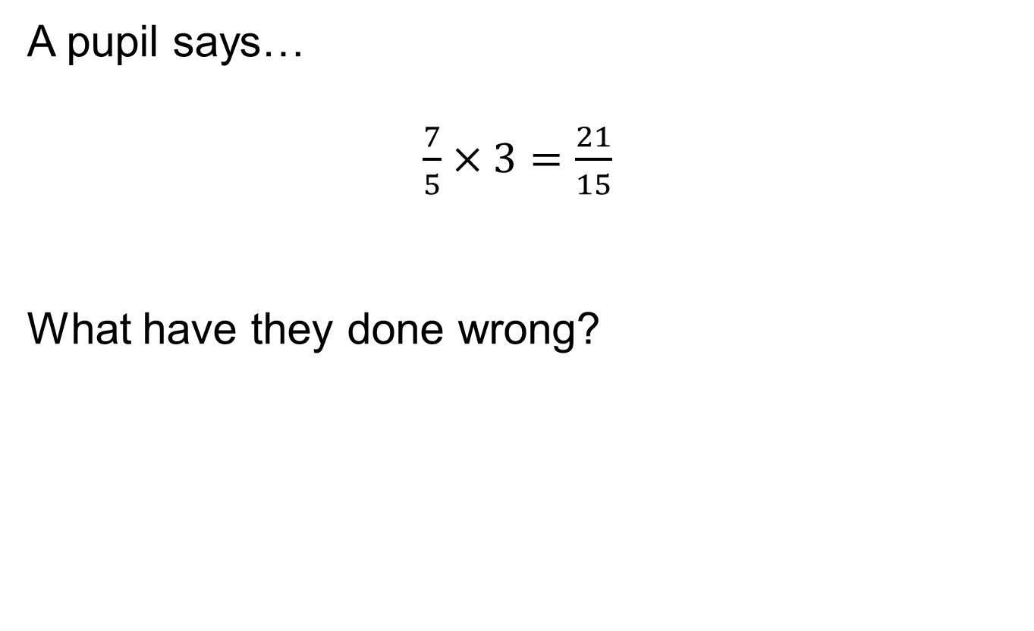
What went wrong?

Slide 7
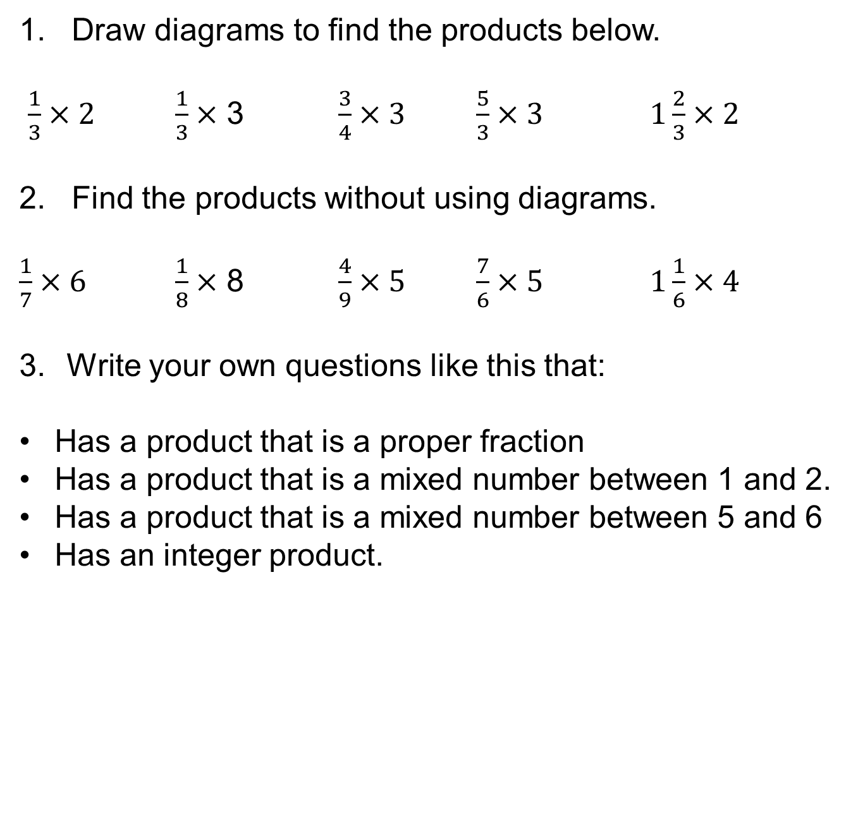
In your books…

Slide 8
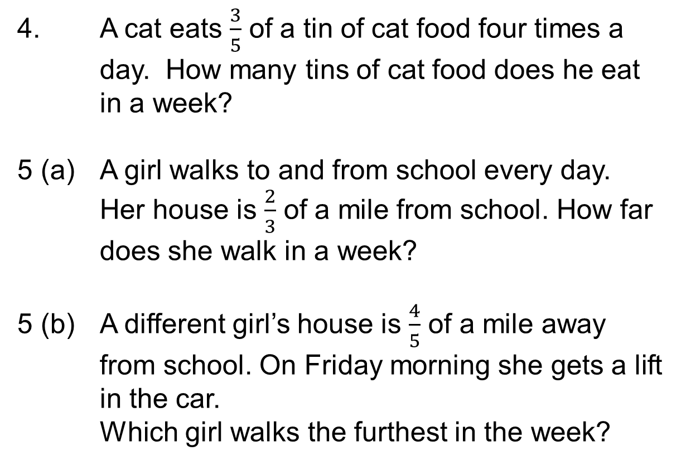
In your books…
4. A cat eats $\frac{3}{5}$ of a tin of cat food four times a day. How many tins of cat food does he eat in a week?
5 (a) A girl walks to and from school every day. Her house is $\frac{2}{3}$ of a mile from school. How far does she walk in a week?
5 (b) A different girl’s house is $\frac{4}{5}$ of a mile away from school. On Friday morning she gets a lift in the car.
Which girl walks the furthest in the week?

Slide 9
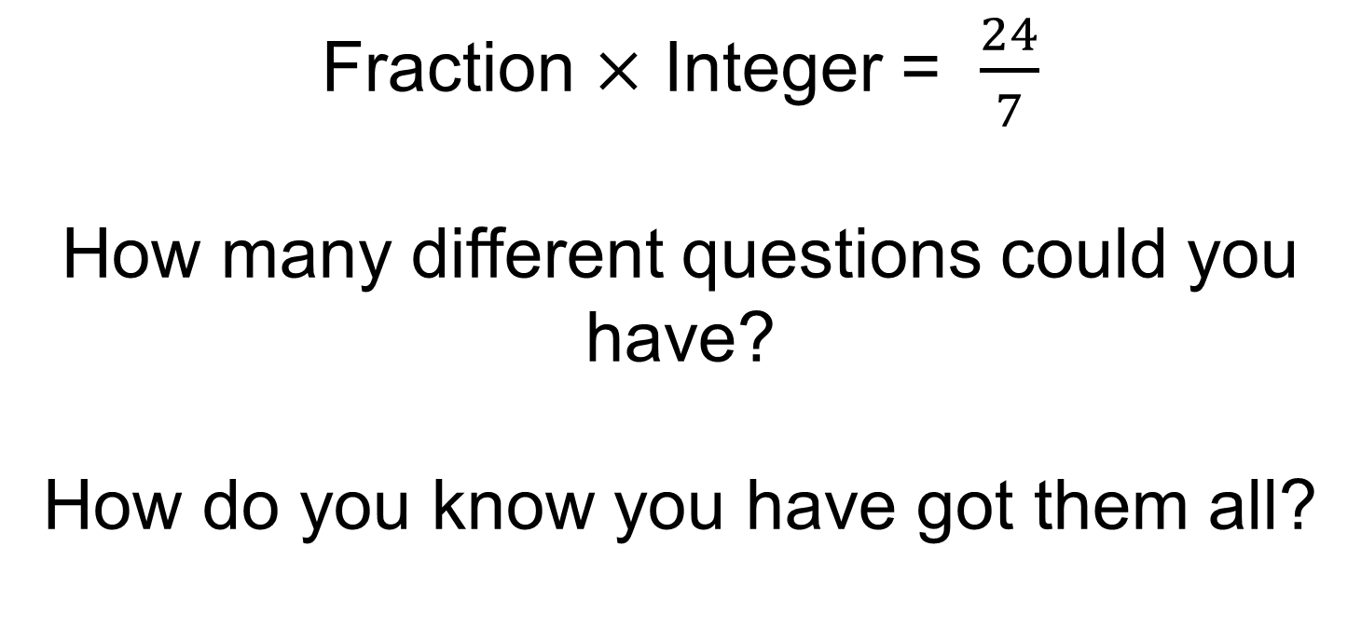
Challenge 1:

Slide 10
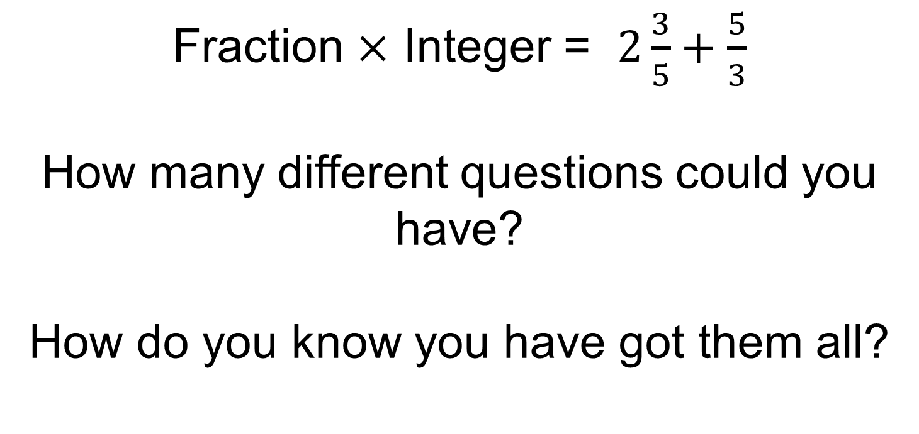
Challenge 2:

