Slide 1
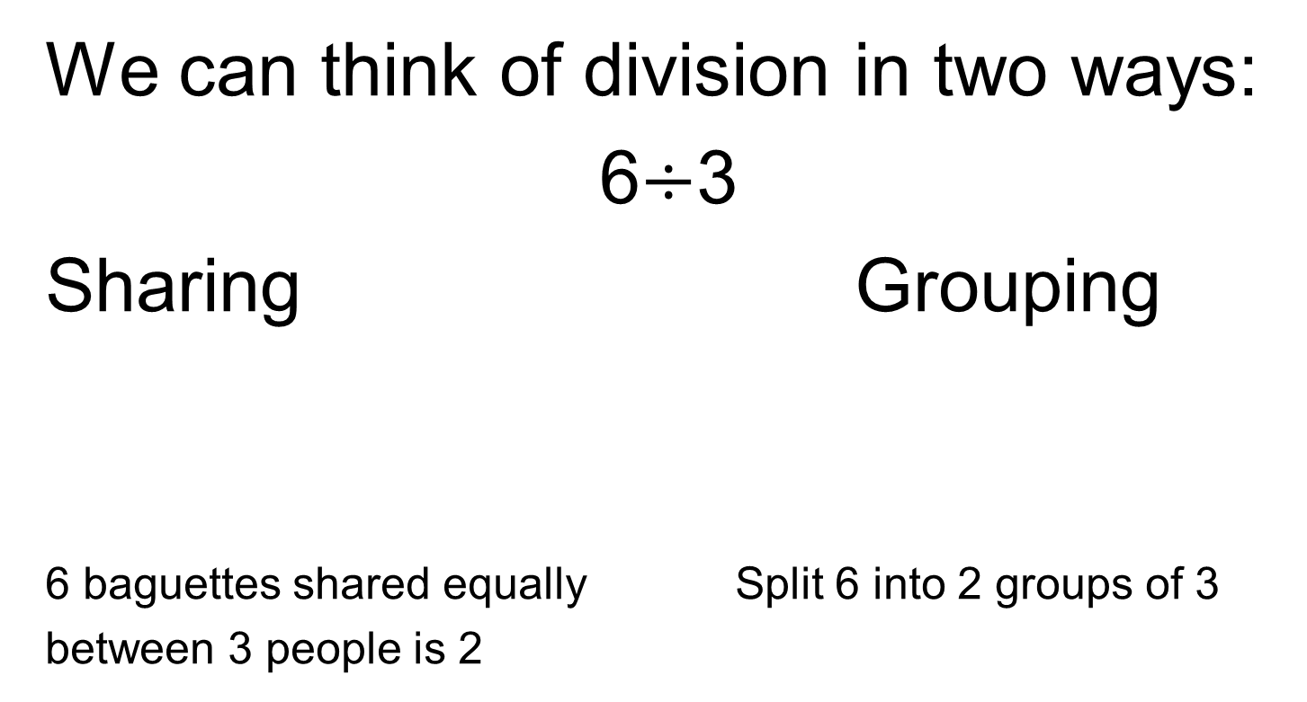
Division
We can think of division in two ways:
6$÷$3
Sharing Grouping
6 baguettes shared equally Split 6 into 2 groups of 3
between 3 people is 2

Slide 2
Division
The grouping method is sometimes thought of as ‘how many go into’.
How many of the divisor fit into the dividend
This is how we will think of division when dividing fractions

Slide 3
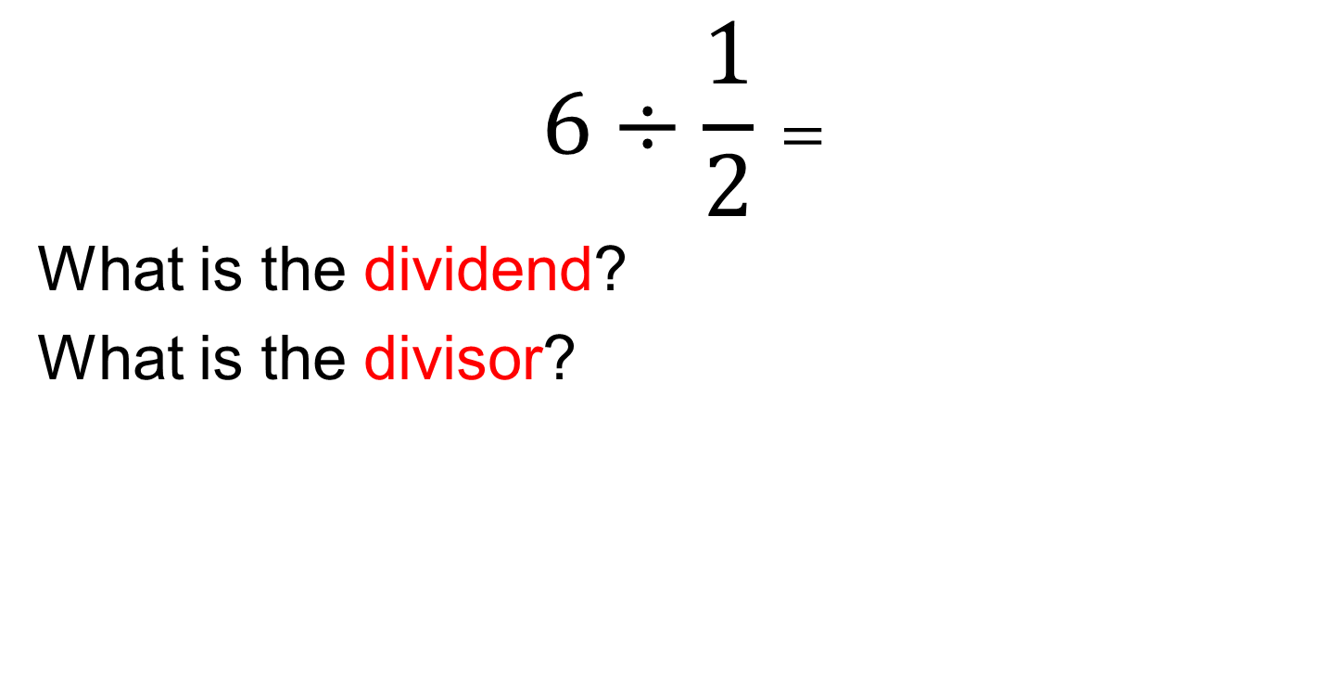
Dividing Fractions
$$6÷\frac{1}{2}=$$
What is the dividend?
What is the divisor?

Slide 4
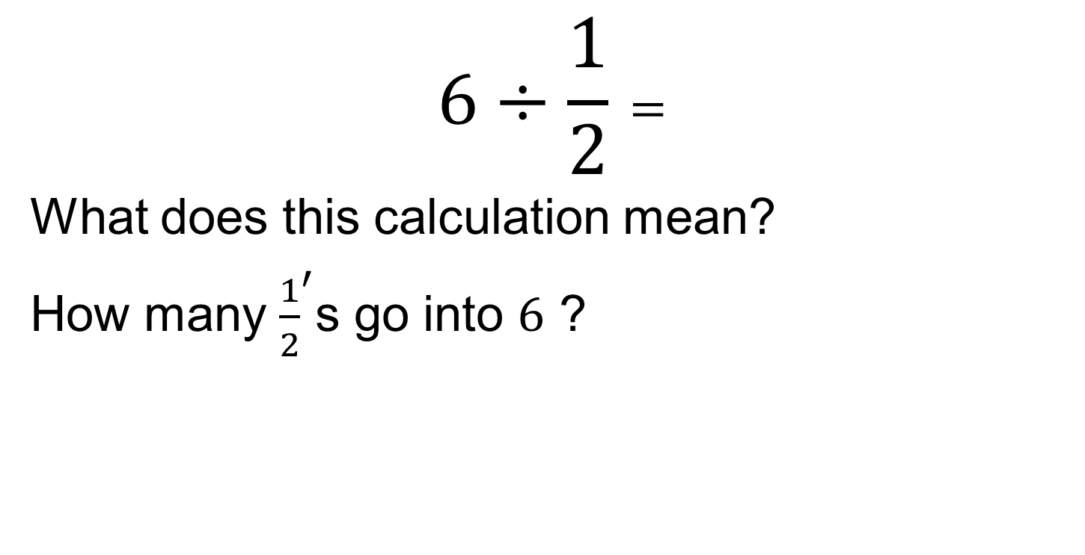


Dividing Fractions
$$6÷\frac{1}{2}=$$
What does this calculation mean?
How many ${\frac{1}{2}}^{′}$s go into $6$ ?
$$6$$
$$\frac{1}{2}$$

Slide 5
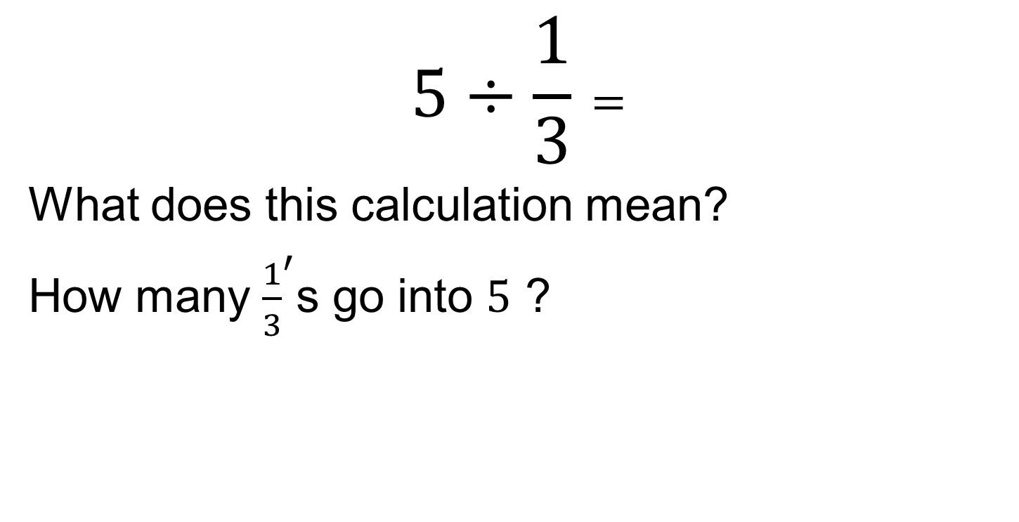


Dividing Fractions
$$5÷\frac{1}{3}=$$
What does this calculation mean?
How many ${\frac{1}{3}}^{′}$s go into $5$ ?
$$5$$
$$\frac{1}{3}$$

Slide 6
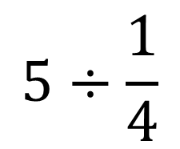
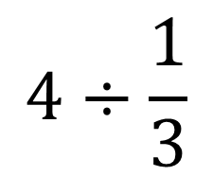
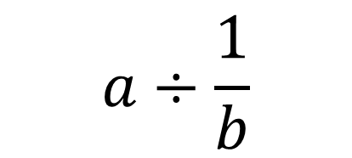
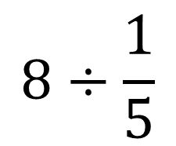
Dividing Fractions
On your whiteboards, draw diagrams to find the quotients:
$$4÷\frac{1}{3}$$
1. Choose your own example to
draw in your books.
2. Can you generalise?
$$5÷\frac{1}{4}$$
$$a÷\frac{1}{b}$$
$$8÷\frac{1}{5}$$

Slide 7
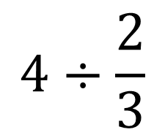
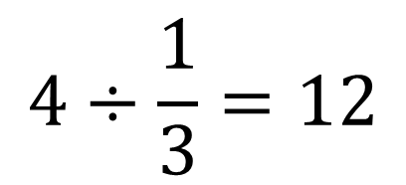
Dividing Fractions
We know that
$$4÷\frac{1}{3}=12$$
What about.
$$4÷\frac{2}{3}$$
Draw a diagram to find your answer.
How does the answer compare to the first answer?

Slide 8
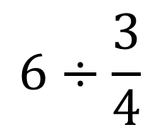
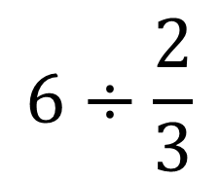
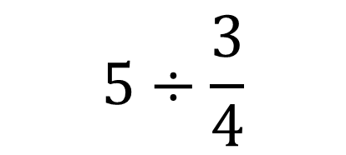
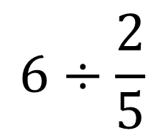
Dividing Fractions
On your whiteboards, draw diagrams to find the quotients:
$$6÷\frac{2}{3}$$
1. Choose one of these to draw into your book.
2. Why is this question more difficult? Can you find a way to answer it?
$$6÷\frac{3}{4}$$
$$5÷\frac{3}{4}$$
$$6÷\frac{2}{5}$$

Slide 9
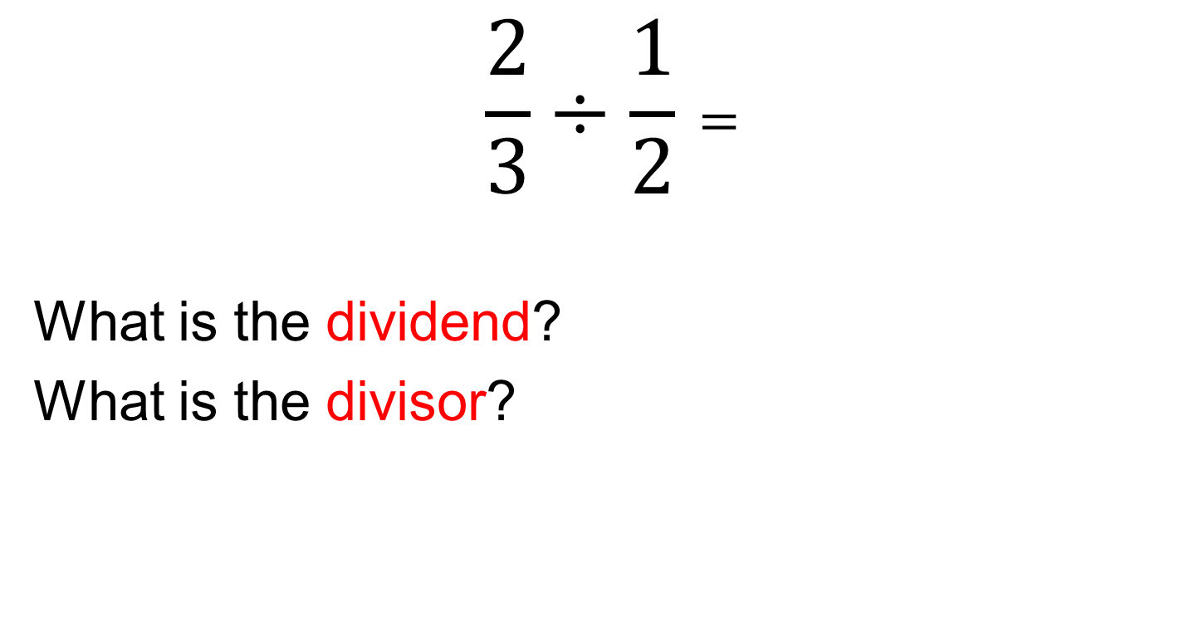
Dividing Fractions
$$\frac{2}{3}÷\frac{1}{2}=$$
What is the dividend?
What is the divisor?

Slide 10
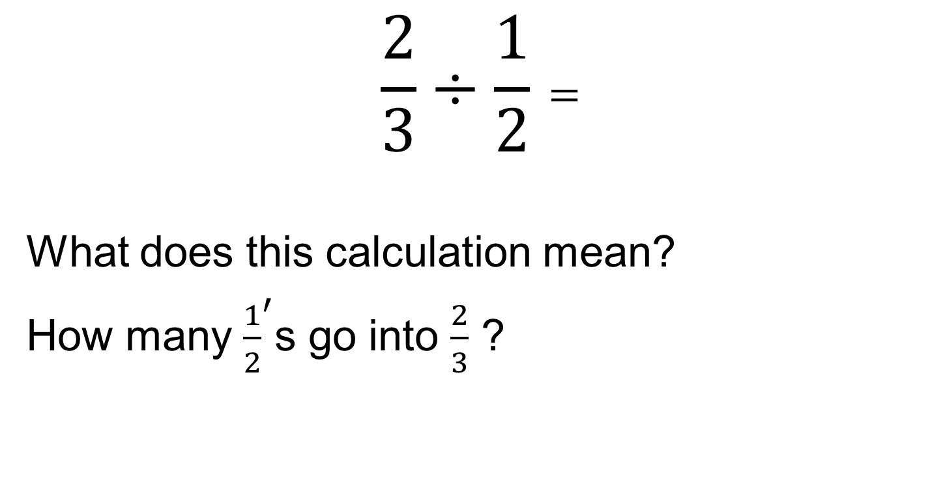
Dividing Fractions
$$\frac{2}{3}÷\frac{1}{2}=$$
What does this calculation mean?
How many ${\frac{1}{2}}^{′}$s go into $\frac{2}{3}$ ?

Slide 11

Dividing Fractions
$$\frac{2}{3}÷\frac{1}{2}=$$
How many times does the yellow bar (divisor)
fit inside the red bar (dividend)?
Discuss in your pairs

Slide 12
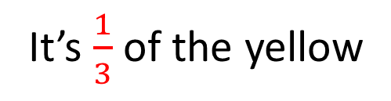
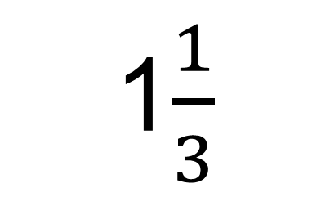
Dividing Fractions
$$\frac{2}{3}÷\frac{1}{2}=$$
1$\frac{1}{3}$
What fraction of the yellow is this?
1
?
It’s $\frac{1}{3}$of the yellow

Slide 13
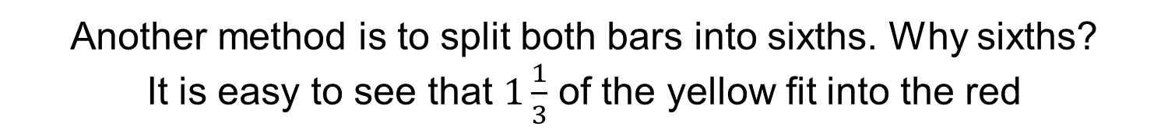
Dividing Fractions
$$\frac{2}{3}÷\frac{1}{2}=$$
Another method is to split both bars into sixths. Why sixths?
It is easy to see that $1\frac{1}{3}$ of the yellow fit into the red

Slide 14
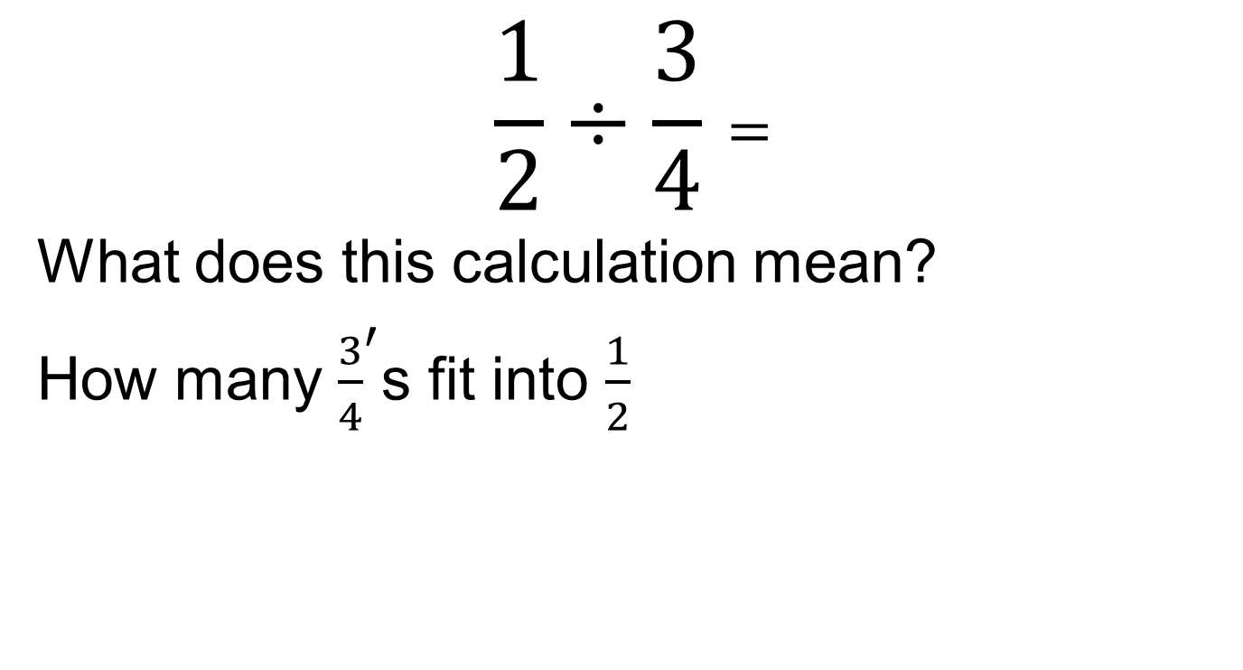
Dividing Fractions
$$\frac{1}{2}÷\frac{3}{4}=$$
What does this calculation mean?
How many ${\frac{3}{4}}^{′}$s fit into $\frac{1}{2}$

Slide 15

Dividing Fractions
$$\frac{1}{2}÷\frac{3}{4}=$$
How many times does the yellow bar fit inside the red bar?
Discuss in your pairs

Slide 16
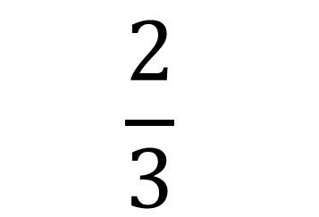
Dividing Fractions
$$\frac{1}{2}÷\frac{3}{4}=$$
$$\frac{2}{3}$$
What fraction of the yellow is this?
This is how much of the yellow fits into the red

Slide 17
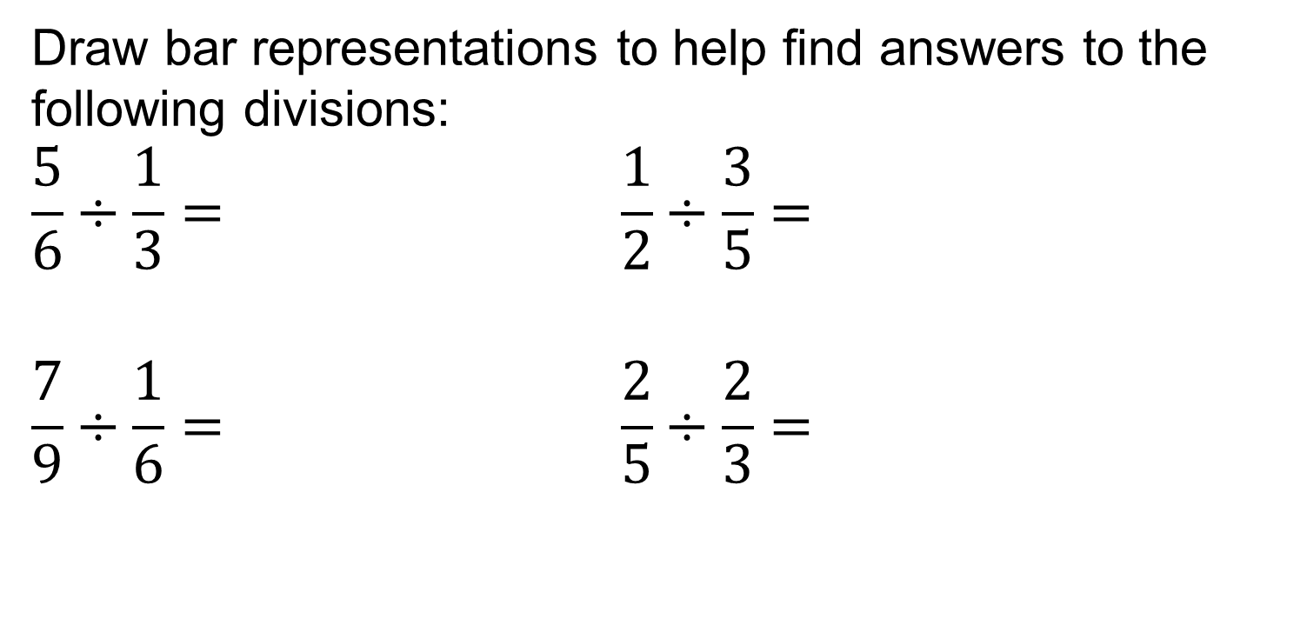
Dividing Fractions
Draw bar representations to help find answers to the following divisions:
$$\frac{5}{6}÷\frac{1}{3}= \frac{1}{2}÷\frac{3}{5}=$$
$$\frac{7}{9}÷\frac{1}{6}= \frac{2}{5}÷\frac{2}{3}=$$
Finished?
Reflect:
Look at these four questions and your solutions carefully, write down anything interesting you notice.
Which answers are less than 1? Why is this?
Convert any mixed number answers to improper fractions
What do you notice?

Slide 18
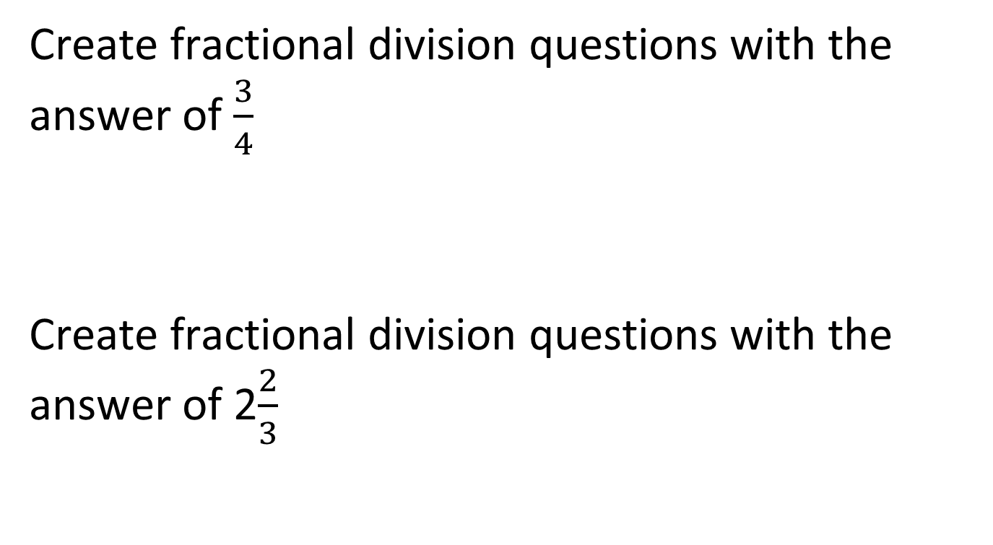
Challenges
Create fractional division questions with the answer of $\frac{3}{4}$
Create fractional division questions with the answer of 2$\frac{2}{3}$

Slide 19
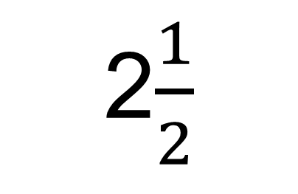

Solutions
$$\frac{5}{6}÷\frac{1}{3}=$$
2$\frac{1}{2}$
How many thirds fit in?
What fraction of the yellow is this?
2
?

Slide 20
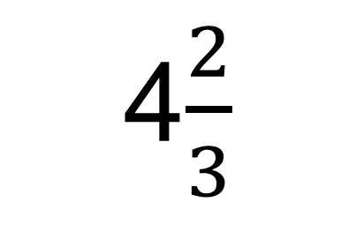

Solutions
$$\frac{7}{9}÷\frac{1}{6}=$$
4$\frac{2}{3}$
How many sixths fit in?
4
?
What fraction of the yellow is this?

Slide 21

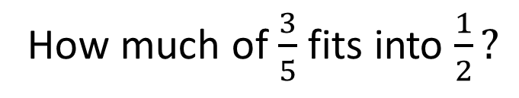
Solutions
It’s hard to compare.
Let’s split into tenths. Why tenths?
$$\frac{1}{2}÷\frac{3}{5}=$$
How much of $\frac{3}{5}$ fits into $\frac{1}{2}?$
?

Slide 22
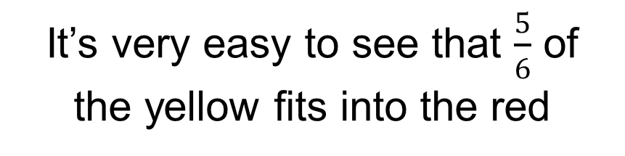
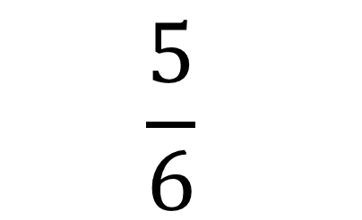
Solutions
$$\frac{1}{2}÷\frac{3}{5}=$$
$$\frac{5}{6}$$
It’s very easy to see that $\frac{5}{6}$ of the yellow fits into the red
?

Slide 23

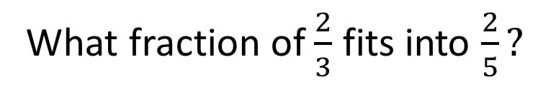
Solutions
Again, It’s hard to compare.
Let’s split into fifteenths.
$$\frac{2}{5}÷\frac{2}{3}=$$
What fraction of $\frac{2}{3}$ fits into $\frac{2}{5}?$
?

Slide 24
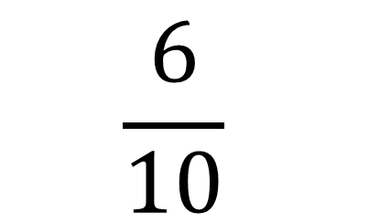
Solutions
$$\frac{2}{5}÷\frac{2}{3}=$$
$$\frac{6}{10}$$
What fraction of the yellow is this?
?

Slide 25
Reflection
Look at the four questions and your solutions carefully, write down anything interesting you notice.
Which answers are less than 1? Why is this?
Convert any mixed number answers to improper fractions
What do you notice?

