Slide 1
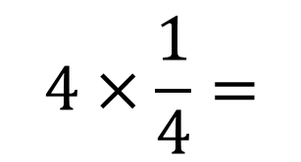
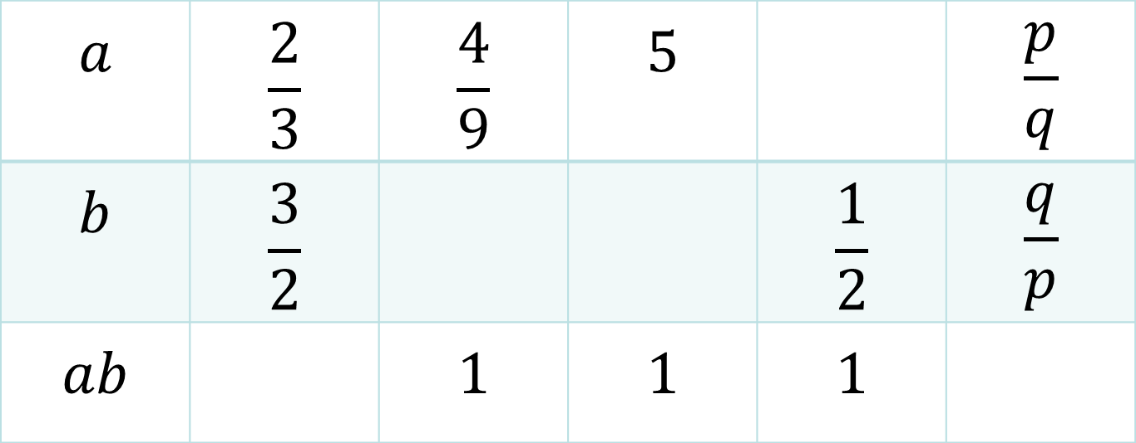
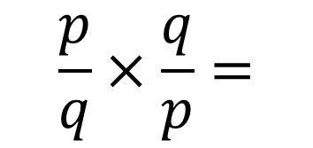
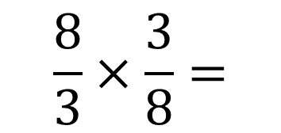
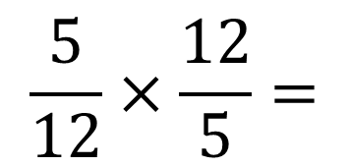
On your whiteboards:
$$4×\frac{1}{4}=$$
$$\frac{5}{12}×\frac{12}{5}=$$
$$\frac{8}{3}×\frac{3}{8}=$$
$$\frac{p}{q}×\frac{q}{p}=$$
Fill in the blanks
$$a$$ | $$\frac{2}{3}$$ | $$\frac{4}{9}$$ | $$5$$ |  | $$\frac{p}{q}$$
$$b$$ | $$\frac{3}{2}$$ |  |  | $$\frac{1}{2}$$ | $$\frac{q}{p}$$
$$ab$$ |  | $$1$$ | $$1$$ | $$1$$

Slide 2
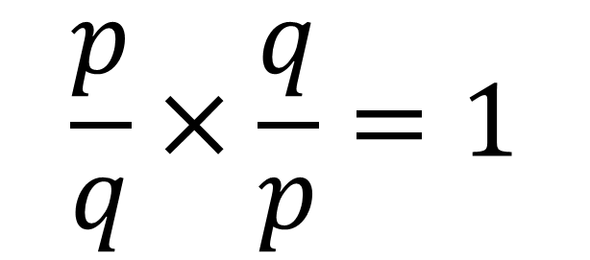
Observation and conclusion
If the numerator and denominator of two fractions are inverted, then their product is 1.
$$\frac{p}{q}×\frac{q}{p}=1$$
We say that one is the reciprocal of the other.

Slide 3



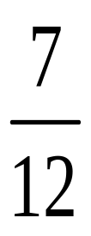

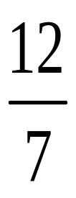




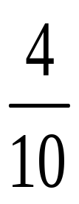
Match the pairs

Slide 4
In your pairs
Say a number and ask your partner to say the reciprocal of the number

Slide 5
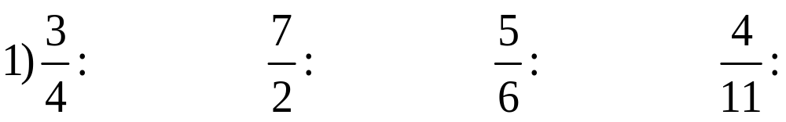
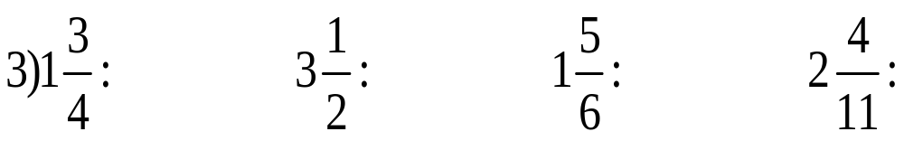
On your whiteboards
Find the reciprocal of the following fractions
Invert the numerator and denominator
Change integer a to a/1 first
Change a mixed fraction to improper fraction

Slide 6
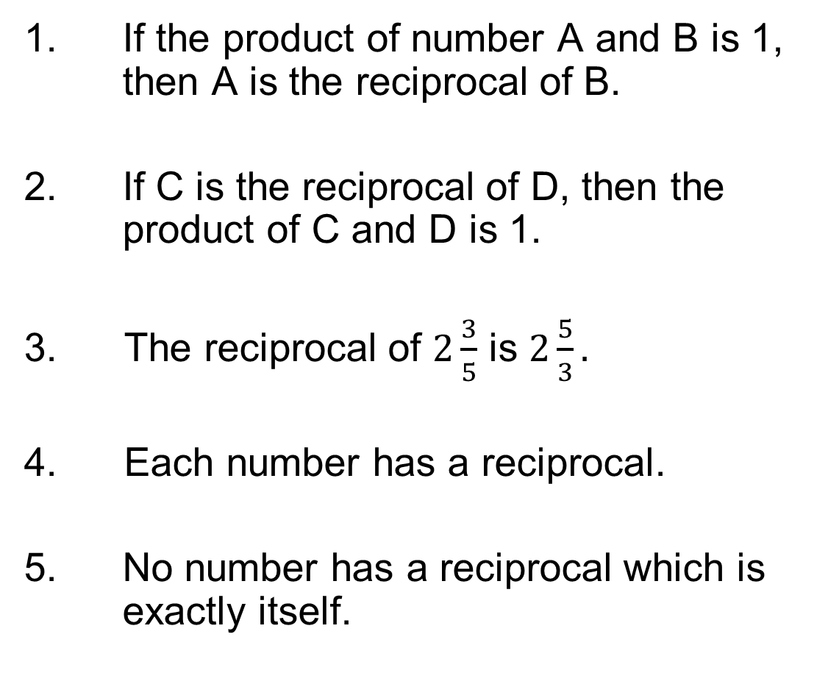
True or False
1. If the product of number A and B is 1, then A is the reciprocal of B.
2. If C is the reciprocal of D, then the product of C and D is 1.
3. The reciprocal of $2\frac{3}{5}$ is $2\frac{5}{3}.$
4. Each number has a reciprocal.
5. No number has a reciprocal which is exactly itself.
T
T
F
F
F

Slide 7
Reflection
In your books, write:
Reciprocal
    Definition
    Reciprocal of a fraction
    Reciprocal of an integer
    Reciprocal of a mixed fraction

Slide 8
Some other conclusions
Zero does not have a reciprocal because no real number multiplied by 0 produces 1 (the product of any number with zero is zero)
The only number that has a reciprocal that is itself is 1.

Slide 9
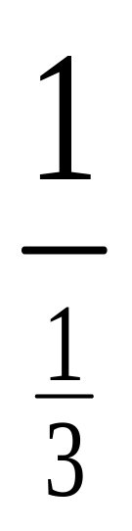
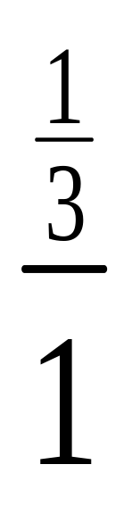
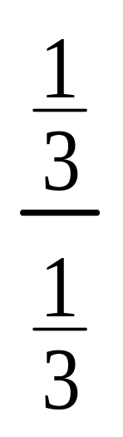
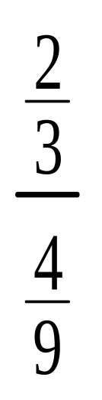
Challenge:
Find the reciprocal of the following fractions

