Slide 1


Let’s think about how to find the volume of a shape like
Can you remember how you found the area of shapes like ?

Slide 2
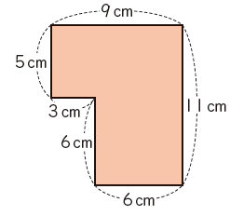
Can you find three different ways of finding the area of this shape?

Slide 3
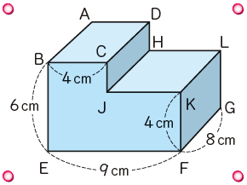
Find the volume of the solid figure
Express your ideas using diagrams, maths sentences and words.

Slide 4
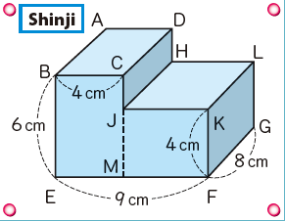
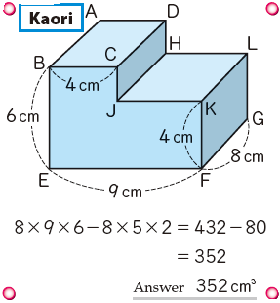
Seth
Jack
Look at the picture Seth drew and write the maths sentences to describe the working out.

Slide 5
Seth
Jack
Look at the Jack’s working out and use words and diagrams to describe what he has done.

Slide 6
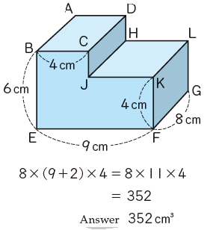
Challenge: Can you figure out what this student did?
Use diagrams and words to explain.

Slide 7
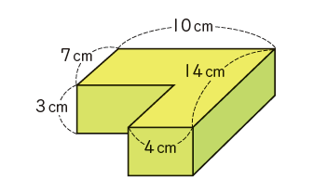
Find the volume of this shape.
You must use diagrams, maths sentences and words for your description.
Now find the volume in a different way.

Slide 8
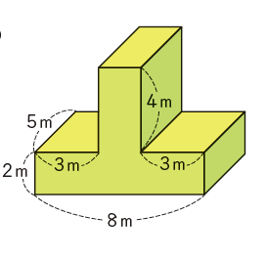
Find the volume of this shape.
You must use diagrams, maths sentences and words for your description.
Now find the volume in a different way.

Slide 9
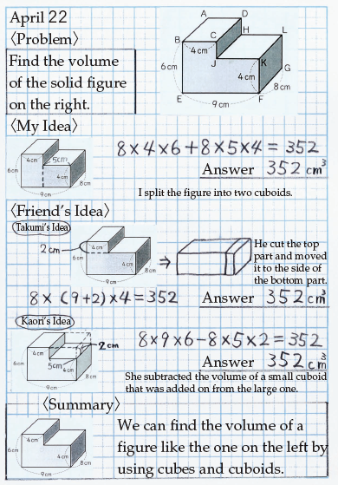
Write down the problem and how you solved it
Write down friends’ ideas that were different to yours
Summarise your learning with a sentence.

