Slide 1
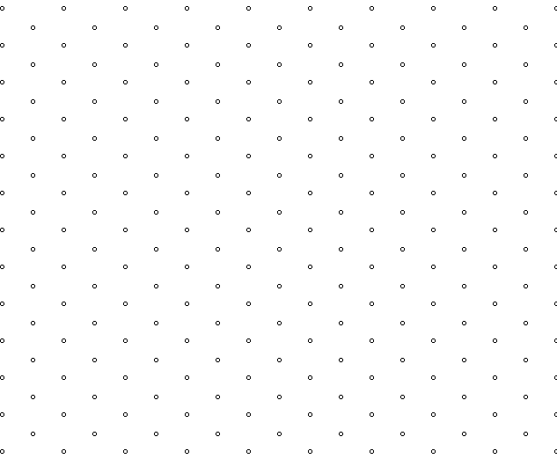
Before you begin…
Make sure the isometric paper is the right way round (landscape).
Check you have a ruler.
Sharpen your pencil.
Choose three coloured pencils.

Slide 2
Draw this cube on your plastic wallet
The word isometric is derived from a Greek word meaning ‘same measure’.
All dots are exactly 1cm apart in all directions.
Notice there are no horizontal lines -
only vertical and diagonal.

Slide 3
Now draw it on the isometric paper
Colour this face in your third colour.
This is called the plan view
Colour this face a different colour. This is the side elevation
Colour this face one colour.
This is the front elevation

Slide 4
Practice drawing these shapes on your isometric grids on your plastic wallets.
Now draw them accurately on your paper.

Slide 5
Practice drawing these shapes on your isometric grids on your plastic wallets.
Colour the faces using the same three colours as your cube. Make sure the same elevations are coloured in the same colour.

Slide 6
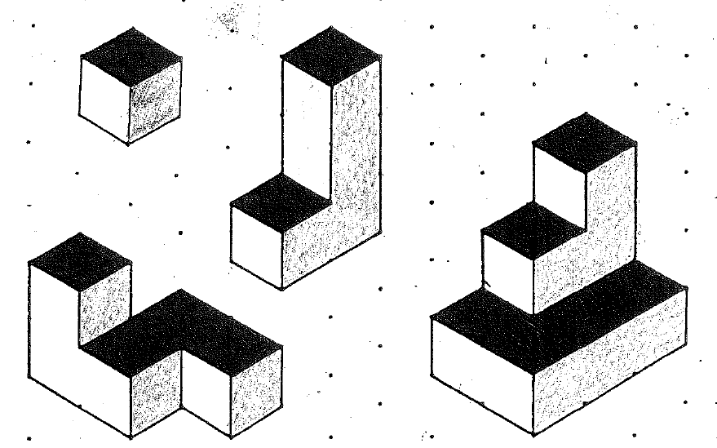
Draw these shapes on your isometric grids
Colour the faces using the same three colours again. Make sure the same elevations are coloured in the same colour.

Slide 7
For all of the isometric drawings, you should use three colours to colour the three different elevations.
The sheet shows different shapes made from four cubes.
Each shape has been drawn twice, but in a different direction.
Draw each shape next to its partner. Use multilink cubes if you are struggling to visualise the different shapes
Challenge:
Work through the rest of the booklet. The problems get increasingly more difficult.

