Slide 1

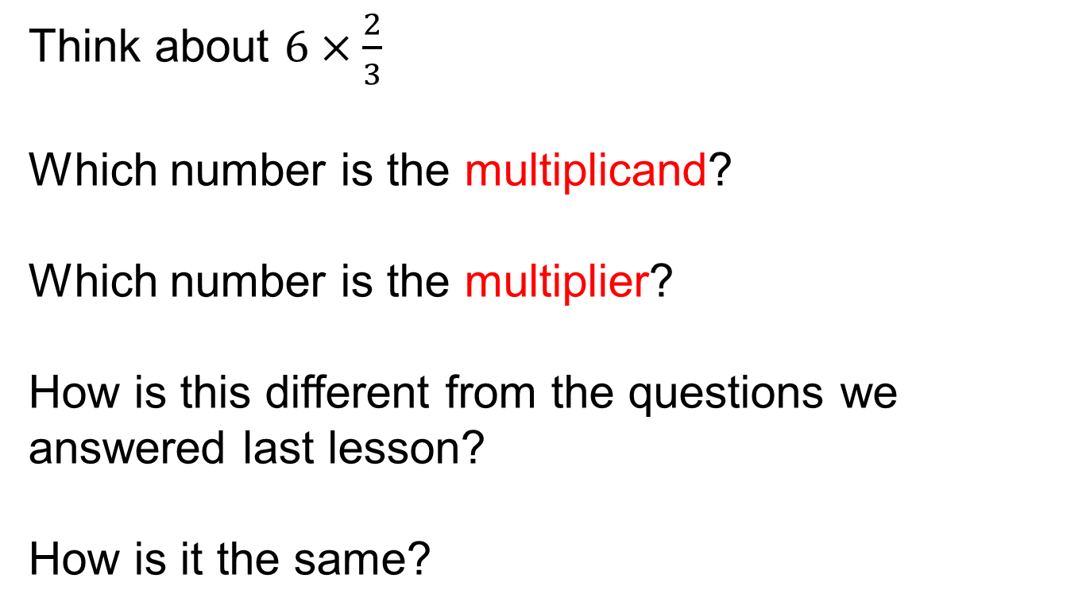
Multiplying with Fractions
Integer $×$ Fraction
Think about $6×\frac{2}{3}$
Which number is the multiplicand?
Which number is the multiplier?
How is this different from the questions we answered last lesson?
How is it the same?

Slide 2
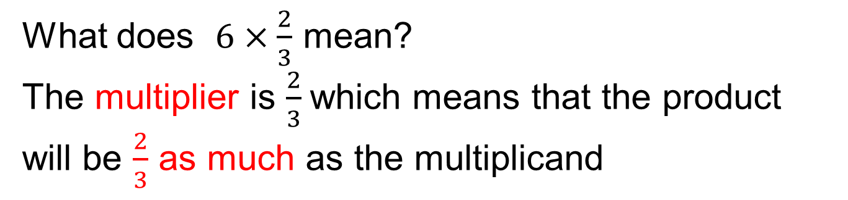
Multiplying with Fractions
Integer $×$ Fraction
What does $6×\frac{2}{3}$ mean?
The multiplier is $\frac{2}{3}$which means that the product will be $\frac{2}{3}$ as much as the multiplicand
6
The size of each part is $6÷3=2$
So two parts is $4$

Slide 3
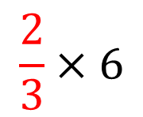
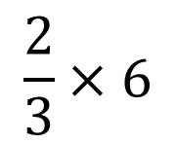
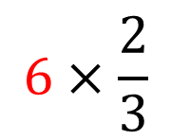
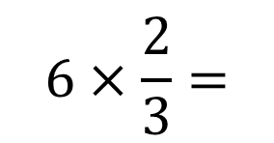


$$6×\frac{2}{3}$$
$$\frac{2}{3}×6$$
Make six $\frac{2}{3}$times as big
Make $\frac{2}{3}$6 times as big
6
1
2
2
6
1
2
3
4
5
6
1
2
3
4
5
6
$$6×\frac{2}{3}=$$
$$\frac{2}{3}×6$$
Answer is the same, but the situation is different.

Slide 4
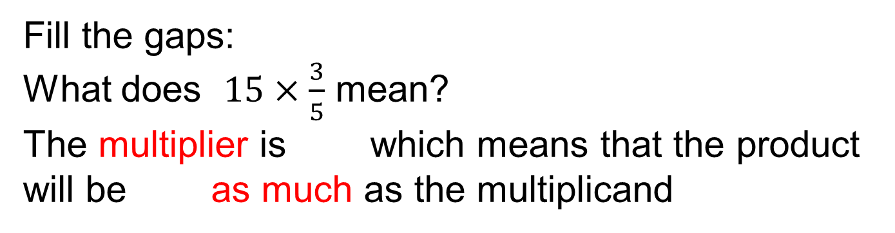
Multiplying with Fractions
Integer $×$ Fraction
Fill the gaps:
What does $15×\frac{3}{5}$ mean?
The multiplier is which means that the product will be as much as the multiplicand
The size of each part is $÷ =$
So parts is

Slide 5
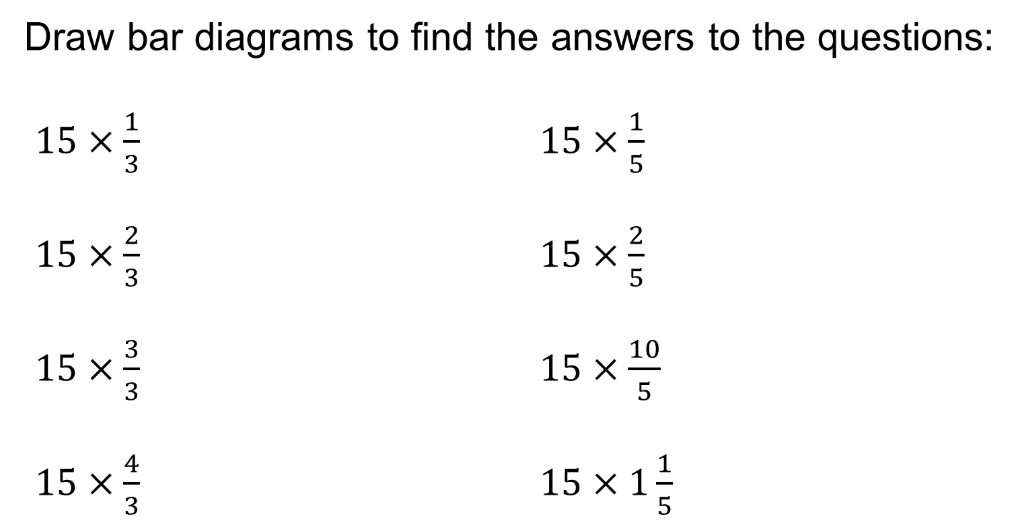
Multiplying with Fractions
Integer $×$ Fraction
Draw bar diagrams to find the answers to the questions:
$15×\frac{1}{3}$ $15×\frac{1}{5}$
$15×\frac{2}{3}$ $15×\frac{2}{5}$
$15×\frac{3}{3}$ $15×\frac{10}{5}$
$15×\frac{4}{3}$ $15×1\frac{1}{5}$

Slide 6
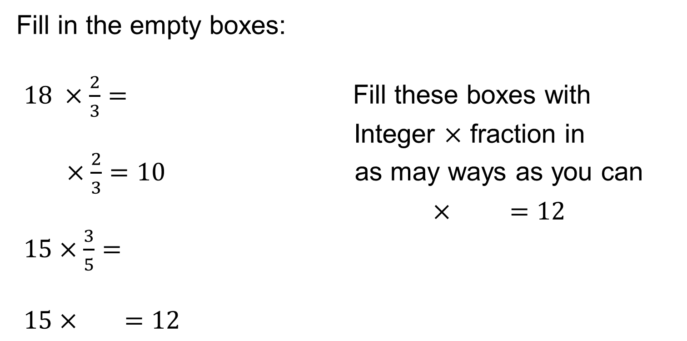
Challenge:
Fill in the empty boxes:
$18 ×\frac{2}{3}=$ Fill these boxes with
Integer $×$ fraction in
$×\frac{2}{3}=10$ as may ways as you can
$× =12$
$15×\frac{3}{5}=$
$15× =12$

Slide 7
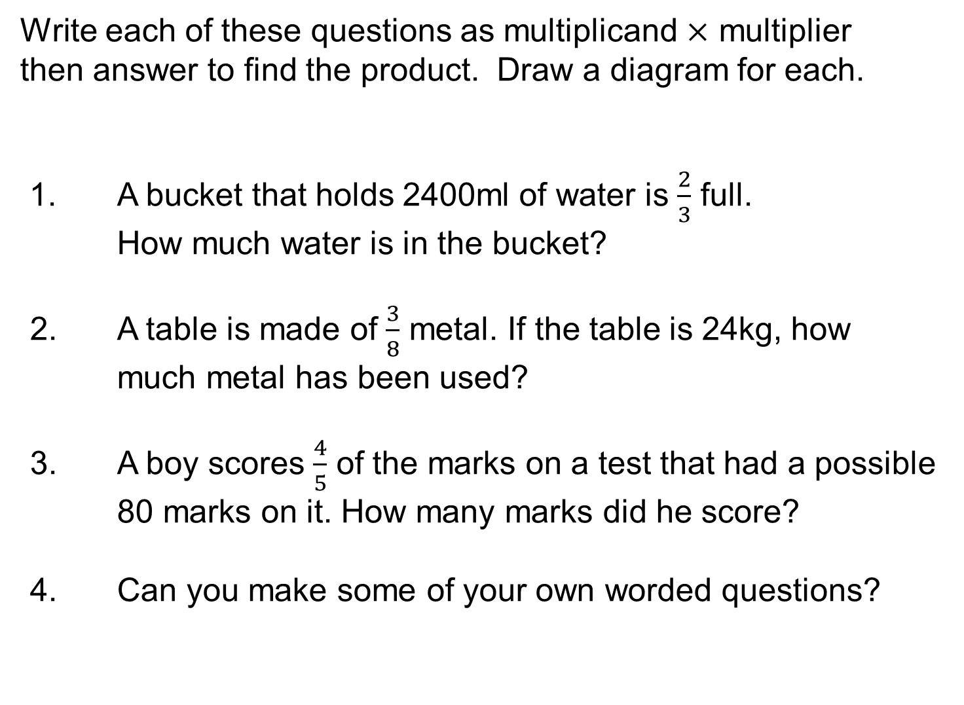
Write each of these questions as multiplicand $×$ multiplier
then answer to find the product. Draw a diagram for each.
1. A bucket that holds 2400ml of water is $\frac{2}{3}$ full.
How much water is in the bucket?
A table is made of $\frac{3}{8}$ metal. If the table is 24kg, how much metal has been used?
A boy scores $\frac{4}{5}$ of the marks on a test that had a possible 80 marks on it. How many marks did he score?
Can you make some of your own worded questions?

Slide 8

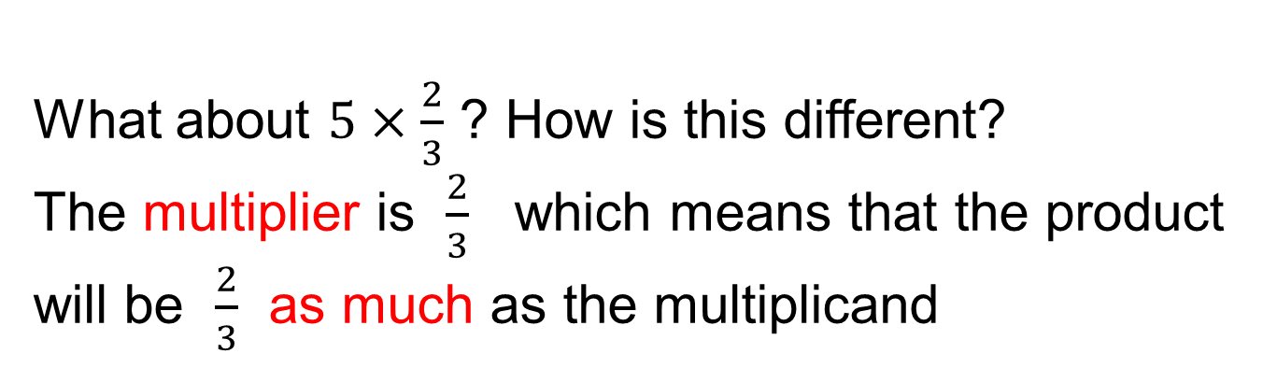

Multiplying with Fractions
Integer $×$ Fraction
What about $5×\frac{2}{3}$ ? How is this different?
The multiplier is $\frac{2}{3}$ which means that the product will be $\frac{2}{3}$ as much as the multiplicand
Remember from previous lesson
$$\frac{5}{3}$$
$$\frac{5}{3}$$
5
The size of each part is $5÷3=\frac{5}{3}$
So two parts is $\frac{5}{3}×2=\frac{10}{3}=3\frac{1}{3}$

Slide 9
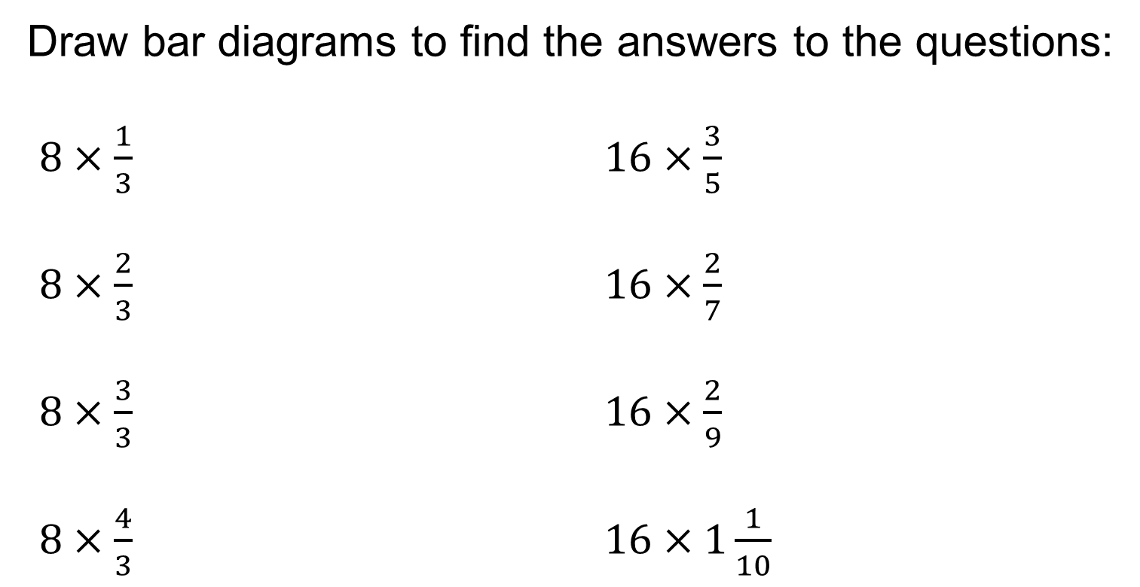
Multiplying with Fractions
Integer $×$ Fraction
Draw bar diagrams to find the answers to the questions:
$8×\frac{1}{3}$ $16×\frac{3}{5}$
$8×\frac{2}{3}$ $16×\frac{2}{7}$
$8×\frac{3}{3}$ $16×\frac{2}{9}$
$8×\frac{4}{3}$ $16×1\frac{1}{10}$

