Slide 1
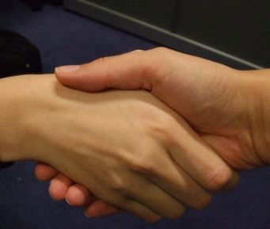
Handshakes

Slide 2
Seven mathematicians met up one week.
The first mathematician shook hands with all the others.
The second one shook hands with all the others apart from the first one (since they had already shaken hands).
The third one shook hands with all the others apart from the first and the second mathematicians, and so on, until everyone had shaken hands with everyone else.
How many handshakes were there altogether?

Slide 3
The next week, eight mathematicians met.
How many handshakes took place this time?
The following week, there were nine mathematicians...

Slide 4
Sam is trying to work out how many handshakes there would be if 20 mathematicians met.
He says that since each mathematician shakes hands 19 times, there must be 20×19 handshakes altogether.
Helen disagrees; she worked out 19+18+17+...+2+1 and got a different answer.
What is wrong with Sam's reasoning? How should he modify his method?

Slide 5
One day, 161 mathematicians met.
How many handshakes took place this time?
Can you describe a quick way of working out the number of handshakes for any size of mathematical gathering?

Slide 6
Could there be exactly 4851 handshakes at a gathering where everyone shakes hands?
How many mathematicians would there be?
What about the following numbers of handshakes?
6214
3655
7626
8656

