Slide 1


From last lesson we saw that:
$$\frac{2}{5}÷\frac{2}{3}=\frac{6}{10}$$
One student noticed that
$$\frac{2}{5}×\frac{3}{2}=\frac{6}{10}$$

Slide 2
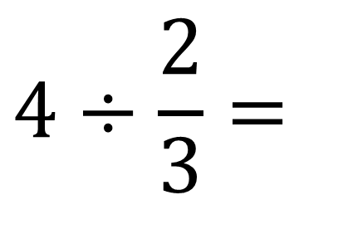
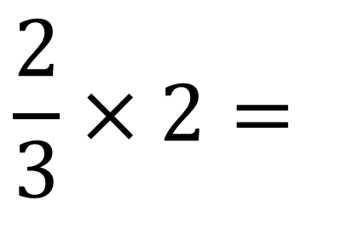
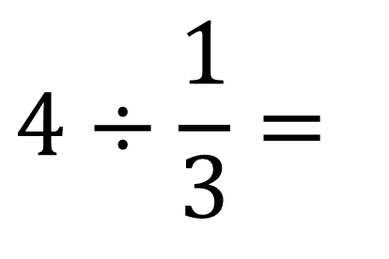
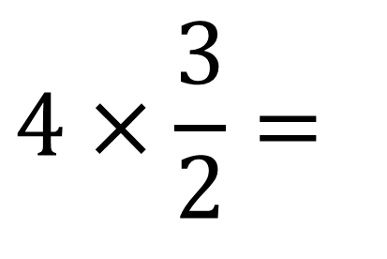
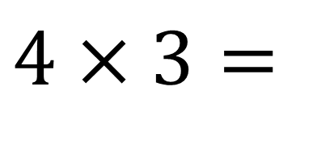
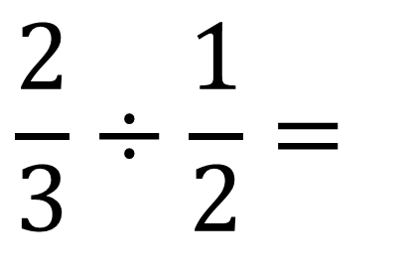
$$4÷\frac{1}{3}=$$
$$4×3=$$
$$4×\frac{3}{2}=$$
$$4÷\frac{2}{3}=$$
$$\frac{2}{3}÷\frac{1}{2}=$$
$$\frac{2}{3}×2=$$

Slide 3
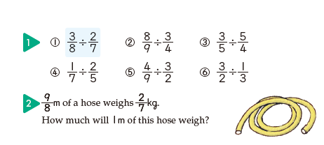
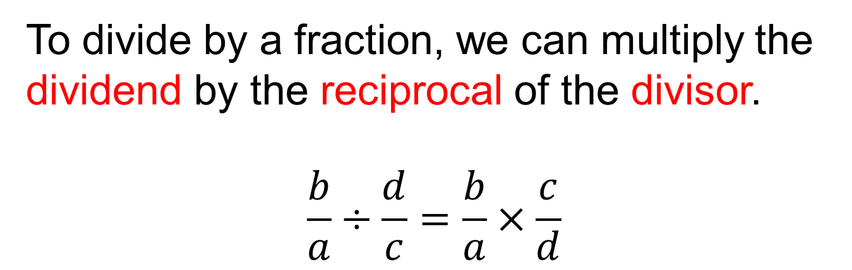
To divide by a fraction, we can multiply the dividend by the reciprocal of the divisor.
$$\frac{b}{a}÷\frac{d}{c}=\frac{b}{a}×\frac{c}{d}$$

Slide 4






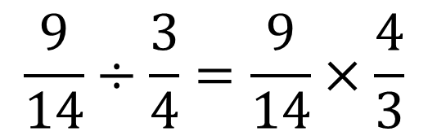
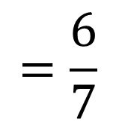
Think about how to answer $\frac{9}{14}÷\frac{3}{4}$
$$3$$
$$2$$
$$\frac{9}{14}÷\frac{3}{4}=\frac{9}{14}×\frac{4}{3}$$
$$=\frac{6}{7}$$
$$7$$
$$1$$

Slide 5

