Slide 1
Rectangle ABCD is in the 1st quadrant.
Vertex A (bottom left) is at (4, 5)
The perimeter of the rectangle is 10 units.
Draw one possible rectangle ABCD.
What are its coordinates?
How many different possibilities can you find?
Write down the coordinates of each rectangle.

Slide 2
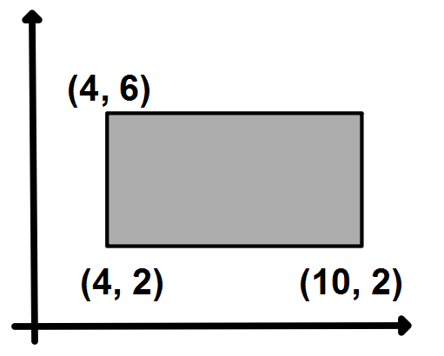
This shape is a rectangle.
What is the missing coordinate?
How do you know?
What is the perimeter of the rectangle?

Slide 3
Draw another rectangle with the same dimensions somewhere else on your grid.
What are its coordinates?
Draw one in each quadrant and write down the coordinates of the vertices.
Compare yours with your neighbour’s.

Slide 4
Challenge:
Can you write down the coordinates of a another rectangle with the same dimensions that isn’t on your grid?
How do you know it’s correct?

Slide 5
Challenge 2:
If another rectangle with the same dimensions has coordinate A (a , b) what are the other coordinates?
What if the rectangle had coordinate D (c, d)?

Slide 6
If I translate this rectangle two squares down, what will the coordinates of the vertices be now?
How have they changed?

Slide 7
If I translate the rectangle one square to the right, what will the coordinates of the vertices be now?
How have they changed?

Slide 8
If I translate the rectangle five squares to the left, what will the coordinates of the vertices be now?
How have they changed?

Slide 9
If I translate the rectangle 4 squares to the left, and 3 square up what will the coordinates of the vertices be now?

Slide 10
If I translate the rectangle a squares to the left, and b square up what will the coordinates of the vertices be now?

