Slide 1
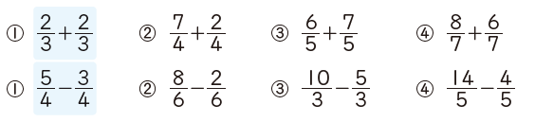

On your whiteboards:
Section 1: Write your answers as mixed numbers
Describe the error in the calculation below, then find the correct answer.

Slide 2

On your whiteboards:
Section 2: Write your answers as mixed numbers
Describe the error in the calculation below, then find the correct answer.

Slide 3
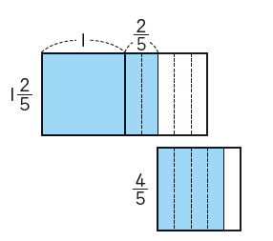

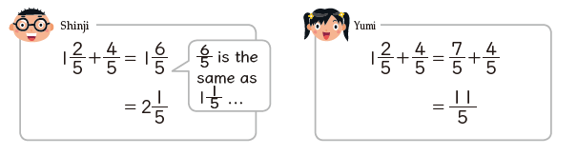
Student 1
Student 2

Slide 4
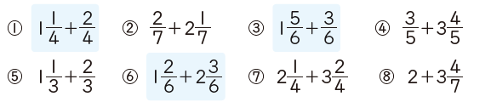

In your books
Title: Adding Mixed numbers and proper fractions.
Section 3:
Write your answers as a mixed number.
Challenge:
Write as many questions as you can that have the answer

Slide 5

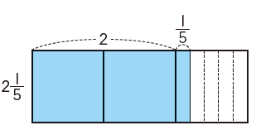
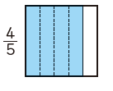
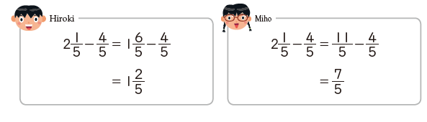
Student 1
Student 2

Slide 6
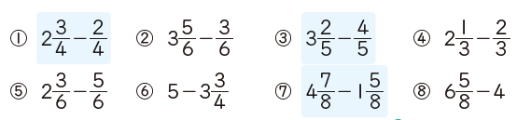
In your books:
Title: Adding Mixed numbers and proper fractions.
Section 4:
Write your answers as a mixed number.

Slide 7
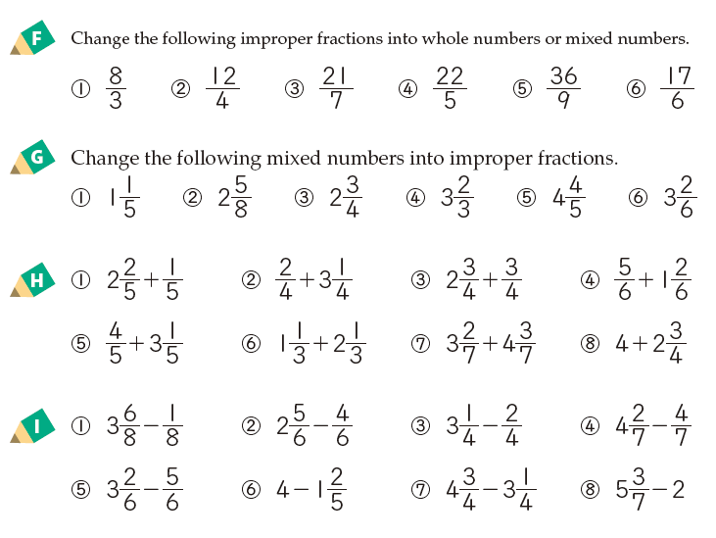
A
B
C
D

