Slide 1
World Book Day

Slide 2
Introduction
The object of this investigation is to analyse one or more elements of books.
You will be expected to analyse and compare two of three books provided.
Most of you will be expected to analyse both of the following:
Number of letters per word
Number of words per sentence

Slide 3
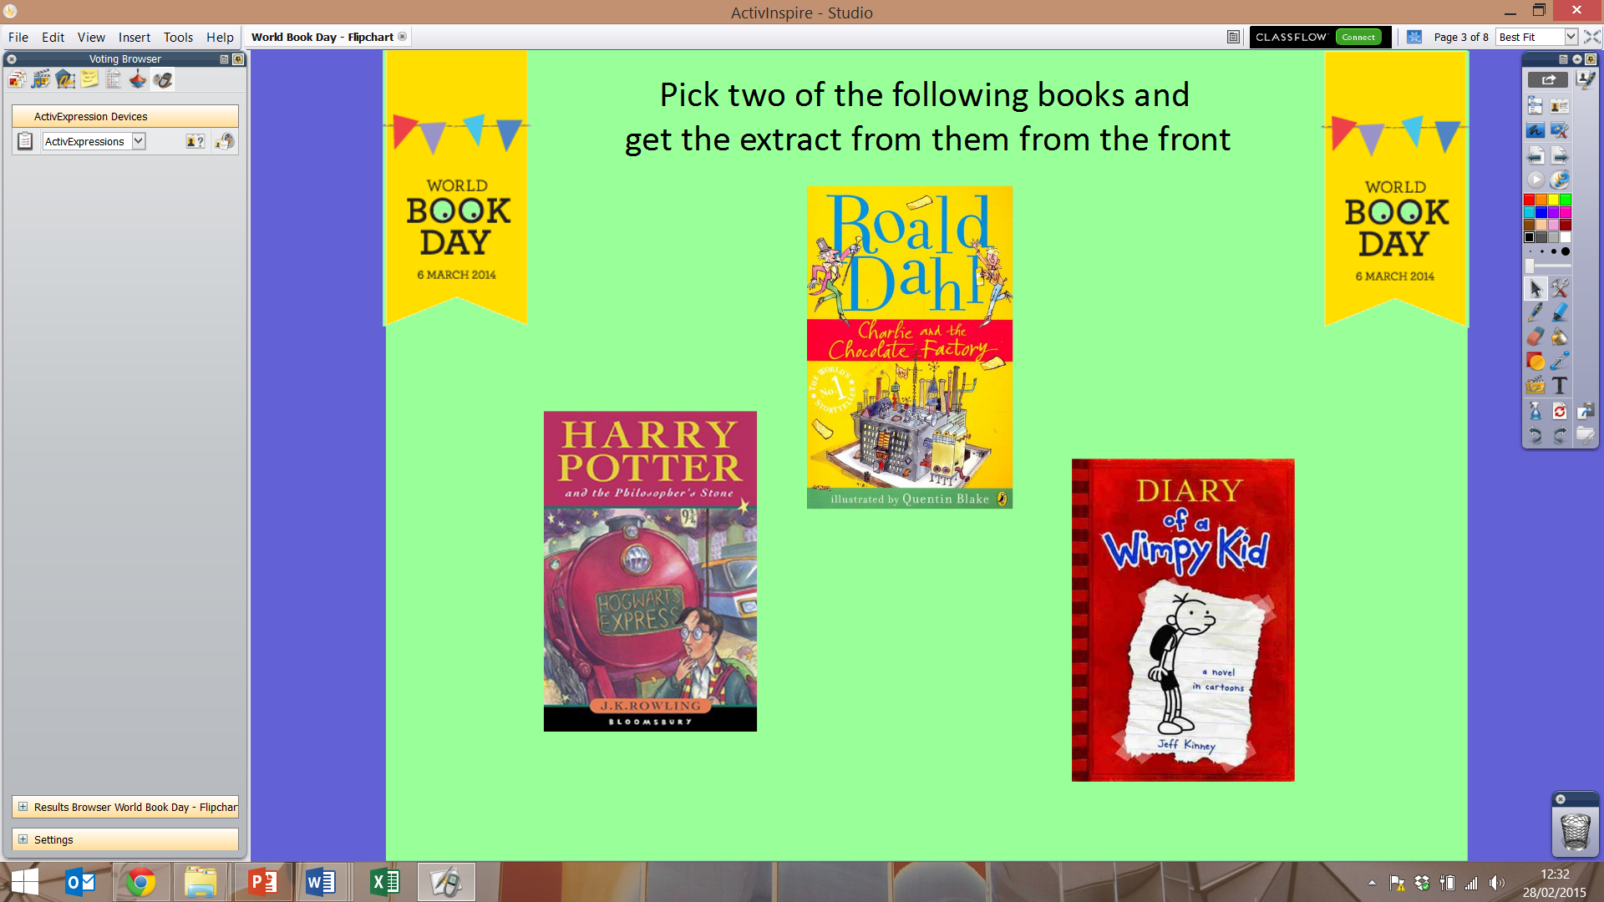
Books
Pick two of the following books and get the extracts from the front.

Slide 4
Method
You will first need to state a hypothesis about what you think you will find out about the data while analysing it, e.g. I think I will find that on average, the Harry Potter book will have longer sentence lengths than Diary of a Wimpy Kid.
You will then need to fill in the tally chart for the number of words per sentence or number of letters per word.
You will need to take a sample, let’s say 20 words or sentences. You can choose how you do this sample, e.g. every 10th word.

Slide 5
Analyse the data
Number of letters per word
Calculate the mean or mode number of letters per word to compare your extracts.
or/and
Draw a bar chart of your results
Number of words per sentence
Calculate the mean or mode number of words per sentence to compare your extracts.
or/and
Draw a frequency diagram for your results

Slide 6
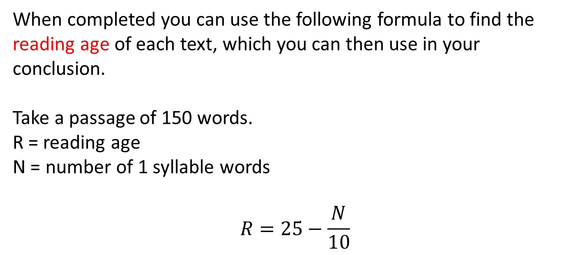
Challenge
When completed you can use the following formula to find the reading age of each text, which you can then use in your conclusion.
Take a passage of 150 words.
R = reading age
N = number of 1 syllable words
$$R=25−\frac{N}{10}$$

Slide 7
Conclusion
Draw conclusions and link them back to your original prediction.
As a group we need to discuss what we found and if we found different things, what could be the reasons for that.

