Slide 1
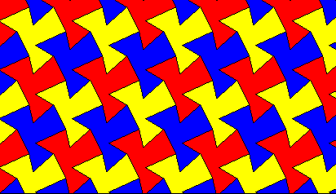
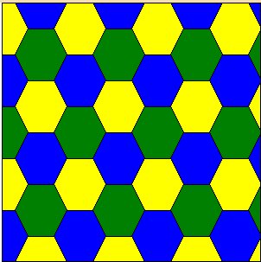

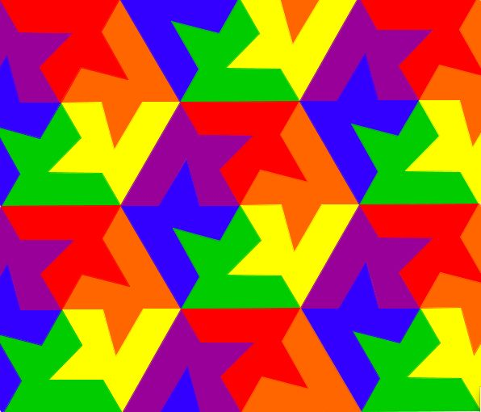

Slide 2
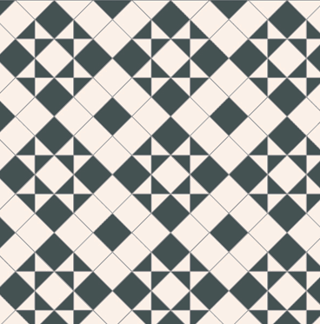
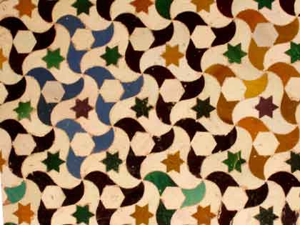
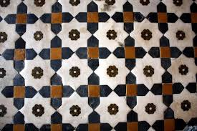
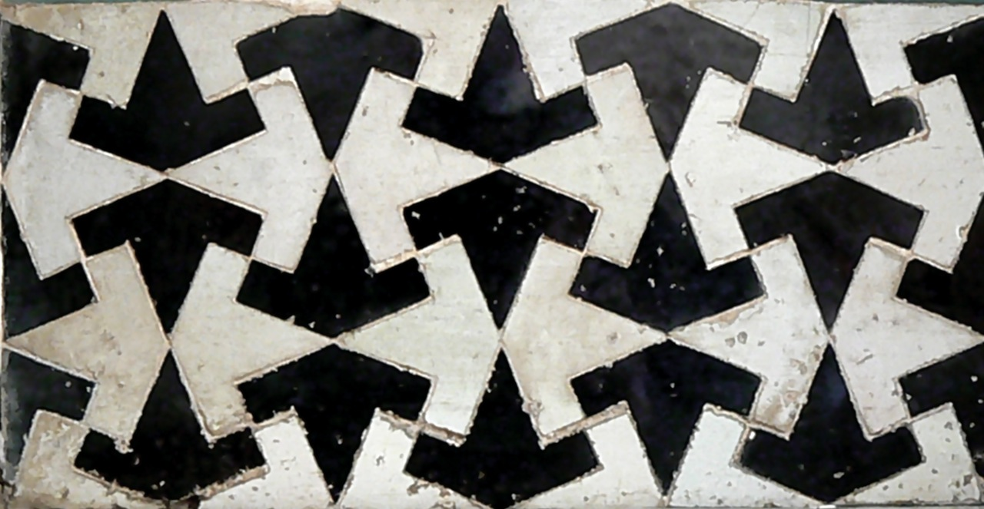

Slide 3
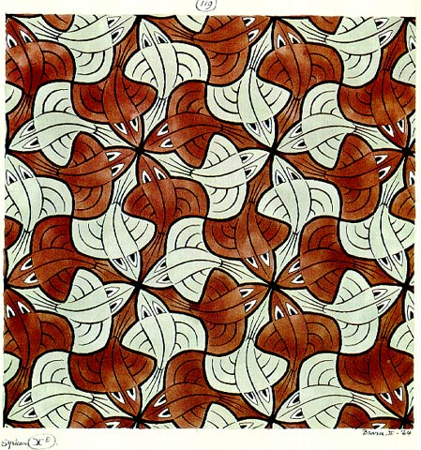
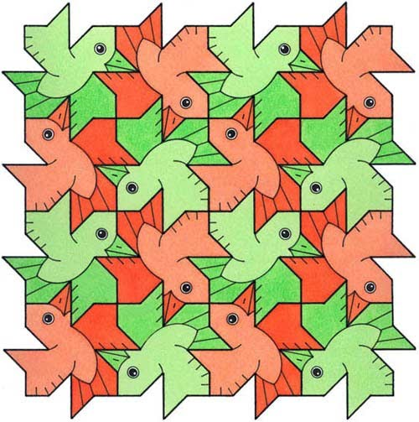
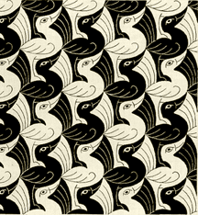
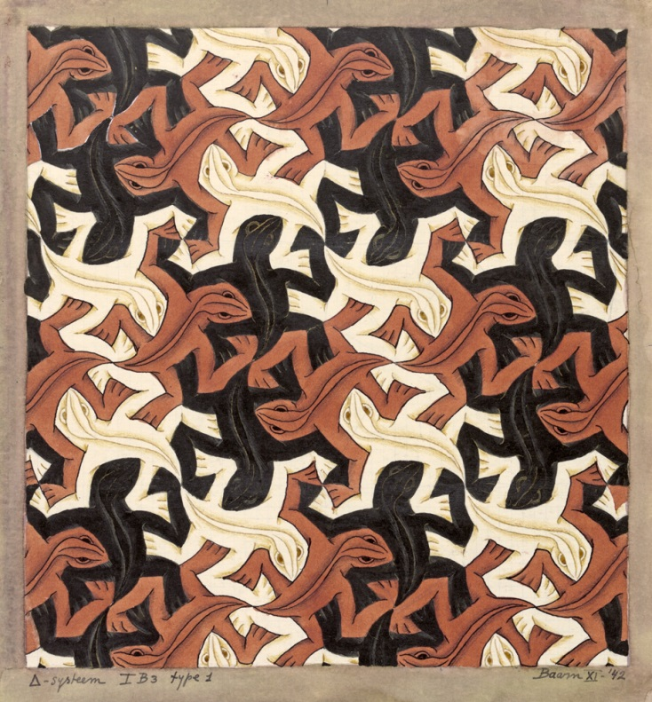
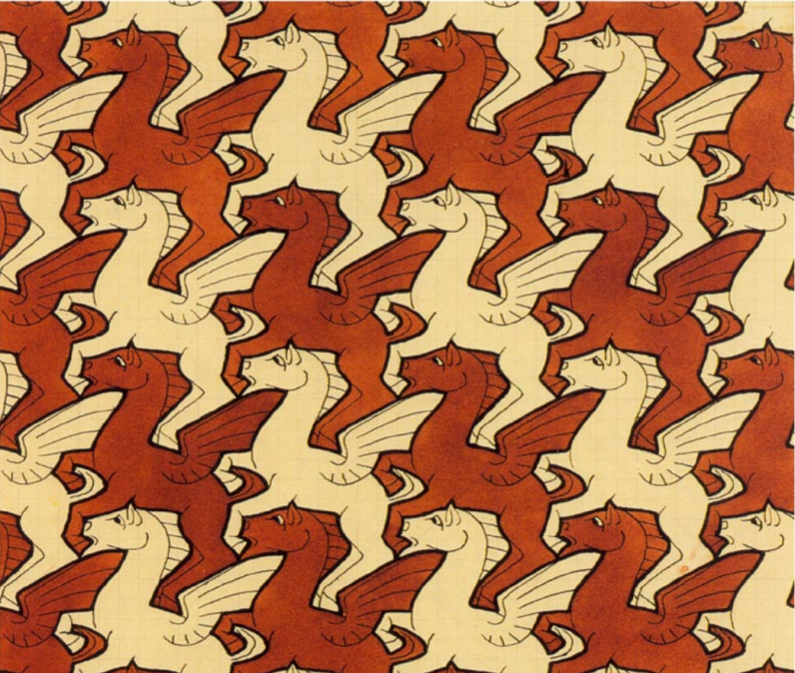
The artist M C Escher created these tessellations

Slide 4
All quadrilaterals tessellate
Is this sometimes, always or never true?

Slide 5
How can you check?
You have:
Square dotty paper
Scissors
Glue

Slide 6
Which quadrilaterals tessellate?
Choose a quadrilateral to try. Draw 4 congruent shapes and see if they tessellate.
Square
Rectangle
Parallelogram
Rhombus
Trapezium
Kite
‘Irregular’ quadrilateral

Slide 7
https://www.geogebra.org/m/BpZa7hy8

Slide 8
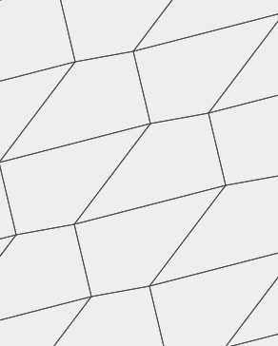
To show that quadrilaterals always tessellate, we can use letters to represent the angles.
Write a maths sentence using the letters in the diagram.
a
b
c
d

Slide 9
Imagine tracing the quadrilateral and rotating it to make the other tiles.
What would the missing letters be?
?
?
a
b
?
c
d

Slide 10
What do angles around a point add up to?
b
c
a
b
d
c
d

Slide 11
We know that
a + b + c + d = 360°
Which means that quadrilaterals will always tessellate.
b
c
a
b
d
c
d

Slide 12
Write an explanation of why quadrilaterals tessellate in your books.
Use the tessellations of your tiles.
b
c
a
b
d
c
d

