Slide 1
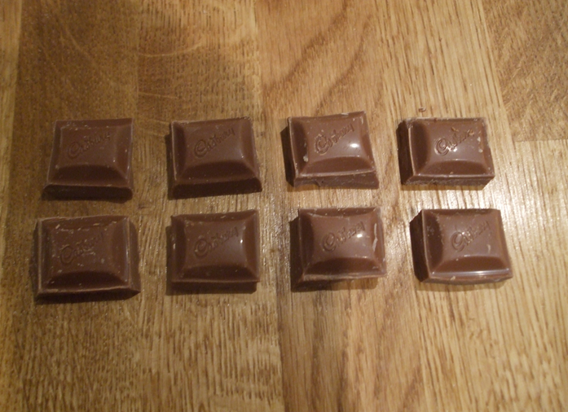
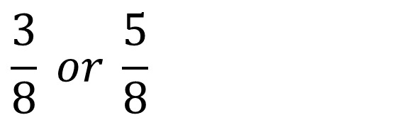
$$\frac{3}{8} or \frac{5}{8}$$
Would you rather have of a chocolate bar?
The denominators are the same so we can easily compare the numerators.

Slide 2
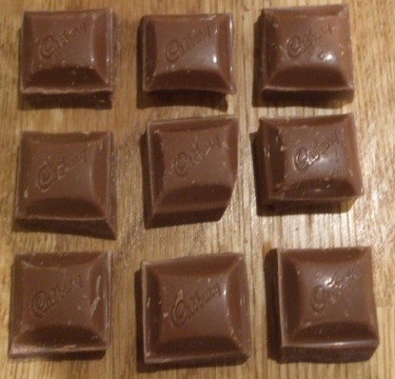
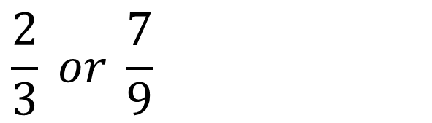
$$\frac{2}{3} or \frac{7}{9}$$
Would you rather have of a chocolate bar?
How many pieces of chocolate are you imagining?
Why?

Slide 3



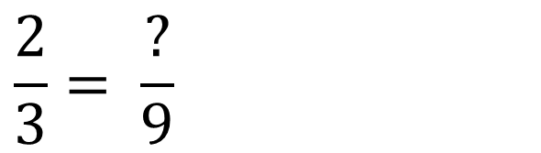
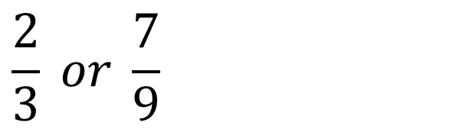
$$\frac{2}{3} or \frac{7}{9}$$
Which is bigger, ?
$$\frac{2}{3}= \frac{?}{9}$$

Slide 4


$$\frac{2}{3} or \frac{7}{9}$$
Which is bigger, ?
$$\frac{2}{3}= \frac{6}{9}$$
$$\frac{7}{9}$$

Slide 5
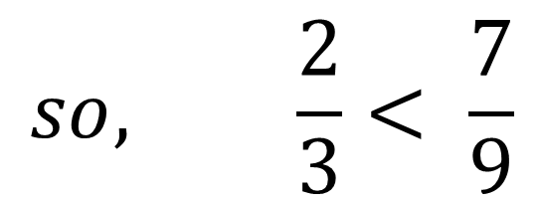
$$\frac{2}{3} or \frac{7}{9}$$
Which is bigger, ?

Slide 6
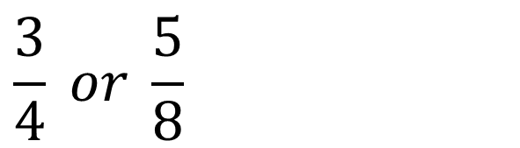
$$\frac{3}{4} or \frac{5}{8}$$
Which is bigger, of a chocolate bar?
How many pieces of chocolate are you imagining?
Why?

Slide 7


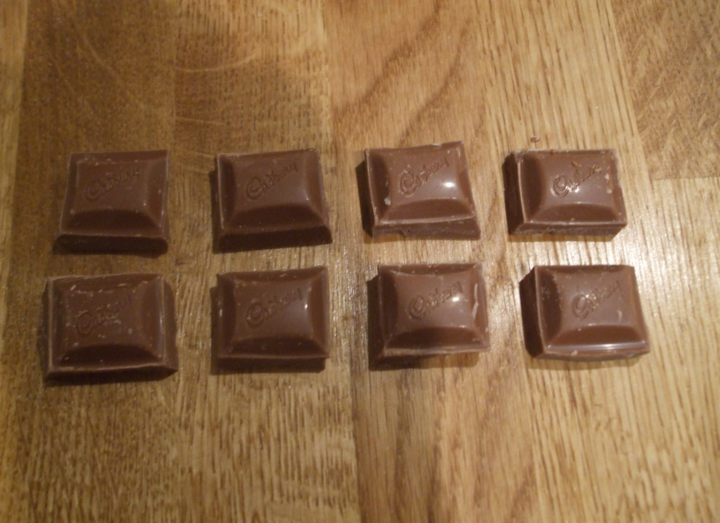
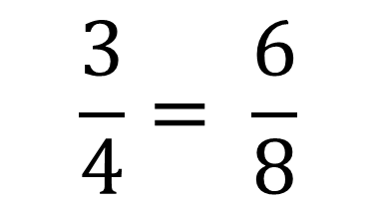
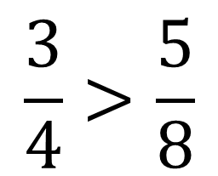
$$\frac{3}{4} or \frac{5}{8}$$
Which is bigger, of a chocolate bar?

Slide 8
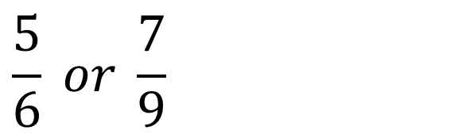
$$\frac{5}{6} or \frac{7}{9}$$
Which is bigger, of a chocolate bar?
How many pieces of chocolate are you imagining?
Why?
The number should be divisible by 6 and 9?
18, 36, 54… are all common multiples of 6 and 9

Slide 9
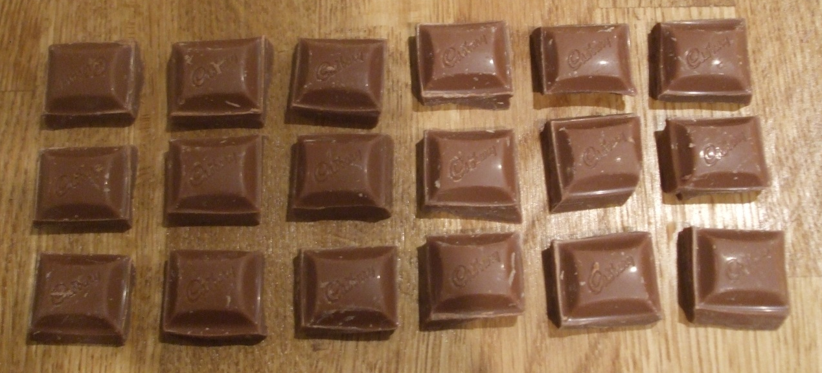
$$\frac{5}{6} or \frac{7}{9}$$
Which is bigger, of a chocolate bar?
18 is the lowest common multiple.

Slide 10

$$\frac{5}{6} or \frac{7}{9}$$
Which is bigger, of a chocolate bar?
How many pieces is $\frac{5}{6}$ of the bar?

Slide 11
$$\frac{5}{6} or \frac{7}{9}$$
Which is bigger, of a chocolate bar?
How many pieces is $\frac{7}{9}$ of the bar?

Slide 12
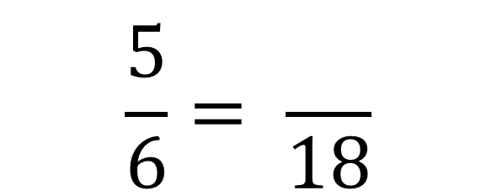
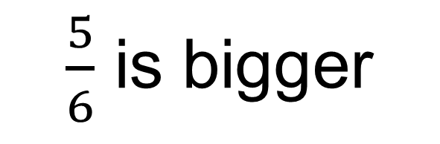
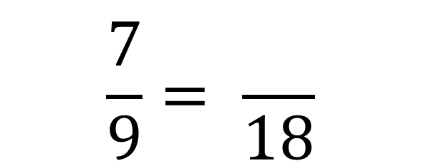
$$\frac{5}{6} or \frac{7}{9}$$
Which is bigger, of a chocolate bar?
×3
×2
$$\frac{5}{6}= \frac{}{18}$$
$$\frac{7}{9}= \frac{}{18}$$
15
14
×3
×2
$\frac{5}{6}$ is bigger

Slide 13
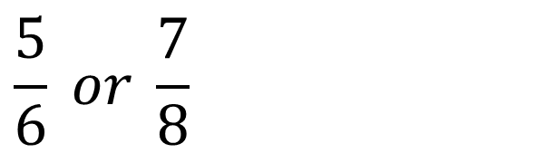
$$\frac{5}{6} or \frac{7}{8}$$
Which is bigger, of a chocolate bar?
How many pieces of chocolate are you imagining?
Why?
The number should be divisible by 6 and 8?
24, 48, 72… are all common multiples of 6 and 8

Slide 14
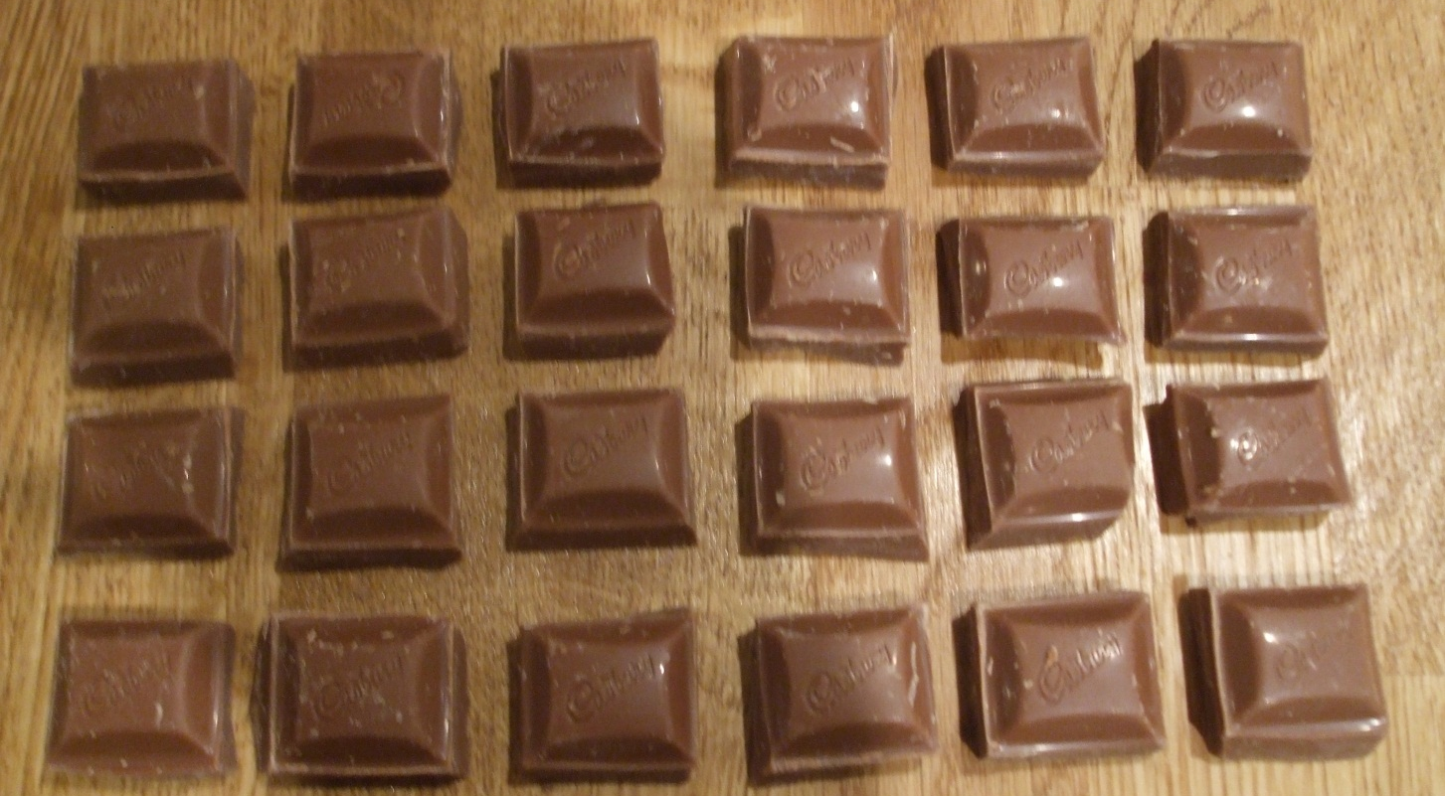
$$\frac{5}{6} or \frac{7}{8}$$
Which is bigger, of a chocolate bar?

Slide 15
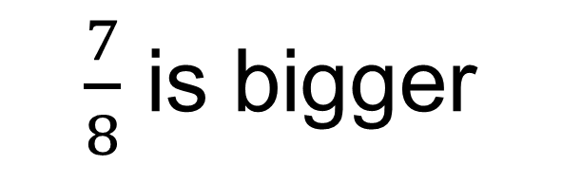
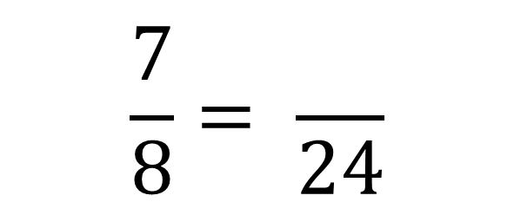
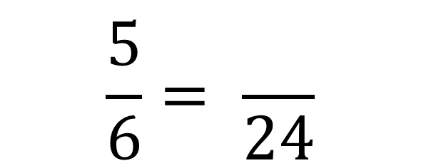
$$\frac{5}{6} or \frac{7}{8}$$
Which is bigger, of a chocolate bar?
×4
×3
$$\frac{5}{6}= \frac{}{24}$$
$$\frac{7}{8}= \frac{}{24}$$
20
21
×4
×3
$\frac{7}{8}$ is bigger

Slide 16
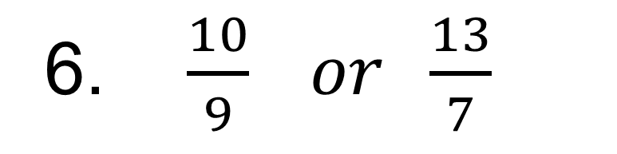

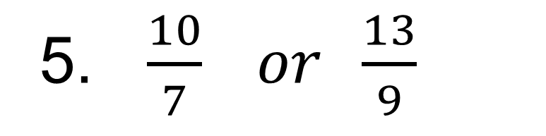



Use equivalent fractions to show which fraction is bigger
1. $\frac{7}{12} or \frac{3}{4}$
4. $\frac{4}{7} or \frac{5}{9}$
2. $\frac{7}{10} or \frac{3}{4}$
5. $\frac{10}{7} or \frac{13}{9}$
3. $\frac{5}{7} or \frac{4}{9}$
6. $\frac{10}{9} or \frac{13}{7}$

Slide 17

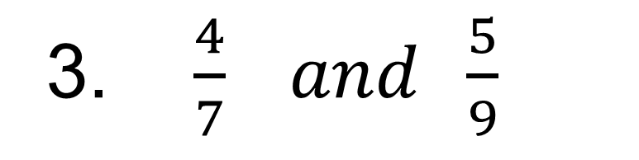
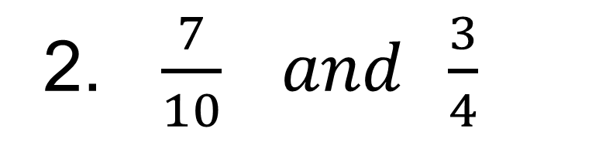
Challenge
Write down a fraction that is exactly halfway between the two fractions
1. $\frac{7}{12} and \frac{3}{4}$
2. $\frac{7}{10} and \frac{3}{4}$
3. $\frac{4}{7} and \frac{5}{9}$

Slide 18
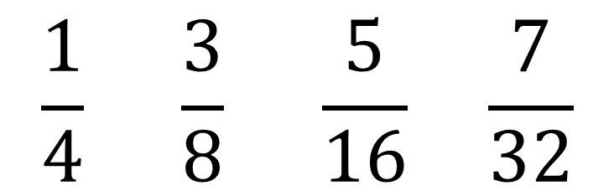
Put the fractions into ascending order.
$$\frac{1}{4} \frac{3}{8} \frac{5}{16} \frac{7}{32}$$

Slide 19
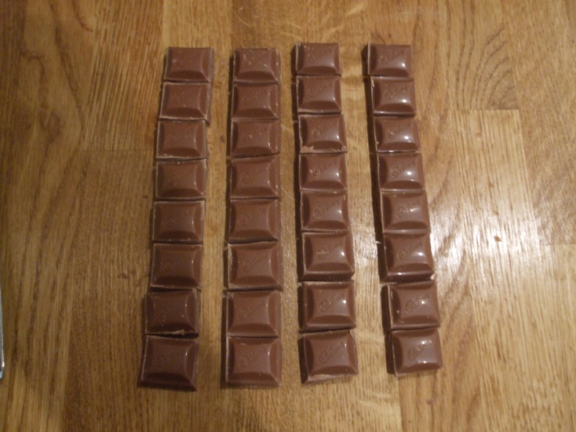
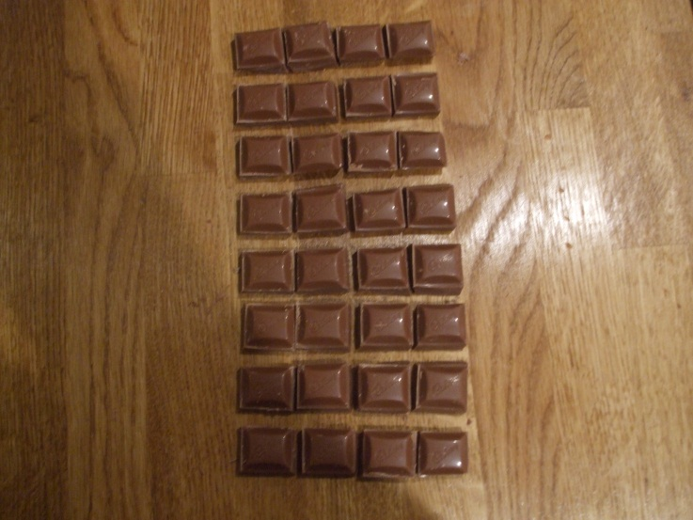
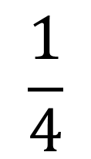
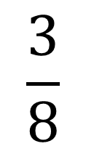

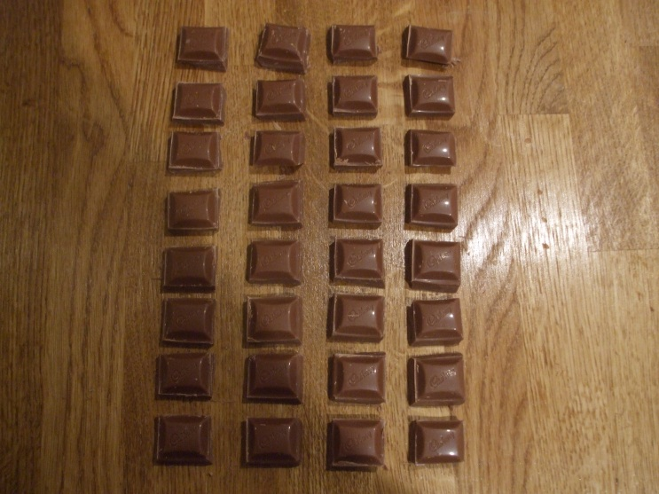
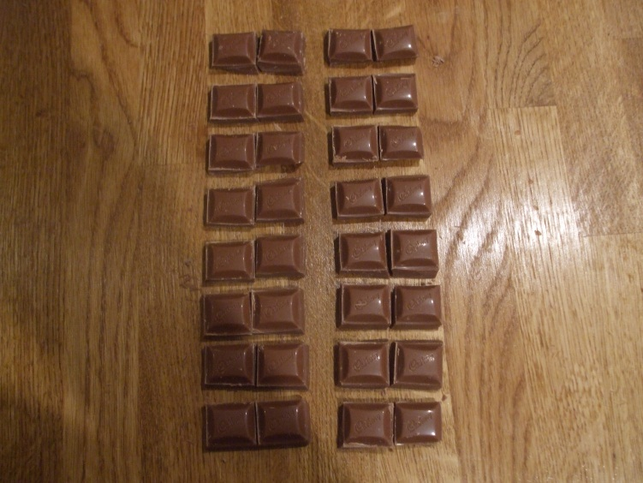
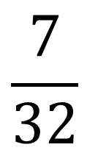
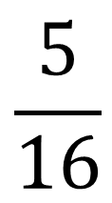
To illustrate this, I have used 32 pieces of chocolate. Why 32?

Slide 20
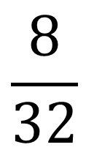
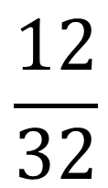
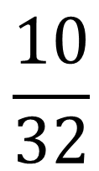
Put the fractions into ascending order.

Slide 21
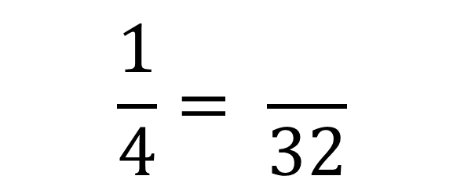
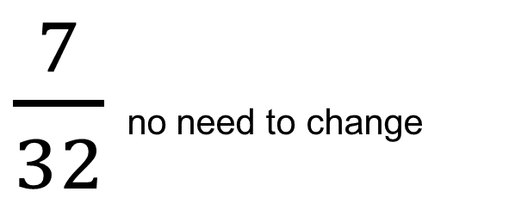
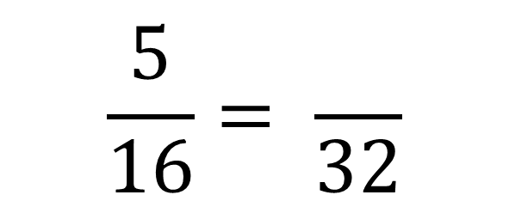
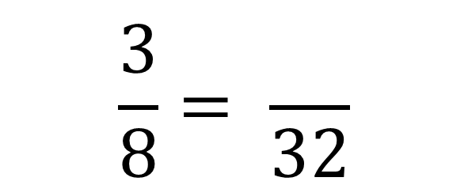
Put the fractions into ascending order.
×8
×4
$$\frac{1}{4}= \frac{}{32}$$
$$\frac{3}{8}= \frac{}{32}$$
8
12
×8
×4
×2
$$\frac{5}{16}= \frac{}{32}$$
$\frac{7}{32}$ no need to change
10
×2

Slide 22

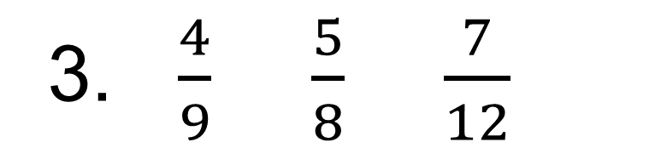
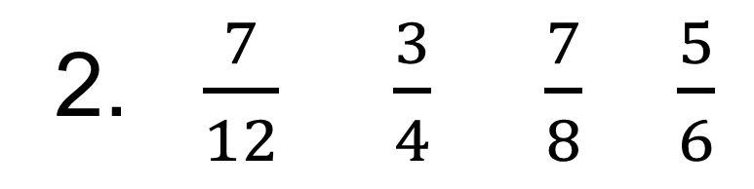
Put the fractions in ascending order.
1. $\frac{7}{10} \frac{3}{4} \frac{13}{20} \frac{3}{5}$
Challenge:
Can you write four of your own fractions with different denominators in ascending order that would have a common denominator of:
36?
42?
56?
2. $\frac{7}{12} \frac{3}{4} \frac{7}{8} \frac{5}{6}$
3. $\frac{4}{9} \frac{5}{8} \frac{7}{12}$

Slide 23

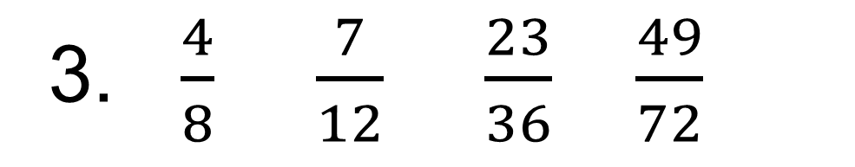
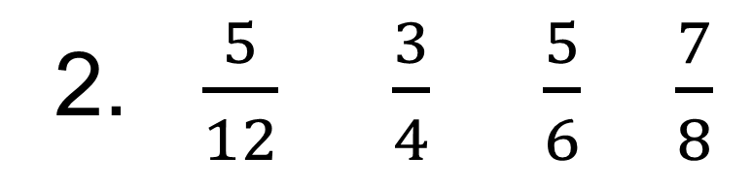
The sets of fractions below are in ascending order. True or False?
1. $\frac{3}{4} \frac{4}{5} \frac{7}{10} \frac{17}{20}$
2. $\frac{5}{12} \frac{3}{4} \frac{5}{6} \frac{7}{8}$
3. $\frac{4}{8} \frac{7}{12} \frac{23}{36} \frac{49}{72}$

