Slide 1
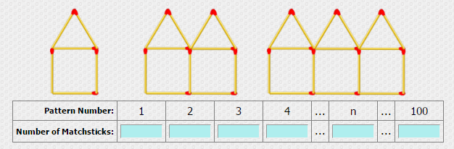
Look back in your books to this table.
6
11
16
21
5n + 1
501
We can consider the sequence without the table or the context.

Slide 2
The ‘term to term’ rule is ‘add 5’
6
11
16
21…
5n + 1…
501…
The ‘nth term’ is 5n + 1.
We can use the nth term to generate sequences

Slide 3
On your whiteboards:
Find the first five terms of the following sequences:
T(n) = 2n + 3
T(n) = 2n - 5
T(n) = 1 – 2n
What do you notice about the sequences?

Slide 4
On your whiteboards:
Find the 50th term of:
T(n) = 2n + 3
T(n) = 2n - 5
T(n) = 1 – 2n

Slide 5
On your whiteboards:
Does the number 72 appear in any of the sequences below?
T(n) = 2n + 3
T(n) = 2n - 5
T(n) = 1 – 2n
Can you alter one aspect of the nth terms above which would mean that 72 would appear in the sequence?

Slide 6
Sequence Search
Find the first 5 terms of the sequences in the table.
Find them in the sequences search.
Afterwards, using the code A=1, B=2, C=3 etc on the far left, the unused numbers will form a message reading left to right along each row starting with the first row.

Slide 7
On your whiteboards:
Find the first five terms of the following sequences
T(n) = n² + 3
T(n) = 2n² + 3
T(n) = 3n³ + 3
How do these sequences differ to the earlier sequences?

