Slide 1
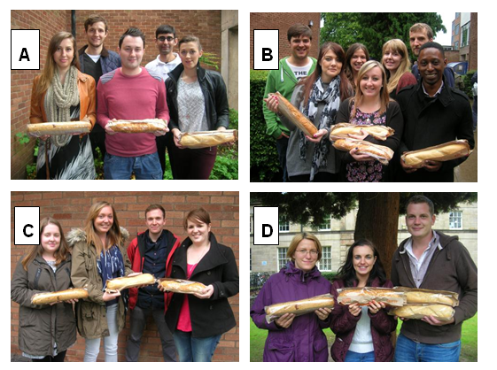
What did we discover last lesson?

Slide 2

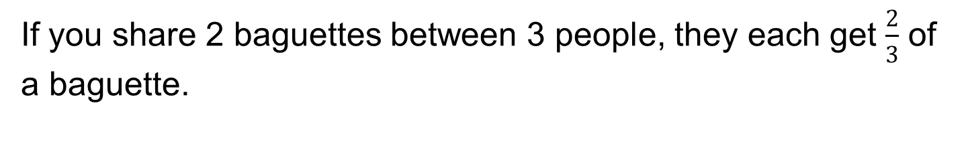
From last lesson how did you show this to be true?
If you share 2 baguettes between 3 people, they each get $\frac{2}{3}$ of a baguette.
Show this by using diagrams in the space below.

Slide 3
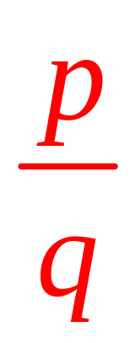
We discovered…
Dividing p by q can be expressed as a fraction by:

Slide 4
Discuss: Which group is the odd one out and why?

Slide 5
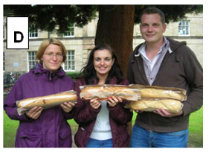
Group D had 4 baguettes between 3 people
This is the only group with more baguettes than people.
What division calculation is this?
What fraction is this?
How else could we represent this fraction?

Slide 6
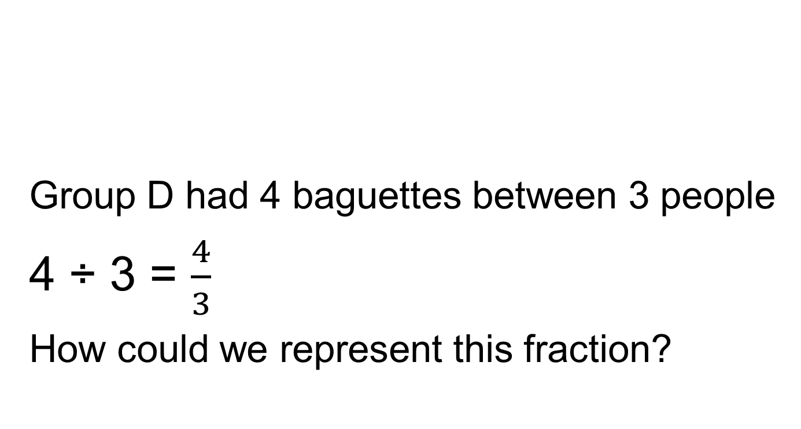
Group D had 4 baguettes between 3 people
4 ÷ 3 = $\frac{4}{3}$
How could we represent this fraction?

Slide 7
Can you write some more examples where each teacher would get more than one baguette?
What if each teacher gets more than two baguettes?

Slide 8
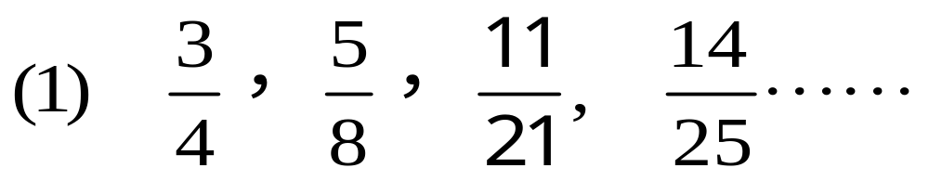
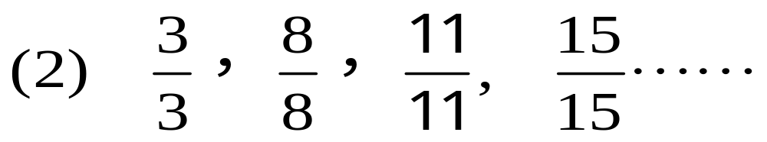
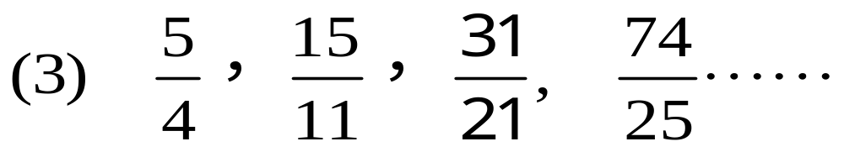
  Look at these three groups of fractions
  What is the same and what is different within and between the groups?
  Could you add more fractions to each group?

Slide 9
Summary
1. A fraction is called a proper fraction if the numerator is less than the denominator.
2. A fraction is called an improper fraction if the numerator is greater than or equal to the denominator

Slide 10
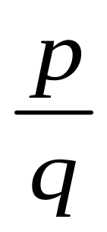
Proper fraction
(p < q)
fraction
Improper fraction
(p ≥ q)
（p, q are positive integers）
In pairs
Give some examples of proper/improper fractions?
What different ways could we represent improper fractions?

Slide 11
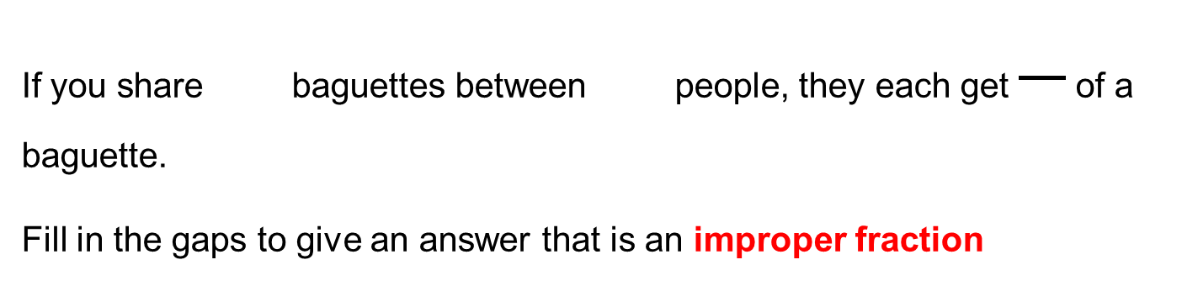
Exit Ticket
If you share baguettes between people, they each get of a baguette.
Fill in the gaps to give an answer that is an improper fraction
Show this by using diagrams below.

